Slide 1


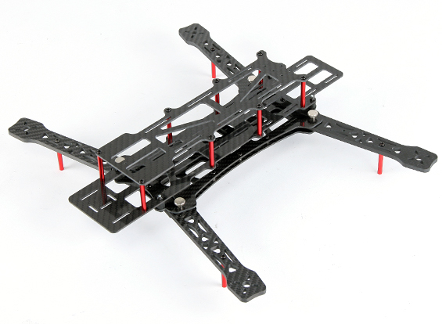
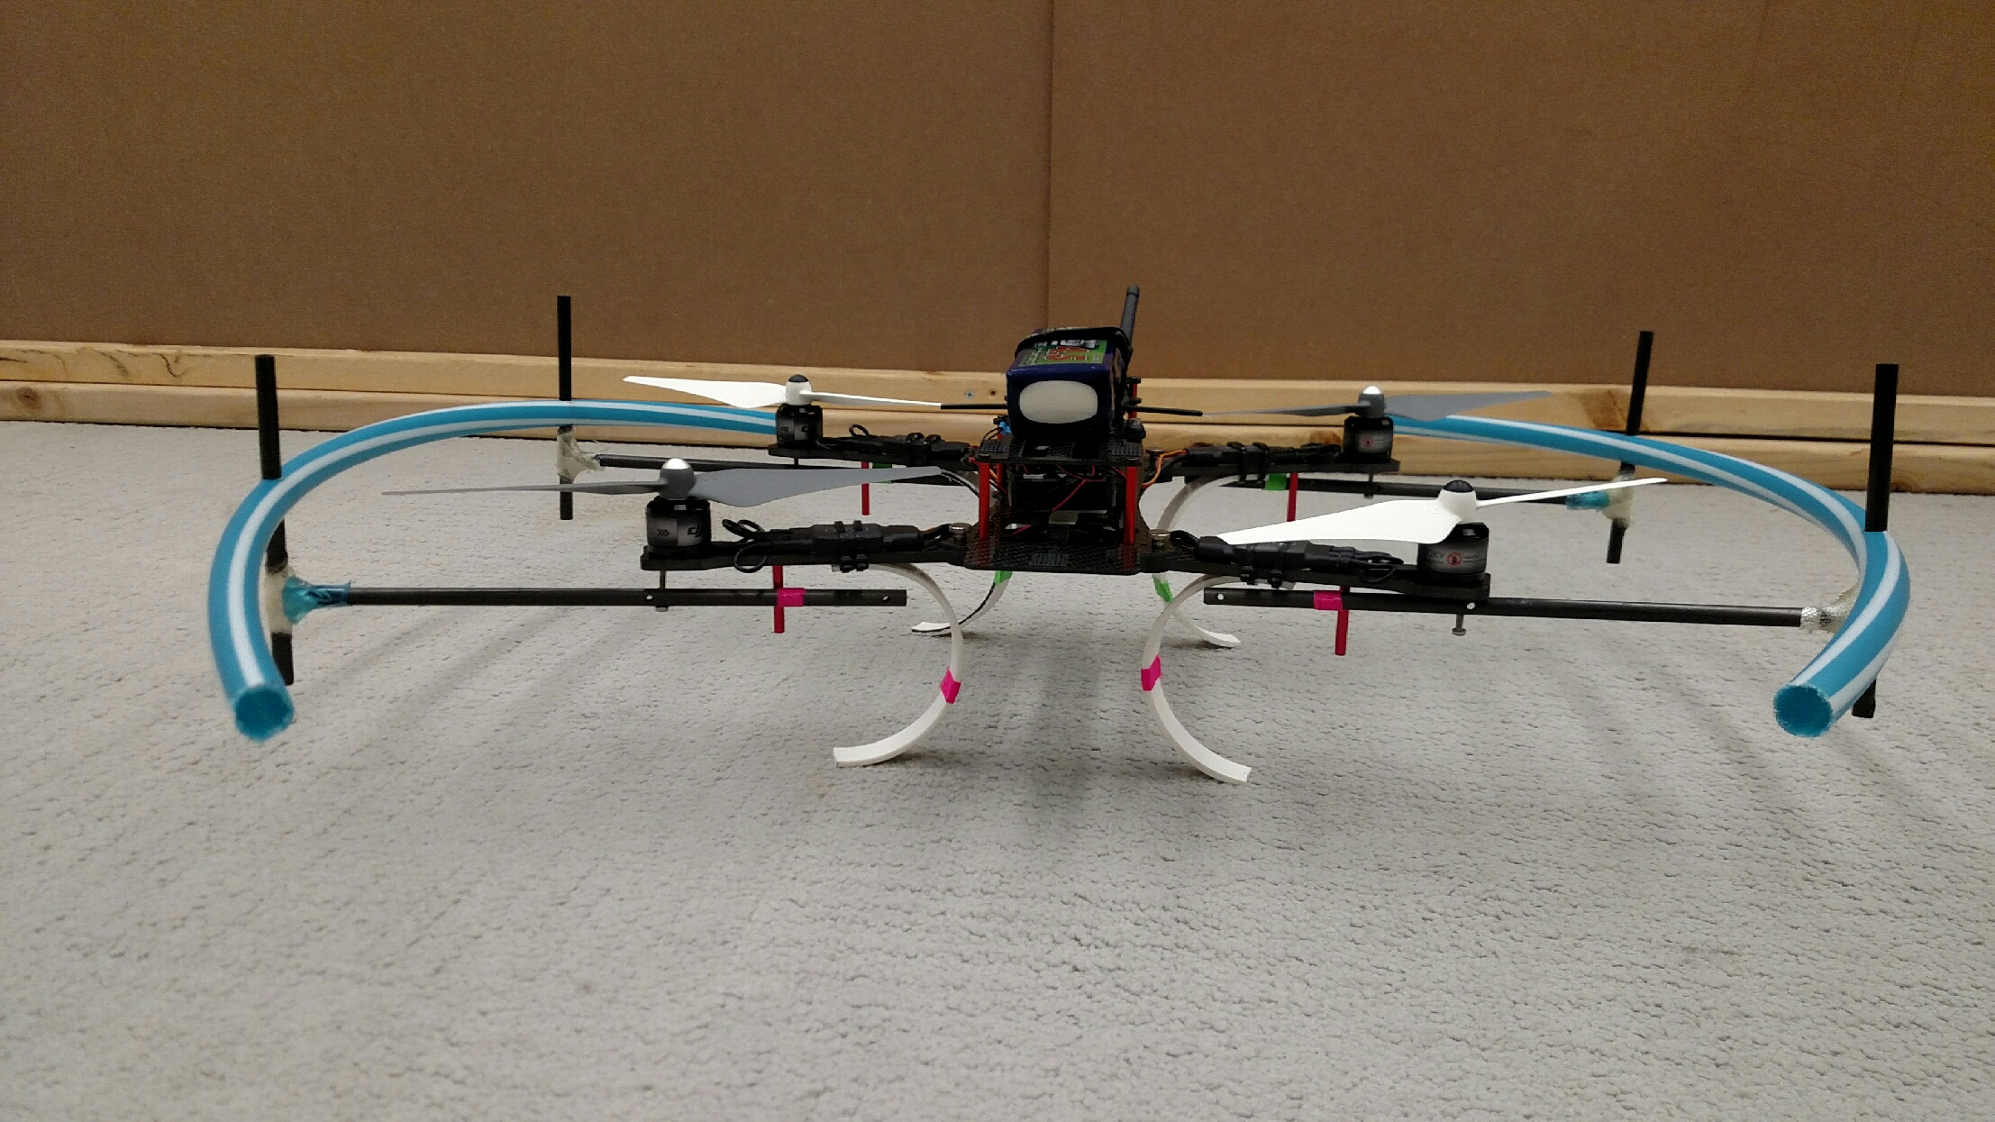
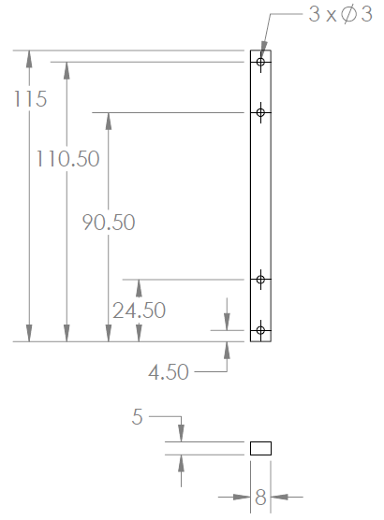
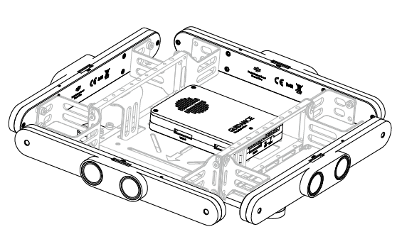
FlyNet: Quad Structure
Holes for Custom Guidance Mount
Stereo Camera Pair
Ultrasonics

Slide 2
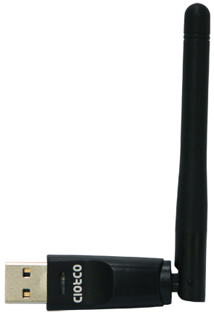
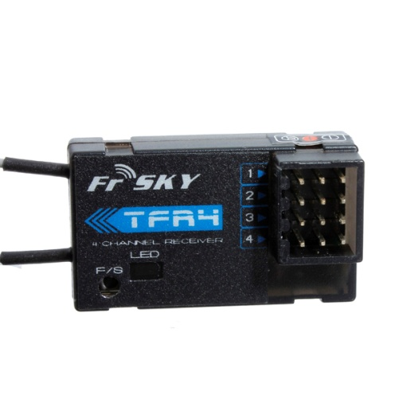
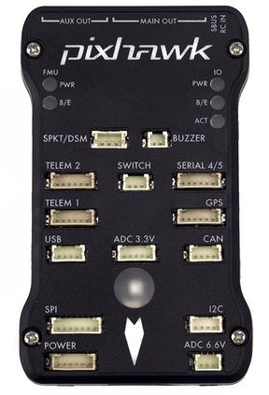
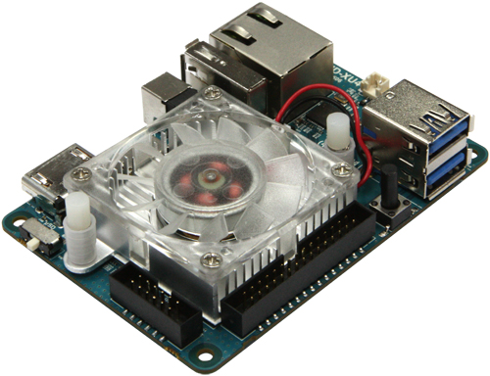
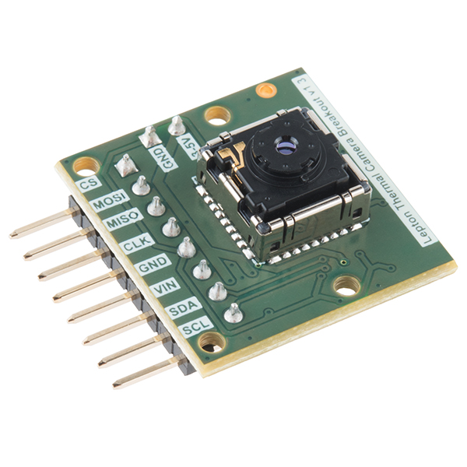
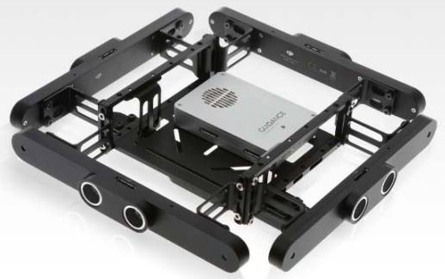
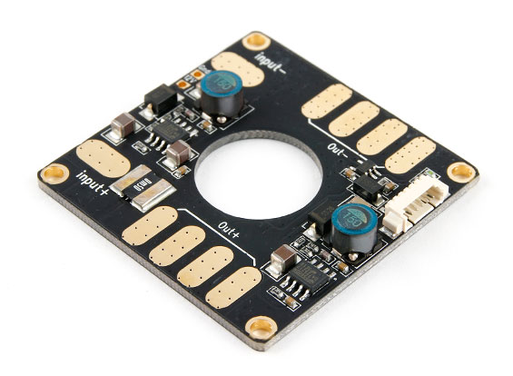
FlyNet: QuadCopter System Design
FrSKY TFR4 Radio Receiver
Comms
Power
UART
(RC inputs)
WiFi Adapter
USB 3.0 (#0)
USB 2.0 (#1)
(Position
Commands)
SPI (video)
I2C (control)
Pixhawk with PX4 Firmware
FLiR Sensor
ODROID XU4
PWM Signals
USB 2.0 (#2)
(odometry & BW images)
ESC/ Motor
Battery (14.8V)
DJI Guidance

Slide 3
FlyNet: Mass Budget
Component | Qty | Mass (each) [g]
AlienCopter Bee Frame | 1 | 303.0
Custom Landing Gear | 4 | 22.5
Custom Propeller Guards | 2 | 123.0
ODROID XU4 (w/ case and Wi-Fi dongle) | 1 | 83.5
ODROID Expansion Shield | 1 | 21.1
DJI Guidance Sensor (w/ mounting hardware) | 1 | 470.4
Pixhawk | 1 | 40.3
FliR Lepton LWIR Camera | 1 | 0.6
FrSKY TFR4 Radio Receiver | 1 | 8.7
Power Distribution Board | 1 | 21.0
SunnySky V2216-12 II Motors | 4 | 68.7
10x4.7 Propellers | 4 | 11.1
20A ESC | 4 | 28.4
Turnigy Multistar 4S 10.0 LiPo Battery Pack | 1 | 815.8
 | Total | 2365.3

Slide 4
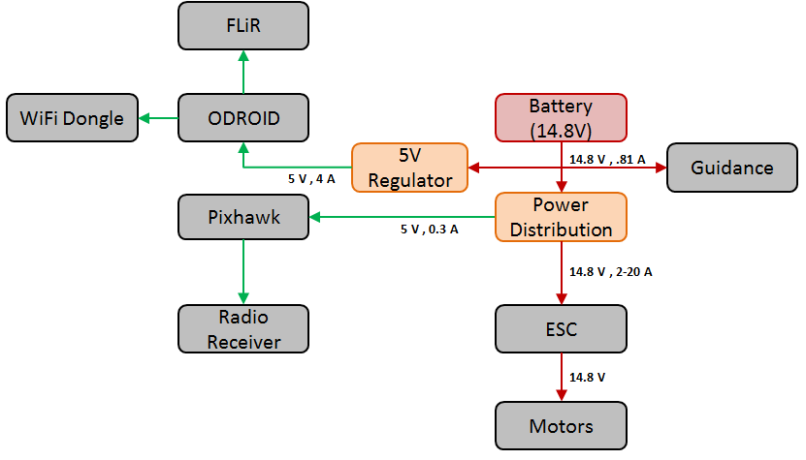
FlyNet: Power Distribution FBD

Slide 5
FlyNet: Power Budget
Component | Qty | Nominal Voltage [V] | Current Draw [mA] | Power Consumption [mW]
ODROID XU4 (powers FLiR & Wi-Fi) | 1 | 5 | 4000 | 20000
DJI Guidance Sensor | 1 | 14.8 | 810 | 12000
Pixhawk (powers radio receiver) | 1 | 5 | 300 | 1500
SunnySky V2216-12 II Motors | 4 | 14.8 | 4730 | 70017
Total |  |  | 24030 | 313568
Motors use 89.3% of total power consumption (78.7% of Current Draw)
Motor estimated at hovering condition

Slide 6
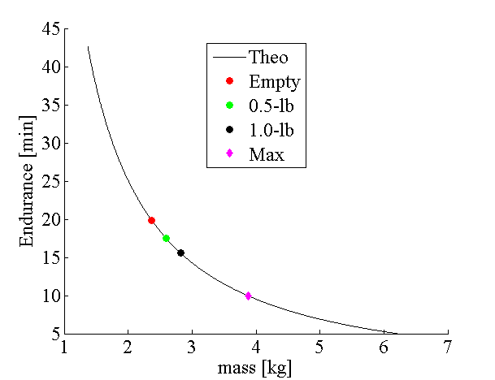
FlyNet: Flight Endurance
Mass [kg] | Time [min]
2.37 | 20
2.60 (0.5 lb) | 17.5
2.82 (1.0 lb) | 15.6
3.87 (MAX) | 10

Slide 7
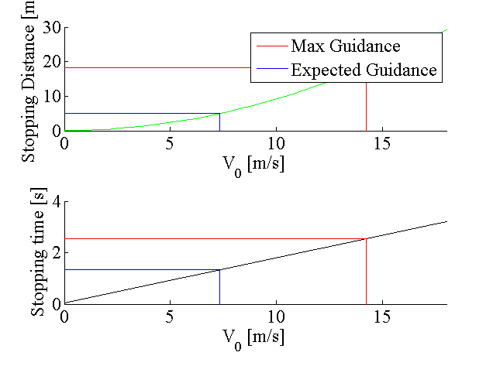
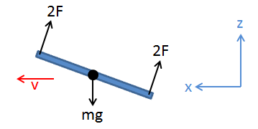
FlyNet: Stopping Distance Simulation

Slide 8
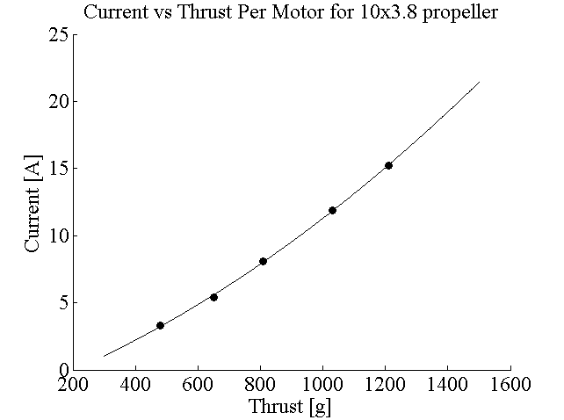

FlyNet: Motor Current Estimation
Experimental Results of SunnySky V2212 Motors
Propeller | Throttle | Current Draw [A] | Thrust [g]
10x3.8 | 50% | 3.3 | 480
 | 65% | 5.4 | 650
 | 75% | 8.1 | 810
 | 85% | 11.9 | 1030
 | 100% | 15.2 | 1210
Experimental results were found for 10x3.8 propeller
Quadratic fit to get an equation for current depending on thrust
a | 4.72E-06
b | 8.50E-03
c | -1.947
$$I=a^{2}T∗bT+c$$

