Slide 1
FlyNet Overview
Austin Anderson
Steve McGuire

Slide 2
Project Requirements

Slide 3
Project Requirements
Disaster!

Slide 4
Project Requirements
Goal:
Find the Survivor!
Blocked Door
Survivor
Drones
Dark Room
Responder
Operator
Debris
Inaccessible Room

Slide 5
Project Requirements
Goal:
Find the Survivor!
Blocked Door
Requirements
Survivor
Operate in GPS denied environment
Operate in low/no light
Identify and track survivors
Identify and track responders
Navigate 3D environment
Plan with prior map
Update plan based on findings
Update prior map
Explore the space in one flight
Work in a team to explore
Include ground and air vehicles
Carry/deploy aide package
Communicate findings to operator
Drones
Dark Room
Responder
Operator
Debris
Inaccessible Room

Slide 6
Project Requirements
Goal:
Find the Survivor!
Blocked Door
Requirements
Survivor
Operate in GPS denied environment
Operate in low/no light
Identify and track survivors
Identify and track responders
Navigate 3D environment
Plan with prior map
Update plan based on findings
Update prior map
Explore the space in one flight
Work in a team to explore
Include ground and air vehicles
Carry/deploy aide package
Communicate findings to operator
Dark Room
Drone
Responder
Operator
Debris
Inaccessible Room

Slide 7
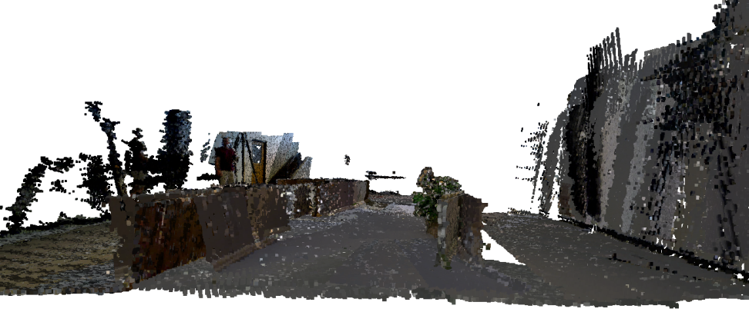
SLAM Background
SLAM = Simultaneous Localization and Mapping
Family of algorithms used for robotic exploration
Localizes a robot using sensor odometry and map landmarks
Updates map landmarks as it goes
Uses estimation filters
Plywood Structures
Floor
Wall
Occupancy map of Fleming Flight Space
Generated with RGBD sensor

Slide 8
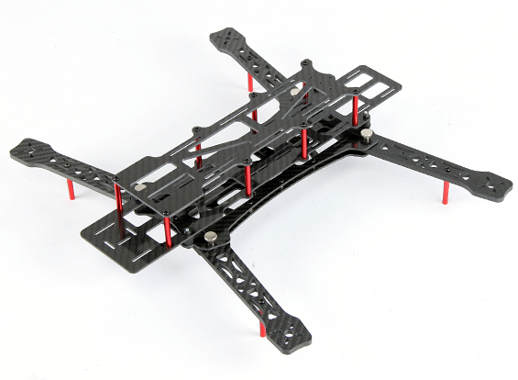
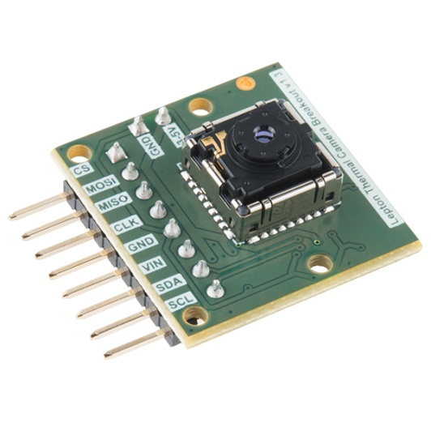
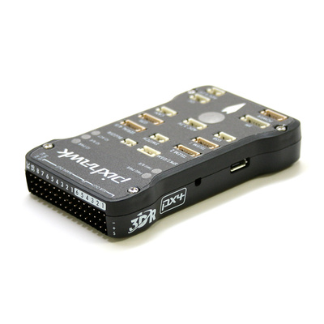
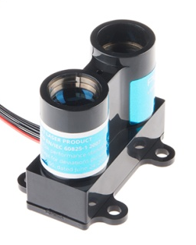
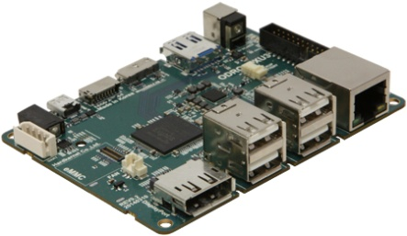
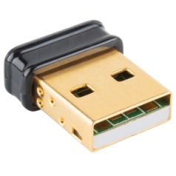
Common Platform Components
Quadcopter Frame*
Pixhawk Autopilot
FLiR Sensor
Laser Altimeter*
Embedded Processor*
WiFi Radio Link
* Indicates design options being evaluated
Laser Altimeter image from: sparkfun.com
Quadrotor frame image from: hobbyking.com
Embedded Proc. image from: hardkernel.com
Pixhawk image from: pixhawk.org
WiFi Radio Link image from: sparkfun.com
FLiR Sensor image from: sparkfun.com

Slide 9
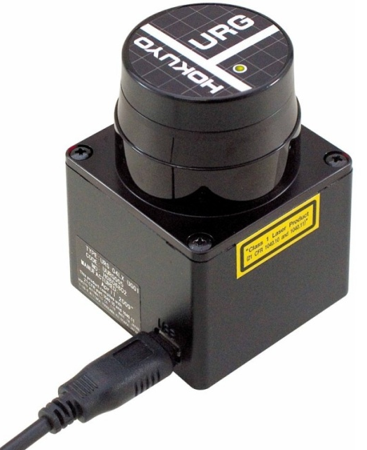
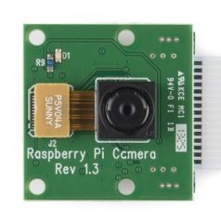
SLAM Sensors
LiDAR and monocular camera
LiDAR provides 2-D scans
Camera supplements scans
LiDAR is robust to lighting conditions
Platform can fly fast
Relatively light processing requirement
LiDAR is heavy/expensive
Hokuyo Lidar image from: robotshop.com
Monocular camera image from: sparkfun.com

Slide 10
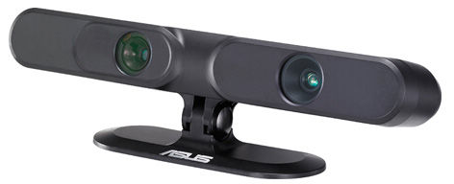
SLAM Sensors
RGBD Camera
Red, green, blue, depth
Depth map constructed from structured light projection
Depth robust to lighting conditions
Heavy
Medium computational complexity
Suffers from image blurring
ASUS Xtion Pro RGBD Camera image from: asus.com

Slide 11
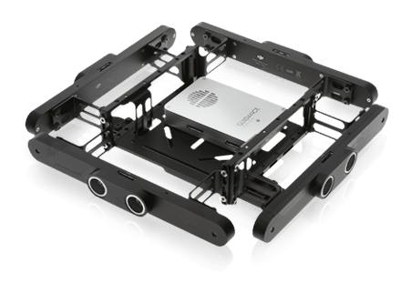
SLAM Sensors
DJI Guidance
Stereo vision with ultrasonic ranging
Five simultaneous modules
IMU fused
FPGA accelerated to reduce computation costs
Provides visual odometery and collision avoidance out of the box
Sensitive to lighting conditions
Expensive and heavy
DJI Guidance sensor image from: developer.dji.com

Slide 12
Technical Challenges
Robust indoor flight
GPS denied navigation
Embedded processing of SLAM algorithms
Robust planning for efficient search
Planning with known prior map
Planning for obstacle avoidance in 3-D
Multi-platform search
Multi-platform information fusion
Robust target identification
Target discrimination
SLAM with moving targets

Slide 13
Technical Challenges
Robust indoor flight ⬅
GPS denied navigation ⬅
Embedded processing of SLAM algorithms ⬅
Robust planning for efficient search
Planning with known prior map
Planning for obstacle avoidance in 3-D
Multi-platform search
Multi-platform information fusion
Robust target identification ⬅
Target discrimination
SLAM with moving targets

Slide 14
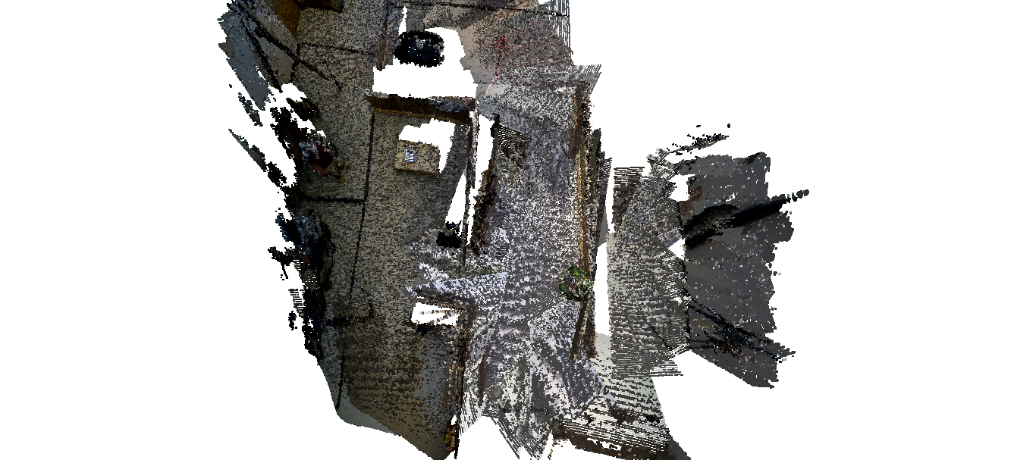
Questions?

Slide 15
Backups

Slide 16
FlyNet Overview or: How I Learned to Stop Worrying and Love the Drones
Austin Anderson
Steve McGuire

