Slide 1
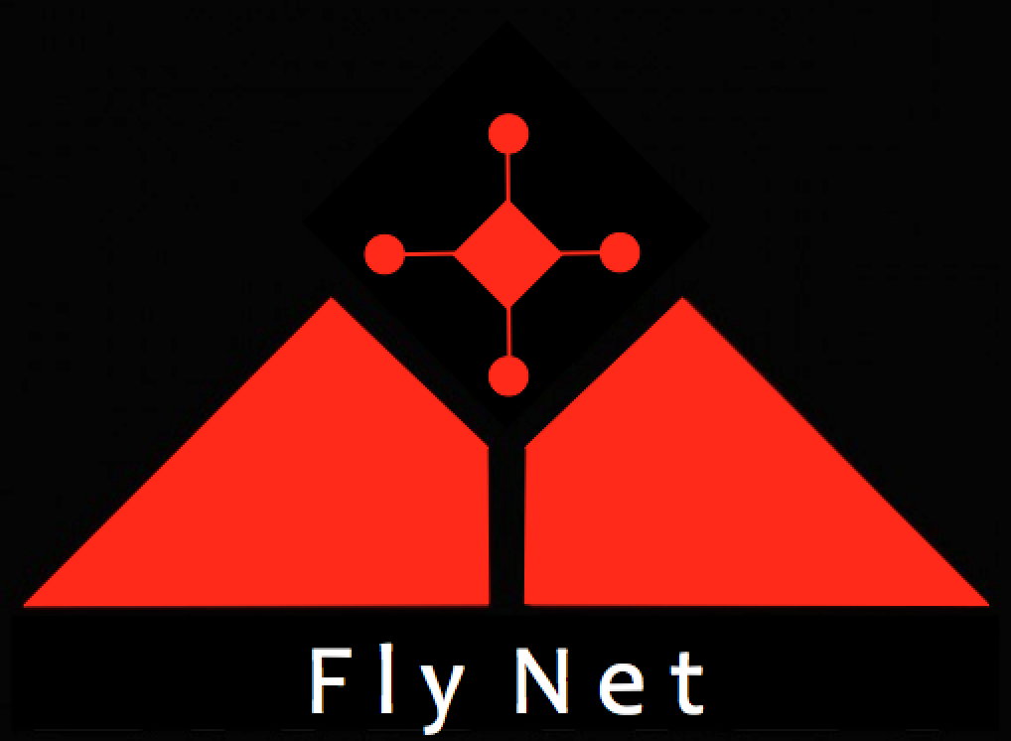

FlyNet: Autonomous Quadcopter Search and Rescue
Objectives:
Establish comm. With Pixhawk
Develop SLAM algorithms on SBC’s
Develop target tracking algorithms
Design blade guards and landing gear
Test range finding sensors
Budget:
Remaining: $8000 ($13000?)
Planned future purchases:
Matrice 100?
Approach:
Pixhawk tutorials, modification of firmware to receive commands
Porting algorithms to ODROID/Jetson
Multiple Hypothesis tracking system using OpenCV
Bumper car style blade guards?
Online tutorials
Schedule:
Mid Semester Review: 10/21/15
Send position set points to Pixhawk
Create SLAM map on ODROID/Jetson
Tracking multiple targets demo
Platform finalization

