Slide 1


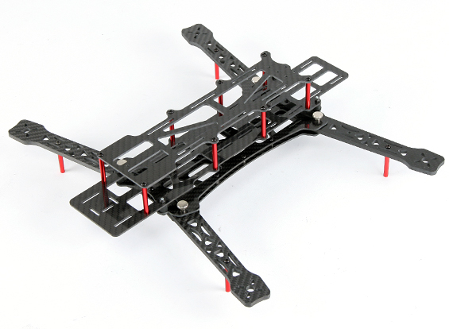
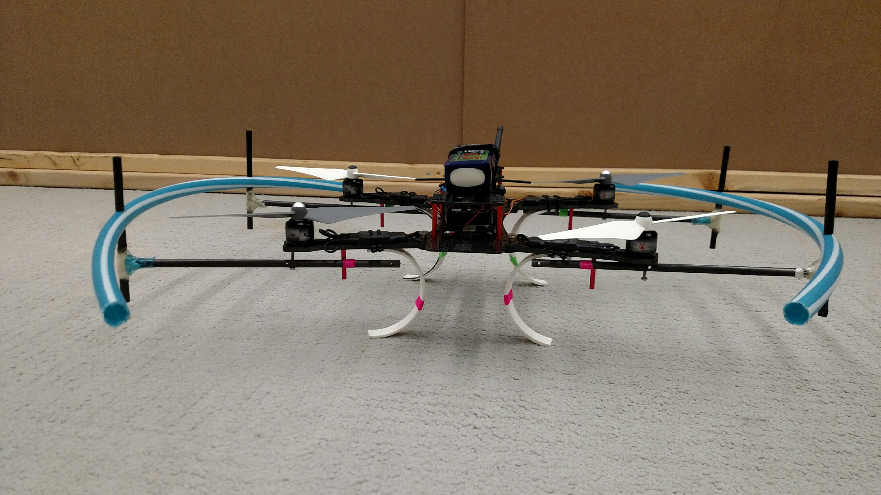
FlyNet: Quad Structure

Slide 2
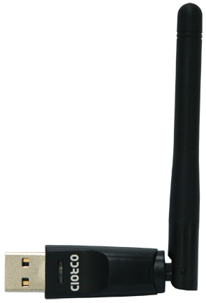
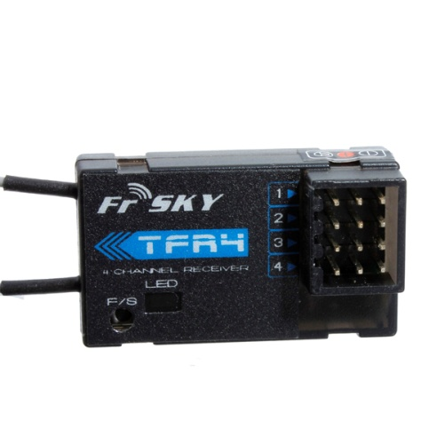
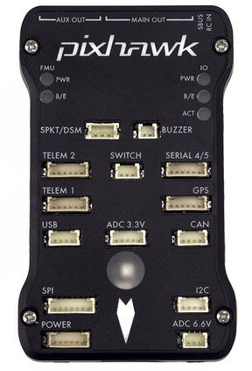
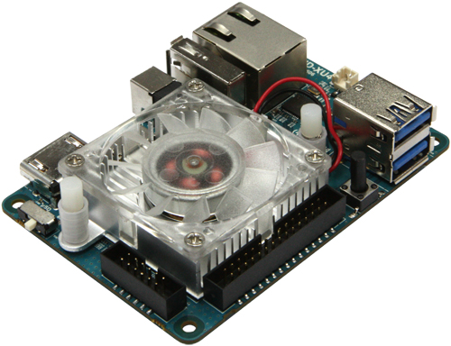
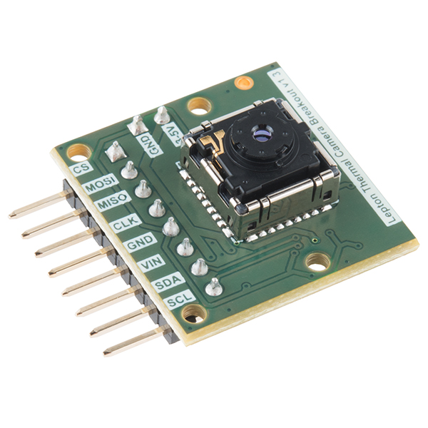
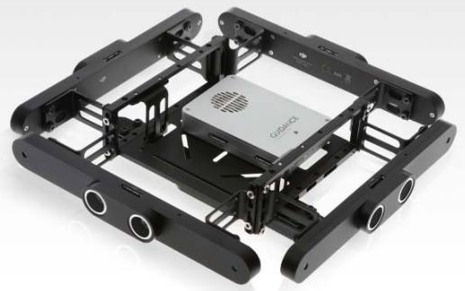
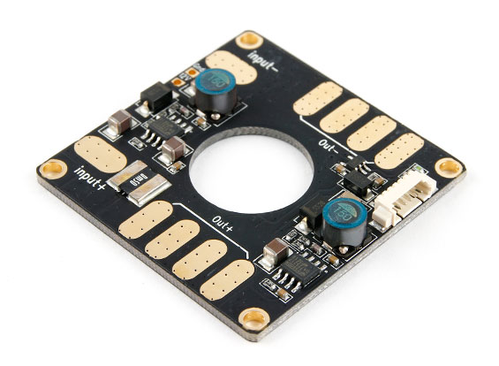
FlyNet: QuadCopter System Design
FrSKY TFR4 Radio Receiver
Comms
Power
UART
(RC inputs)
WiFi Adapter
USB 3.0 (#0)
USB 2.0 (#1)
(Position
Commands)
SPI (video)
I2C (control)
Pixhawk with PX4 Firmware
FLiR Sensor
ODROID XU4
PWM Signals
USB 2.0 (#2)
(odometry & BW images)
ESC/ Motor
Battery (14.8V)
DJI Guidance

Slide 3
FlyNet: Mass Budget
Component | Qty | Mass (each) [g]
AlienCopter Bee Frame | 1 | 303.0
Custom Landing Gear | 4 | 22.5
Custom Propeller Guards | 2 | 123.0
ODROID XU4 (w/ case and WiFi dongle) | 1 | 83.5
ODROID Expansion Shield | 1
DJI Guidance Sensor | 1 | 462.2
Pixhawk | 1 | 40.3
FliR Lepton LWIR Camera | 1 | 0.6
FrSKY TFR4 Radio Receiver | 1
SunnySky V2216-12 II Motors | 4 | 68.7
10x4.7 Propellers | 4 | 11.1
20A ESC | 4 | 28.4
Turnigy Multistar 4S 10.0 LiPo Battery Pack | 1 | 815.8

Slide 4
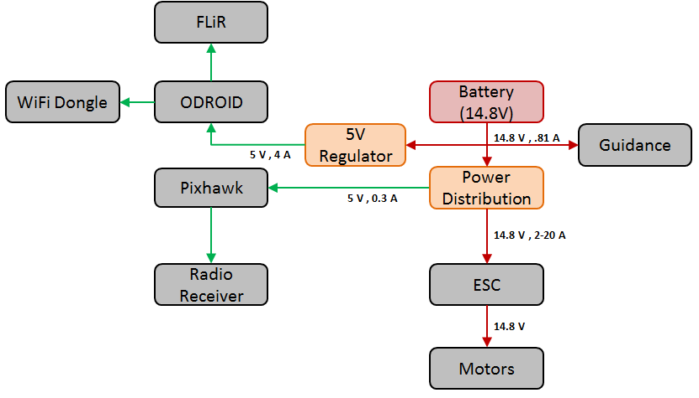
FlyNet: Power Distribution FBD

Slide 5
FlyNet: Power Budget
Component | Qty | Nominal Voltage [V] | Nominal Current [mA] | Nominal Power [mW]
ODROID XU4 | 1 | 5 | 4000 | 20000
DJI Guidance Sensor | 1 | 14.8 | 810 | 12000
Pixhawk | 1 | 5 | 300 | 1500
FliR Lepton LWIR Camera | 1
FrSKY TFR4 Radio Receiver | 1
SunnySky V2216-12 II Motors | 4 | 14.8 | 18981* | 280924

Slide 6
FlyNet: Flight Endurance

Slide 7
FlyNet: Stopping Distance Simulation

