Slide 1


Path Planning – Driving Requirements
Level 1 | Level 2 | Level 3
The system shall perform a search for targets. | The system shall navigate an unknown environment, using partial, prior information, e.g. building plans. | 1.2.1 | The vehicles shall avoid unrecoverable collisions with obstacles
 |  | 1.2.2 | The system shall plan vehicle trajectories through the environment
 |  | 1.2.4 | The aerial vehicle will maintain a minimum distance of 5 cm from obstacles.
Level 1 | Level 2 | Level 3
The system shall be autonomous, i.e. no human input once the system begins a search. | The system shall not have external navigation and targeting commands | 4.4.1 | The system shall make all navigation decisions onboard.

Slide 2
2 Steps
Path Planning – High Level
Step 1:
Roadmap Algorithm
Develop list of nodes within operating space
Exclude obstacles from list
Step 2:
Path Selection Algorithm
Select nodes which:
Lead from start -> goal
Inherently avoid obstacles due to step 1
Coverage of the entire space
Notes:
2 options for both

Slide 3
Path Planning – Roadmap (PRM)
Probabilistic Roadmap (PRM)
Inputs
Map grid with obstacles marked
Desired number of nodes
Desired maximum neighbor node distance
Process
Samples possible collision-free quadcopter configurations at random
Connect all nodes within the configured maximum neighbor distance
Discard any routes that intersect with obstacles
Outputs
Roadmap containing collision free nodes and edges representing possible vehicle configurations
Coverage across entirety of open space possible if number of nodes is sufficiently high

Slide 4
Path Planning – Roadmap Voronoi
Voronoi Node Generation
Inputs
Array of X and Y values that represent obstacles
Process
Delaunay triangulation
Draw circles through triangles (where vertices are the obstacles)
Connect centers of circles with lines
Outputs
Ordered list of polygon vertices representing points equidistant from obstacles

Slide 5
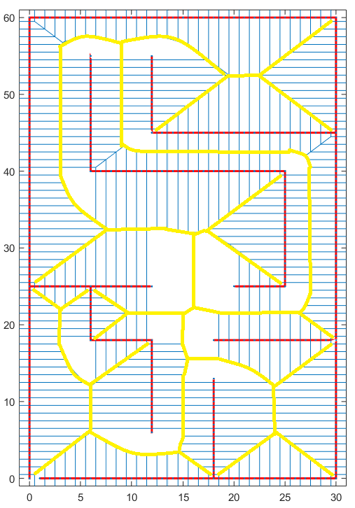
Path Planning – Roadmap Voronoi
Voronoi Node Generation
Inputs
Array of X and Y values that represent obstacles
Process
Delaunay triangulation
Draw circles through triangles (where vertices are the obstacles)
Connect centers of circles with lines
Outputs
Ordered list of polygon vertices representing points equidistant from obstacles

Slide 6
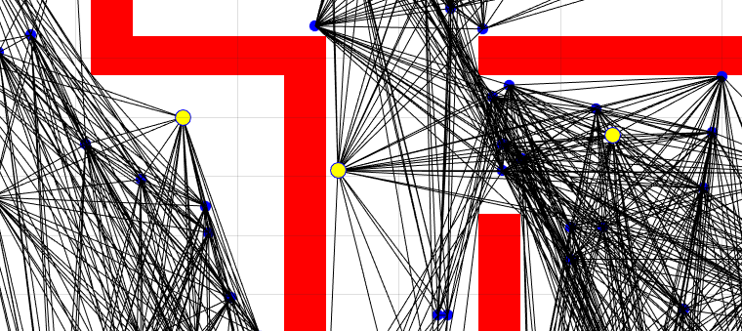
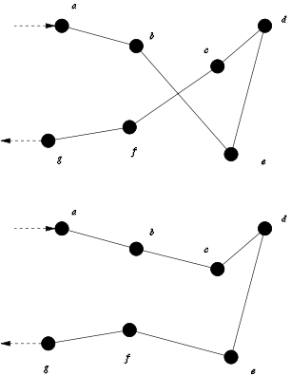
Path Planning –NN+2Opt
Nearest Neighbor + 2-Opt
Nearest Neighbors
Inputs
Auto-generated goal coordinates (a set of uniformly distributed points in free space)
PRM
Process
Build cost-weighted adjacency matrix for each goal coordinate
Compute path to the nearest goal for each goal
Optimize path using 2-Opt which removes unnecessary path crossover
2-Opt Example
Outputs
Position set points that efficiently traverse all goal coordinates.
Image courtesy of https://en.wikipedia.org/wiki/2-opt
Notes:
Advantage of 2opt?

Slide 7
Path Planning – Coverage (NN+2Opt)
Able to handle multiple goals
The computational effort increases as the number of goals (i.e. rooms) increases
Total area coverage is configurable
Depends on the granularity of auto-generated goal points
Goal points can be recalculated during the mission

Slide 8
Path Planning – PRM Performance
Processing time increases quadratically as the number of sampled configurations (nodes) increases
Increasing the number of nodes has diminishing returns for space coverage
Note: Performance based on Matlab computations

Slide 9
Path Planning – Voronoi Performance
Processing time is more or less linear
Note that our space is define in 340 (red *)

Slide 10
Path Planning – Summary
Level 3 |  | Solution
1.2.1 | The vehicles shall avoid unrecoverable collisions with obstacles | - PRM: Nodes are randomly placed in open space. - Voronoi: Nodes selected based on distance from obstacles - Collision-prone node connections are discarded.
1.2.2 | The system shall plan vehicle trajectories through the environment | - Roadmap provides collision-free paths to most points in open space. - NN+2Opt/A* method provides a trajectory to visit most of the open space on the roadmap.
1.2.4 | The aerial vehicle will maintain a minimum distance of 5 cm from obstacles | - PRM/Voronoi have the capability to configure the minimum distance from obstacles.
4.4.1 | The system shall make all navigation decisions onboard. | - PRM/Voronoi both provide position set points in open space with collision-free paths between them.

Slide 11
Path Planning – Backup Slides
Notes:
Incomplete Matlab algorithmic demonstration

Slide 12
Path Planning - Methodology
A*
Inputs
Array of X and Y values that represent waypoint possibilities
Process
Determine path based on least cost approach
Cost = g(n) + h(n)
g(n) = known cost (previously traversed)
h(n) = estimate of node -> goal distance
Outputs
Array of nodes defining path

Slide 13
Path Planning – Backup PRM/NN-2opt
Probabilistic Roadmap (PRM)
Creates roadmap based on randomly sampled quadcopter configurations in open space.
Nearest Neighbor (NN) with 2-Opt
NN: Traverses roadmap goals by minimizing the total distance traveled from one node to the next.
2-Opt: Optimizes path takes a route that crosses over itself and reorders it so it does not.

Slide 14
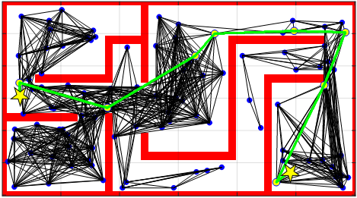
Path Planning – Backup(PRM)
Probabilistically complete
Chance to find route increases as number of nodes increases
Flexible and robust
Collision avoidance threshold distance is configurable
Number of sample nodes is configurable
Maximum node neighbor distance configurable
Re-plan only depends on updated map grid
Certain geometries where straight line connections cannot be made are difficult to navigate

Slide 15
Path Planning – Backup Voronoi/A*
Voronoi path generation
Generates nodes which are equidistant from obstacles
A* search
Least cost node selection
Cost = g(n) + h(n)
g(n) = known cost (previously traversed)
h(n) = estimate of node -> goal distance

Slide 16
Path Planning – Backup (Voronoi)
Fewer nodes to evaluate than probabilistic methods
Optimum obstacle margin
Paths automatically as far from obstacles as possible
Open spaces are often node sparse
Depending on size of room, could require node addition to fill out space

Slide 17
Path Planning – NN+2Opt Performance
Processing time increases quadratically as the number of goals increases
Goals are auto-generated for uniform coverage of the open space
Note: Performance based on Matlab computations

Slide 18
FlyNet: Autonomous Quadcopter Search and Rescue

