Slide 1

Final Architecture
ROS publisher 10Hz
(HW Limited)
Hokuyo Laser scanner
Ground Station
Measurements used by AMCL for position and scanmatcher for velocity
ROS master
Communicates with onboard flight computer
Data visualization with RVIZ
Runs laser scanmatcher
Pixhawk Autopilot
ROS
Running Arducopter Firmware
Providing accelerometer measurements and Euler angles to KF
Providing attitude control (stabilize mode)
Odroid U3
Ubuntu 14.04
Runs Kalman Filter
Runs AMCL
Runs Flight Controllers
PyMavlink
20Hz
(SW Limited)
SSH via WiFi
Motor ESCs
PX4Flow
3DR X8, X8+
Measures Altitude
Octo-Quad configuration
~15 min flight time with 10000mA 4S battery
ROS publisher 40Hz (HW Limited)

Slide 2

ROS Architecture
PixHawk
PWM Conv
PX4 Flow
NAV
Scan Matcher
Localization
Path Planner
Hokuyo
Map
Key
Hardware Node
Software Node
Topic
Pre-loaded Info
Notes:
Quinn
Update PixHawk outputs
Break localization into Kalman Filter and Particle Filter
Change odom to be rates

Slide 3
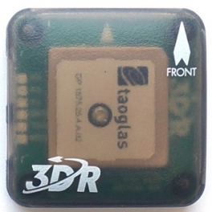
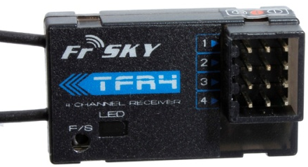
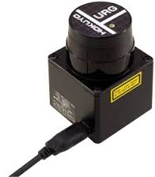
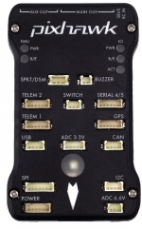
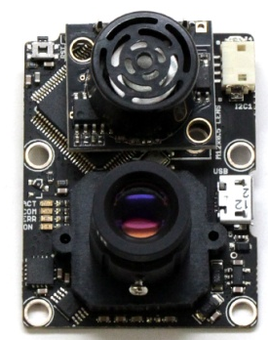
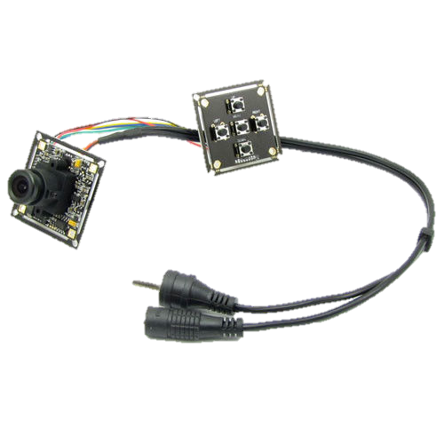

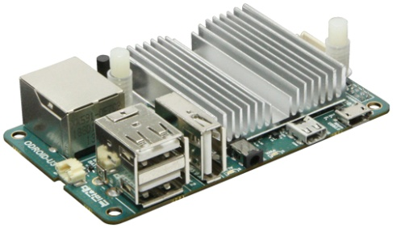
Hardware Configuration
Pixhawk with APM Arducopter Firmware
FrSKY TFR4 Radio Receiver
ublox LEA-6H GPS+MAG
Hokuyo URG-04LX-UG01 Laser Scanner
Sony Camera
USB Hub
PX4Flow
Power Distribution Board
O-Droid U3
ESC/ Motor
Power Module
To USB Hub
Battery
BEC
Intro
Overview
Design
Wrap Up

