Slide 1


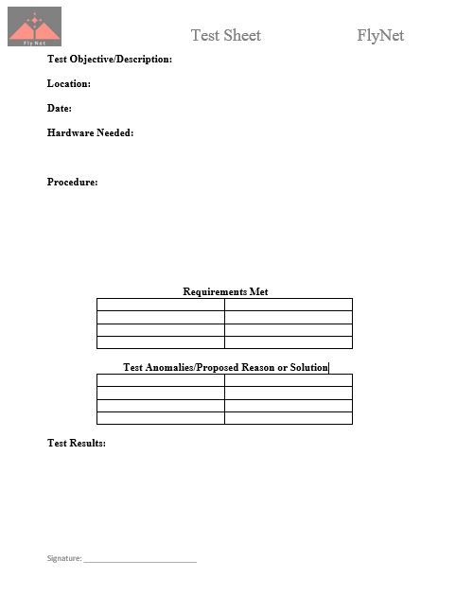
FlyNet: Test Plan
Outlines what tests are needed
Each test verifies/validates requirements
Also provides visual on project progress
Each test has an associated test sheet linked to it

Slide 2
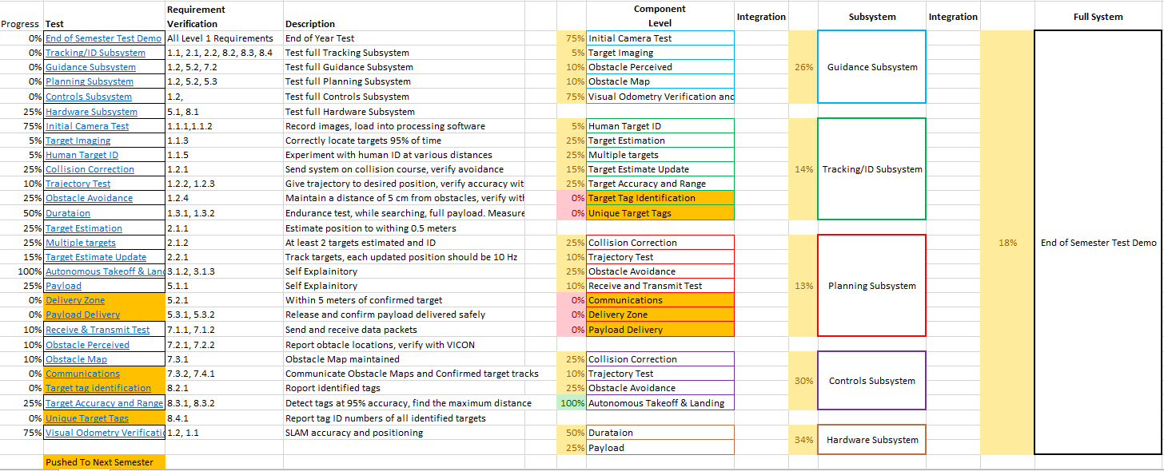
FlyNet: Test Plan

Slide 3
FlyNet: Test Plan
Fell behind schedule
Spent more time designing system then planned
Designs changed
Component issues
Not a total loss
Solid foundation for next semester

Slide 4
FlyNet: Final Demo
Designed for this semester
Pushed back to next semester
Showcase functionality of the system
Performed in Fleming lab

Slide 5
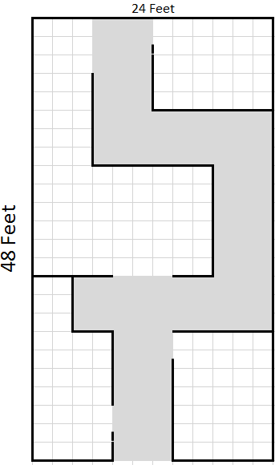
FlyNet: Autonomous Quadcopter Search and Rescue
Start with a known floor plan
2 ft.
2 ft.
Hallway

Slide 6
FlyNet: Autonomous Quadcopter Search and Rescue
Start with a known floor plan
Target placed into area in unknown location
2 ft.
2 ft.
Hallway
Target

Slide 7
FlyNet: Autonomous Quadcopter Search and Rescue
Start with a known floor plan
Target placed into area in unknown location
“Roadblocks” and a “Complete Block” added to simulate debris or obstacles
2 ft.
2 ft.
Hallway
“Roadblock”
Target
“Complete Block”

Slide 8
FlyNet: Autonomous Quadcopter Search and Rescue
Start with a known floor plan
Target placed into area in unknown location
“Roadblocks” and a “Complete Block” added to simulate debris or obstacles
Also have a known entry/exit point
2 ft.
2 ft.
Hallway
“Roadblock”
Target
“Complete Block”
Entry/Exit Point

Slide 9
FlyNet: Autonomous Quadcopter Search and Rescue
System will autonomously fly and map entire space
Planning subsystem will help avoid obstacles and recalculate trajectory
Target will be identified and located in the space
System will return to exit point to deliver map
2 ft.
2 ft.
Hallway
“Roadblock”
Target
“Complete Block”
Entry/Exit Point

Slide 10
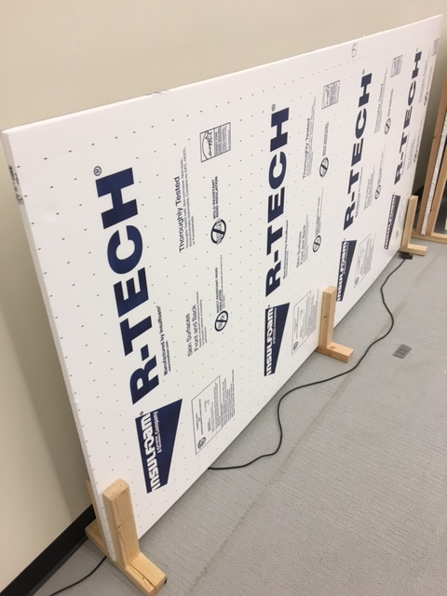
FlyNet: Autonomous Quadcopter Search and Rescue
Building specs:
4’ high walls made of 4’x8’ foam insulation paneling
Walls held upright with wooden frames
Doorframes will have extra reinforcements
Wall design has been tested and proves to be viable

