Slide 1


FlyNet: Mid Semester Review
October 21st, 2015
Critical Design Review

Slide 2
Overview
Project Overview
Organizational Chart
Concept of Operations
System Overview
Subsystem Overviews
Hardware Platform
Flight Controls / Autopilot Interfacing
Perception and Mapping
Target Identification
Planning and Guidance
End of semester demo
Deliverables
Requirement Updates
Budget
Schedule

Slide 3
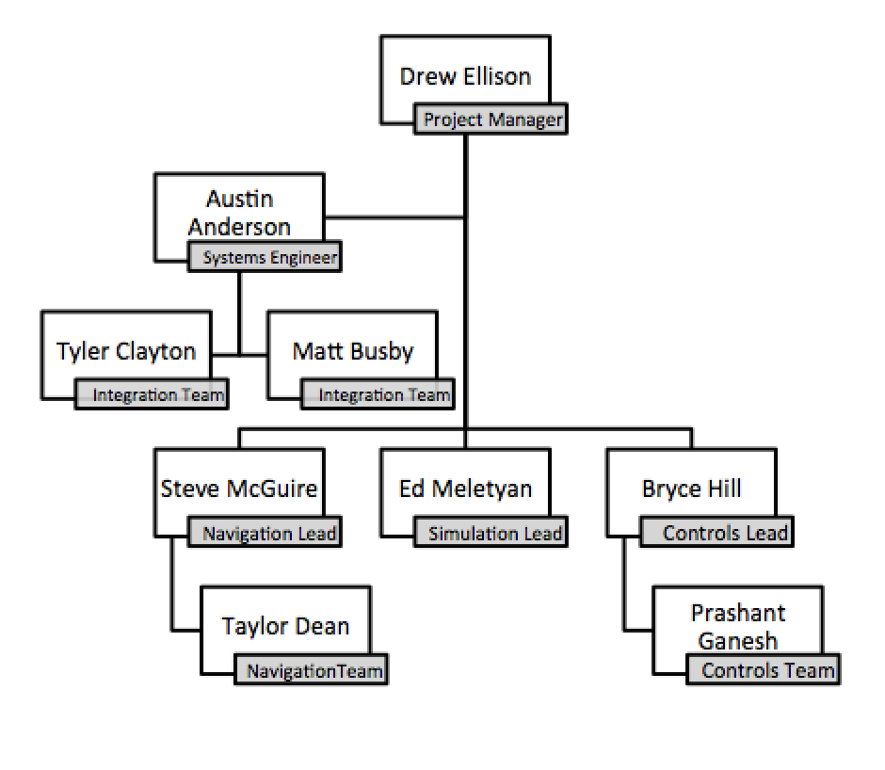
Organization Chart

Slide 4
Organization Chart

Slide 5
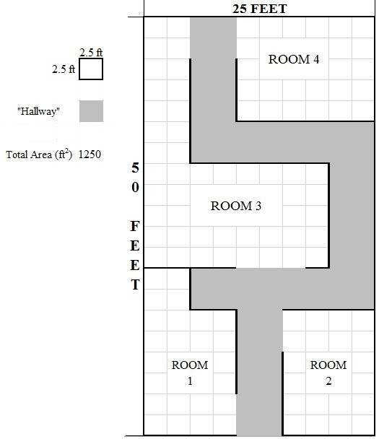
Concept of Operations
Autonomously explore an indoor environment with a team of ground/air robots in a disaster area situation
Map the environment and communicate that map to first responders
Identify humans in the environment and report their locations to first responders
Deliver a package to humans in the environment
“Roadblock”
“Target”
“Complete Block”
Entry/Exit Point

Slide 6
FlyNet: System Block Diagram
= Internal Software hosted on XU4
FLiR
Ground Station
= Off board system
= Sensor
Target Detection and Tracking
= Pixhawk
Guidance
SLAM
Planning
Flight Control
RC Overrides
= Internal software connection using ROS publish/subscribe
= SPI Video
= USB connection
= Wireless link

Slide 7
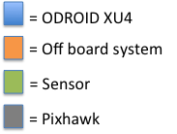
FlyNet: System Block Diagram
To SLAM:
5 x Grey-Scale Image @ 20 Hz
2 x Depth Map @ 20 Hz
Body Frame Velocity
(vN,vE,vD) @ 10 Hz
FLiR
Ground Station
To Planning:
5 x Obstacle distance @ 20 Hz
Target Detection and Tracking
Guidance
SLAM
Planning
Flight Control
RC Overrides

Slide 8
FlyNet: System Block Diagram
To Target D and T:
80x60 IR images @ 8.6 Hz
FLiR
Ground Station
Target Detection and Tracking
Guidance
SLAM
Planning
Flight Control
RC Overrides

Slide 9
FlyNet: System Block Diagram
To Planning:
Map (in octo-map representation) @ ~10 Hz
FLiR
Ground Station
To Planning and Flight Control:
Local NED @ ~10 Hz
To Target D and T:
Local NED @ ~10 Hz
Depth Map @ ~20 Hz
Target Detection and Tracking
Guidance
SLAM
Planning
Flight Control
RC Overrides
From Guidance:
See Guidance Slide
From Target D and T:
Target position estimate in local NED @ <8.6 Hz

Slide 10
FlyNet: System Block Diagram
To Planning, SLAM, Ground Station:
Target position estimate in local NED @ <8.6 Hz
FLiR
Ground Station
Target Detection and Tracking
Guidance
SLAM
Planning
Flight Control
RC Overrides
From FLiR:
80x60 IR images @ 8.6 Hz
From SLAM:
Local NED estimate @ ~10 Hz
Depth Map @ ~20 Hz
From Flight Control:
Attitude estimate in Euler Angles @ TBD Hz

Slide 11
FlyNet: System Block Diagram
To Flight Control:
POS Command in Local (or Global) NED @ Variable Hz
Attitude Command in Euler Angles @ Variable Hz
FLiR
Ground Station
Target Detection and Tracking
Guidance
SLAM
Planning
Flight Control
RC Overrides
From Target D and T:
Target Location Estimate @ <8.6 Hz
From SLAM:
Local NED estimate @ ~10 Hz, Map @ ~10 Hz
From Guidance:
5 x Obstacle distance @ 20 Hz
From Ground Station:
Operator Override Commands

Slide 12
FlyNet: System Block Diagram
To Target D and T:
Attitude estimate in Euler Angles @ TBD Hz
FLiR
Ground Station
Target Detection and Tracking
Guidance
SLAM
Planning
Flight Control
RC Overrides
From Planning:
Set-points (see planning slide)
From SLAM:
Local NED estimate @ ~10 Hz, Map @ ~10 Hz
From RC Overrides:
Arm signal
Max throttle control
From Guidance (TBD):
1 x Sonar distance @ 20 Hz

Slide 13
FlyNet: System Block Diagram
FLiR
Ground Station
Target Detection and Tracking
Guidance
SLAM
Planning
Flight Control
RC Overrides

Slide 14
Autonomous Quadcopter Flight Control
Level 1 | Level 2 | Level 3
The system shall perform a search for targets. | The system shall navigate an unknown environment, using partial, prior information, e.g. building plans. | 1.2.1 | The vehicles shall avoid unrecoverable collisions with obstacles
 |  | 1.2.2 | The system shall plan vehicle trajectories through the environment
 |  | 1.2.3 | The vehicles shall move through the environment along planned trajectories to within 20 RMS error of the planned trajectory when no obstacles are present.
 |  | 1.2.4 | The aerial vehicle will maintain a minimum distance of 5 cm from obstacles.
 | The system shall search a 50,000 ft² area | 1.3.1 | The system shall have power to sustain 10 minutes of search time with full payload
 |  | 1.3.2 | The system shall travel a minimum of 1 mile

Slide 15
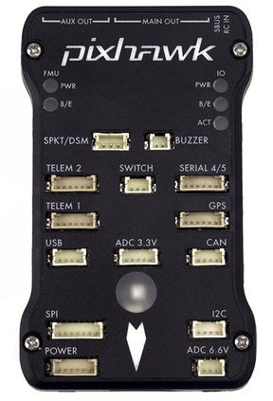
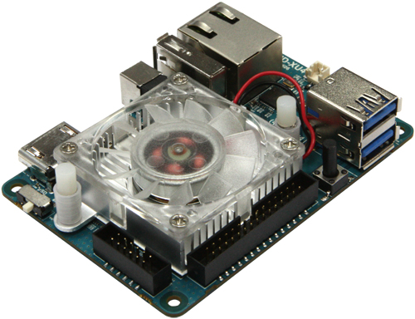
Hardware Solution
ODROID XU4 acts as onboard supervisory computer
Interfaces with planning and perception subsystems to feed set points to the autopilot
Pixhawk autopilot will be used to control the vehicle
Pixhawk was available, cheap enough to procure for multiple platforms, supports open source firmware for flexible software development, and legacy code and experience existed in house
Pixhawk supports position, velocity, or attitude set points for flexible interfacing options
Pixhawk supports the use of external vision position estimate solutions, such as the one provided from SLAM
Pixhawk with PX4 Firmware
ODROID XU4

Slide 16
Software Solution
Robotic operating system was used to integrate the perception, planning, and flight control subsystems
ROS abstracts messaging layers, manages dependencies, is open source, supports heterogeneous code, and has existing code base to support each of the required subsystems
Built on a publish/subscriber and service/consumer architecture
Software is developed as interconnected nodes accomplishing various tasks
The flight control software was architected to maximize code reusability and modularity
Focus on standardizing interfaces
Support swapping nodes as new subsystem functionality becomes mature
Support future integration with software-in-the-loop simulations

Slide 17
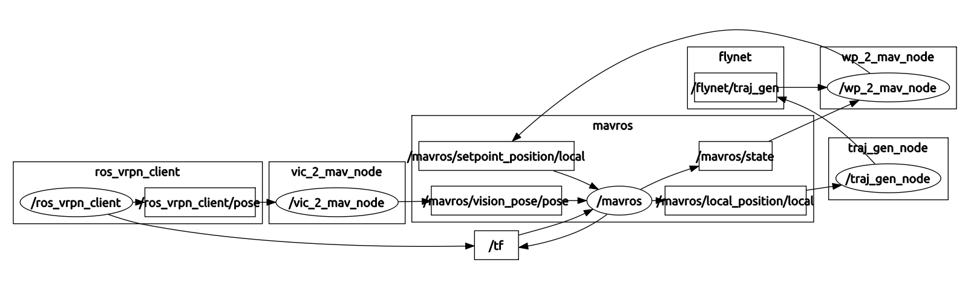
ROS Architecture
Core Flight Control Nodes
Coordinate Frame Translation
Trajectory Generation
Local Position Estimate

Slide 18
ROS Architecture
Core Flight Control Nodes
Perception Subsystem
Planning
Subsystem

Slide 19
Control and Dynamics Modeling
Assumptions placeholder

Slide 20
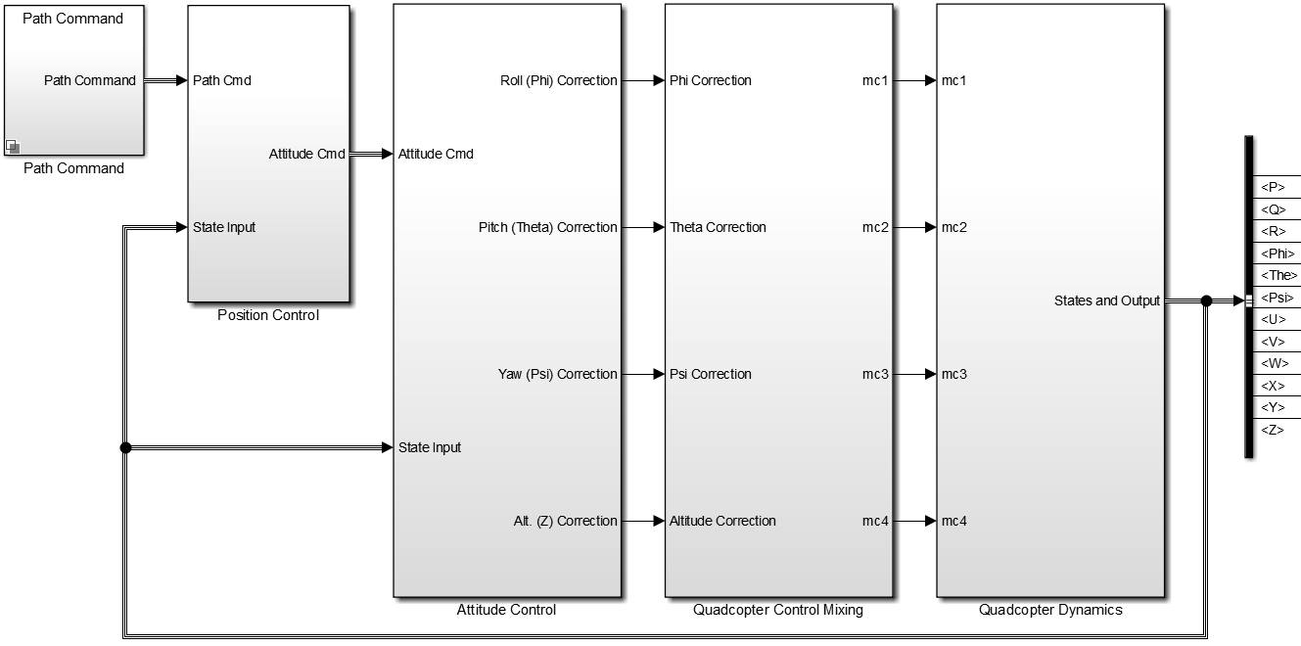
Control and Dynamics Modeling

Slide 21
Control and Dynamics Modeling

Slide 22
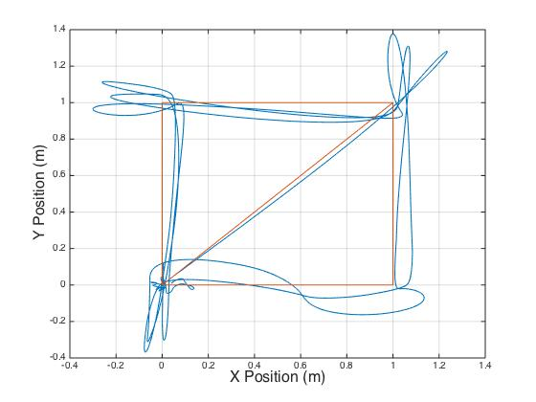
Results

Slide 23
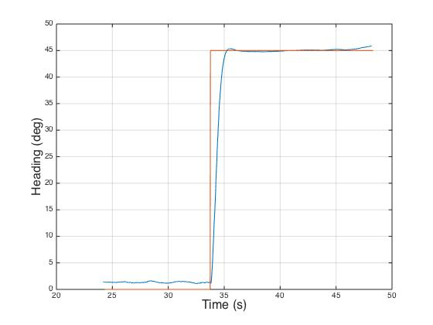
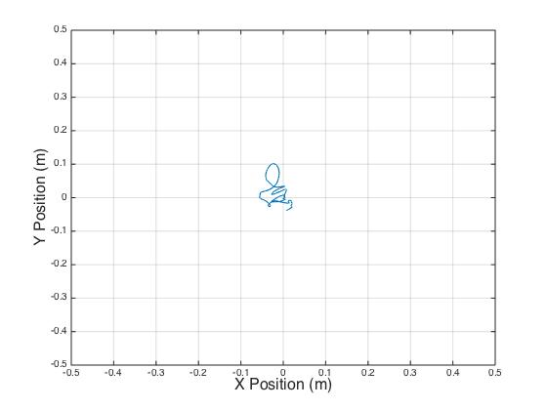
Results

Slide 24
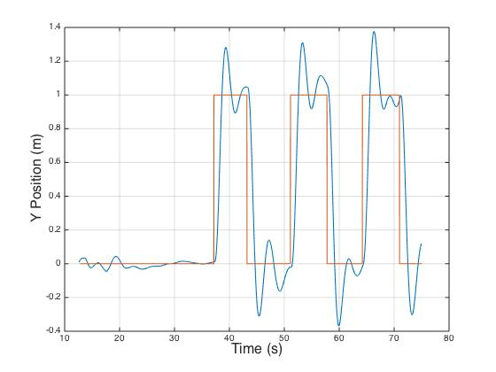
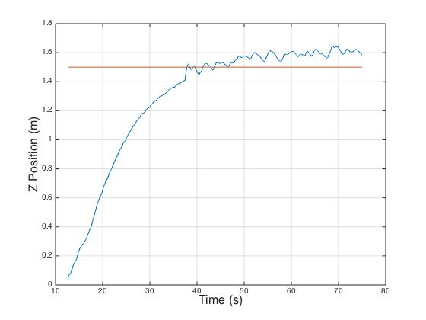
Results

Slide 25
Path Forward
Tune control gains based on modeling results
Refine dynamics model from flight data
Integrate subsystems as they reach maturity
Integrate obstacle avoidance functionality in the ROS architecture
Develop software to overcome obstacles using altitude diversity
Utilize SITL simulations to verify flight control software functionality before hardware deployment

Slide 26
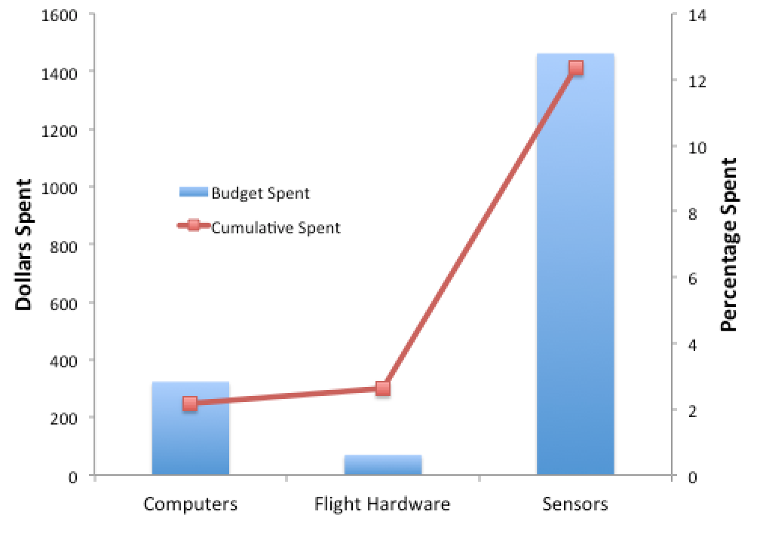
Budget
Currently Spent:
$1855.00 / 12.4%
Previous spending:
Quadrotor platform
Several single board computers (ODROID XU4)
Planned Spending:
Secondary platform:
Estimated to be $3000 per platform

