Slide 1


Target Identification and Tracking - Motivation
Level 1 | Level 2 | Level 3
The system shall perform a search for targets. | The system shall visually identify targets | 1.1.1 | The system shall have visual sensor(s)
 |  | 1.1.2 | The system shall be capable of processing imagery
 |  | 1.1.3 | The system shall locate individual targets with 95% probability of detection
 |  | 1.1.4 | The system shall identify human targets within 5 meters
Level 1 | Level 2 | Level 3
The system shall track visually identified targets | Each PPU shall have the ability to track targets | 2.1.1 | The PPU shall estimate the target position to within 0.5 meters
 |  | 2.1.2 | Each PPU shall estimate at least 2 visually identified targets
 |  | 2.1.3 | Each PPU shall maintain estimates of all confirmed target tracks
 | PPUs shall track targets moving up to 2 m/s along the ground | 2.2.1 | PPUs shall process target estimates at 10 Hz

Slide 2
Target Identification and Tracking
Major Design Choices:
Sensor Type
Visual Spectrum Camera
IR Spectrum Camera
Stereo
Monocular
Tracking Algorithm
Alternative Multiple Models
Multiple Hypothesis Tracker
Discrimination
Simple Masking Tracker

Slide 3
Target Identification and Tracking
Major Design Choices:
Sensor Type
Visual Spectrum Camera
IR Spectrum Camera
Stereo
Monocular
Tracking Algorithm
Alternative Multiple Models
Multiple Hypothesis Tracker
Discrimination
Simple Masking Tracker
Performance varies greatly with lighting conditions.
Increased complexity

Slide 4
Target Identification and Tracking
Major Design Choices:
Sensor Type
Visual Spectrum Camera
IR Spectrum Camera
Stereo
Monocular
Tracking Algorithm
Alternative Multiple Models
Multiple Hypothesis Tracker
Discrimination
Simple Masking Tracker
Provides great contrast between human target and background
Simplifies target identification problem
Not sensitive to lighting conditions

Slide 5
Target Identification and Tracking
Major Design Choices:
Sensor Type
Visual Spectrum Camera
IR Spectrum Camera
Stereo
Monocular
Tracking Algorithm
Alternative Multiple Models
Multiple Hypothesis Tracker
Discrimination
Simple Masking Tracker
Depth may be provided by SLAM sensors

Slide 6
Target Identification and Tracking
Major Design Choices:
Sensor Type
Visual Spectrum Camera
IR Spectrum Camera
Stereo
Monocular
Tracking Algorithm
Alternative Multiple Models
Multiple Hypothesis Tracker
Discrimination
Simple Masking Tracker
Time ordered history of position of target is not required
No need to discriminate between multiple targets.

Slide 7
Target Identification and Tracking
Major Design Choices:
Sensor Type
Visual Spectrum Camera
IR Spectrum Camera
Stereo
Monocular
Tracking Algorithm
Alternative Multiple Models
Multiple Hypothesis Tracker
Discrimination
Simple Masking Tracker

Slide 8
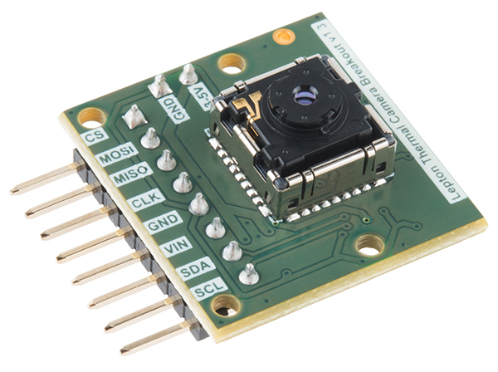
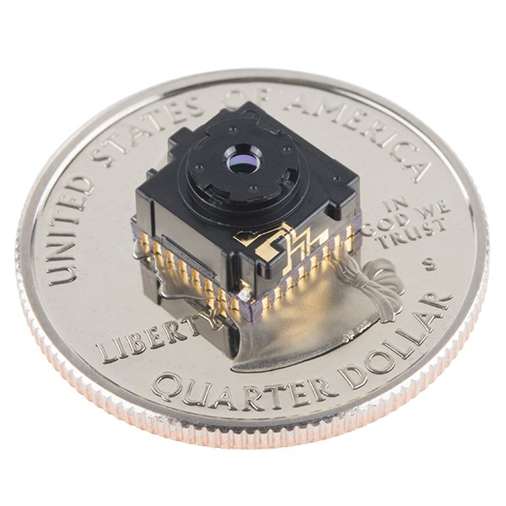
Target Identification and Tracking
Design Solution: FLiR Lepton LWIR Camera with Image Masking and Contour Tracking
FLiR Lepton on Breakout Board
FLiR Lepton on Quarter for Scale

Slide 9
Target Identification and Tracking
Design Solution: FLiR Lepton LWIR Camera with Image Masking and Contour Tracking
Specifications:
LWIR sensor: 8-14 μm
51-deg HFOV, 63.5-deg diagonal FOV
80 x 60 pixels
Thermal sensitivity <50 mK
MIPI and SPI video interfaces
I2C control interface
Power draw <160 mW
8.6 Hz frame rate
Mass 0.55 g

Slide 10
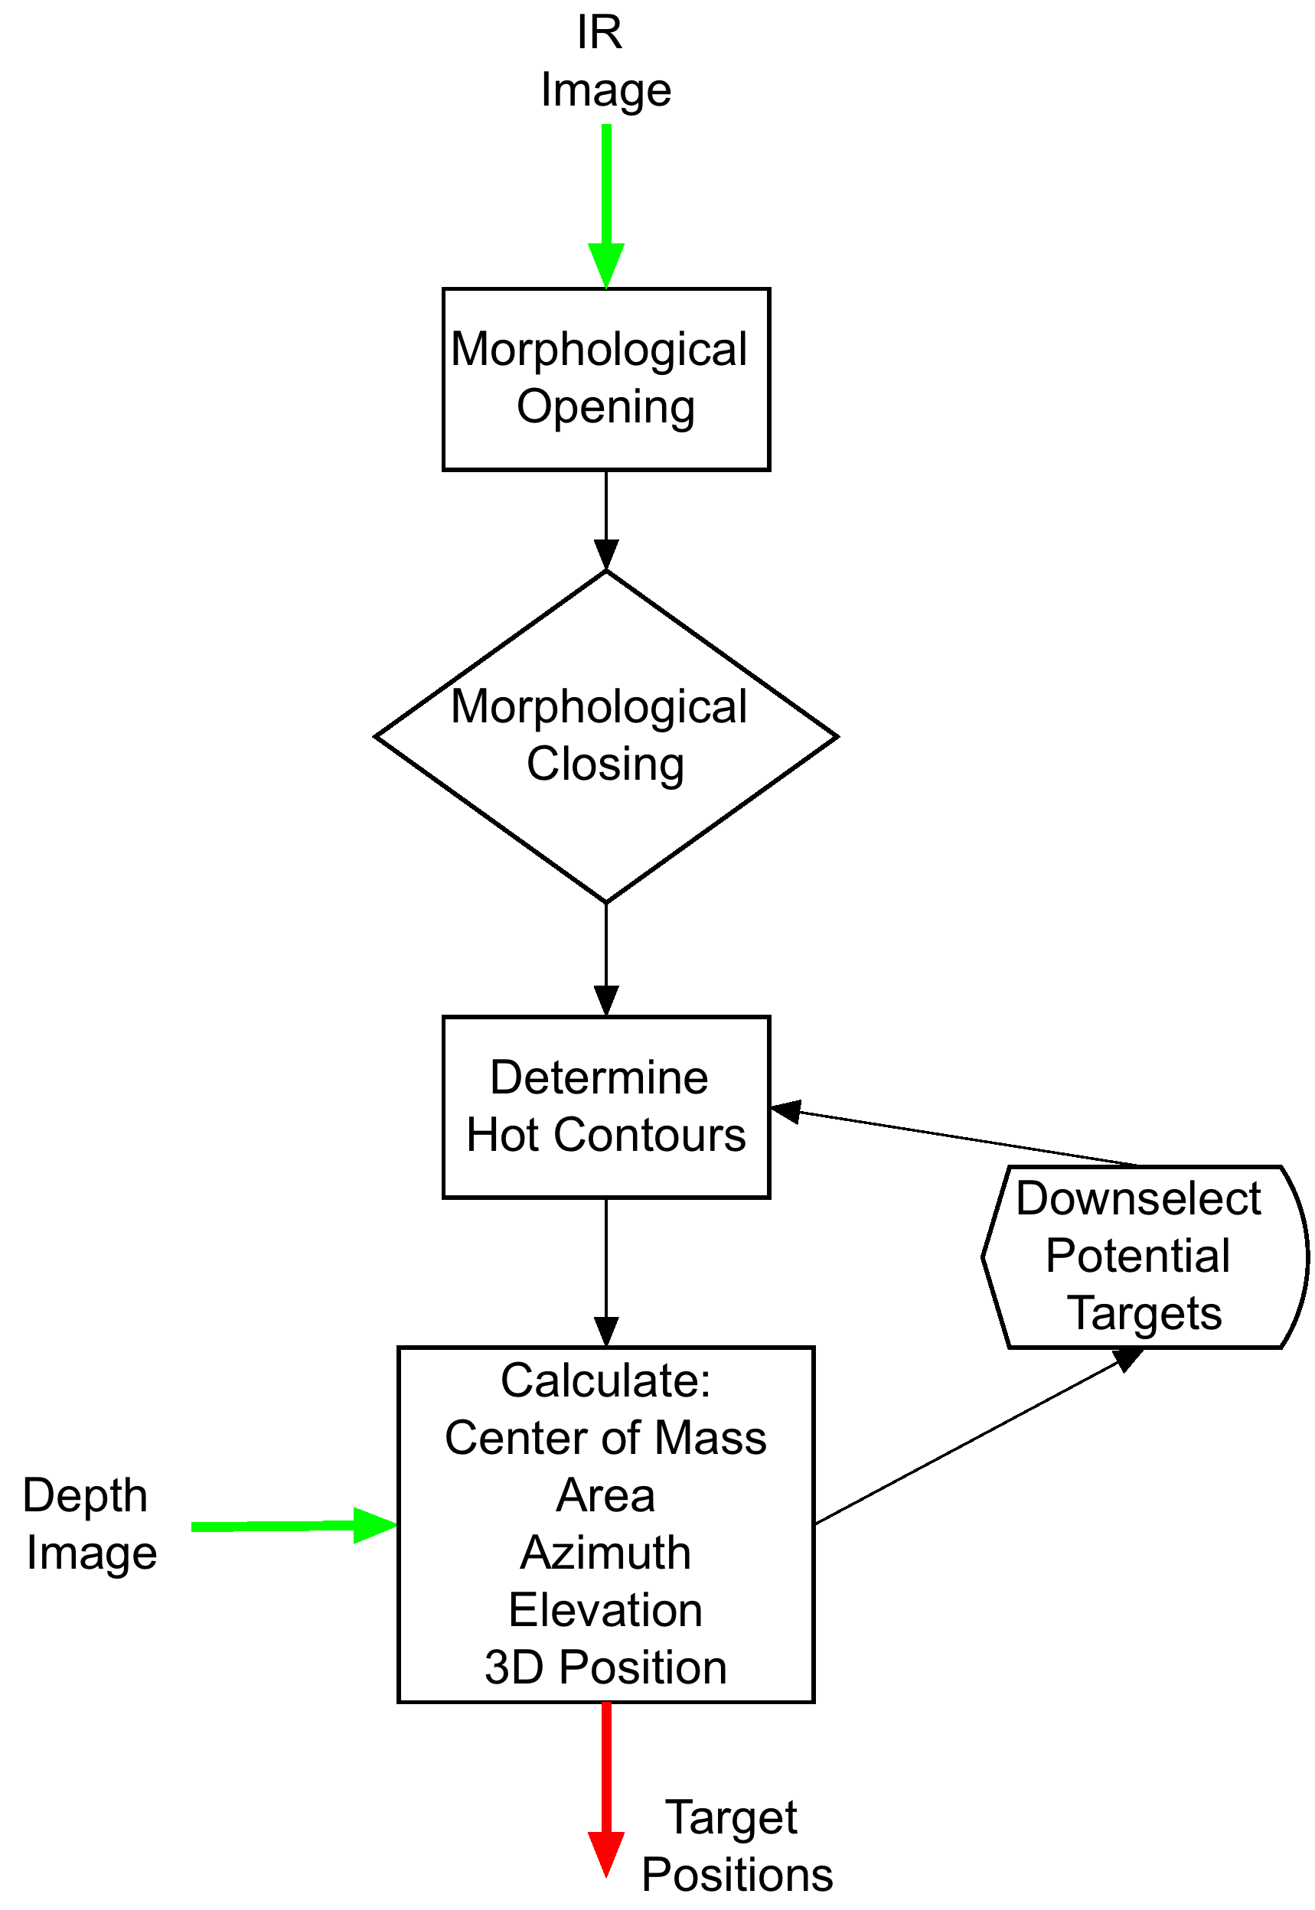
Target Identification and Tracking
Tracking Algorithm Overview

Slide 11

Target Identification and Tracking
Tracking Algorithm Overview
Masking +
Morphology

Slide 12
Target Identification and Tracking
Tracking Algorithm Overview
Contour Detection
And Selection

Slide 13

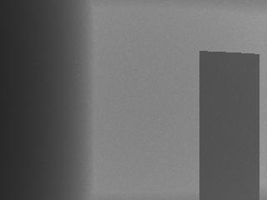
Target Identification and Tracking
Algorithm Performance
Matlab was used to generate simulate FLiR LWIR images and Guidance depth map images
These images were processed to determine sensitivity to noise and target position
Simulated Human-Sized Target at 5m
Simulated 80x60 FLiR Image
Simulated 320x240 Guidance
Depth Map

Slide 14
Target Identification and Tracking
Algorithm Performance
Error due to noise in Guidance depth map was on the order of the noise itself
Error due to position in frame is negligible
Simulated Human-Sized Target at 5m
Simulated 80x60 FLiR Image
Simulated 320x240 Guidance
Depth Map

Slide 15
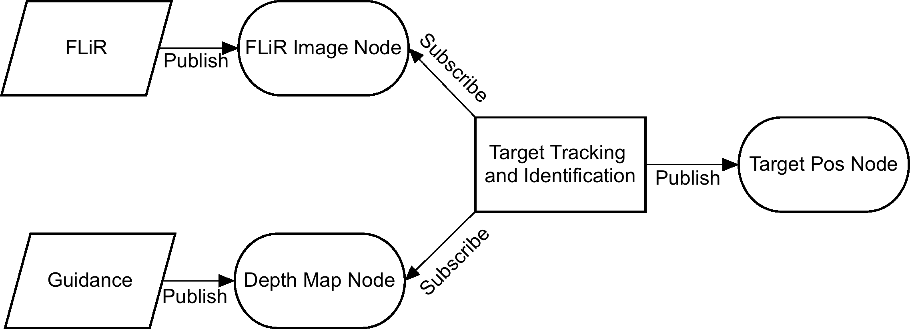
Target Identification and Tracking
Tracking - ROS Integration

Slide 16
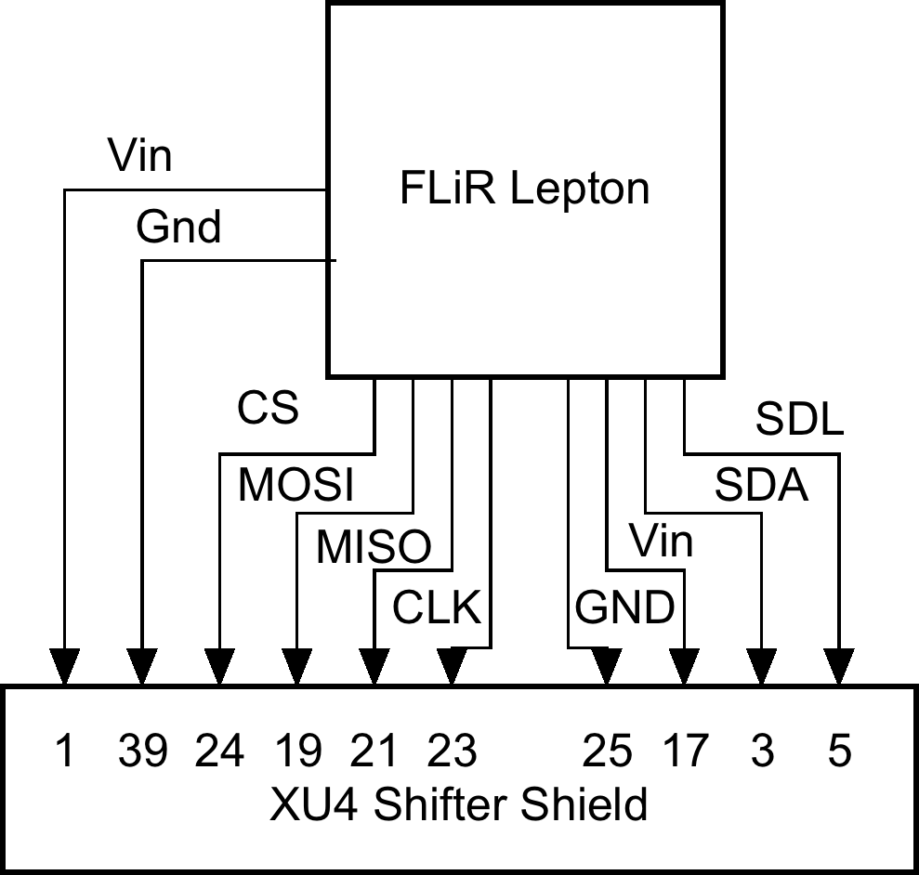
Target Identification and Tracking
FLiR - Odroid Integration

Slide 17
Target Identification and Tracking - Motivation
Level 3 |  | How is Requirement Satisfied
1.1.1 | The system shall have visual sensor(s) | FLiR Lepton LWIR Camera
1.1.2 | The system shall be capable of processing imagery | OpenCV
1.1.3 | The system shall locate individual targets with 95% probability of detection | Use of LWIR instead of visual
1.1.4 | The system shall identify human targets within 5 meters | Sufficient resolution to detect humans at 5 m
Level 3 |  | How is Requirement Satisfied
2.1.1 | The PPU shall estimate the target position to within 0.5 meters | As long as depth map is accurate enough, this is not a problem
2.1.2 | Each PPU shall estimate at least 2 visually identified targets | Number of tracked targets is configurable
2.1.3 | Each PPU shall maintain estimates of all confirmed target tracks | Estimates are published to ROS nodes
2.2.1 | PPUs shall process target estimates at 10 Hz | Small images and simple algorithm = very fast processing (Close to real time with HD images)

