Slide 1


W
C(s)
$$\overset{⃑}{F}, \overset{⃑}{M}$$
G(s)
$$\overset{⃑}{A}, \overset{⃑}{α}$$
R
Y
V

Slide 2
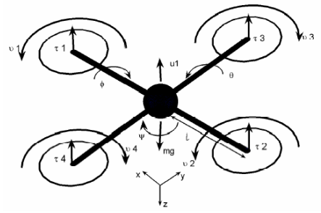
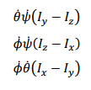

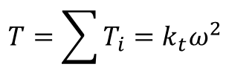


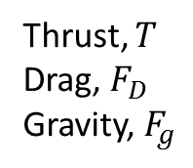

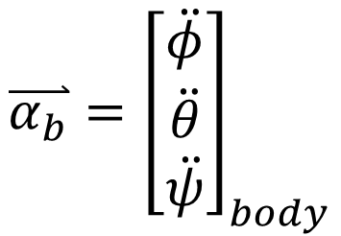

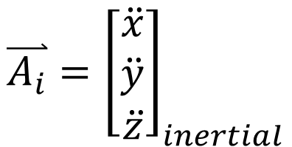



Thrust, $T$
Drag, $F_{D}$
Gravity, $F_{g}$
$$\overset{⃑}{F }$$
$$\overset{⃑}{A_{i}}={\left[\begin{matrix}\ddot{x} \\ \ddot{y} \\ \ddot{z}\end{matrix}\right]}_{inertial}$$
$$\overset{⃑}{M }$$
$$\overset{⃑}{α_{b}}={\left[\begin{matrix}\ddot{φ} \\ \ddot{θ} \\ \ddot{ψ}\end{matrix}\right]}_{body}$$
Roll Torque
Pitch Torque
Yaw Torque
Forces
Moments
Assuming body and propeller gyroscopic moments are small
$$T=\sum{T_{i}}=k_{t}ω^{2}$$
$$τ_{φ}=k_{t}L (ω_{3}^{2}−ω_{4}^{2})$$
$$F_{D}=−k_{d}\dot{\overset{⃑}{x}}$$
$$τ_{θ}=k_{t}L (ω_{1}^{2}−ω_{2}^{2})$$
$$F_{g}=m\ddot{z}$$
$$τ_{ψ}=k_{ψ}L (ω_{1}^{2}−{ω_{2}^{2}+ω_{3}^{2}−ω}_{4}^{2})$$

Slide 3







C(s)
Control System
Voltage1
Rotor Dynamics
$$f(ω)$$
Roll ref
$$ω_{1}$$
Voltage2
$$\overset{⃑}{F }$$
Pitch ref
$$ω_{2}$$
Voltage3
Yaw ref
$$ω_{3}$$
$$\overset{⃑}{M }$$
Voltage4
Throttle ref
$$ω_{4}$$

Slide 4


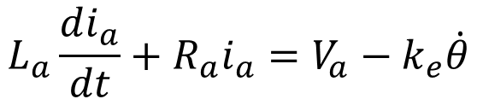
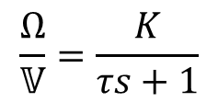


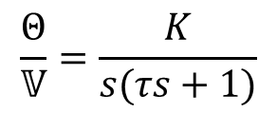




Rotor Dynamics
$$R_{a}$$
$$L_{a}$$
+
$$e=k_{e}\dot{θ}$$
$$τ=k_{t}I_{a}$$
--
$$\frac{Θ}{𝕍}=\frac{K}{s(τs+1)}$$
$$J_{m}\ddot{θ}+b\dot{θ}=k_{t}I_{a}$$
$$J_{m} Θs^{2}+b Θs=k_{t}𝕀_{a}$$
$$ℒ(s)$$
$$L_{a}\frac{di_{a}}{dt}+R_{a}i_{a}=V_{a}−k_{e}\dot{θ}$$
$$L_{a}𝕀_{a}s+R_{a}𝕀_{a}=𝕍_{a}−k_{e}Θs$$
$$\frac{Ω}{𝕍}=\frac{K}{τs+1}$$

Slide 5

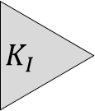
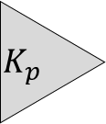



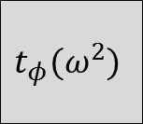



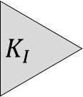

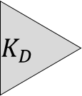


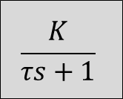





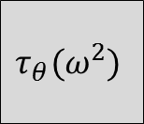







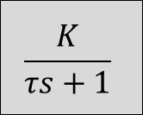


Attitude
Control
$$\frac{1}{s}$$
$$K_{I}$$
$$φ_{des}$$
$$K_{p}$$
$${\dot{φ}}_{des}$$
$$K_{p}$$
V
$$\frac{K}{τs+1}$$
$$ω_{m}$$
$$t_{φ}(ω^{2})$$
$$τ_{m}$$
$$\frac{1}{Js}$$
$$\dot{φ}$$
$$\frac{1}{s}$$
$$φ$$
$$s$$
$$K_{D}$$
$$\frac{1}{s}$$
$$K_{I}$$
$$θ_{des}$$
$$K_{p}$$
$${\dot{θ}}_{des}$$
$$K_{p}$$
V
$$\frac{K}{τs+1}$$
$$ω_{m}$$
$$τ_{θ}(ω^{2})$$
$$τ_{m}$$
$$\frac{1}{Js}$$
$$\dot{θ}$$
$$\frac{1}{s}$$
$$θ$$
$$s$$
$$K_{D}$$

Slide 6
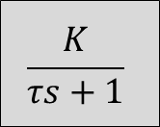



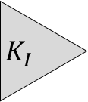





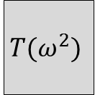
Altitude
Control
$$\frac{1}{s}$$
$$K_{I}$$
$$z_{des}$$
$$K_{p}$$
V
$$\frac{K}{τs+1}$$
$$ω_{m}$$
$$T(ω^{2})$$
$$T$$
$$z_{estimate}$$
$$s$$
$$K_{D}$$

Slide 7



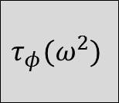











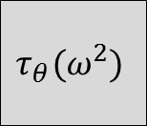














Velocity
Control
$$\frac{1}{s}$$
$$K_{I}$$
$$\dot{x_{b}}$$
$$K_{p}$$
V
$$\frac{K}{τs+1}$$
$$ω_{m}$$
$$τ_{θ}(ω^{2})$$
$$τ_{m}$$
$$\frac{1}{Js}$$
$$\dot{θ}$$
$$\frac{1}{s}$$
$$θ$$
$${\dot{x_{b}}}_{estimate}$$
$$s$$
$$x_{estimate}$$
$$\frac{1}{s}$$
$$K_{I}$$
$$\dot{y_{b}}$$
$$K_{p}$$
V
$$\frac{K}{τs+1}$$
$$ω_{m}$$
$$τ_{φ}(ω^{2})$$
$$τ_{m}$$
$$\frac{1}{Js}$$
$$\dot{φ}$$
$$\frac{1}{s}$$
$$φ$$
$${\dot{y_{b}}}_{estimate}$$
$$s$$
$$y_{estimate}$$

Slide 8










Position
Control
$${x,y}_{des}$$
$$K_{p}$$
$$\dot{x_{i},}\dot{y_{i}}$$
$$R_{i2b}$$
$$\dot{x_{b},}\dot{y_{b}}$$
Velocity Controller
$$θ_{des}$$
Attitude Controller
$$θ$$
$${x,y}_{estimate}$$
$$φ_{des}$$
Attitude Controller
$$φ$$

