Slide 1


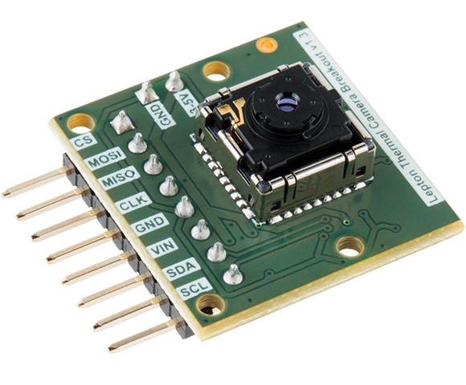
FlyNet: Autonomous Quadcopter Search and Rescue
FLiR Sensor Mounting

Slide 2
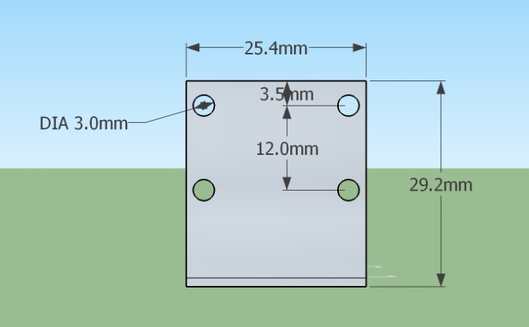
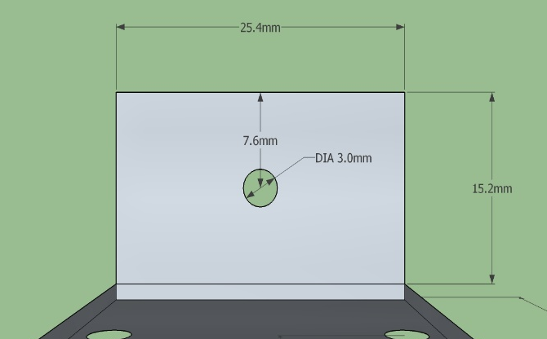
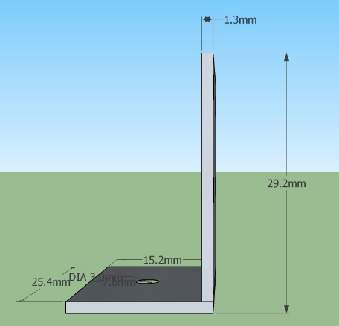
Mounting- Design
FlyNet: Autonomous Quadcopter Search and Rescue
Aluminum Bracket:

Slide 3
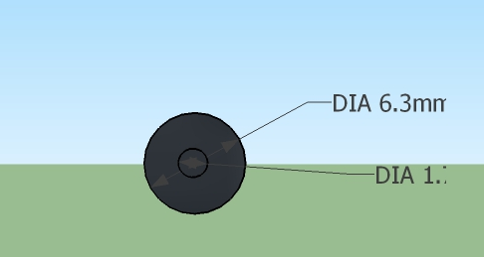
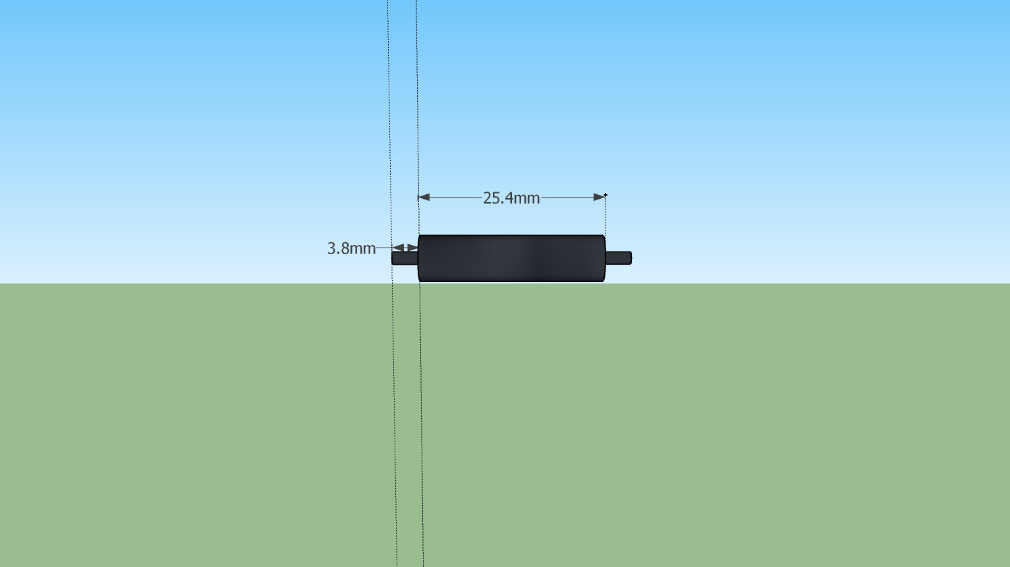
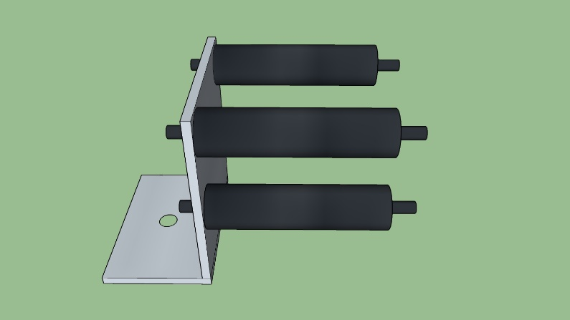
Mounting- Design
FlyNet: Autonomous Quadcopter Search and Rescue
Nylon Stand-Offs

Slide 4
FlyNet: Autonomous Quadcopter Search and Rescue
Ground Robots

Slide 5
Requirement Motivation
FlyNet: Autonomous Quadcopter Search and Rescue
Proposed Solution
Use ground robots to perform the following function:
Map in parallel to quad copter
Used for off-board processing
Carry and deliver payload
Act as a point of communication
Act as central planning unit
Serve as a test bed from planning algorithms
The system shall consist of a team of at least 2 robots
The system shall have at least 1 aerial vehicle

Slide 6
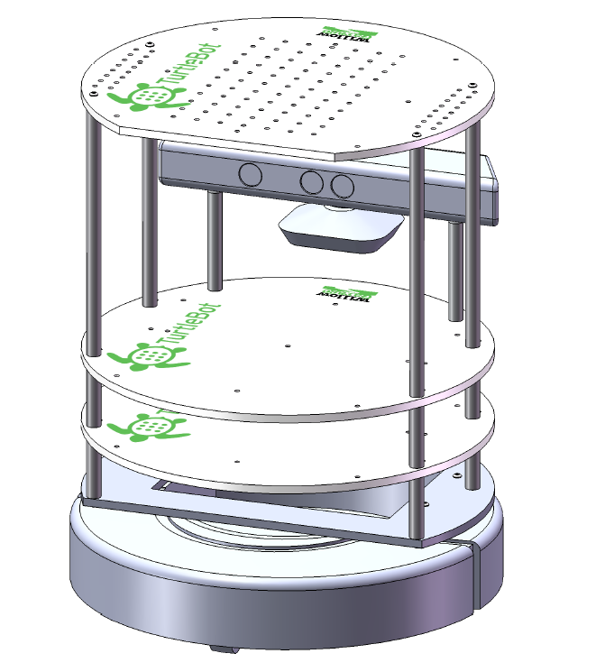
Specifications of Ground Robot
FlyNet: Autonomous Quadcopter Search and Rescue
Proposed to use TurtleBot with:
iRobot Create
Microsoft Kinect
Netbook
Kinect Mounting Hardware
Hokuyo Laser Scanner
FLiR sensor

Slide 7
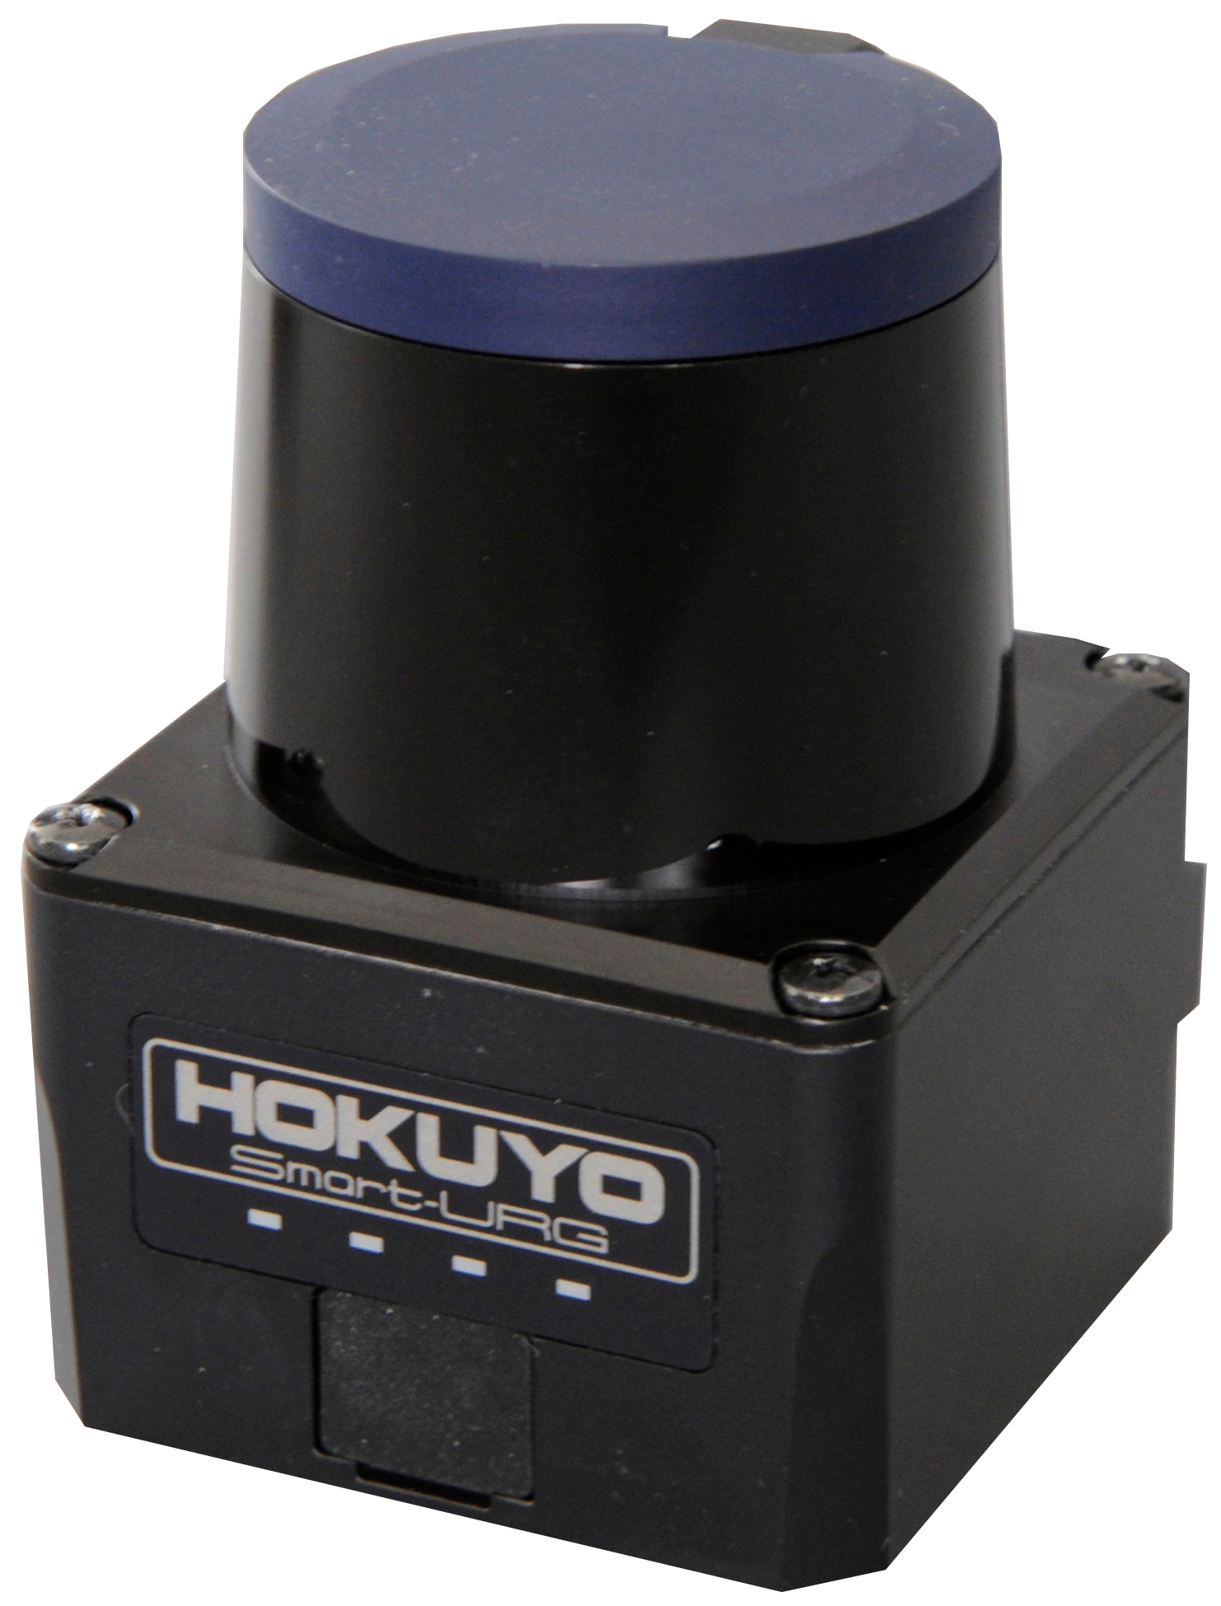
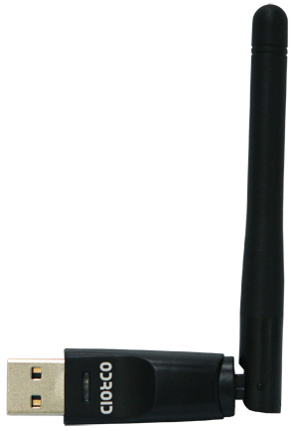
FlyNet: Autonomous Quadcopter Search and Rescue
IMU and Wheel Odometry
WiFi
Adapter
Hokuyo Laser Scanner
Odroid XU4
Kinect
(optional)
FLiR
Power Distribution Board
Power Module
Motor
Battery

Slide 8
FlyNet: Autonomous Quadcopter Search and Rescue
Ground Station
Communicates between the on-board computer
Aerial Robot
Current position
Location of target (if found)
WiFi
WiFi
Odroid XU 4
Ubuntu 14.04
Runs Hector_Slam algorithms
Runs path planning algorithms for the ground
Acts as a task allocator (incase of multiple quadcopters)
FLiR
Provides IR images for human identification
Kinect (optional)
Provides depth map, grayscale images, and visual odometry for RTAB Map
Hokuyo Laser Scanner
Returns range data
USB 3.0

Slide 9
Path Forward
FlyNet: Autonomous Quadcopter Search and Rescue
Understanding the working of the current TurtleBot setup
Implement Hector_Slam on the TurtleBots
Fabricate additional hardware to accommodate hardware additions
Implement path planning algorithms
Integrate with aerial robot

