Slide 1


Perception: Motivation
Level 1 | Level 2 | Level 3
The system shall perform a search for targets | The system shall visually verify targets | 1.1.1 | The system shall have visual sensor(s)
1.1.2 | The system shall be capable of processing imagery
The system shall navigate an unknown environment using partial prior information | 1.2.1 | The system shall avoid unrecoverable collisions with obstacles
1.2.2 | The system shall plan vehicle trajectories through the environment
Level 1 | Level 2 | Level 3
The system shall track visually identified targets | Each PPU shall have the ability to track targets | 2.1.1 | The PPU shall estimate target position to within 0.5 m
The system shall be autonomous | The system shall not rely on external processing | 4.1.2 | The system shall perform perception onboard

Slide 2
Perception: Major Design Choices
Major Design Choices:
Custom vs Off-The-Shelf SLAM Package
Underlying algorithmic options
Sparse vs Dense
Loop closure support
Image processing choices:
Onboard
Auxiliary processor
Image sensor choices:
Monocular
Visual + Depth
Stereo pair
Additional sensor options
Ultrasound
Scanning laser
Laser altimeter

Slide 3
Perception: Custom vs Off-The-Shelf
Given timeline and team resources, development of a custom SLAM solution was not feasible
Turned to available software packages for their support of popular varieties of SLAM:
RGBDSlam
RTABMap
CCNYSlam
LSDSlam
Package determines sensors required and potential limitations
Loop closure determined to be a necessary feature to support operations in larger spaces
Necessary to have immediate position output for use in control system
Required to provide reasonable performance on a CPU that can be flown as payload

Slide 4
Perception: SLAM Design Choice
Design choice: RTABMap
Demonstrated capability aboard ARM SOCs
Provides for loop closure and map generation
Able to use a variety of sensor inputs (RGB-D / stereo / laser)
Uses sparse methods with a keyframe approach to minimize growth of map over large areas

Slide 5
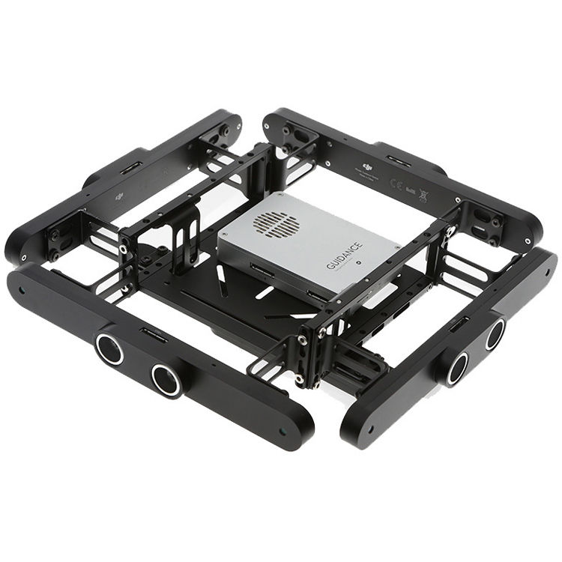
Perception: Onboard vs Auxiliary
RTABMap requires an odometry source of some sort
External odometry could offload a major source of CPU utilization
Capable of generating odometry from monocular or stereo sensors
Design Choice: Guidance
Provides an external auxiliary processor to compute odometry, as well as sychronized global shutter stereo pairs
Includes ultrasound sensors as a bonus
Available as a turn-key solution
Other solutions considered:
Mounting a second CPU to handle perception
Required external cameras as well
Rejected due to SWaP impact

Slide 6
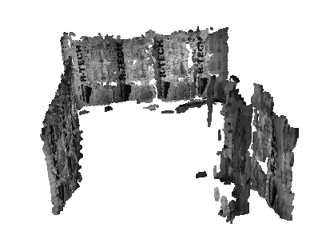
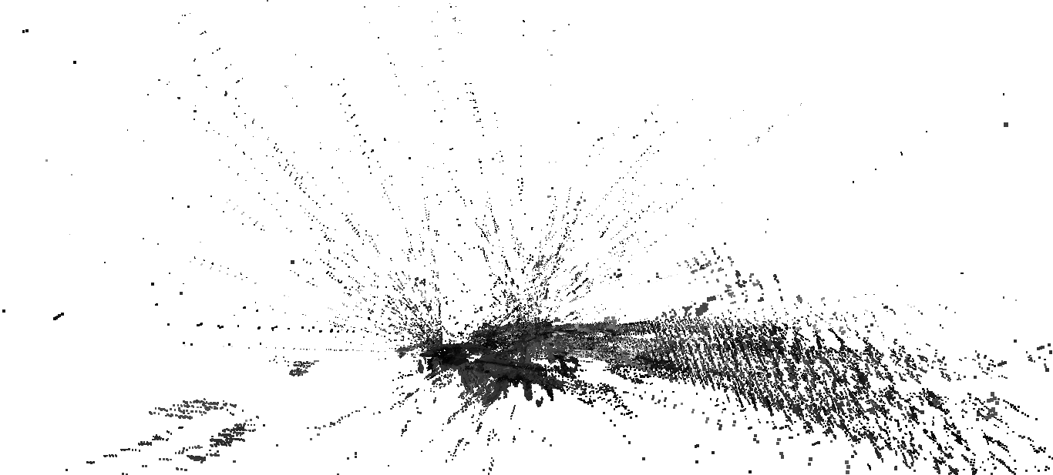
Perception: Camera Choice
RTABMap requires imagery input, either as a RGB-D or a stereo pair
Design choice: Stereo Pair
Depth maps produced by Guidance show poor performance, related to stereo pipeline algorithm parameters that can't be changed
Software stereo pipeline available to produce depth maps for use in target registration to 3D coordinates
Map produced by RGB+Depth
Map produced by stereo pair

Slide 7
Perception: Additional Sensors
Design choice: Potentially laser altimeter
Guidance provides ultrasounds for coarse object detection and coarse altitude estimation
As testing proceeds, the laser altimeter may become necessary to ensure safe autonomous takeoffs and landings

Slide 8
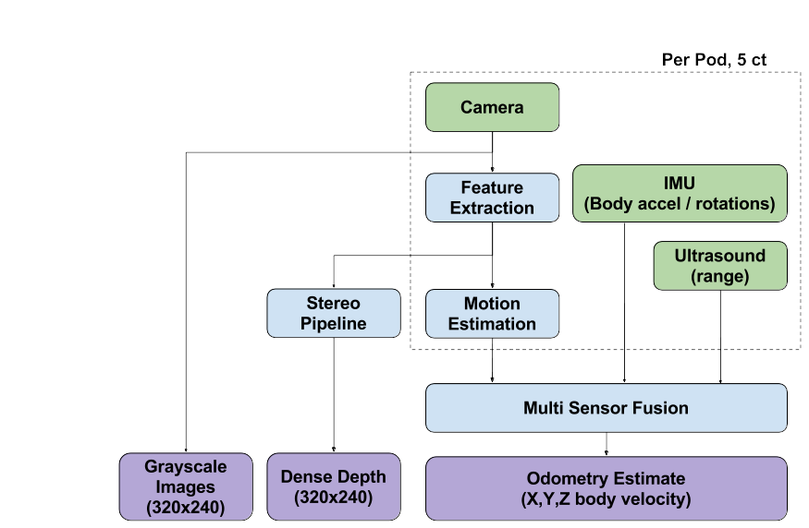
Perception: Block Diagram, Guidance

Slide 9
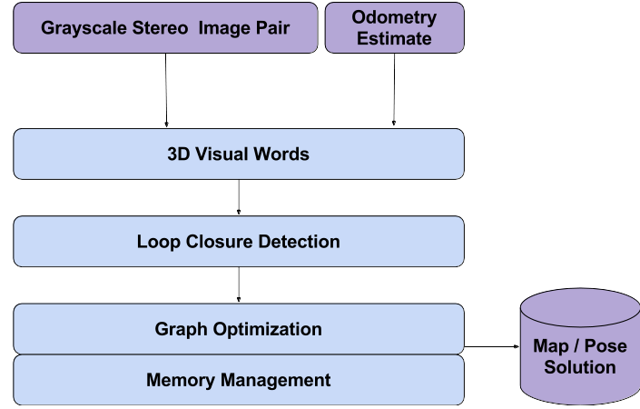
Perception: Block Diagram, RTABMap

Slide 10
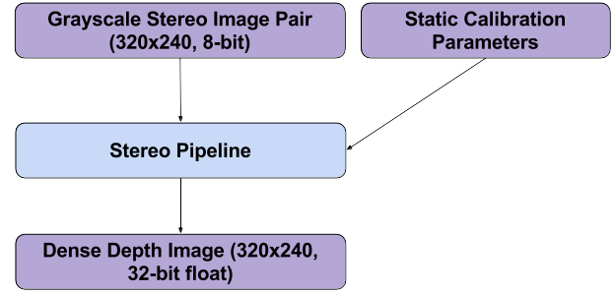
Perception: Block Diagram, Software Stereo

Slide 11
Perception: Requirements
Level 3 | How is Requirement Satisfied
1.1.1 | The system shall have visual sensor(s) | Guidance cameras
1.1.2 | The system shall be capable of processing imagery | Guidance and software pipelines
1.2.1 | The system shall avoid unrecoverable collisions with obstacles | Obstacle detection via Guidance
1.2.2 | The system shall plan vehicle trajectories through the environment | Map production from RTABMap
Level 3 | How is Requirement Satisfied
2.1.1 | The PPU shall estimate target position to within 0.5 m | Software stereo pipeline's depth image coupled with RTABMap position estimate
4.1.2 | The system shall perform perception onboard | Guidance + RTABMap

