Slide 1


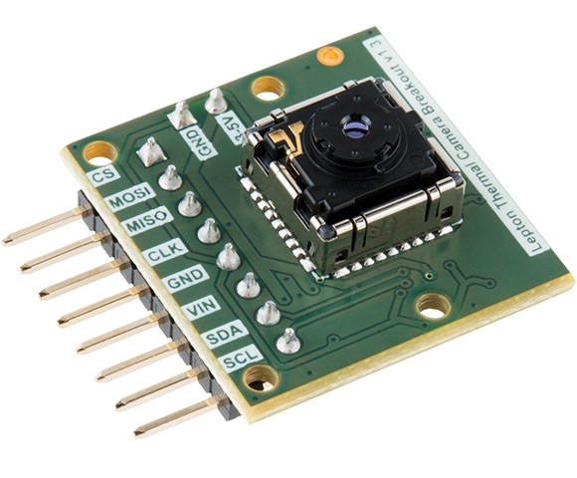
FlyNet: Autonomous Quadcopter Search and Rescue
FLiR Sensor Mounting

Slide 2
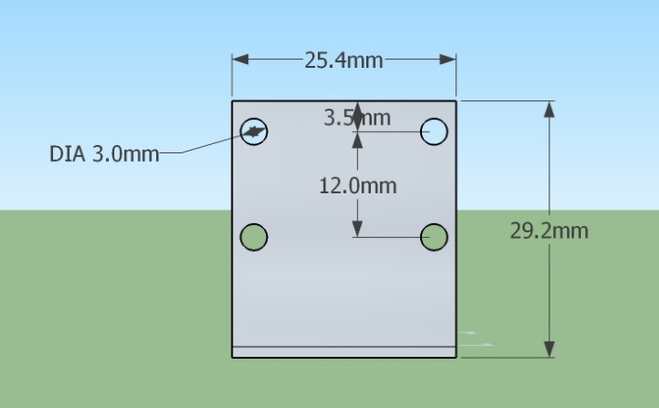
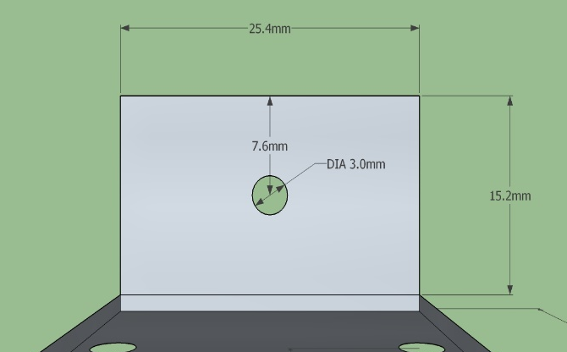
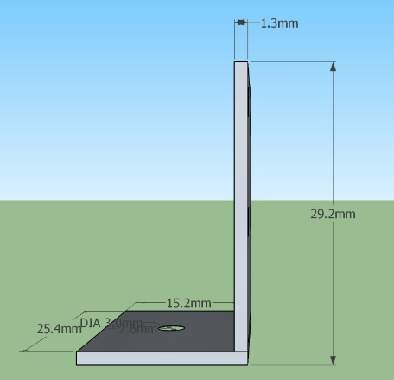
Mounting- Design
FlyNet: Autonomous Quadcopter Search and Rescue
Aluminum Bracket:

Slide 3
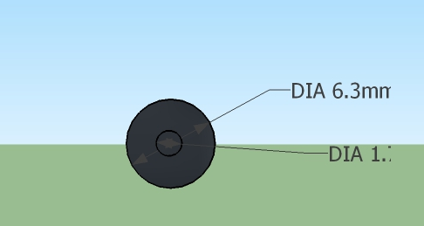
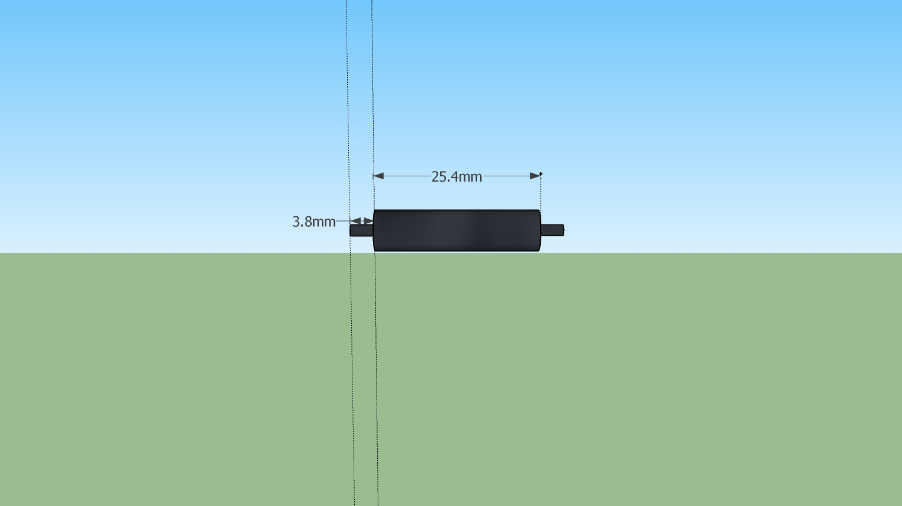
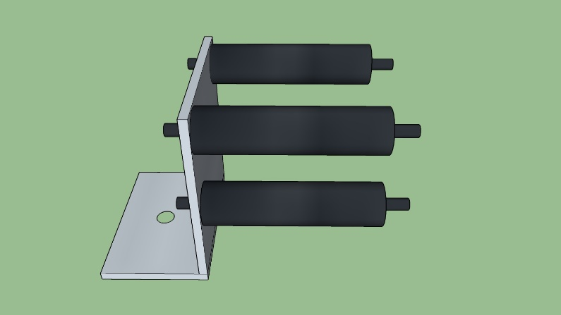
Mounting- Design
FlyNet: Autonomous Quadcopter Search and Rescue
Nylon Stand-Offs

Slide 4
FlyNet: Autonomous Quadcopter Search and Rescue
Ground Robots

Slide 5
Requirement Motivation
FlyNet: Autonomous Quadcopter Search and Rescue
Proposed Solution
Use ground robots to perform the following function:
Map in parallel to quad copter
Used for off-board processing
Carry and deliver payload
Act as a point of communication
Act as central planning unit
The system shall consist of a team of at least 2 robots
The system shall have at least 1 aerial vehicle

Slide 6
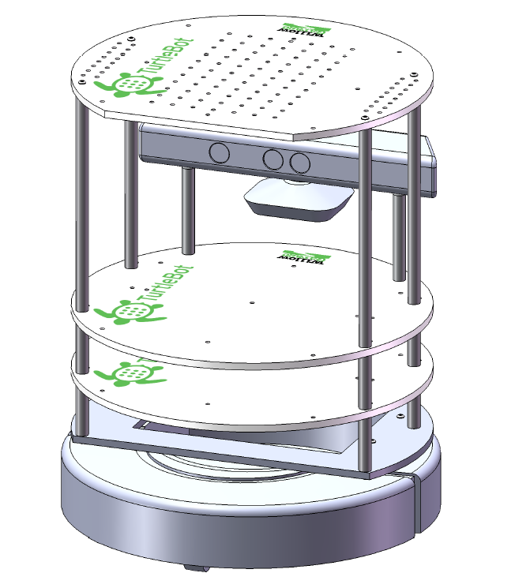
Specifications of Ground Robot
FlyNet: Autonomous Quadcopter Search and Rescue
Proposed to use TurtleBot with:
iRobot Create
Microsoft Kinect
Netbook
Kinect Mounting Hardware

Slide 7
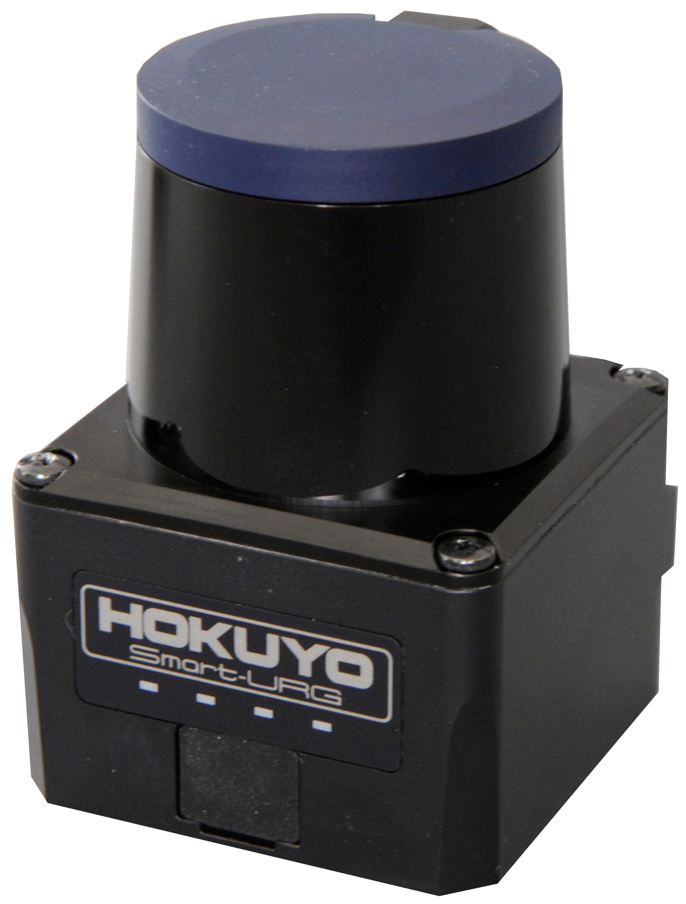
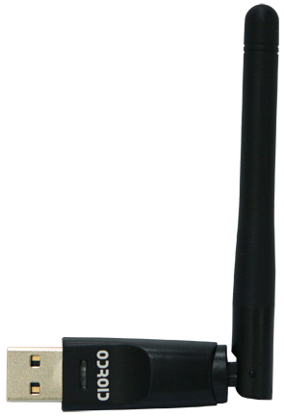
FlyNet: Autonomous Quadcopter Search and Rescue
IMU
WiFi
Adapter
Hokuyo Laser Scanner
On-board Computer
Power Distribution Board
Power Module
Motor
Battery

Slide 8
FlyNet: Autonomous Quadcopter Search and Rescue
Sensors
Visual Sensor
Camera
Data
Sensor Data, Map, Position,
Commands
Sensor
Data
On-board Computer
Transmitter/
Receiver
Motor Commands
Position of quad, camera data from quad,
Motors

Slide 9
FlyNet: Autonomous Quadcopter Search and Rescue
Ground Station
Communicates between the on-board computer
Aerial Robot
Current position
Location of target (if found)
WiFi
WiFi
On-board Computer
Ubuntu 14.04
Runs Hector_Slam algorithms
Runs path planning algorithms for the ground and aerial robot
Processes data from Quadcopter
Hokuyo Laser Scanner
Returns range data
USB 3.0

Slide 10
Path Forward
FlyNet: Autonomous Quadcopter Search and Rescue
Understanding the working of the current TurtleBot setup
Implement Hector_Slam on the TurtleBots
Fabricate additional hardware to accommodate hardware additions
Implement path planning algorithms
Integrate with aerial robot

