Slide 1
Morphology Optimization of a Tilt-Rotor MAV
Luca Rinsoz
Master Thesis performed at the Autonomous System Lab
Supervised by Karen Bodie and Zachary Taylor

Slide 2
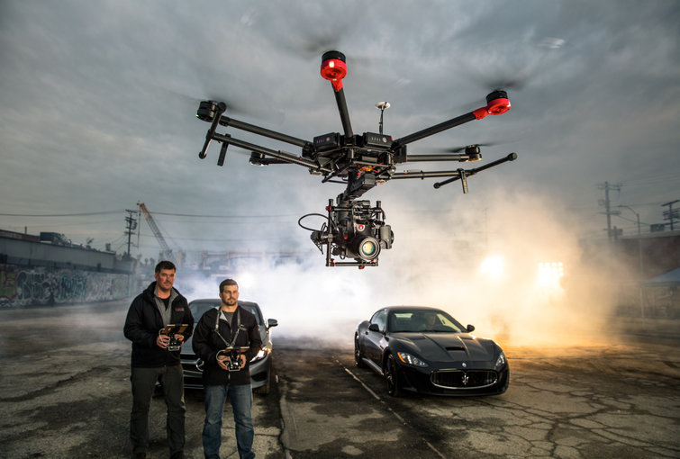
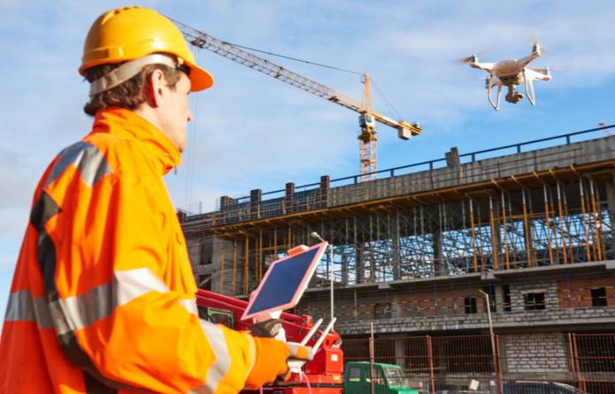
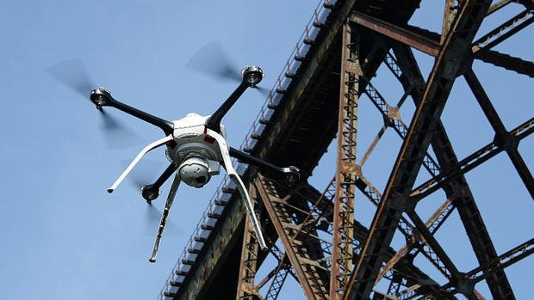
Motivation
https://www.duluthnewstribune.com/news/3849087-mndot-test-bridge-inspecting-drones-duluth
http://www.constructionmanagermagazine.com/news/uk-construction-use-thousands-drones-2030/
https://www.duluthnewstribune.com/news/3849087-mndot-test-bridge-inspecting-drones-duluth

Slide 3
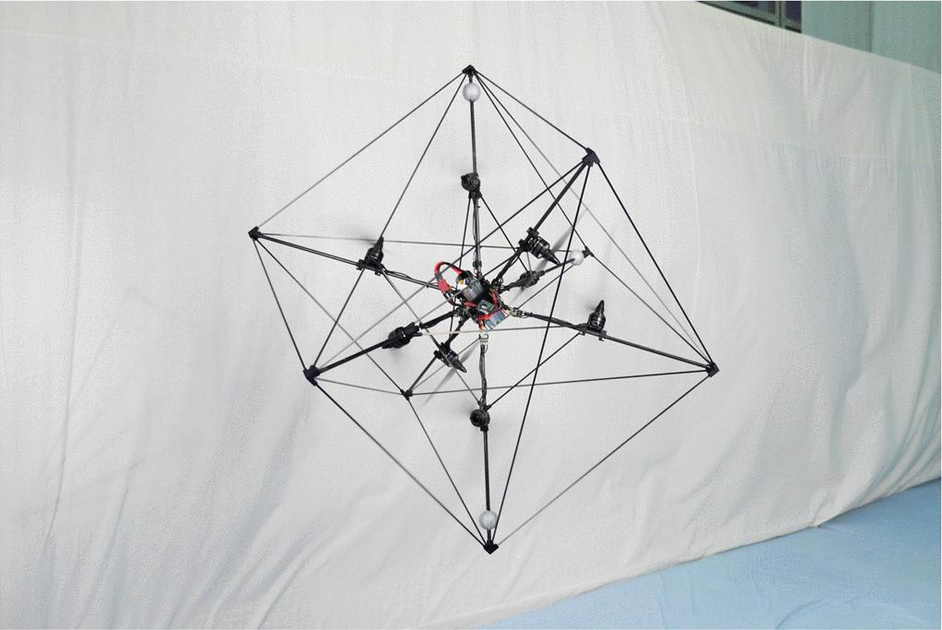
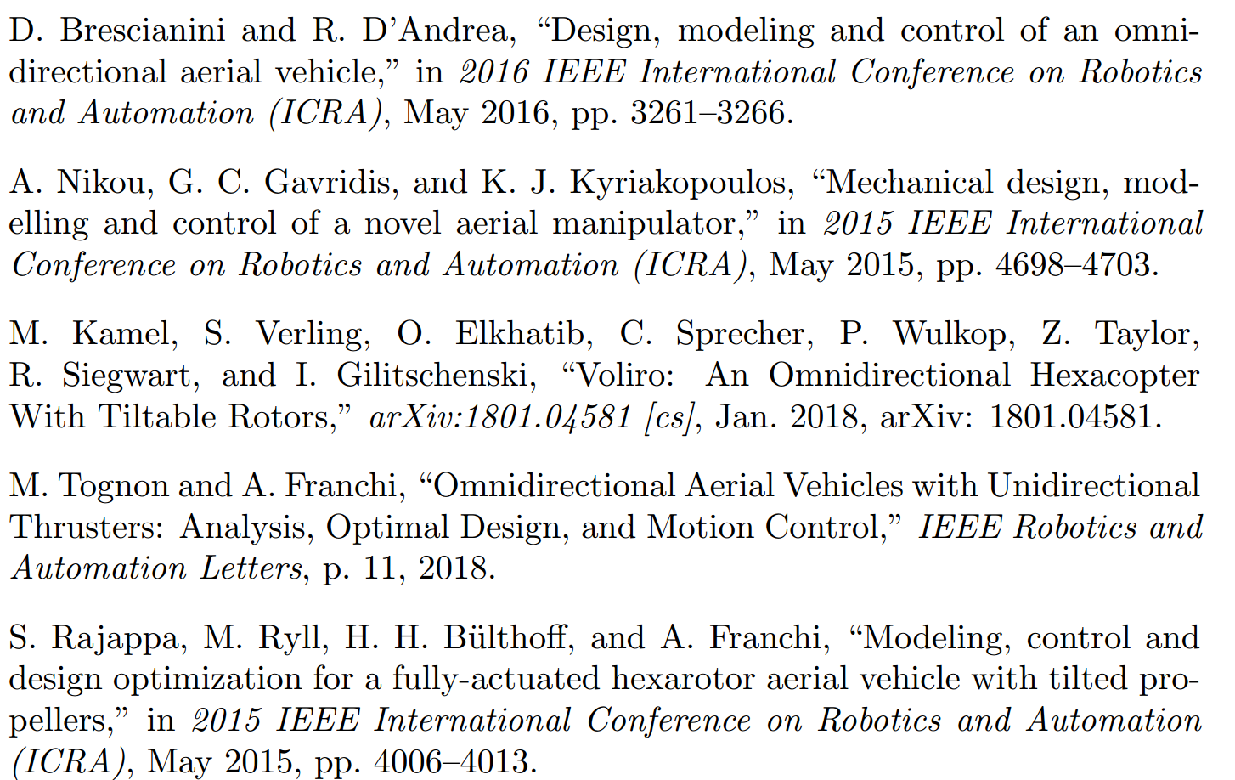
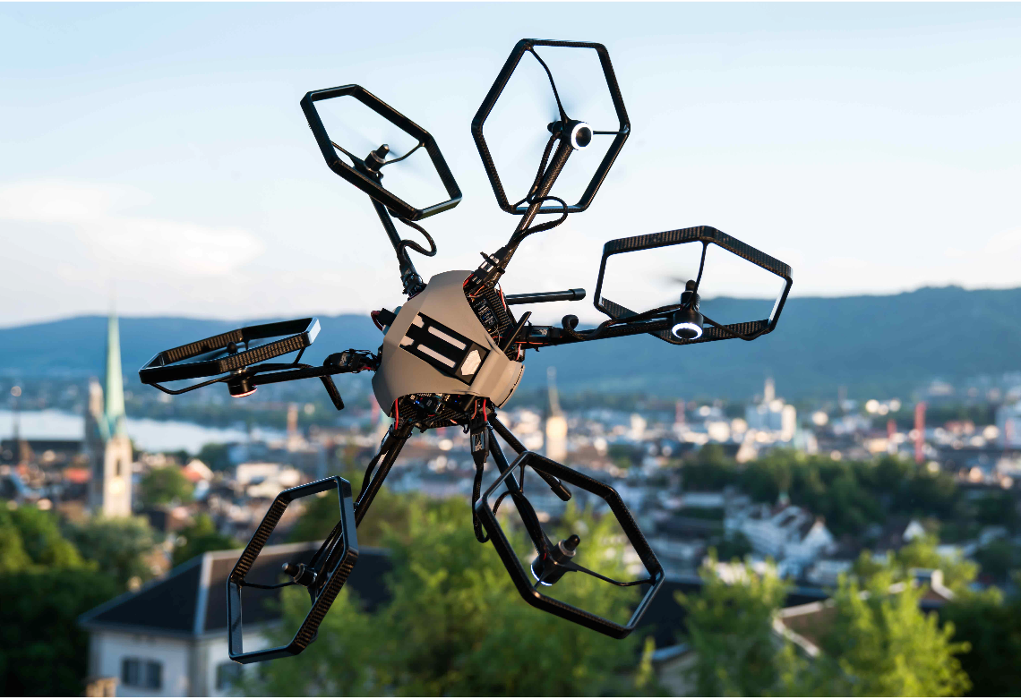
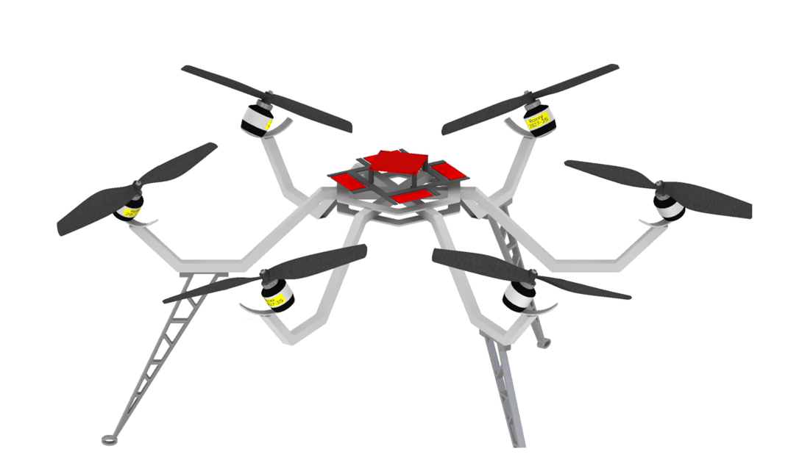
State of the Art

Slide 4
Problem Statement
Design of a micro aerial vehicle (MAV) with tilting propellers as a result of an optimization problem
  Omnidirectionality
  Flight efficiency
  Controlability

Slide 5
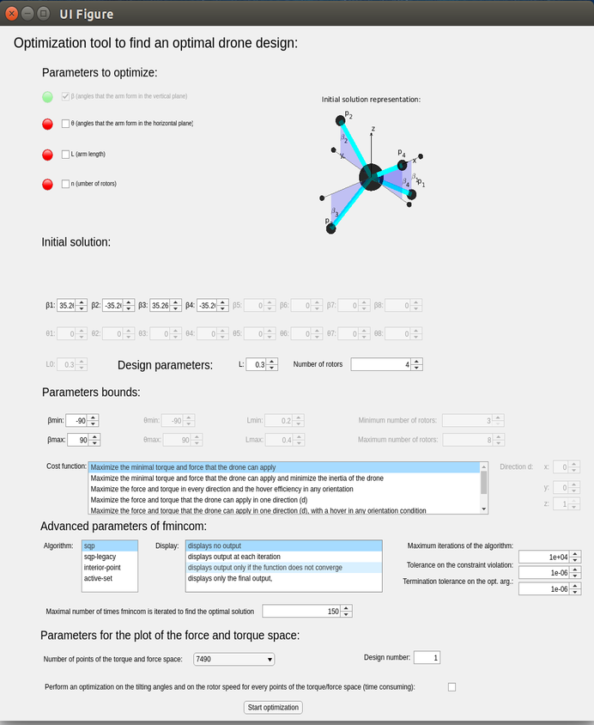
Optimization Tool User Guide
Choose parameters to optimize
Specify design parameters
Specify an initial solution
Specify a cost function
Launch optimization
Obtain result

Slide 6
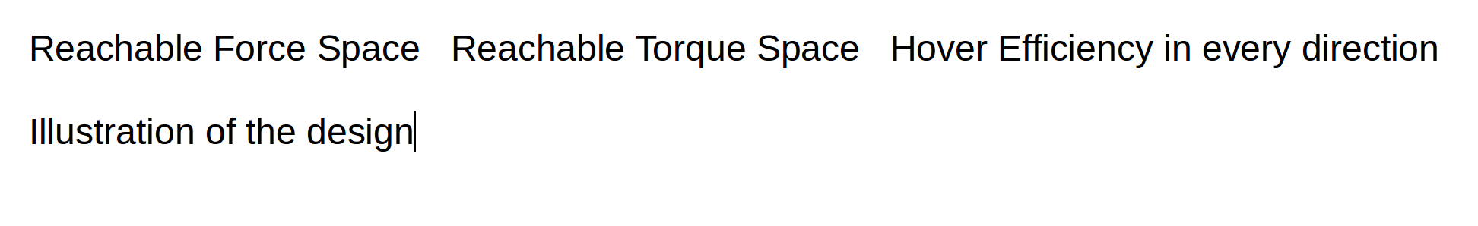
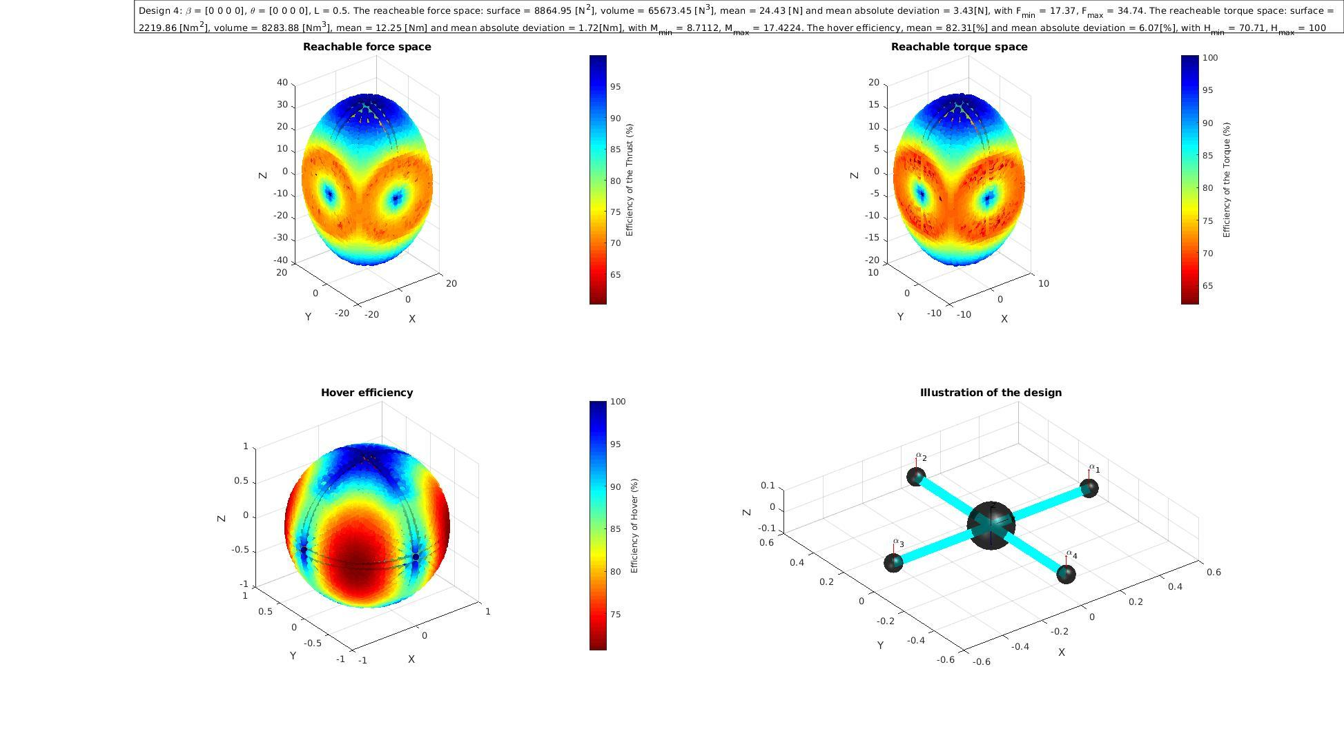
Optimization Tool Output

Slide 7
Optimization Tool Output
Information on the design:
  Volume of the reachable force and torque space
  Surface of the reachable force and torque space
  Maximal and minimal forces and torques
  Mean of the force, torque and hover efficiency
  Mean absolute deviation of the force, torque and hover efficiency

Slide 8
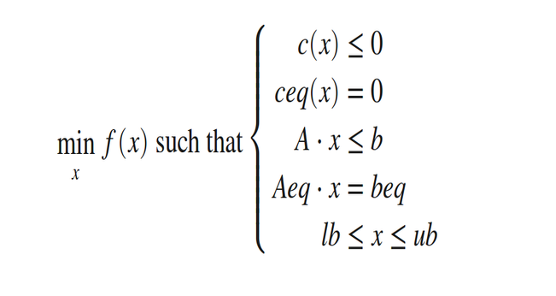
MAV Morphology Optimization Tool
The optimisation solved by matlab and an Sequential quadratic programming (sqp) algorithm
The MAV‘s design is the result of an optimization problem

Slide 9
Cost functions
Maximize the minimal force and the minimal torque
Maximize the minimal force and the minimal torque, and minimize the inertia
Maximize the volume of the reachable force and torque space
Maximize the force, the torque and the hover efficiency in every direction
Maximize the force and the torque in one defined direction d

Slide 10
Limitations
Non-linear cost functions
Algorithm provides local minima
Solution dependent on the chosen initial solution
The more parameters to optimize the more it gets stuck in local optima

Slide 11
Results
Drone design obtained for different numbers of propellers
  Three propellers Tri-copter
  Four propellers Quad-copter
  Five propellers Penta-copter
  Six propellers Hexa-copter
  Seven propellers Hepta-copter
  Eight propellers Octa-copter

Slide 12
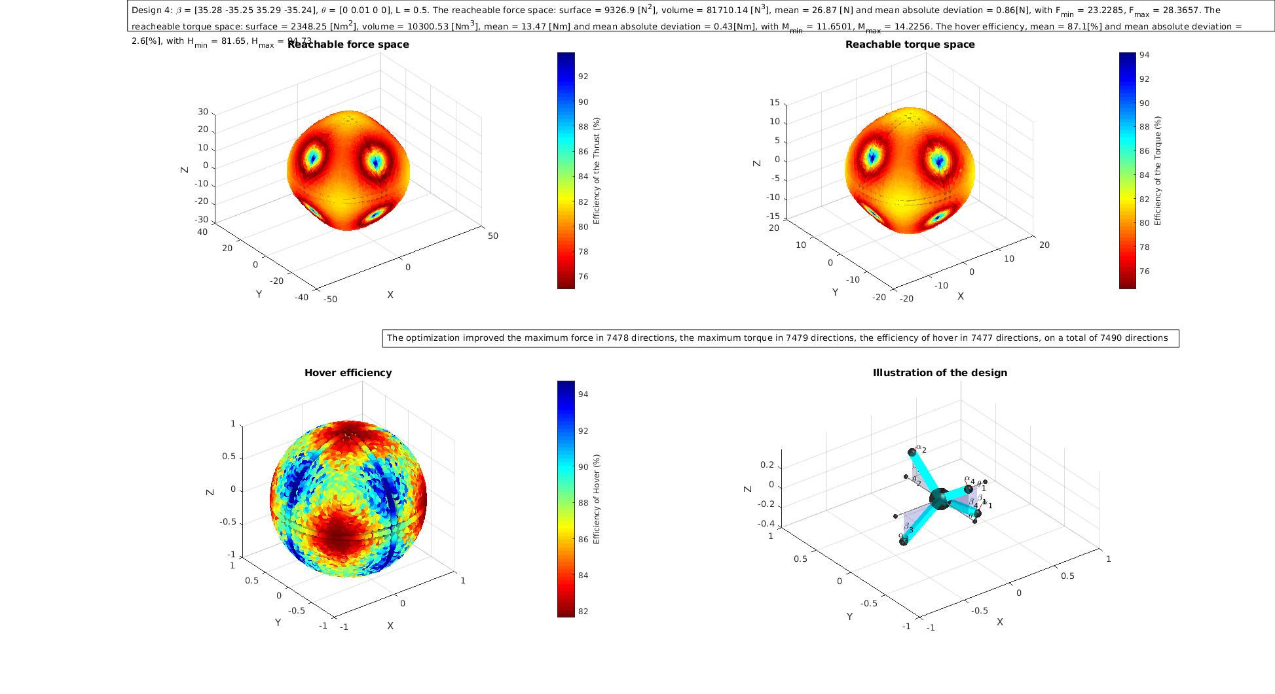
Results
Quad-copter
  Maximizing the minimal force and torque
    β = [35.26, -35.26, 35.26, -35.26]

Slide 13
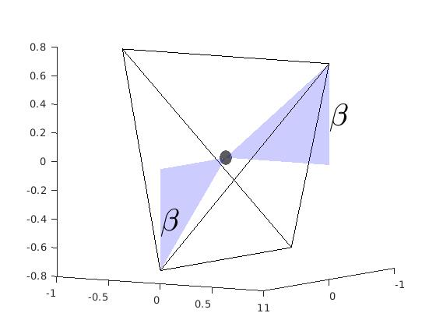
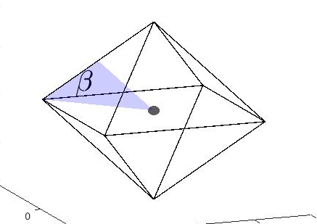
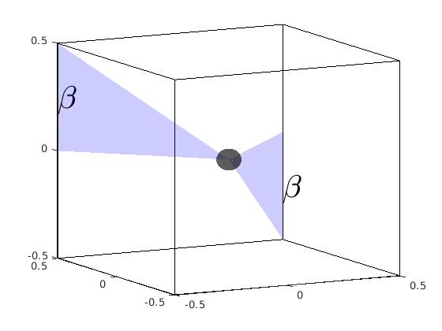

Platonic solids

Slide 14
Results
Quad-copter

Slide 15
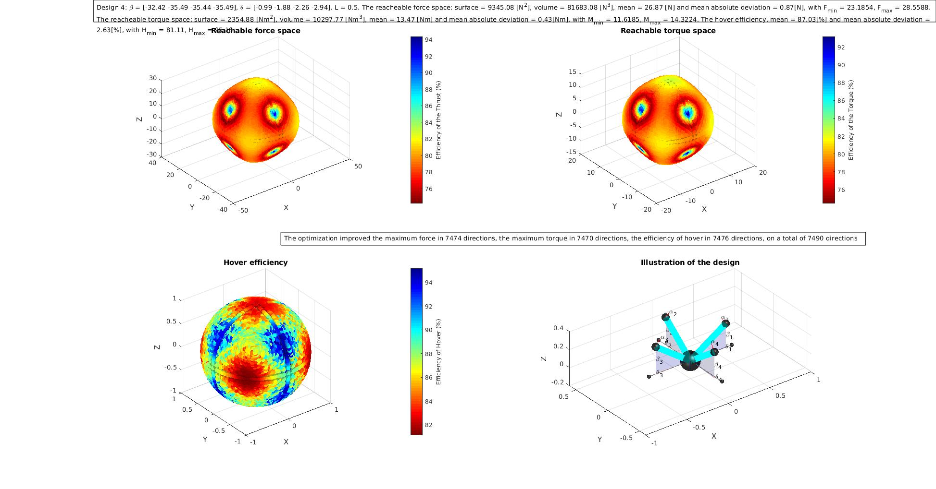
Results
Quad-copter
  Maximizing the minimal force and torque
  Starting as with β0 = [0, 0, 0, 0] β = [-32.42, -35.49, -35.44, -35.49]
  Starting with β0 = [35.26, -35.26, 35.26, -35.26] β = [35.26, -35.26, 35.26, -35.26]

Slide 16
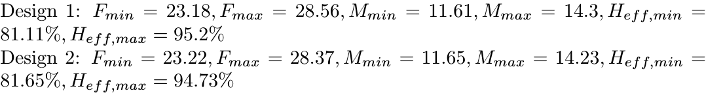
Results
Quad-copter

Slide 17
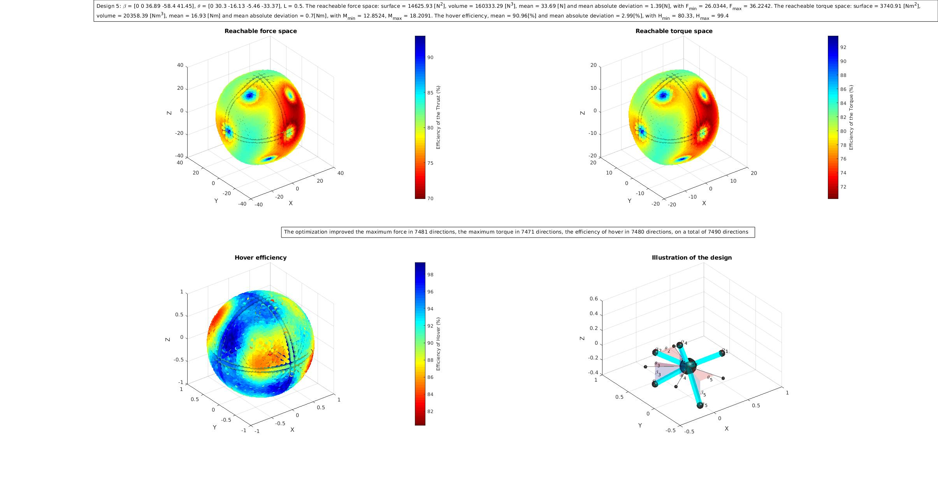
Results
Penta-copter
  Maximizing the minimal force and torque and minimzing the drone inertia
  Starting with β0 = [0, 0, 0, 0, 0]
  Solution β = [0, 0, 36.9, -58.4, -41.5]

Slide 18
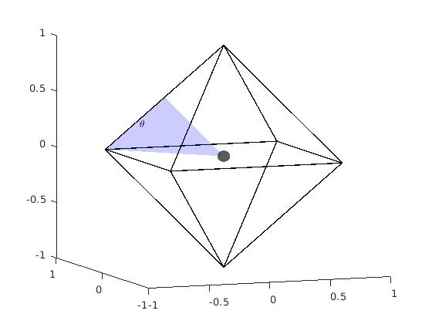
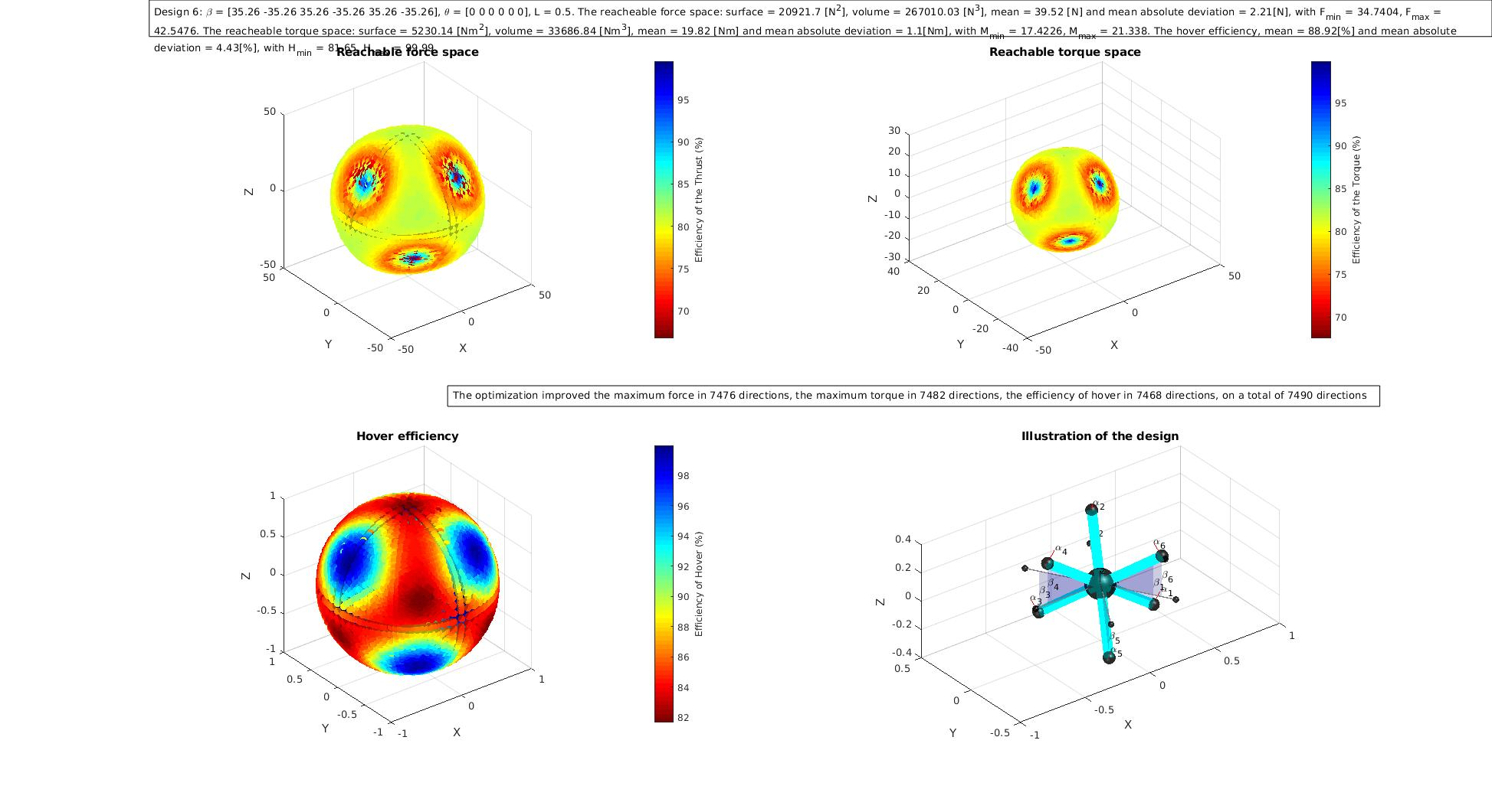
Results
Hexa-copter
    Obtained maximizing the volumes of the force and torque spaces
      Solution β = [35.26, -35.26, -35.26, 35.26,-35.26, 35.26]

Slide 19
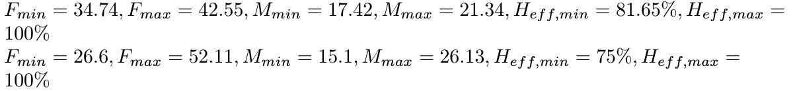
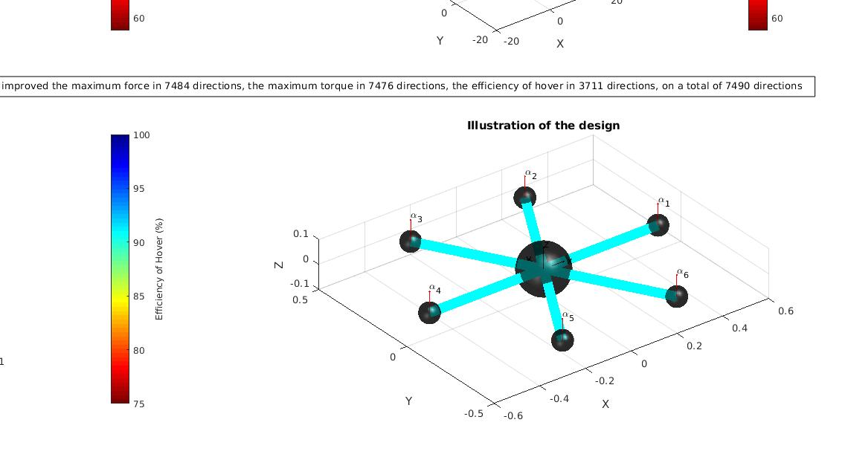
Results
Hexa-copter
    Obtained maximizing the volumes of the force and torque spaces
Voliro

Slide 20
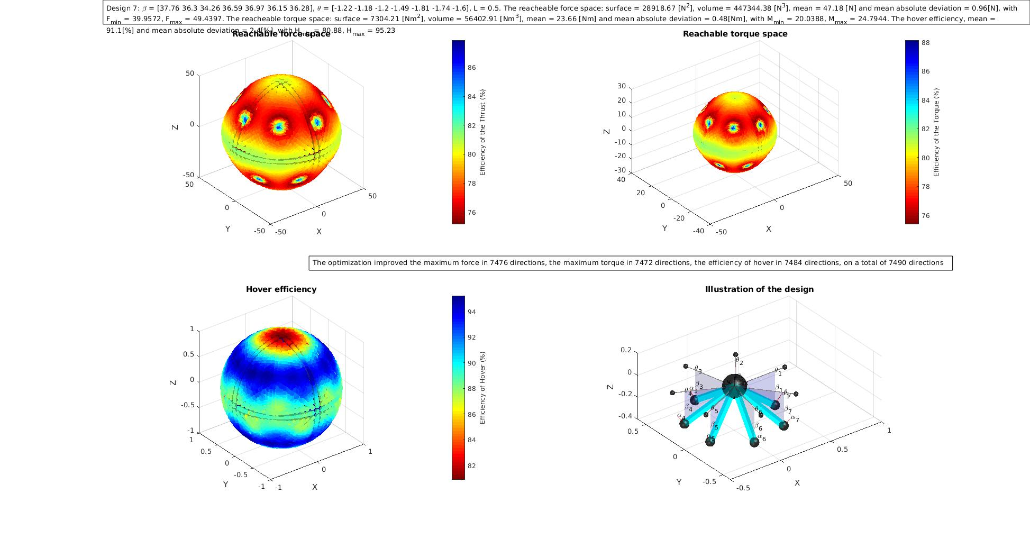
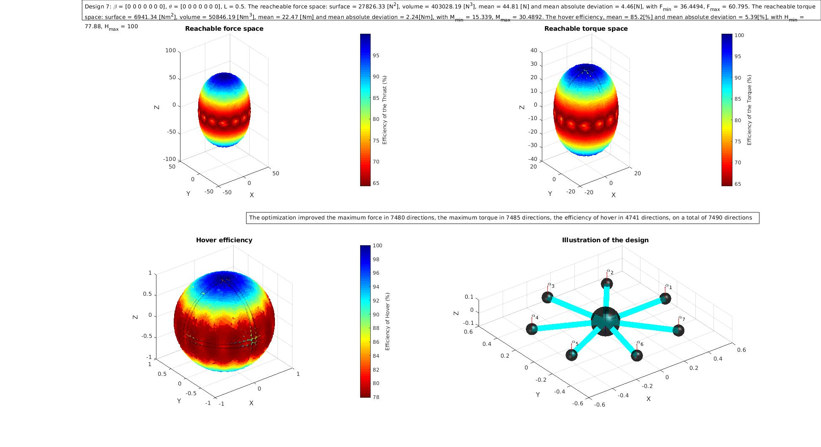
Results
Hepta-copter

Slide 21
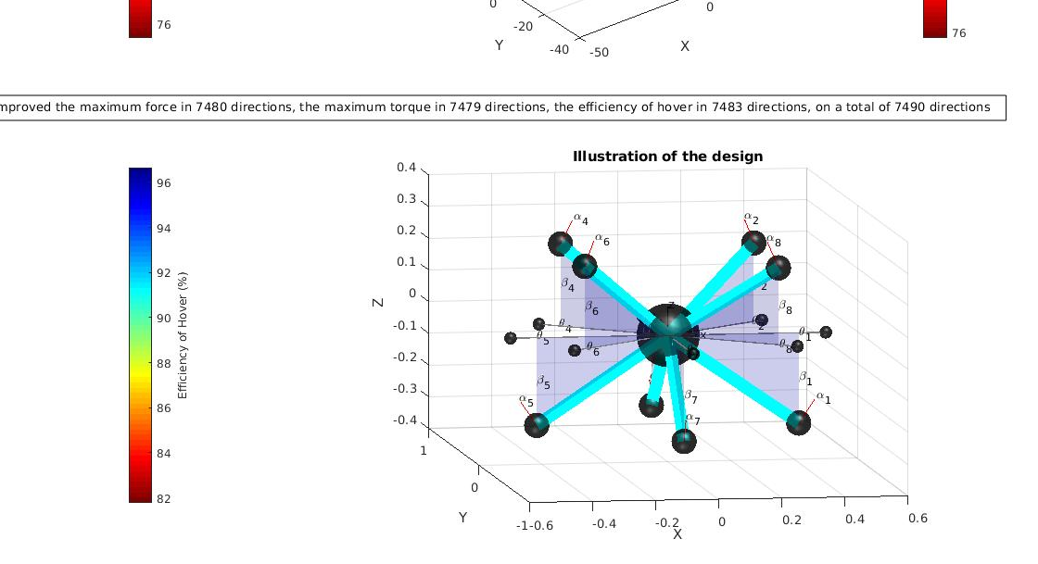
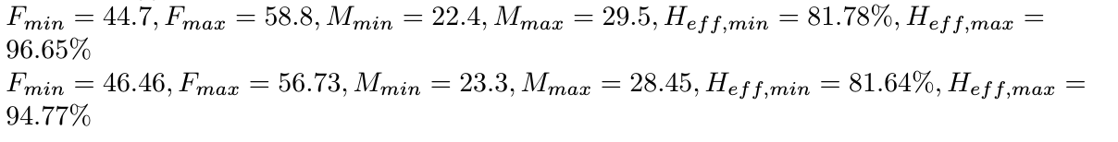
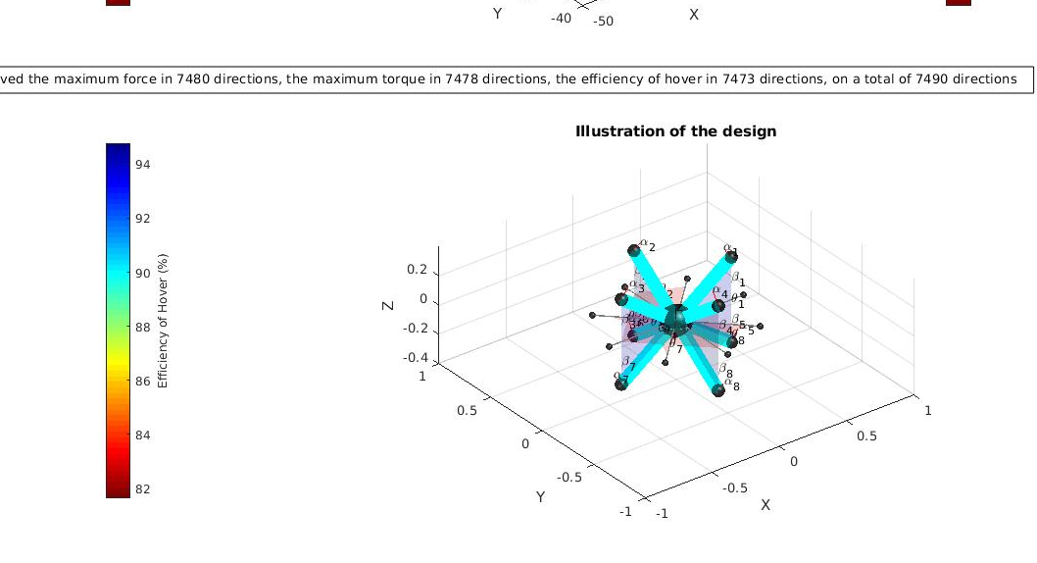
Results
Octa-copter
    Obtained maximizing the minimal force and torque that the drone can apply
IDSC‘s Omnicopter

Slide 22
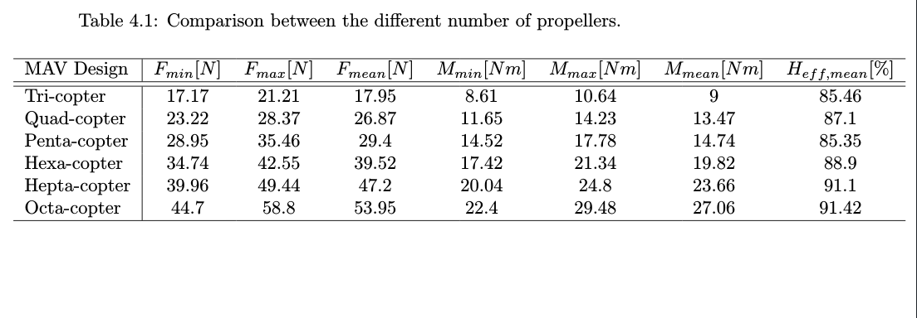
Results
Comparison

Slide 23
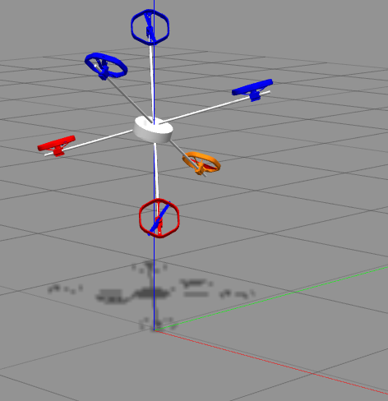
Simulation
Simulated different design in ROS to test them

Slide 24
Simulation
Hepta-copter interaction with a wall

Slide 25
Conclusion
Developped a design optimization tool

Slide 26
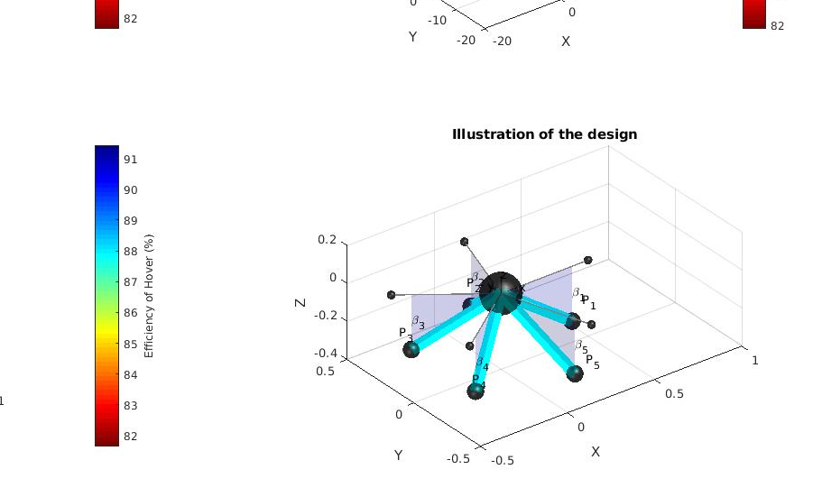
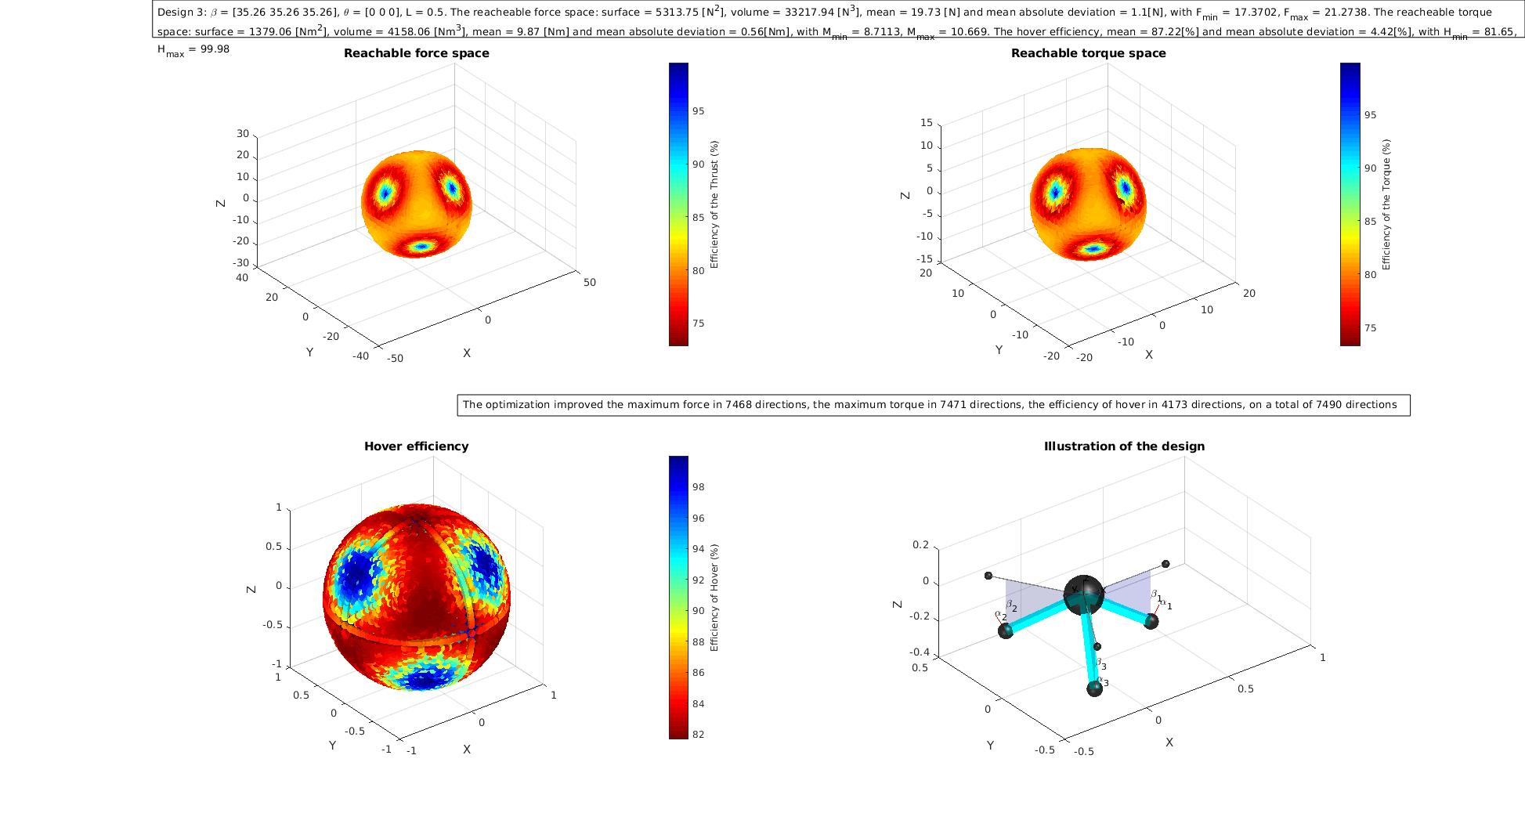
Conclusion
Obtained results using different cost functions and parameters and compared different design

Slide 27
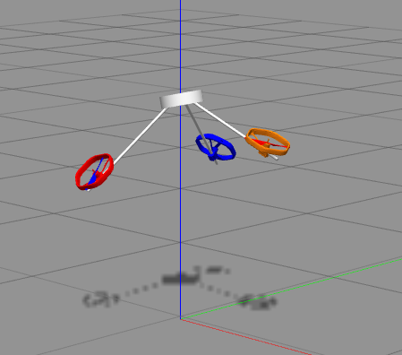
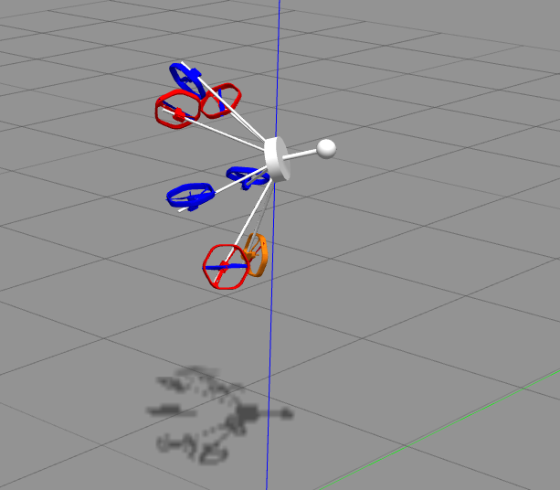
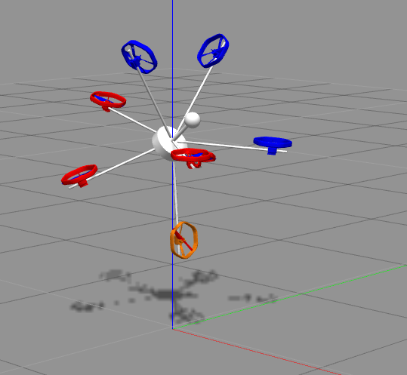
Conclusion
Simulated some of the results in ROS environment

Slide 28
Outlook
Further development

Slide 29
Questions ?
Thank you for your attention !

Slide 30
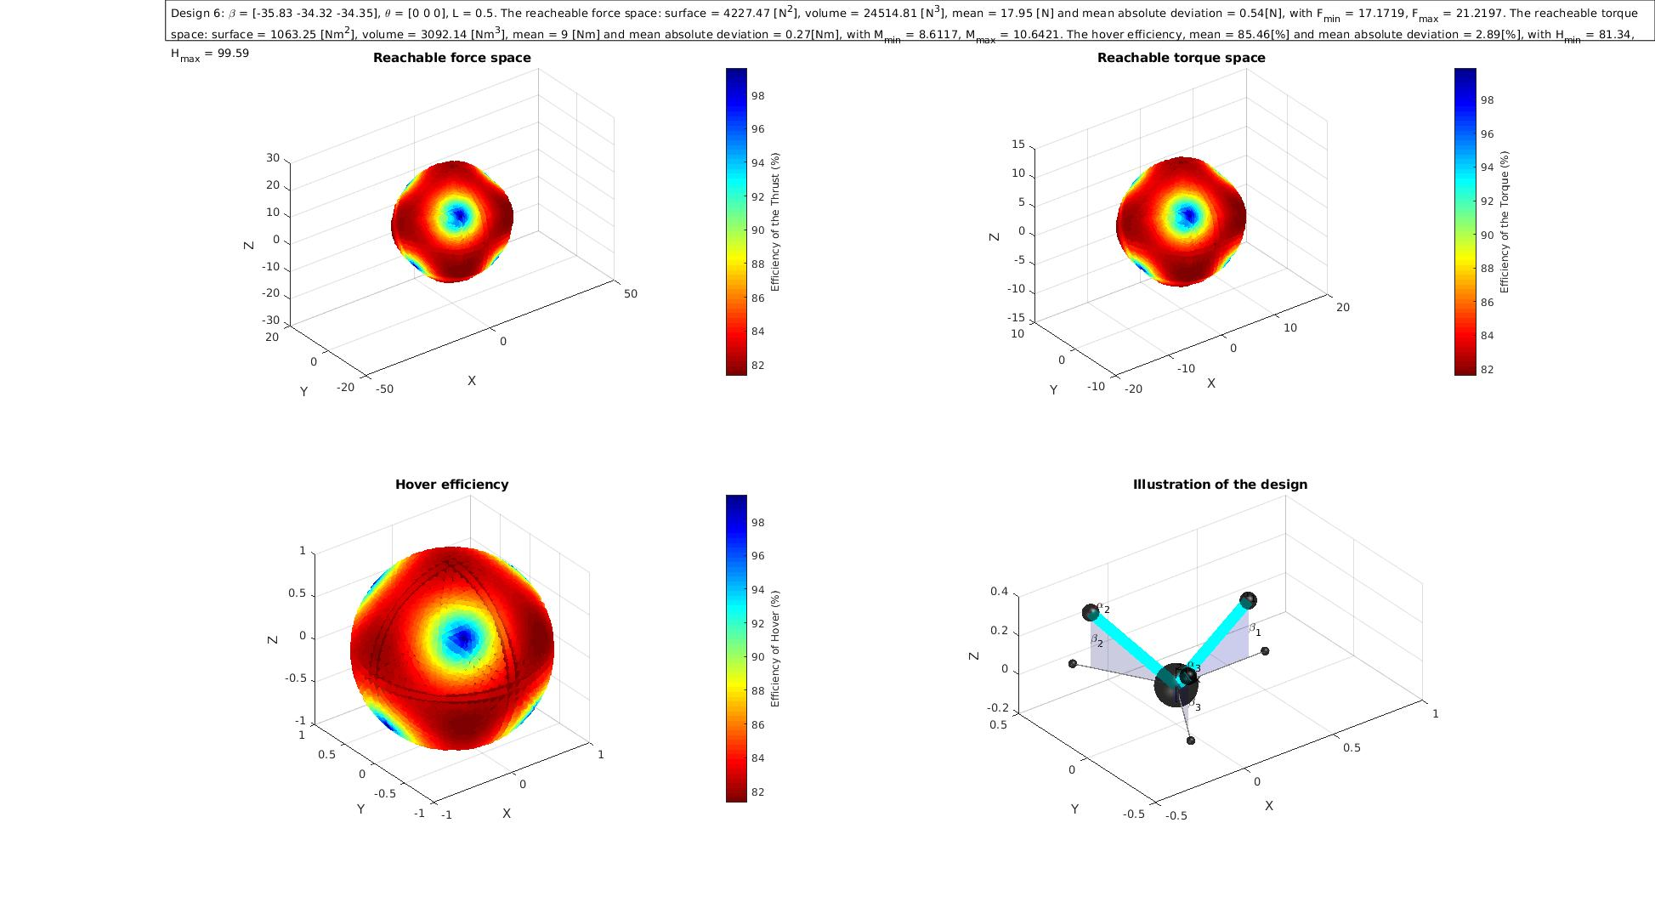
Suplementary Slides
Quad-copter
  Maximizing the minimal force and torque
  Starting as with β0 = [0, 0, 0 ] β = [-32.42, -35.49, -35.44, -35.49]
  Starting with β0 = [35.26, -35.26, 35.26, -35.26] β = [35.26, -35.26, 35.26, -35.26]

