Slide 1
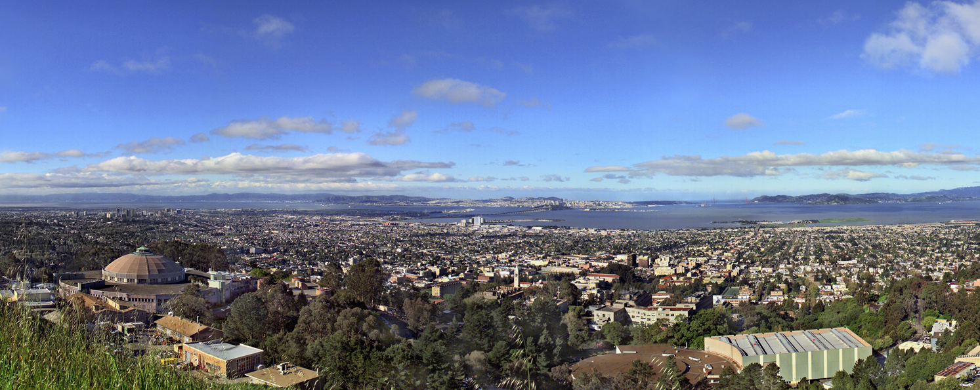
The Art of Giving Talks: Some Thoughts, Advice, and Lessons Learned the Hard Way
Juan Meza
Department Head, Lawrence Berkeley National Laboratory
http://hpcrd.lbl.gov/~meza
CS Summer Student Seminar July 28, 2011

Slide 2
Your mileage may vary!
This talk may not make you a gifted speaker
None of the rules that I give you are iron-clad
You will need to modify these rules to suit your personal speaking style

Slide 3
What is a talk?
A good talk is
nothing more than a story

Slide 4
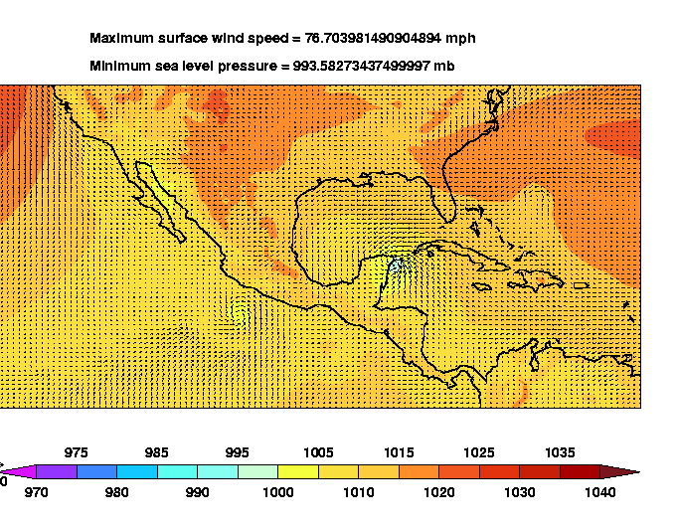
Climate modeling and predicting hurricane patterns
Tropical cyclones are not generally seen in integrations of global atmospheric general circulation models at climate model resolutions (~300km or T42)
At 50km (T239), the lowest pressure attained is 995mb. No realistic cyclones are simulated.
In high resolution simulations of the finite volume dynamics version of CAM2, strong tropical cyclones are common.
Michael Wehner, Scientific Computing, LBNL

Slide 5
Some reasons for sharpening your communication skills
Probably the single most important aspect in job hunting is your interview talk. The interview talk can make or break the interview.
Giving talks is expected in many jobs and is a critical factor in job success.
If you’re heading into academia then you’ll be giving talks almost every day!

Slide 6
What types of talks are there?
Job interview
Present a new result (e.g. at a conference) or a status report for a project
Argue for/against something
Each of these talks will be different but the basic structure will be the same !

Slide 7
There are three key elements
The message - what is the main idea that you would like to get across to your audience
The audience - who are the people that you want to give your message to
The connections - how do the pieces of your talk fit together

Slide 8
The Message or What’s your point?

Slide 9
What is your message ?
You should be able to answer the question – What’s your point?
The message should be short, 2-3 sentences at most and understandable at a high level
Short talks (15 minutes or less) should have only one message
Most common mistake in a talk is not having a clear message

Slide 10
Everything in your talk should support your message
Start with the message and work backwards in developing your talk
It’s incredibly easy to fall into the trap of thinking that
____ is just too interesting to let the audience miss
If you’re not sure, ask yourself once again – What’s your point?

Slide 11
The Audience

Slide 12
You need to tune the talk to the audience
You need to be able to answer the question – Why should I care?
Find out what the makeup of the audience will be and why they are there
Emphasize or de-emphasize parts of your argument to suit the audience - respect your audience
Second most common mistake is using the same talk for all audiences

Slide 13
The Connections: Putting it Together

Slide 14
Structuring your talk
It’s not enough to lay out the key elements – you need to show how the elements fit together
Walk the audience through your key points and show them how they are related
Most talks suffer from too much detail and not enough overview - a talk is not a paper
Third most common mistake is to give details rather than showing the connections

Slide 15
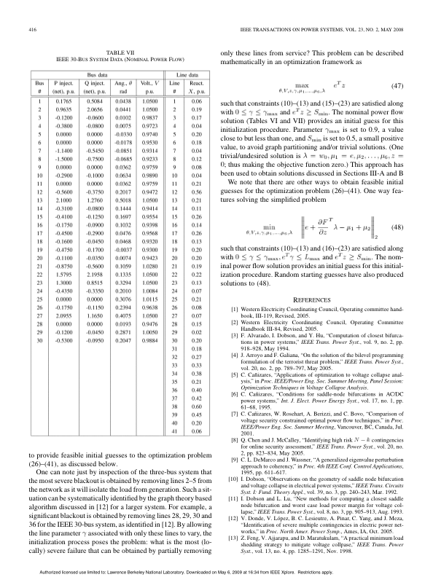
Please don’t do this ….

Slide 16
Some Tips and Tricks Lessons Learned the Hard Way

Slide 17
Keep your main points simple
Use at most 3 main points at any given time
Most people/societies/cultures have a hard time dealing with more than 3 ideas at one time
Remember that for a large part of your audience the material is new

Slide 18
Give specific examples wherever possible
Examples can be used to clarify a given point
Examples can be used to create a big impact
Most audiences relate to visual examples better than to written examples

Slide 19
Drug Design
Drug design can be formulated as an energy minimization problem.
A single new drug may cost between $800 million and $1.8 billion to develop from start to finish.
The design process typically takes over 10 years due to the large number of trial drugs that need to be considered.
There are various energy functions used to describe the molecules involved.
There are thousands of parameters because the size of the drugs is large.
Due to physical constraints the optimization problem contains numerous nonlinear constraints.
It can be shown that there are thousands of local minima which makes it difficult for most optimization methods.
We are working on special optimization methods to solve this minimization problem.
By using visualization techniques we can speed up the optimization methods.

Slide 20
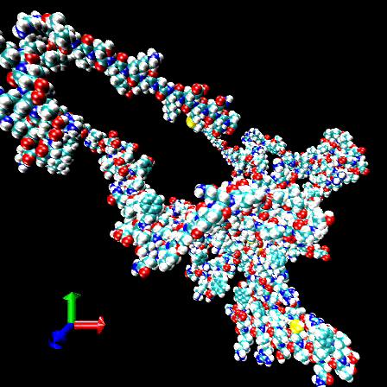
Protein T162 from CASP5
A single new drug may cost over $800 million to develop and the design process typically takes over 10 years.
Energy minimization computed using OPT++/LBFGS. Initial configuration created using ProteinShop (S. Crivelli et al)
Total simulation took approximately 32 hours
Juan Meza, Ricardo Oliva, Scientific Computing, LBNL

Slide 21
Some essential elements that should be included in a seminar talk
Why is this problem important?
Why should I care?
What was the outcome/product/….
Is there a tangible result?
What was your contribution?
Use words like, “This is my main result”

Slide 22
Handling questions
Anticipate and prepare for the obvious questions
Make sure you understand the question
Try to answer all questions, but some questions can/should be deferred.
Don’t Panic !

Slide 23
Top 10
Have a clear message you want to deliver
Prepare for your audience
Tie the pieces together into a story
Only use material that supports your message
Avoid unnecessary details
Use (visual) examples to clarify your points
State the importance of your problem
Present your contribution
Prepare for questions
Practice, practice, practice

Slide 24
The End

Slide 25
Sample 30 minute talk
Set the stage (5-10 minutes)
Tell the audience what the main issues are
Lay out your problem/issue
Describe why it’s important!
What happened (10-15 minutes)
How was the problem resolved
Only need the key ideas here
Don’t necessarily need chronological order
Summarize (5 minutes)
Questions?

Slide 26
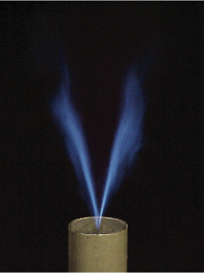
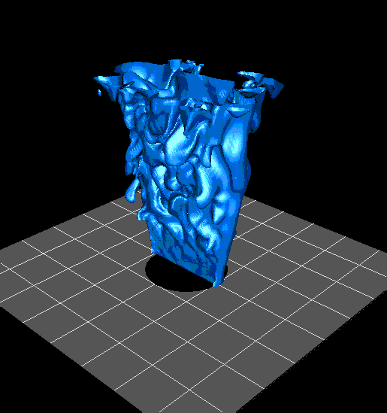
Turbulent Premixed V-Flame
Experimental Turbulent V-Flame
Recent Calculations
(photo courtesy R. K. Cheng, LBNL)

