Slide 1
Homework 6 PPT
By Alex Agudelo

Slide 2
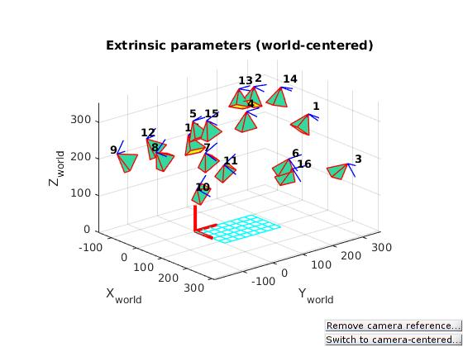
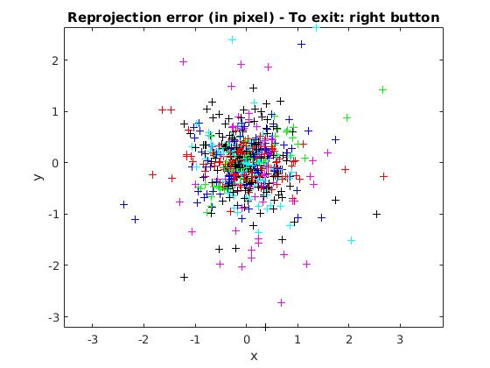
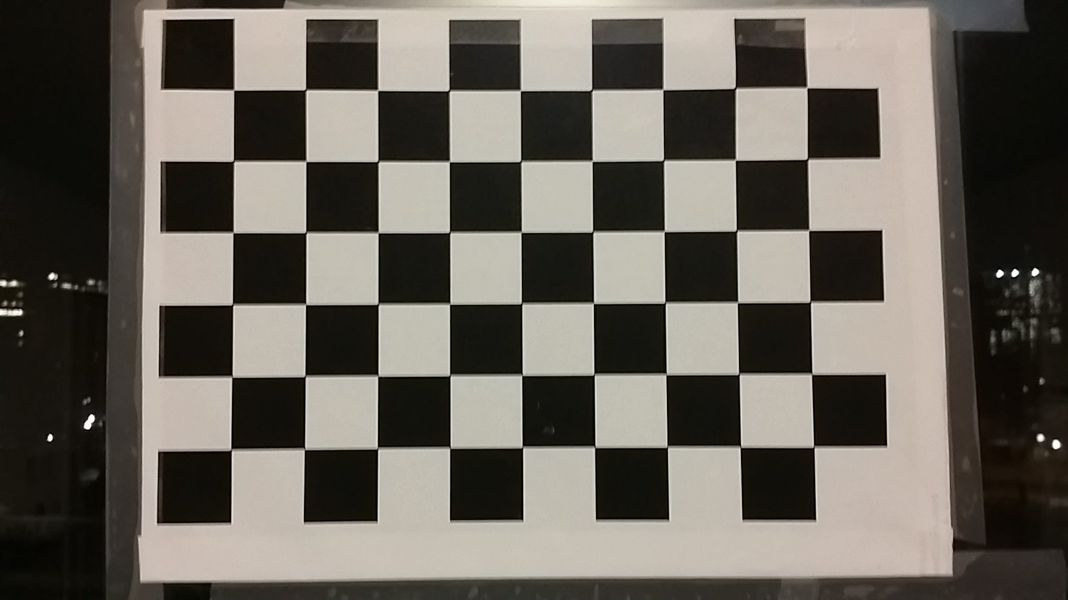
Camera Calibration
First I took the image:
With this image, I took 17 other angles and then inserted them into Matlab. I used the Caltech Calibration with required selecting the corners of the checker board. After a simple calibration, I manually change the window size for certain pictures to attempt to improve the pixel error. My end calibration data was:
Focal Length: fc = [ 1929.58164 1932.52408 ] ± [ 4.11507 3.98456 ]
Principal point: cc = [ 1012.74271 604.92230 ] ± [ 7.05175 4.78969 ]
Skew: alpha_c = [ 0.00000 ] ± [ 0.00000 ] => angle of pixel axes = 90.00000 ± 0.00000 degrees
Distortion: kc = [ 0.14051 -0.33700 -0.00182 0.00206 0.00000 ] ± [ 0.01469 0.09582 0.00113 0.00166 0.00000 ]
Pixel error: err = [ 0.46894 0.48335 ]

Slide 3
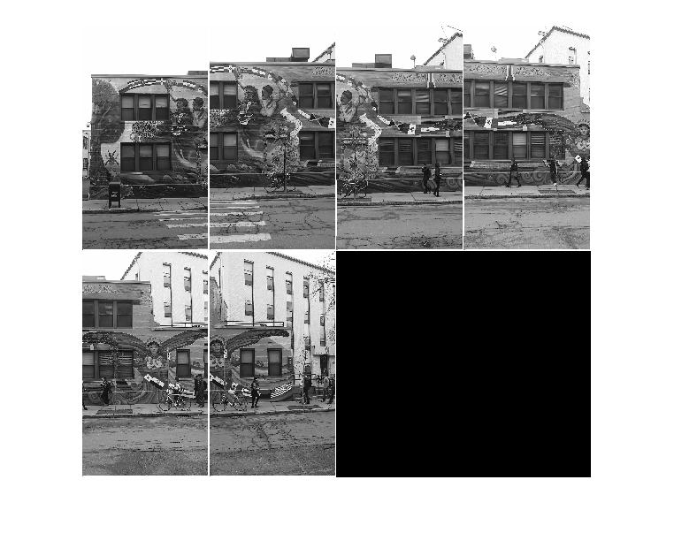
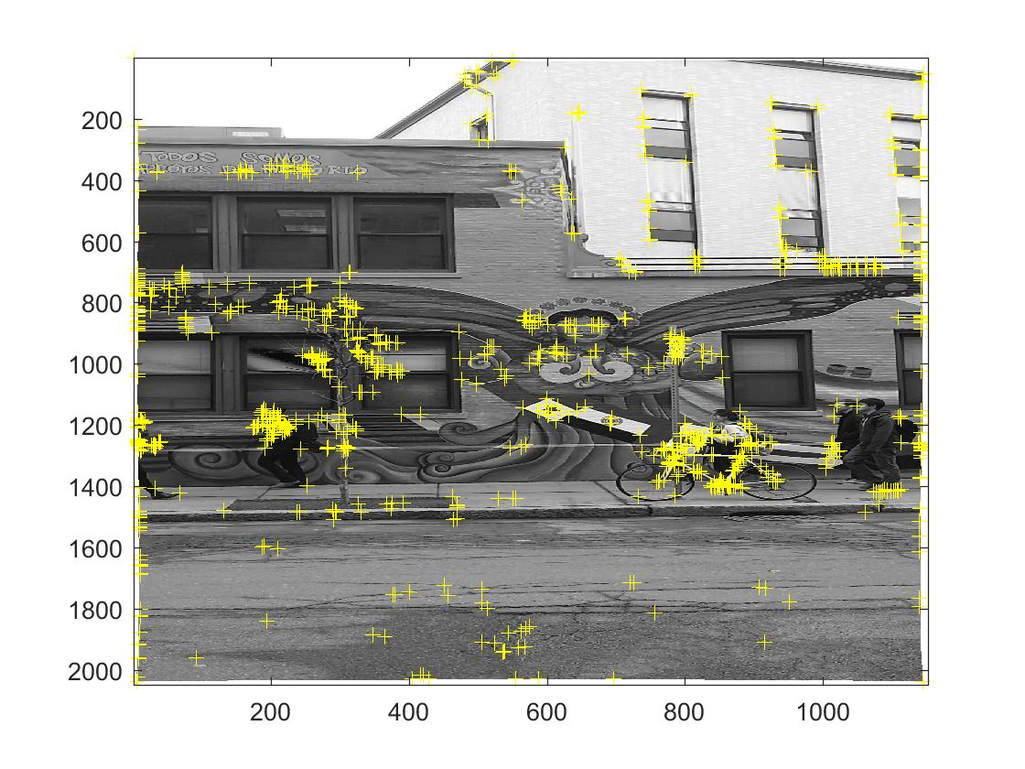
Forsyth Pictures
After calibrating the data I then took photos of the Forsyth building and applied the calibration data to get the undistorted images shown to the right.
Using the undistorted images, I used the harris filter to detect corners on the image. I used a tile of [2 2] since I know that I want the mural to dominate in features and do not want many features else where. I applied the feature detector to all the photos to see the distribution of features across all the photos. They are all well distributed around features in the mural which is what I wanted.

Slide 4
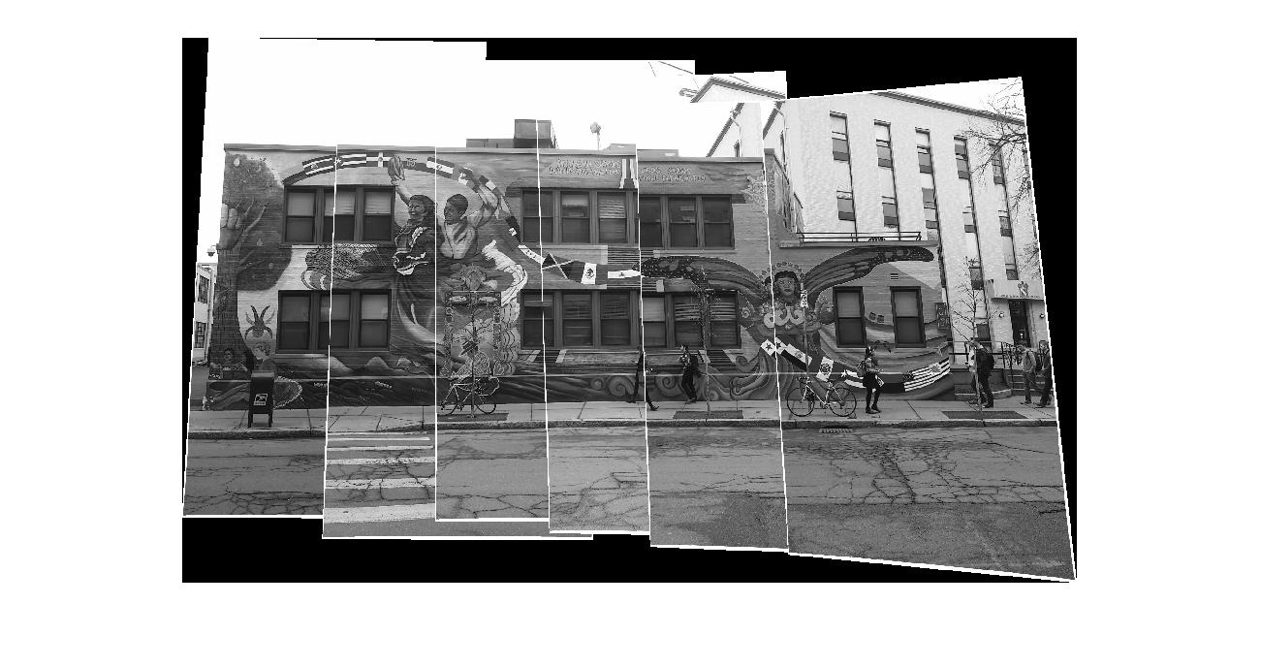
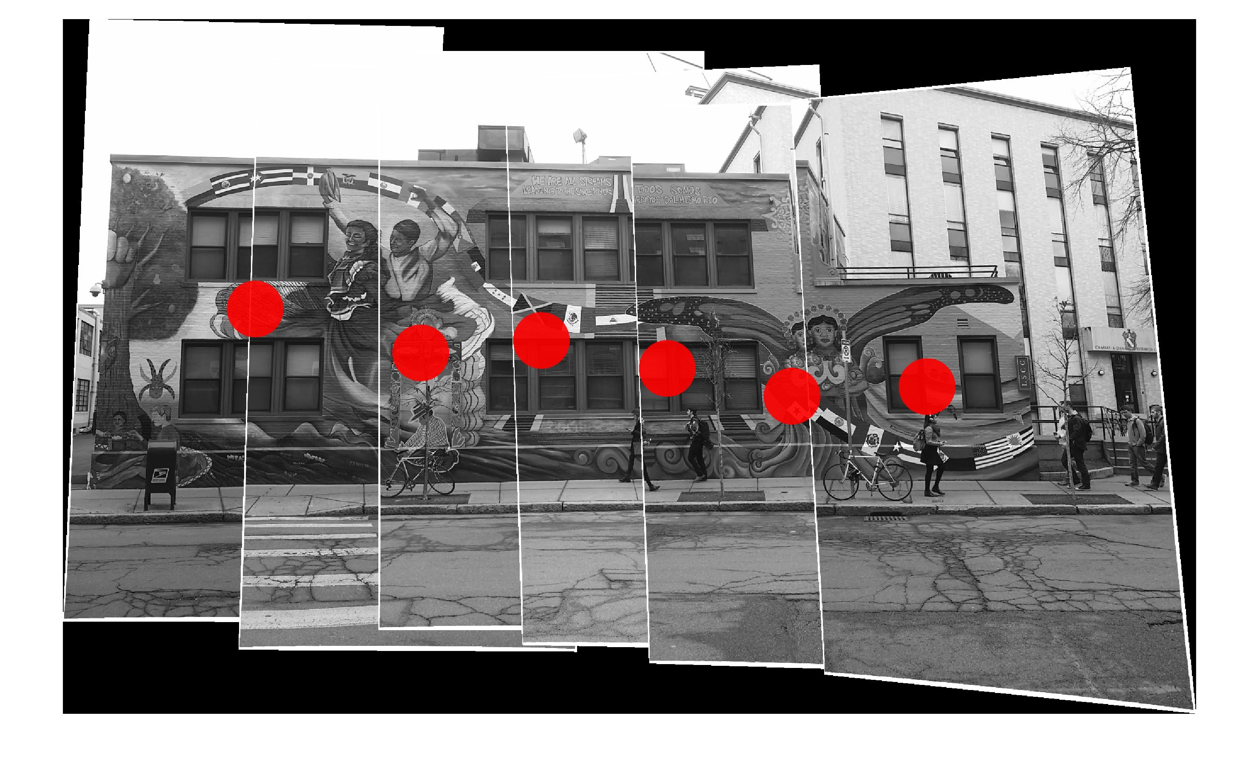
Forsyth Panoramic
After matching features across all the undistorted images. I applied the panoramic algorithm to match all the images together and create the panoramic. The top right shows the panoramic stitched together without the camera position measured, while the bottom shows the same thing but with the camera position shown.
The panoramic has some errors but I could not resolve the small error with the different arguments of the harris feature. Furthermore, the camera position makes sense given that I was not able to keep the camera steady and the camera was bouncing around.

Slide 5
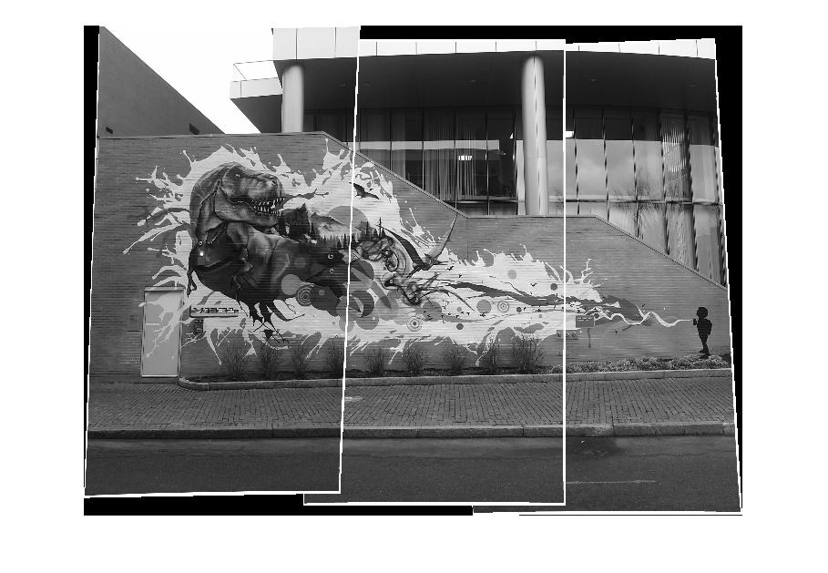
Second Mural
I applied the panoramic algorithm on a second mural with less overlap. With a bit of tweaking of the harris filter and the matching confidence interval, I got the panoramic to correctly set. I ended up setting the confidence interval to 95% and then the matrix to [3 3].

Slide 6
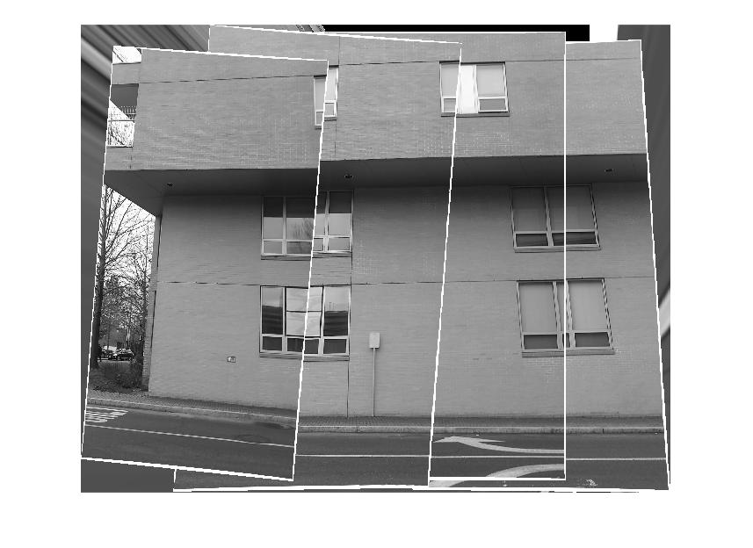
Mosaic Plain Wall
With the plain wall, I tried to choose something that was very repetitive but also have some features to match. Therefore, I chose the side of west village E which is a very plain wall with not many features. After applying the panoramic algorithm, I found that it needed a lot of tweaking of the tile algorithm and the confidence interval. Even still, it would not match correctly, since as shown in the background one of the pictures is incorrectly matched.

