Slide 1
Robotics 5698
Sensing & navigation
Homework 3
By Alex Agudelo

Slide 2
GpsData structure
1. timestamp -stores time since epoch
2. lat – stores latitude
3. latDir – stores direction of latitude
4. lon – stores longitude
5. lonDir – stores longitude direction
6. alt – stores altitude
7. utm_x – stores x utm
8. utm_y stores y utm

Slide 3
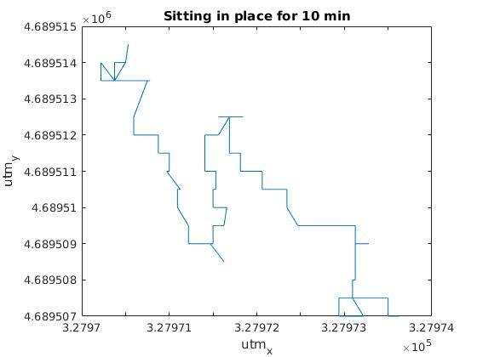
Data from sitting in place for 10 min

Slide 4
Analysis Sitting in place
The data points from standing in place make sense due to the inaccuracy of GPS data. According to the United states government, they claim 4 meter accuracy. In the graph, the x direction varies from 327970 to 327974 which is about 4 meters. On the y graph it ranges from 4689507 to 46895515. This is about 8 m difference which is slightly bad. This could be due to the fact that I was sitting in the quad surrounded by curry, Snell library and Hayden hall. This can scatter the GPS signal and make it less accurate

Slide 5
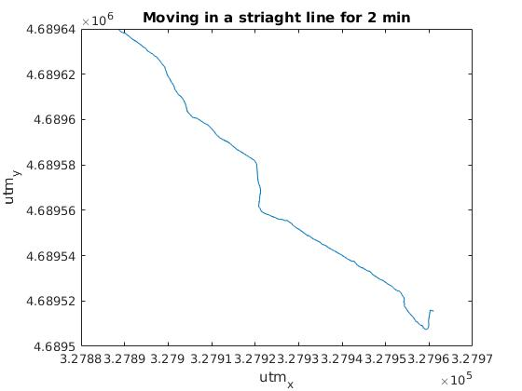

Slide 6
Analysis Moving
The moving graph also makes sense because we were walking in a north westerly direction which would account for the graph going to the top left. Also, the line varies slightly but keeps a pretty steady straight direction. We were walking in between Cabot and Hayden/Richards which could also cause GPS scattering from the buildings

Slide 7
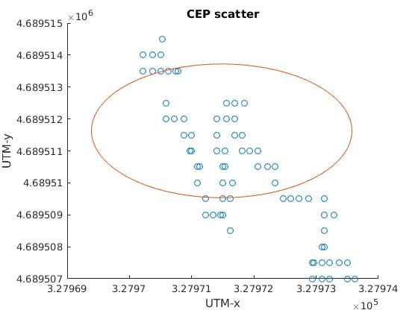

Slide 8
Overall
Overall, the GPS positioning was relatively accurate. We were inside the CEP 50% error range. GPS should not be used for ultra precise location services but regardless it gives a good estimate on the location. Furthermore, the noise distribution seems to be relatively even because in both cases it seemed to be coming back to the correct location. For example, while the gps was moving, it would serve left and right of the trajectory but would never veer to far of course. After veering one direction it seemed to veer the other direction which would average out to the correct line. For us the biggest factors were the scattering of the signals from the building which would be a non-guassian distribution. Also, the position of the Satellites at that time could affect the gps data. It depends on how spread out the Satellites are.

