Slide 1
Robotics Homework 5
Calculating the INS to compare it to the GPS puck

Slide 2
Networking
We tested the networking portion by creating a mobile hotspot with one of our group mates phones. Then we ran the publisher script off of his computer and connected my machine to the same wifi network. We than ran lcm-spy and also a INS_listener.py which was able to receive the packets and print the content. Not sure how you wanted this to be proven.

Slide 3
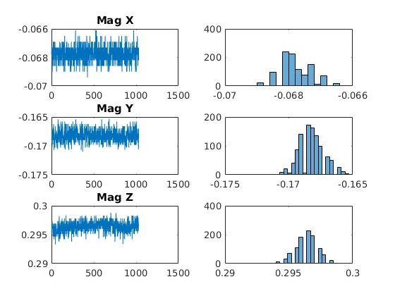
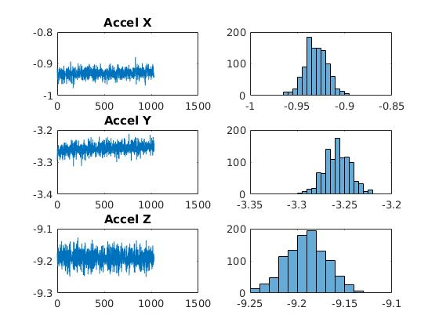
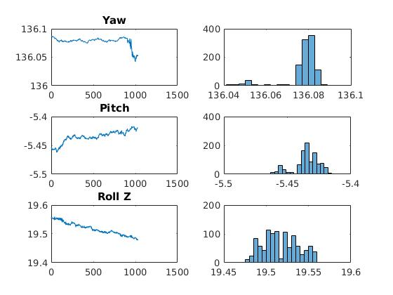
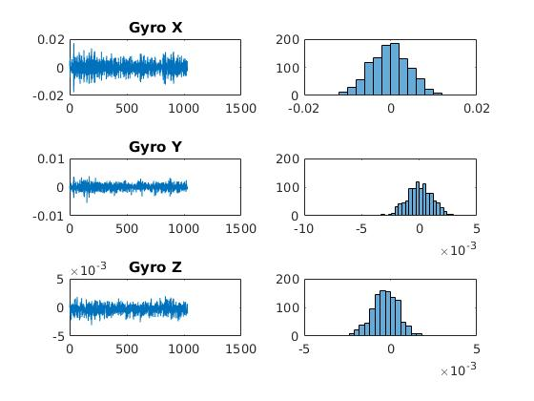
The first step was seeing the data with a station INS

Slide 4
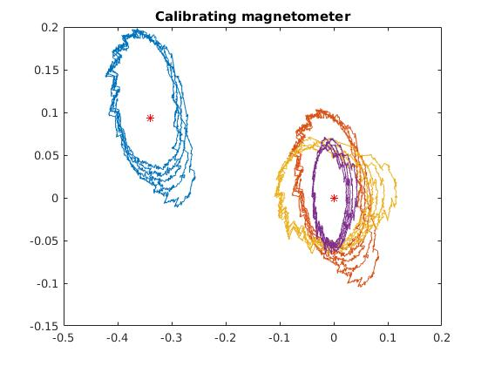
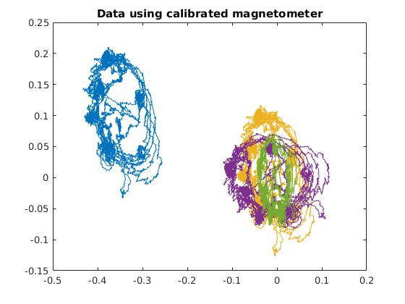
Second we corrected the magnetometer
First we reduce the data size to only include the circle. Therefore, it is easy to calculate the soft iron and hard iron errors using the offset and the rotation matrix. Furthermore, we find the scaling factor. Once these values are found we then apply them to the full data set to correct the data points.

Slide 5
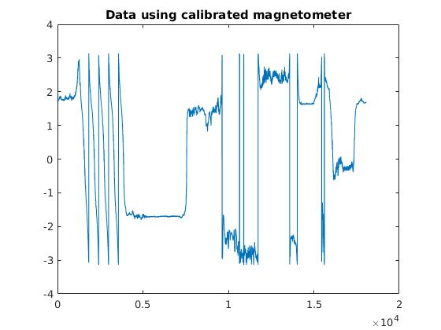
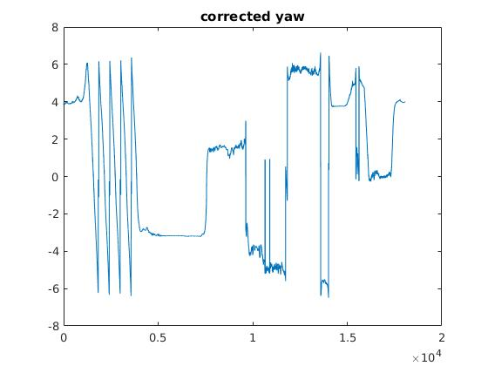
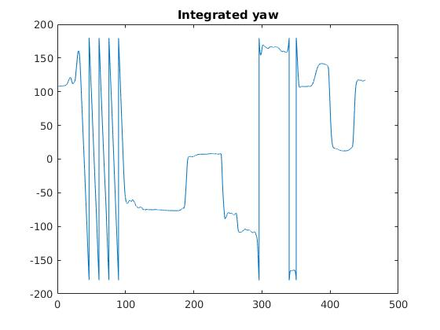
Finding Yaw Angle
In this step, we calculated the yaw angle from the magnetometer readings and also the integrated yaw from the yaw rate sensor. Then we used a complementary filter to combine the two to the corrected yaw. We found that the corrected yaw was less noise than the individual components

Slide 6
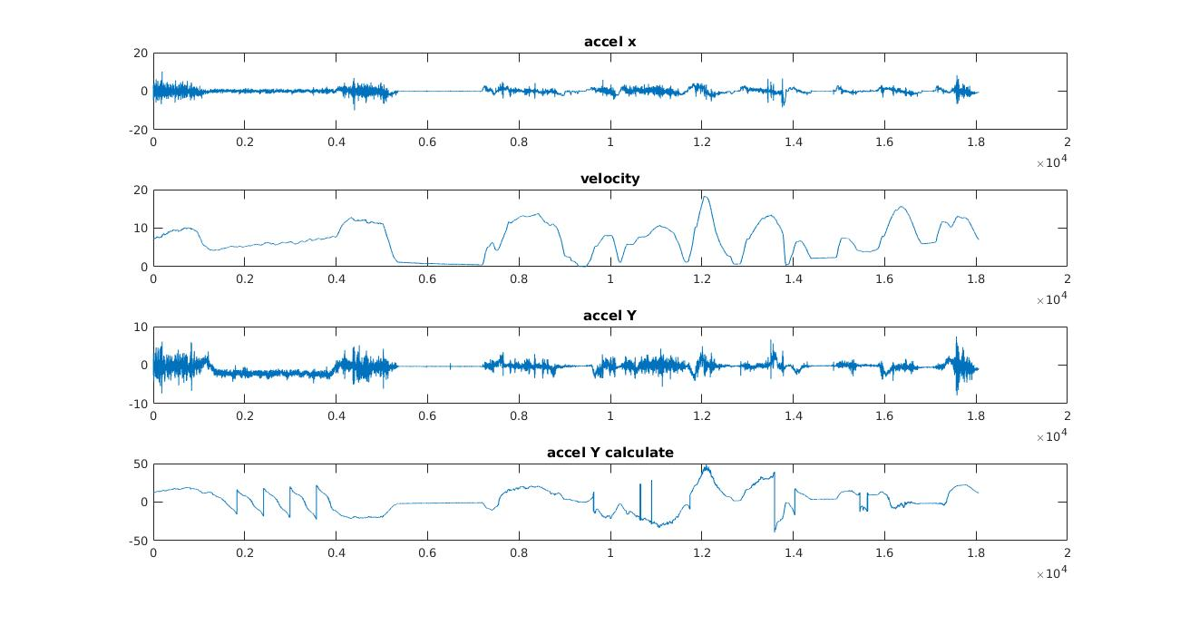
Comparing y acceleration and mapping velocity
We found the velocity by integrated the accelX data since we assumed that the y velocity is zero because we shouldn't be skidding or slidding. Then we added the offset so the extreme negative values were the zero, aka stop values. After wards we computed the accelY from the velocity data by finding omega. We compared it to the accelY read from the accelerometer and found that it was definitely related but the data was not perfectly matched

Slide 7
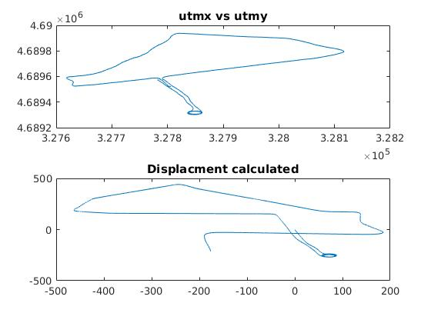
Displacement Calculated
Given the velocity in the relative plane, we needed to transpose this to the north east plane. Therefore, we found the angle of the data from the yaw angle readings either from the INS or from the calculated yaw angle. We then used that yaw angle to find the absolute velocity in the north east plane. This allowed us to map the displacement and give us a similar map as the gps. The reason why it is off is because a small error is integrated over the whole series which then causes it to be off at the end.

Slide 8
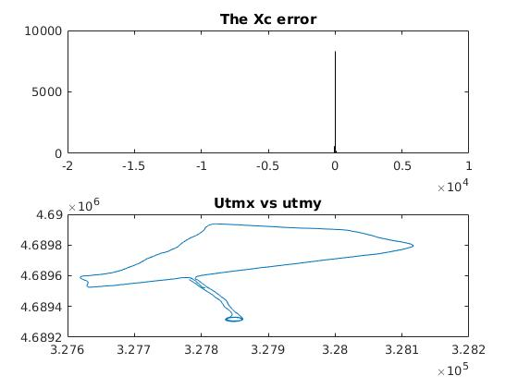
Xc calculation
We then calcuated the Xc values given the yaw rate, the direvitive of yaw rate, the y accelerometer the corrected velocity. In a histogram this gave us a large peak at around .2 meters with outliers Therefore, the plot has a lot of noise but the median of the plot is .2. Also, the average value after removing the extreme data points is about .5. This makes sense given we put the INS near the center of the car and not on the dashboard.

