Slide 1
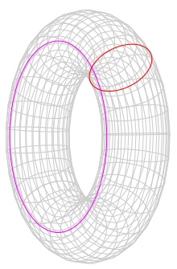


$$q_{1}$$
$$q_{2}$$

Slide 2


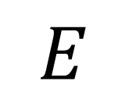
$$E$$
$$q_{2}$$
$$q_{1}$$

Slide 3
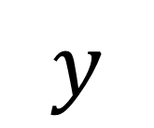
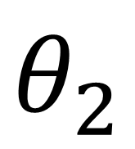
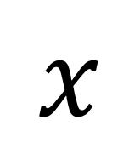
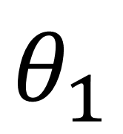
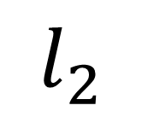
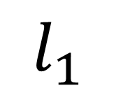
$$E$$
$$y$$
$$l_{2}$$
$$θ_{2}$$
$$l_{1}$$
$$θ_{1}$$
$$x$$

Slide 4
$$y$$
$$x$$

Slide 5
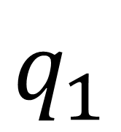
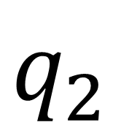
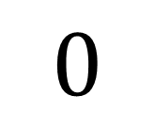
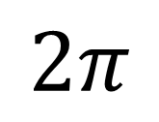
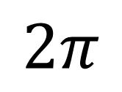
$$q_{2}$$
$$2π$$
$$q_{1}$$
$$0$$
$$2π$$

Slide 6
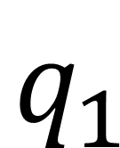
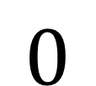
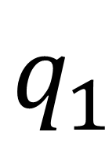
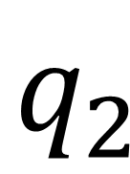
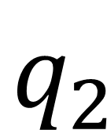
$$q_{1}$$
$$q_{2}$$
$$q_{2}$$
$$q_{1}$$
$$0$$

Slide 7

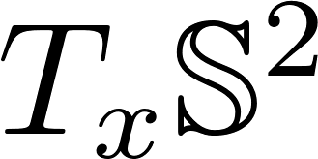








$$q_{1}$$
$$x$$
$$q_{2}$$
$$v$$
$$q_{2}$$
$$q_{1}$$
$$x$$

Slide 8



$$q_{1}$$
$$x$$
$$q_{2}$$

Slide 9
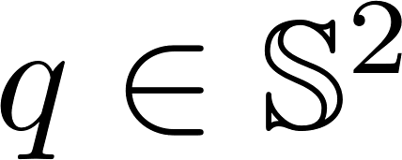
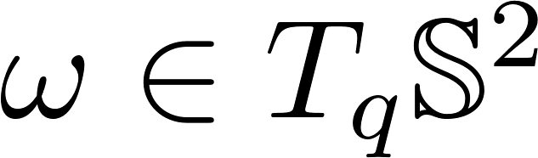

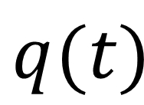
$$q$$
$$q(t)$$

Slide 10
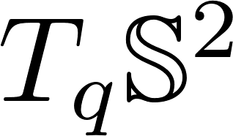
$$q$$
$$q(t)$$

Slide 11
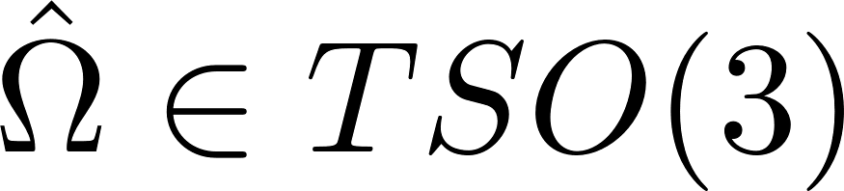
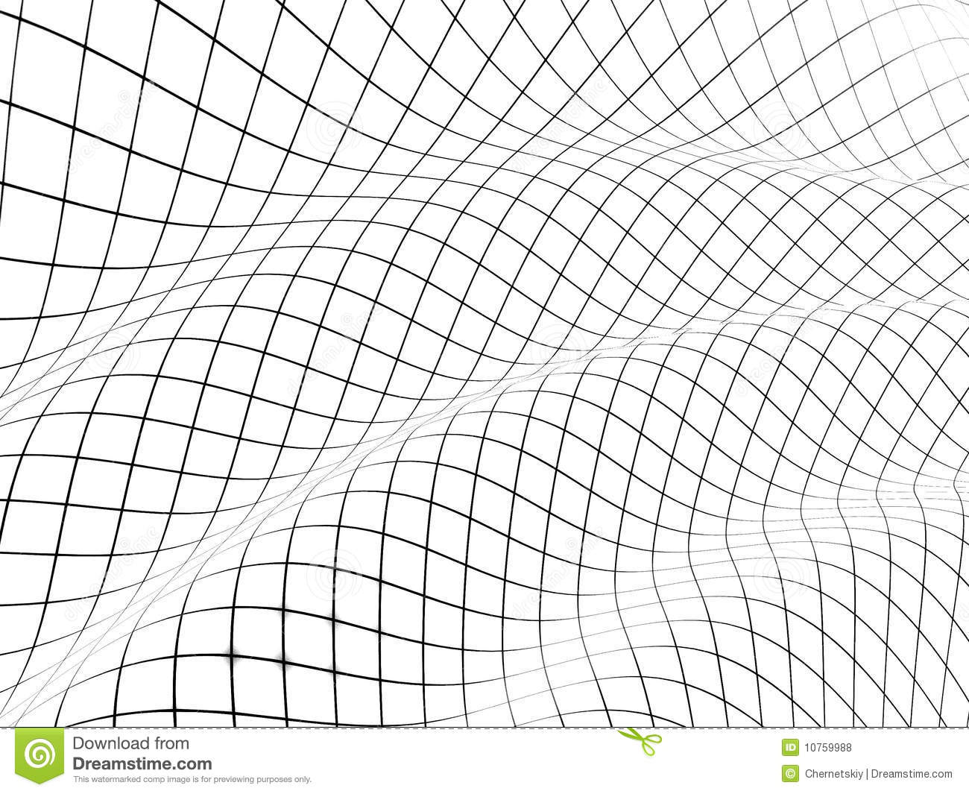
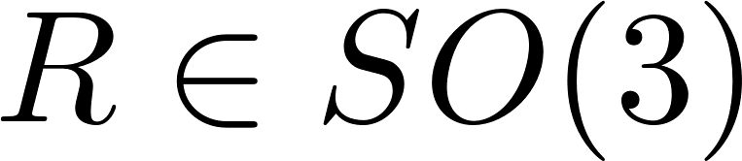
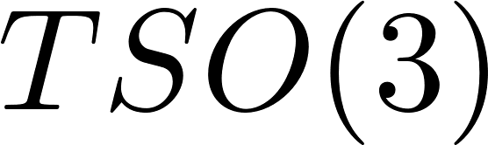



$$I$$
$$R$$

Slide 12
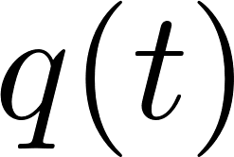


Slide 13
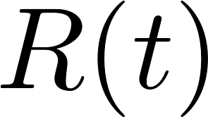


Slide 14
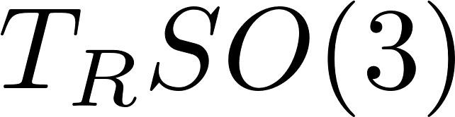

Slide 15
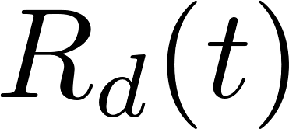

Slide 16



Slide 17
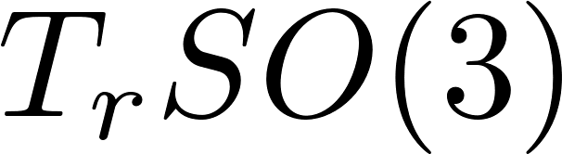

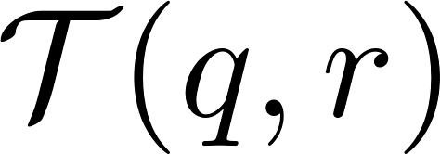

Slide 18
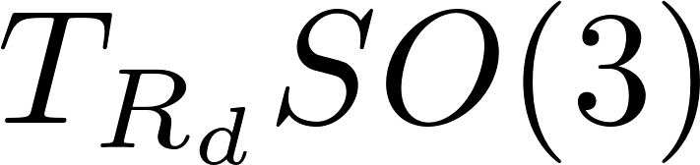
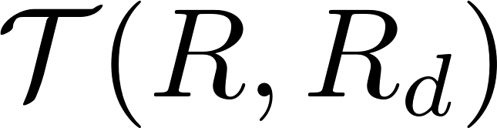

Slide 19






Slide 20


Slide 23


Slide 25


Slide 28





$$e_{3}$$
$$e_{2}$$
$$e_{1}$$
$$φ_{L}$$
$$θ_{L}$$

Slide 29



$$e_{3}$$
$$e_{2}$$
$$e_{1}$$
$$θ_{L}$$
$$φ_{L}$$

Slide 30







$$b_{3}$$
$$ψ$$
$$b_{2}$$
$$θ$$
$$b_{1}$$
$$φ$$

Slide 31


$$e_{3}$$
$$e_{2}$$
$$e_{1}$$
$$θ_{L}$$
$$φ_{L}$$

Slide 32

C
Controller
QR attitude controller
QR-Load
Dynamics
Feedback: $x_{Q}, v_{Q}, x_{L}, v_{L}, q, R$

Slide 33




Load Position
Load Attitude
Quadrotor Attitude
Inputs
$$x_{L,d}$$
$$q_{c}$$
$$R_{c}$$
$$f, M$$
Load position controller
Load attitude controller
QR attitude controller
QR-Load
Dynamics
Feedback: $x_{Q}, v_{Q}, x_{L}, v_{L}, q, R$

Slide 34


$$R_{d}$$
$$f, M$$
QR attitude controller
QR-Load
Dynamics
Feedback: $x_{Q}, v_{Q}, x_{L}, v_{L}, q, R$

Slide 35

$$q_{d}$$
$$R_{c}$$
$$f, M$$
Load attitude controller
QR attitude controller
QR-Load
Dynamics
Feedback: $x_{Q}, v_{Q}, x_{L}, v_{L}, q, R$

Slide 36
$$x_{L,d}$$
$$q_{c}$$
$$R_{c}$$
$$f, M$$
Load position controller
Load attitude controller
QR attitude controller
QR-Load
Dynamics
Feedback: $x_{Q}, v_{Q}, x_{L}, v_{L}, q, R$

Slide 37









$$F_{n}$$
$$F_{pd},F_{ff}$$
$$F$$
$$f$$
Load position controller
Load attitude controller
QR attitude controller
QR-Load
Dynamics
$$x_{L,d}$$
$$q_{c}$$
$$R_{c}$$
$$M$$
$$x_{Q}, v_{Q}, x_{L}, v_{L}, q, R$$

Slide 38
$$F_{n}$$
$$F_{pd},F_{ff}$$
$$F$$
$$f$$
Load position controller
Load attitude controller
QR attitude controller
QR-Load
Dynamics
$$x_{L,d}$$
$$q_{c}$$
$$R_{c}$$
$$M$$
$$x_{Q}, v_{Q}, x_{L}, v_{L}, q, R$$

Slide 39








$$F_{n}$$
$$F$$
$$f$$
Load position controller
Load attitude controller
QR attitude controller
Rotor Controller
QR-Load
Dynamics
$$x_{L,d}$$
$$q_{c}$$
$$R_{c}$$
$$M$$
$$x_{Q}, v_{Q}, x_{L}, v_{L}, q, R$$

Slide 40


$$f$$
QR attitude controller
Rotor Controller
QR-Load
Dynamics
$$R_{d}$$
$$M$$
$$x_{Q}, v_{Q}, x_{L}, v_{L}, q, R$$

Slide 41







$$x_{Q,d}$$
$$u$$
$$\dot{x}$$
$$x$$
$$y$$
$$−K$$
B
$$∫$$
C
-
A

Slide 42





$$b_{1d}$$
$$b_{3c}$$
$$b_{1c}$$
$$plane$$
$$normal$$
$$to b_{3c}$$
$$b_{2c}$$

