Slide 1
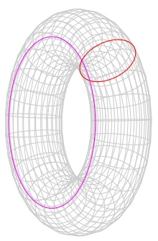


$$q_{1}$$
$$q_{2}$$

Slide 2


$$q_{2}$$
$$q_{1}$$

Slide 3
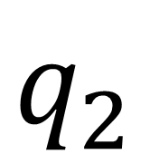
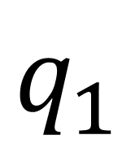
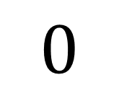
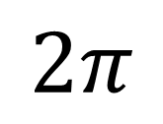
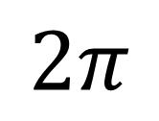
$$q_{1}$$
$$2π$$
$$q_{2}$$
$$0$$
$$2π$$

Slide 4
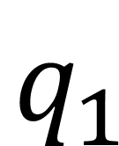
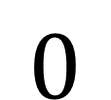
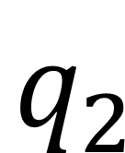
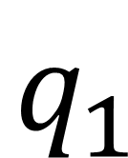
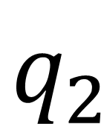
$$q_{1}$$
$$q_{1}$$
$$q_{2}$$
$$q_{2}$$
$$0$$

Slide 5
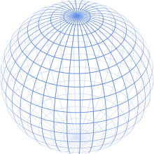
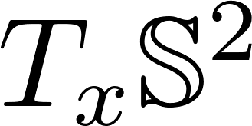








$$θ$$
$$x$$
$$θ$$
$$φ$$
$$v$$
$$φ$$
$$x$$

Slide 6
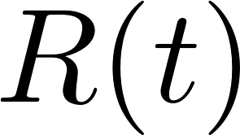
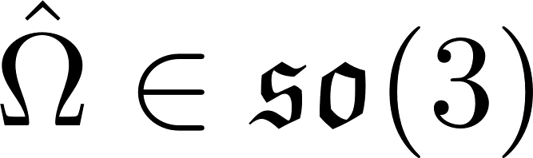

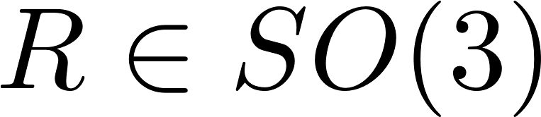

Slide 7


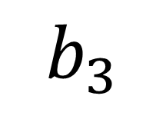
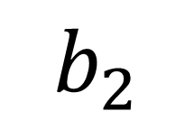
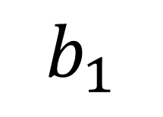
$$b_{3}$$
$$b_{2}$$
$$b_{1}$$
$$θ_{L}$$
$$φ_{L}$$

Slide 8
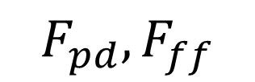








$$F_{n}$$
$$F_{pd},F_{ff}$$
$$F$$
$$f$$
Load position controller
Load attitude controller
QR attitude controller
QR-Load
Dynamics
$$x_{L,d}$$
$$q_{c}$$
$$R_{c}$$
$$M$$
$$x_{Q}, v_{Q}, x_{L}, v_{L}, q, R$$

Slide 9









$$F_{n}$$
$$F_{pd},F_{ff}$$
$$F$$
$$f$$
Load position controller
Load attitude controller
QR attitude controller
Rotor Controller
QR-Load
Dynamics
$$x_{L,d}$$
$$q_{c}$$
$$R_{c}$$
$$M$$
$$x_{Q}, v_{Q}, x_{L}, v_{L}, q, R$$

