Slide 1
CFS Presentation
By: Jake Orben & Gregg falcon

Slide 2
Support of Non-uniformity
As of kernel 2.6.23 Linux’s task scheduler is modular
Allows for separate scheduling functions
First in First out
Round Robin
Bucket
Etc.
Made possible by the base scheduler
Contains functions that cover the majority of scheduling tasks that can be performed
Allows for system flexibility when dealing with varied situations
For instance video editing vs. cloud syncing

Slide 3
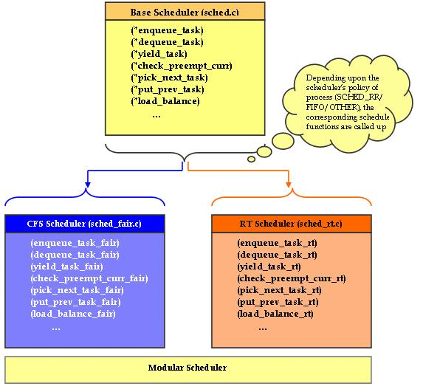

Slide 4
Benefits of variability
Has greater degree of flexibility than competing operating systems
Can use a variety of different task schedulers
Such schedulers can be used to deal with a variety of different situations
Real Time – used to schedule important tasks that need to occur in real time
Assigns priority to important tasks
CFS – Maximizes CPU performance as well as interactive performance
Gives all data equal access to the processor
Assigns higher priority to I/O tasks
Allows CPU intensive tasks to be run while I/O is waiting

Slide 5
Q1: What processes are handled well by CFS?

Slide 6
Q2: What sorts of processes are not handled well by CFS

