Slide 1
Model predictive control of compressor networks
Master’s Thesis: Midterm Presentation
Kathleen Jones
April 21, 2016

Slide 2
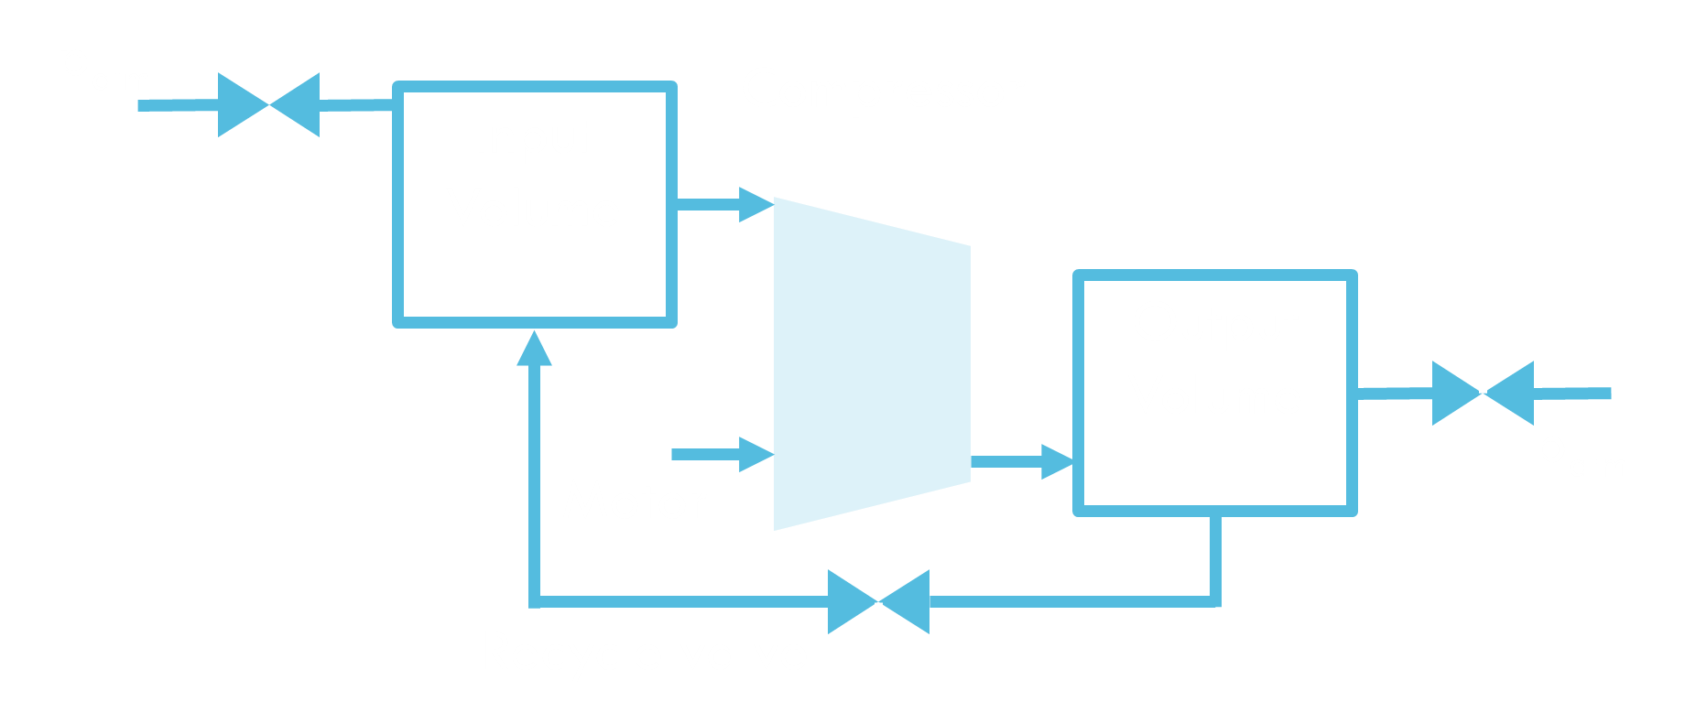
Introduction
System: Compressor Surge
Causes:
Increased pressure ratio/decreased mass flow
Effects:
Unstable oscillations in mass flow through compressor
Increased wear/maintenance cost
Can cause safety concerns
Avoidance with recycle valve

Slide 3
Introduction
Current Industry Practices
Dedicated surge avoidance controller:
Feedback loop for small disturbances
Additional feedforward terms when certain thresholds are crossed
Loop decoupling to separate it from pressure control/for multiple compressors
Disadvantages:
Designed for gas turbines – don’t take advantage of quick response of electric drivers
No explicit consideration of input constraints
Interaction of multiple controllers

Slide 4
Introduction
Thesis Goals
Design and simulate MPC controllers for both parallel and serial networks of two compressors
Needs to be computationally efficient
Implemented by each compressor independently
Why MPC?
Already been shown that MPC increases surge avoidance performance relative to traditional controllers for single compressors
Can naturally handle interactions & input constraints

Slide 5
Modelling
Single Compressor
u_in
p_{atm}
Compressor
wc, mc
Input Volume
p1
u_out
States
Inputs
Disturbances
OutputVolume
p2
Td
p_{atm}
Recycle valve
urec, mr

Slide 6
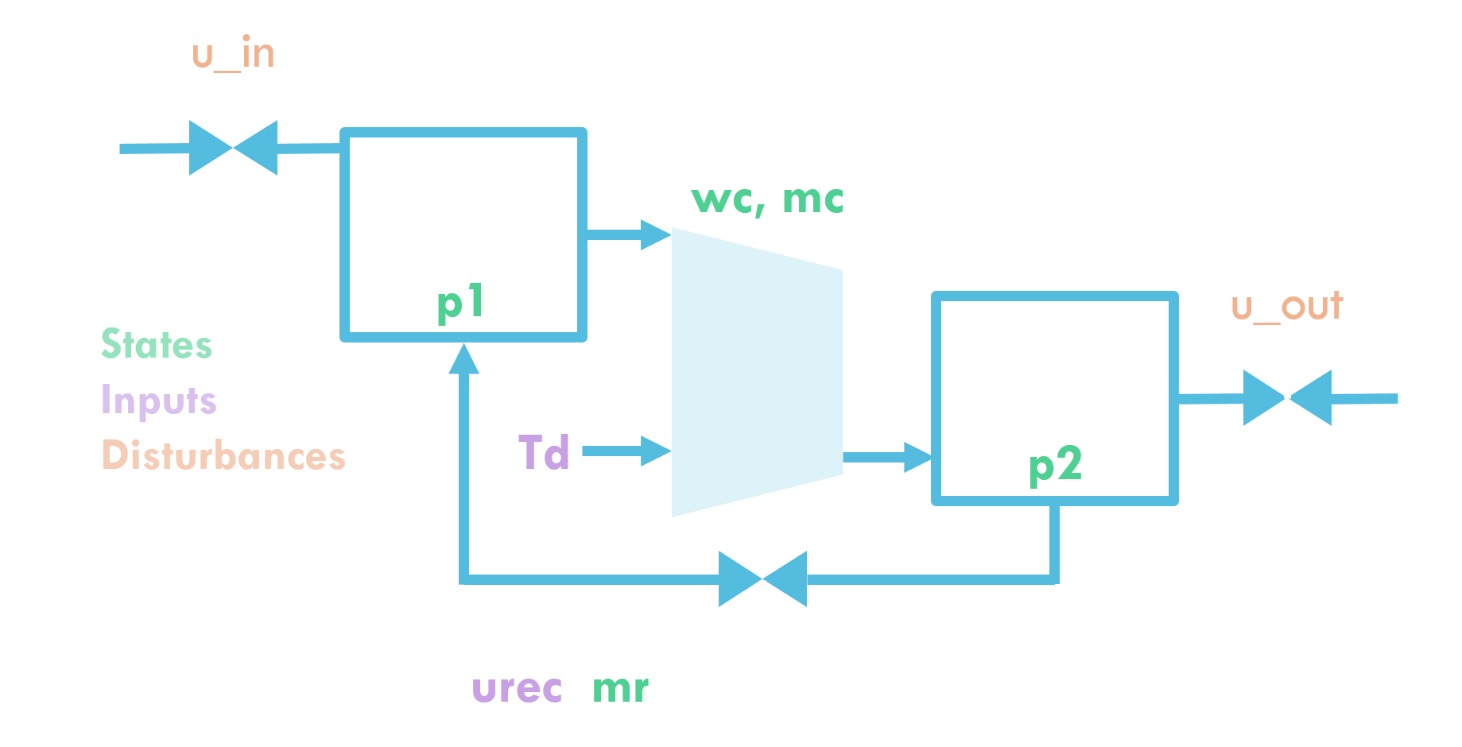
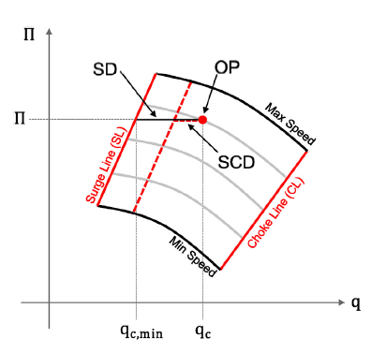

Modelling
Single Compressor
Outputs
p2: Output pressure
SD: Surge distance
$$SD={−c}_{1}\frac{p_{2}}{p_{1}}+c_{0}+m_{c}$$

Slide 7
Modelling
Approach
Grey-box modelling:
Combination of parameter fitting and first principles
Fix order of model based on first principles
Use steady-state measurements to determine static model parameters
Dynamic parameters taken equal to physical characteristics

Slide 8
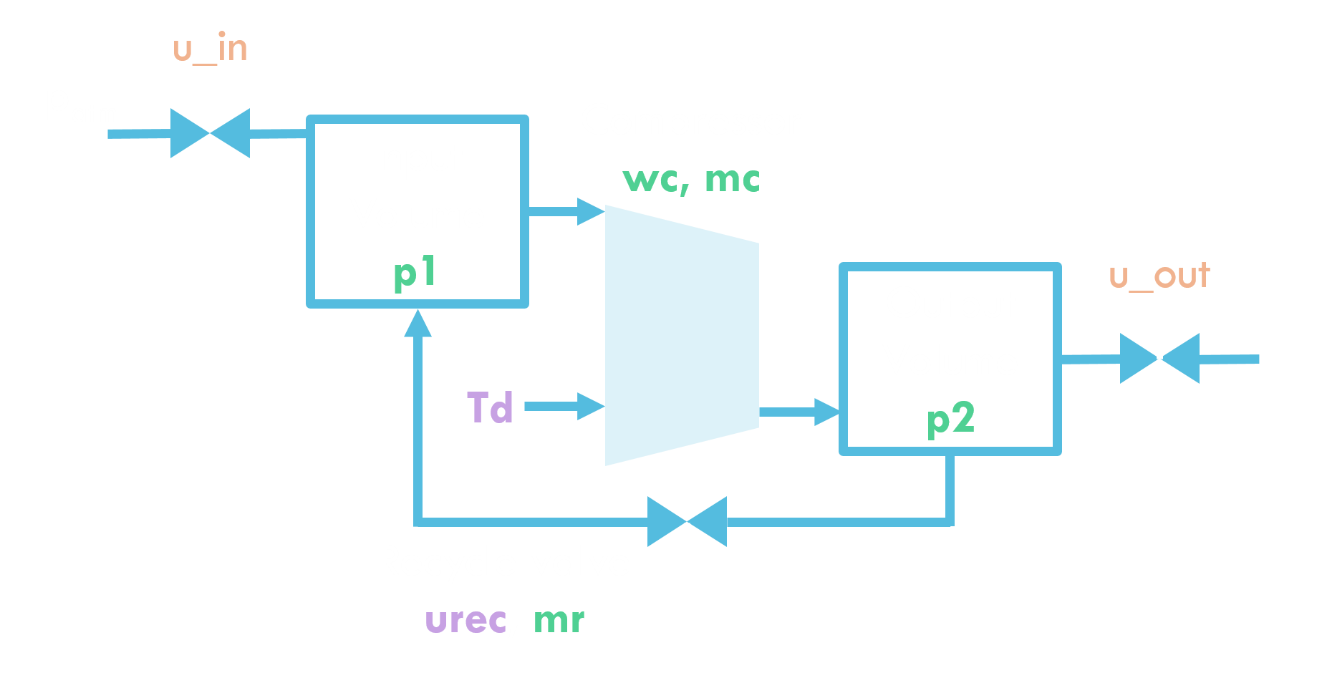
Modelling
Compressor Network
States
Inputs
Disturbances
Discharge Tank
P_{D}
u_tank
p_{atm}

Slide 9
Control
Overview
Linearized MPC
Prediction horizon: p = 100
Move horizon: u = 2
Augmented state includes:
5 states per compressor
Discharge tank pressure
20-40 recycle valve delay states
2 integrator states/compressor
Primary control objective: surge control of both compressors
Secondary control objectives:
follow discharge pressure setpoint
keep both output pressures equal (or objective from load-sharing controller)

Slide 10


Control
Controller Setup
$\hat{x}$, A, B, C
Procedure at each time step:
A posteriori state estimation
Linearize/discretize system around current operating point
Set up & solve QP
Apply optimal inputs
A priori state prediction
y
Observer & Linearization
QP Problem generation
$${\hat{x}}_{p}$$
QP
u
State Prediction
QP solver & output

Slide 11

Control
Equations
Objective: $\min_{∆Y, ∆u}{{(∆Y−{∆Y}_{REF})}^{T}} W_{y} \left(∆Y−{∆Y}_{REF}\right)+ {∆u}^{T} W_{u} ∆u$
Such that: $∆Y=S_{x}∆x+ S_{u}∆u+S_{\dot{x}}\dot{x}(x_{0})$
${∆u}_{min} ≤∆u ≤ {∆u}_{max}$
where $∆$ is relative to the linearization point

Slide 12
Control
Centralized Approach
4 inputs, 4 outputs
Likely too computationally expensive to implement in practice
Used as benchmark for other controllers
Outputs: SD and p2 for both compressors

Slide 13

Control
Decentralized Approach
$$∆Y=S_{x}∆x+ S_{u1}∆u_{1}+S_{u2}∆u_{2}+S_{\dot{x}}\dot{x}(x_{0})$$
Solve separate, smaller QP for each controller individually
Each QP depends on inputs of other compressor – unknown
Perform fixed # of iterations, updating the inputs at each step
Assume full state information available to both compressors (for now)
Can also implement separate observers for each compressor
2 variants examined
Cooperative: use single cost function for both compressors
Non-cooperative: use separate cost function for each compressor

Slide 14
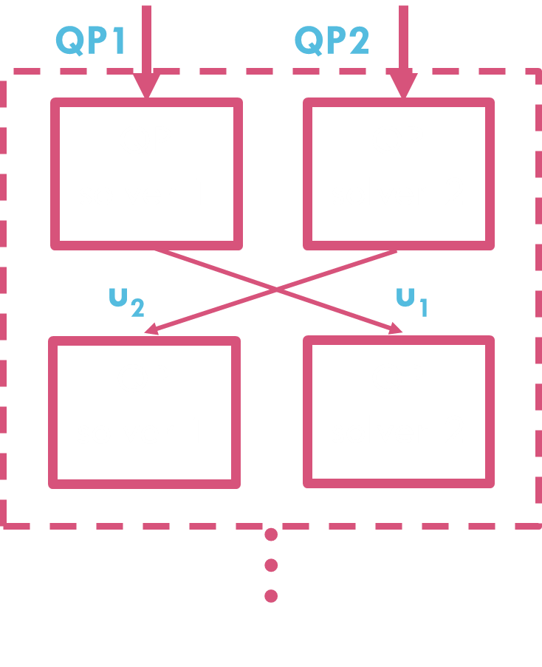
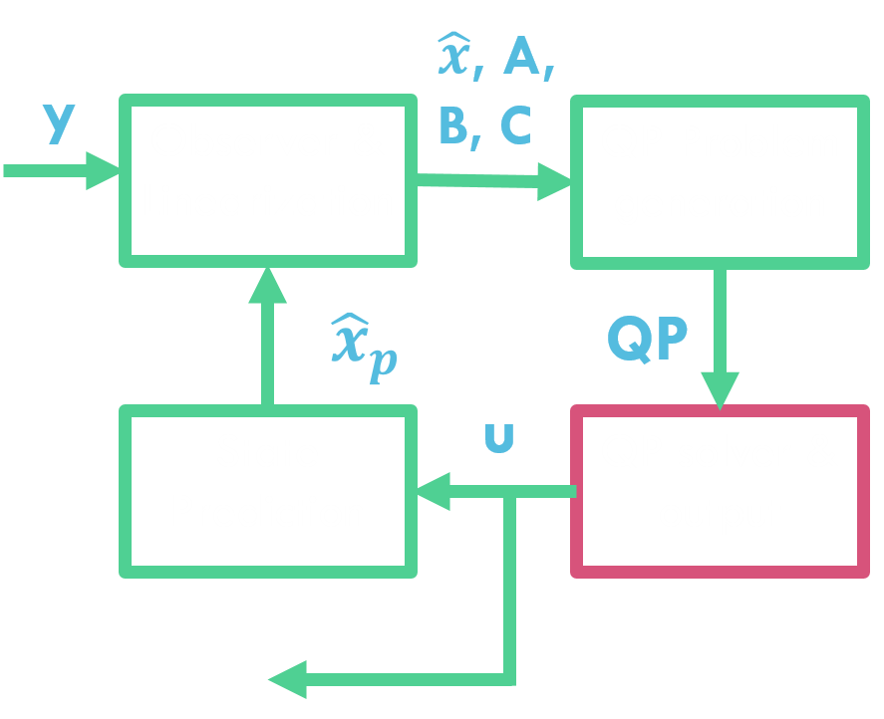
Control
Decentralized: QP Solver

Slide 15
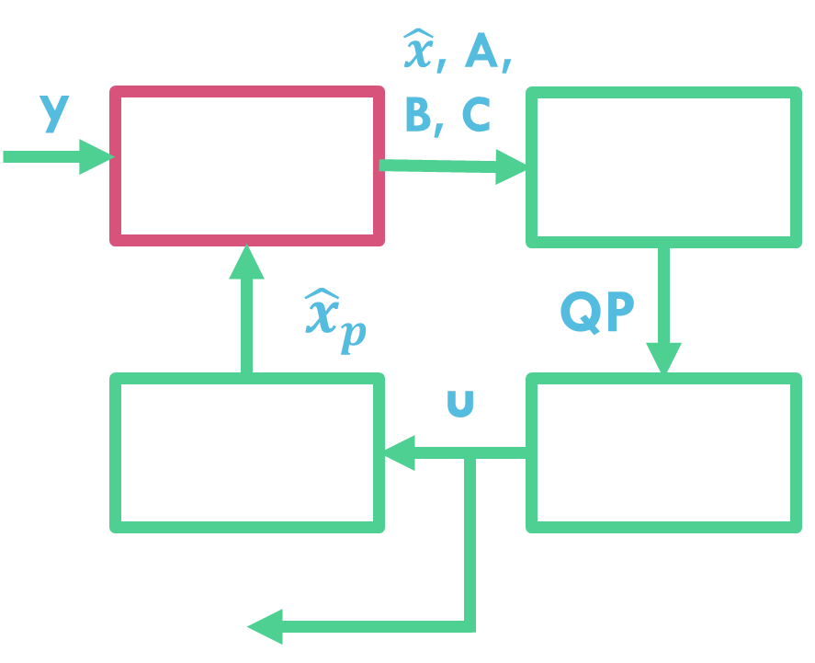







Control
Decentralized: Observer
$$y_{1}$$
A1,B1,C1
Observer 1
QP Generator1
$${\hat{x}}_{1}$$
$$P_{d}$$
QP1
$${\hat{x}}_{1}$$
$${\hat{x}}_{2}$$
Observer 2
QP Generator 2
$$y_{2}$$
$${\hat{x}}_{2}$$
QP2
A2,B2,C2

Slide 16
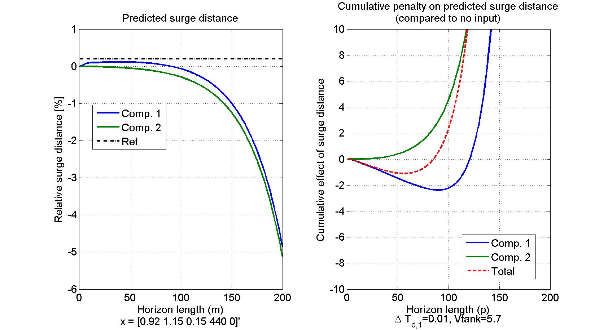
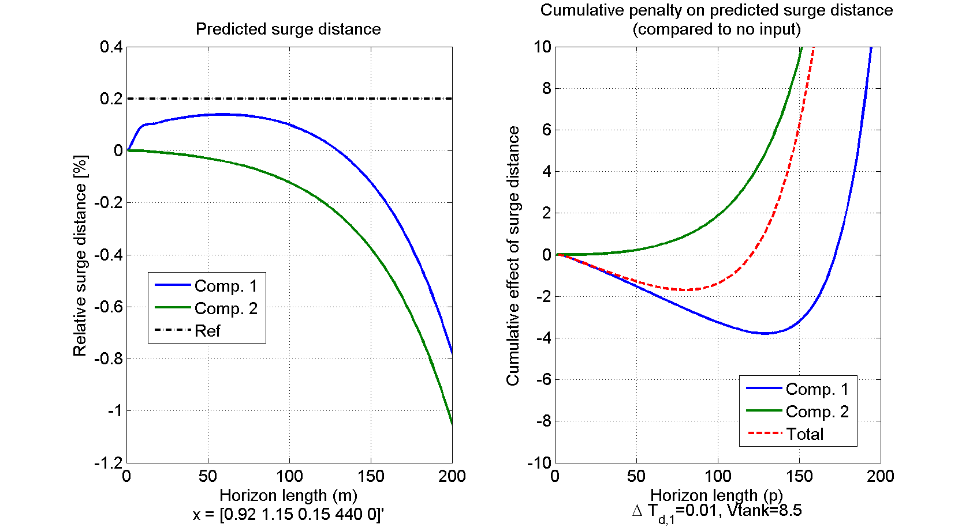


Considerations
Tank Size
Assume steady-state and use prediction matrices to predict QP solution:
Cooperative unstable for $m≳90$
Non-cooperative unstable for $m≳120$
Cooperative unstable for $m≳120$
Non-cooperative unstable for $m≳170$

Slide 17
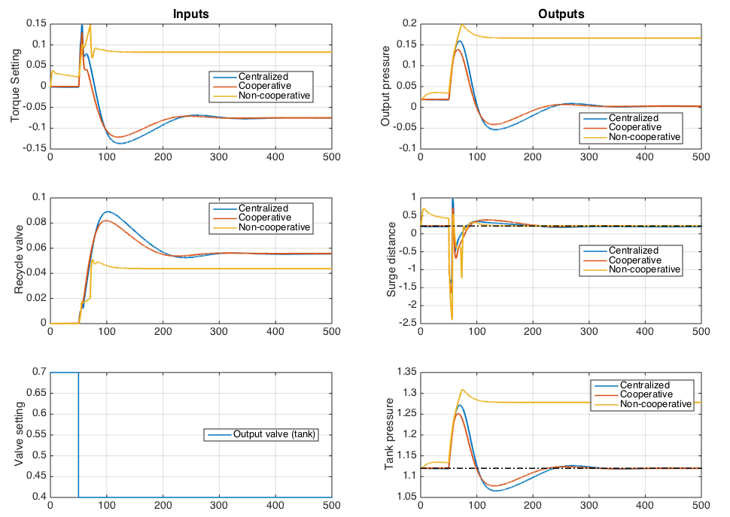
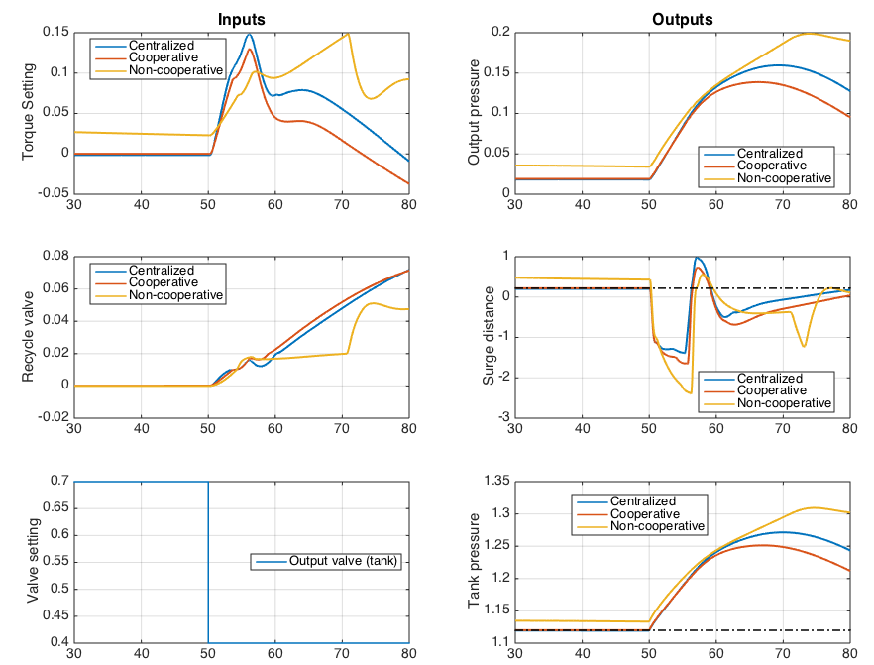
Results
Output Disturbance

Slide 18
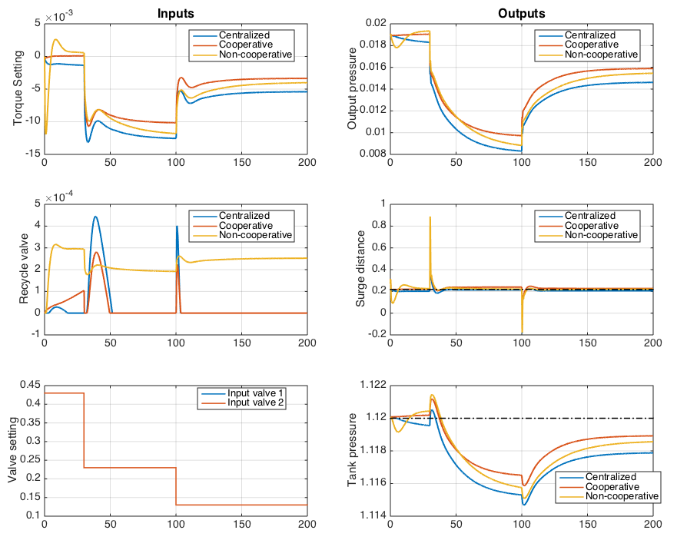
Results
Input Disturbances

Slide 19
Conclusion
Future Work
Fine-tune controllers
Implement individual observers for each compressor
Quantify computational cost of each solution
How many iterations of decentralized are still cheaper than centralized solution?
Compare results to industry standard (traditional control)
Repeat process for serial network

