Slide 1
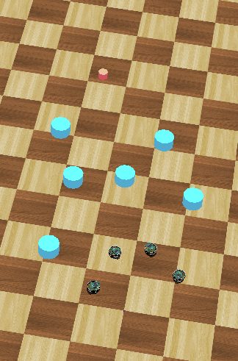
Distributed Intelligent Systems – Course Project
CSE - IN
Optimized Navigation Behaviour of Multiple Robots based on Motor-Schema
Students:
Ondine Chanon
Computational Science and
Engineering
Nicolas Hubacher
Computer Science
Stefano Savarè
Computational Science and
Engineering
Professor:
Alcherio Martinoli
Distributed Intelligent Systems
and Algorithms Laboratory
Assistant:
Zeynab Talebpour
Distributed Intelligent Systems
and Algorithms Laboratory
Ondine Chanon, Nicolas Hubacher, Stefano Savarè
December, 16th 2015

Slide 2
Introduction
Anatomia: cuore e sistema di conduzione
Ondine Chanon, Nicolas Hubacher, Stefano Savarè
December, 16th 2015

Slide 3
Introduction
Anatomia: cuore e sistema di conduzione
Ondine Chanon, Nicolas Hubacher, Stefano Savarè
December, 16th 2015

Slide 4
Introduction
Anatomia: cuore e sistema di conduzione
Ondine Chanon, Nicolas Hubacher, Stefano Savarè
December, 16th 2015

Slide 5
Introduction
Anatomia: cuore e sistema di conduzione
Ondine Chanon, Nicolas Hubacher, Stefano Savarè
December, 16th 2015

Slide 6
Introduction
Anatomia: cuore e sistema di conduzione
Ondine Chanon, Nicolas Hubacher, Stefano Savarè
December, 16th 2015

Slide 7
Introduction
Anatomia: cuore e sistema di conduzione
Ondine Chanon, Nicolas Hubacher, Stefano Savarè
December, 16th 2015

Slide 8
Introduction
Anatomia: cuore e sistema di conduzione
Ondine Chanon, Nicolas Hubacher, Stefano Savarè
December, 16th 2015

Slide 9
Introduction
Anatomia: cuore e sistema di conduzione
Ondine Chanon, Nicolas Hubacher, Stefano Savarè
December, 16th 2015

Slide 10
Introduction
Anatomia: cuore e sistema di conduzione
Ondine Chanon, Nicolas Hubacher, Stefano Savarè
December, 16th 2015

Slide 11
Introduzione
Bibliography
C. Vergara, S. Palamara, D. Catanzariti, F. Nobile, E. Fag- giano, C. Pangrazzi, M. Centonze, M. Maines, A. Quarteroni, and G. Vergara Patient-specific generation of the purkinje network driven by clinical measurements of a normal propagation Med Biol Eng Comput, 2014
Palamara, C. Vergara, D. Catanzariti, E. Faggiano, M. Cen- tonze, C. Pangrazzi, M. Maines, and A. Quarteroni, Patient- specific generation of the purkinje network driven by clinical measurements: The case of pathological propagationsy Mox Report, 2014
P. Colli Franzone, L. Guerri, M. Pennacchio, e B. Taccardi Spread of excitation in 3-D models of the anisotropic cardiac tissue. II. Effec- ts of fiber architecture and ventricular geometry Math. Biosci, 1998.
S. Palamara, C. Vergara, E. Faggiano, and F. Nobile, An effective algorithm for the generation of patient-specific purkinje networks in computational electrocardiology Mox Report, 2013
Sethian Fast Marching Method SIAM Rev., 1999
Stefano Savarè
30 settembre 2014

