Slide 1
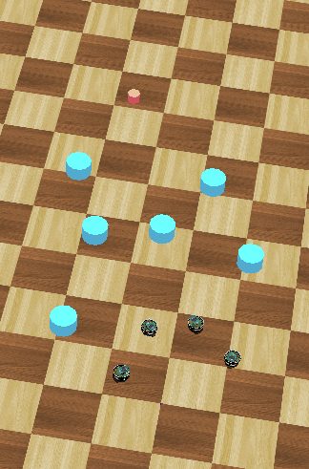
Distributed Intelligent Systems – Course Project
CSE - IN
Optimized Navigation Behaviour of Multiple Robots based on Motor-Schema
Students:
Ondine Chanon
Computational Science and
Engineering
Nicolas Hubacher
Computer Science
Stefano Savarè
Computational Science and
Engineering
Professor:
Alcherio Martinoli
Distributed Intelligent Systems
and Algorithms Laboratory
Assistant:
Zeynab Talebpour
Distributed Intelligent Systems
and Algorithms Laboratory
Ondine Chanon, Nicolas Hubacher, Stefano Savarè
December, 16th 2015

Slide 2
Introduction
Distributed Intelligent Systems – Course Project
2/16
Content
Introduction, goals and motivation
Motor-schemas based navigation behaviour
Particle Swarm Optimization (PSO)
Results
Conclusions
Ondine Chanon, Nicolas Hubacher, Stefano Savarè
December, 16th 2015

Slide 3
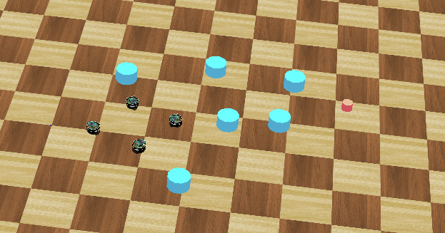
Introduction
Distributed Intelligent Systems – Course Project
3/16
Introduction, goals and motivation
Set-up
- 1 goal
- 4 robots
- some obstacles
Two-step project
- basic navigation control, based of 4 motor-schemas
- PSO implementation
Aim
- find the good balance between the objectives to get the best
possible behaviour
Ondine Chanon, Nicolas Hubacher, Stefano Savarè
December, 16th 2015

Slide 4


Introduction
Distributed Intelligent Systems – Course Project
4/16
Motor-schemas
General concept
Each motor-schema generates a vector
field
The global vector field is the sum of all the computed individual vector fields
Difficulty: presence of local minima
Sphere of influence
Most of the implemented motor-schemas use this concept
Example equation
TODO: Image
Ondine Chanon, Nicolas Hubacher, Stefano Savarè
December, 16th 2015

Slide 5
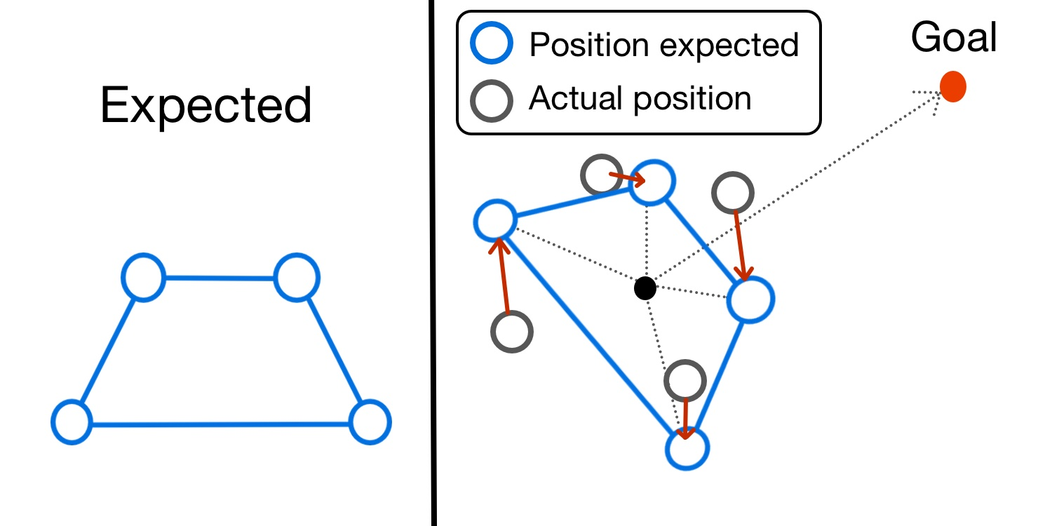
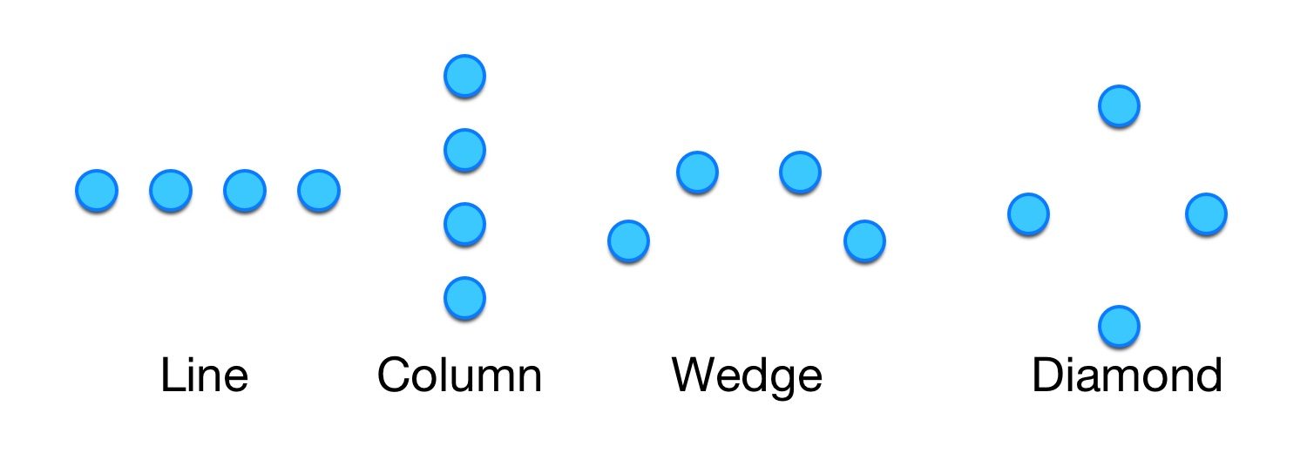
Introduction
Distributed Intelligent Systems – Course Project
5/16
Motor-schemas
Move to goal
Keep formation
- unit centered
Robot avoidance
- local communication
Obstacle avoidance
- supervisor
- distance sensors
Random walk
- noise generation frequency
- fading
Ondine Chanon, Nicolas Hubacher, Stefano Savarè
December, 16th 2015

Slide 6
Introduction
Distributed Intelligent Systems – Course Project
6/16
Particle Swarm Optimization
General concepts + equations
Ondine Chanon, Nicolas Hubacher, Stefano Savarè
December, 16th 2015

Slide 7
Introduction
Distributed Intelligent Systems – Course Project
7/16
Particle Swarm Optimization
OCBA
Ondine Chanon, Nicolas Hubacher, Stefano Savarè
December, 16th 2015

Slide 8
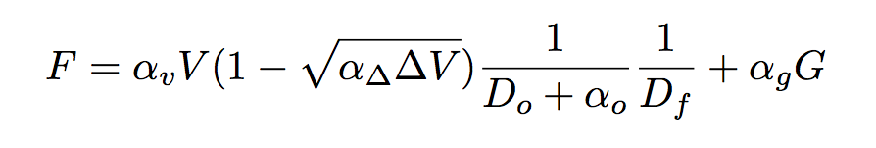
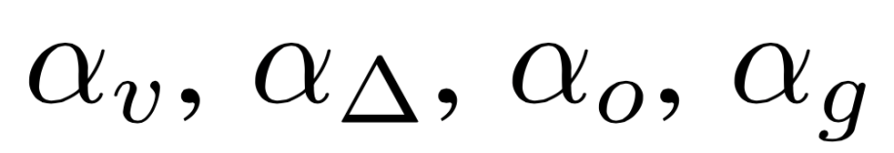
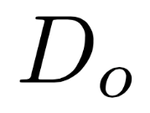
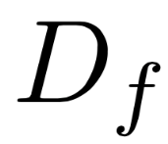

Introduction
Distributed Intelligent Systems – Course Project
8/16
Particle Swarm Optimization
Parameters to optimize
- weights for each motor-schema
- minimum and maximum thresholds
- 4 chosen parameters
Fitness function
appropriate weights
mean distance of the robot with the nearest obstacle
mean distance to the expected position in the formation
decreases with the final distance to the goal
Ondine Chanon, Nicolas Hubacher, Stefano Savarè
December, 16th 2015

Slide 9
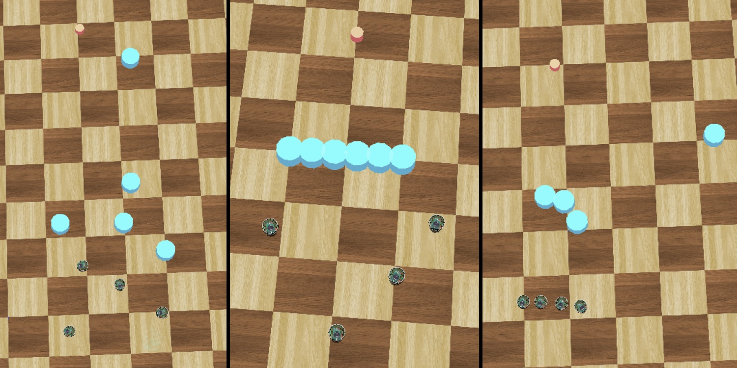
Introduction
Distributed Intelligent Systems – Course Project
9/16
Results
3 different worlds consided for PSO
1. Random
2. Wall of obstacles
3. Difficult configuration
Ondine Chanon, Nicolas Hubacher, Stefano Savarè
December, 16th 2015

Slide 10
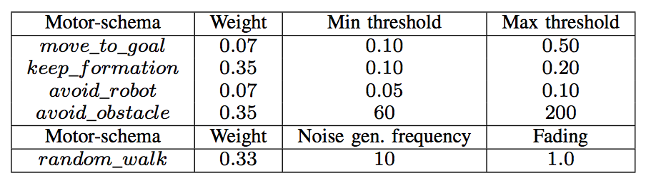
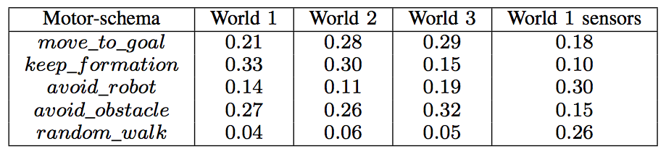
Introduction
Distributed Intelligent Systems – Course Project
10/16
Results
Parameters manually tuned
Weights found by PSO
Ondine Chanon, Nicolas Hubacher, Stefano Savarè
December, 16th 2015

Slide 11
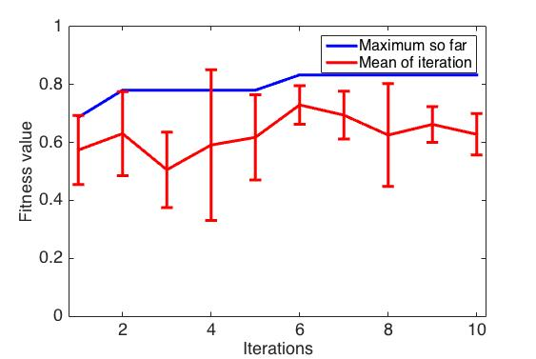
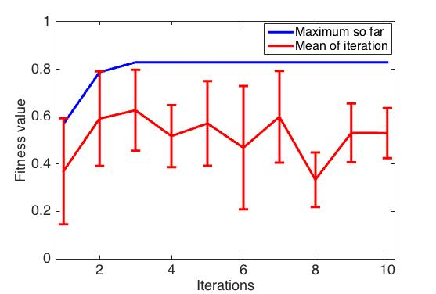
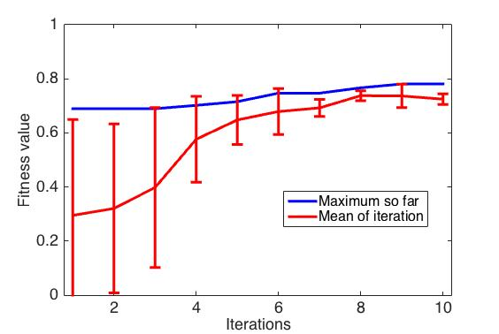
Introduction
Distributed Intelligent Systems – Course Project
11/16
Results
Random world
Wall world
Wedge formation; obstacles known through the supervisor
Better convergence: world with a difficult configuration
More iterations and more particles would be needed in the other 2 worlds to perform a better analysis
Difficult world
Ondine Chanon, Nicolas Hubacher, Stefano Savarè
December, 16th 2015

Slide 12
Introduction
Distributed Intelligent Systems – Course Project
12/16
Results
Ondine Chanon, Nicolas Hubacher, Stefano Savarè
December, 16th 2015

Slide 13
Introduction
Distributed Intelligent Systems – Course Project
13/16
Results
Ondine Chanon, Nicolas Hubacher, Stefano Savarè
December, 16th 2015

Slide 14
Introduction
Distributed Intelligent Systems – Course Project
14/16
Conclusions
Hand tuned parameters already provide a good controller
PSO – OCBA is a powerful tool: better results but higher simulation time
Unit-centered formation control is more robust to different formations than the leader referenced formation control
Formation does not have a big influence on PSO, but worlds do.
Noisy measures lead to suboptimal results: sensor measures and local communications
Further work:
- odometry based positioning
- computation of fitness metrics in the robot’s controllers
- combine PSO worlds
Ondine Chanon, Nicolas Hubacher, Stefano Savarè
December, 16th 2015
Notes:
Column formation have an higher probability to arrive faster to goal

Slide 15
Introduction
Distributed Intelligent Systems – Course Project
15/16
Bibliography
Arkin, Ronald C. Motor-schema based navigation for a mobile robot: An approach to programming by behavior. Robotics and Automation. Proceedings. IEEE International Conference on. Vol. 4. IEEE, 1987.
Balch, Tucker and Arkin. Behavior-based formation control for multi-robot teams. Robotics and Automation. IEEE Transactions on 14.6 (1998): 926-939.
Di Mario, Navarro and Martinoli. Analysis of fitness noise in particle swarm optimization: From robotic learning to benchmark functions. Evolutionaly Computation (CEC). IEEE Congress on. IEEE, 2014.
Eberhart, Kennedy. A New Optimizer Using Particle Swarm Theory. Sixth International Symposium on Micro Machine and Human Science. IEEE 1995.
Di Mario, Navarro and Martinoli. A Distributed Noise-Resistant Particle Swarm Optimization Algorithm for High-Dimensional Multi-Robot Learning. IEEE International Conference on Robotics and Automation. No. EPFL-CONF-206842, 2015.
Floreano and Mondada. Evolution of Homing Navigation in Real Mobile Robot Systems, Man and Cybernetics. Part B, IEEE Transactions on. Vol.26, Iss.3, Jun 1996, p.396-407.
Pugh, Zang and Martinoli. Particle swarm optimization for unsupervised robotic learning. Swarm Intelligence Symposium. No. SWIS-CONF-2005-004. 2005
Ondine Chanon, Nicolas Hubacher, Stefano Savarè
December, 16th 2015

Slide 16
Introduction
Distributed Intelligent Systems – Course Project
16/16
The end… almost !
Thank you for your attention
Questions?
Ondine Chanon, Nicolas Hubacher, Stefano Savarè
December, 16th 2015

Slide 17
Introduction
Distributed Intelligent Systems – Course Project
CSE - IN
Ondine Chanon, Nicolas Hubacher, Stefano Savarè
December, 16th 2015

