Slide 1
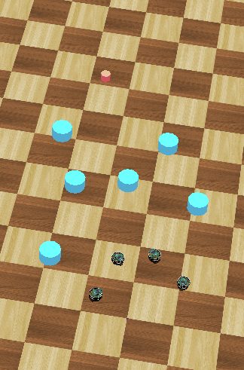
Distributed Intelligent Systems – Course Project
CSE - IN
Optimized Navigation Behaviour of Multiple Robots based on Motor-Schema
Students:
Ondine Chanon
Computational Science and
Engineering
Nicolas Hubacher
Computer Science
Stefano Savarè
Computational Science and
Engineering
Professor:
Alcherio Martinoli
Distributed Intelligent Systems
and Algorithms Laboratory
Assistant:
Zeynab Talebpour
Distributed Intelligent Systems
and Algorithms Laboratory
Ondine Chanon, Nicolas Hubacher, Stefano Savarè
December, 16th 2015

Slide 2
Introduction
Content
Introduction, goals and motivation
Motor-schemas based navigation behaviour
Particle Swarm Optimization (PSO)
Results
Conclusions
Ondine Chanon, Nicolas Hubacher, Stefano Savarè
December, 16th 2015

Slide 3
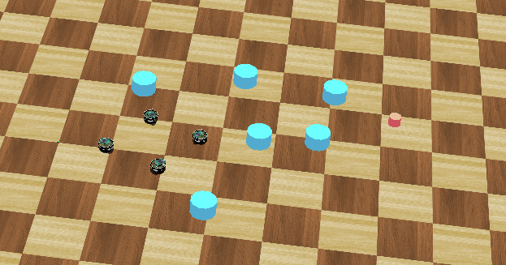
Introduction
Introduction, goals and motivation
Set-up
- 1 goal
- 4 robots
- some obstacles
Two-step project
- basic navigation control, based of 4 motor-schemas
- PSO implementation
Aim
- find the good balance between the objectives to get the best
possible behaviour
Ondine Chanon, Nicolas Hubacher, Stefano Savarè
December, 16th 2015

Slide 4
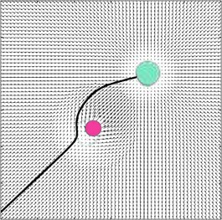

Introduction
Motor-schemas
General concept
Each motor-schema generates a vector
field
The global vector field is the sum of all the computed individual vector fields
Sphere of influence
Most of the implemented motor-schemas use this concept
Example equation
TODO: Image
Ondine Chanon, Nicolas Hubacher, Stefano Savarè
December, 16th 2015

Slide 5
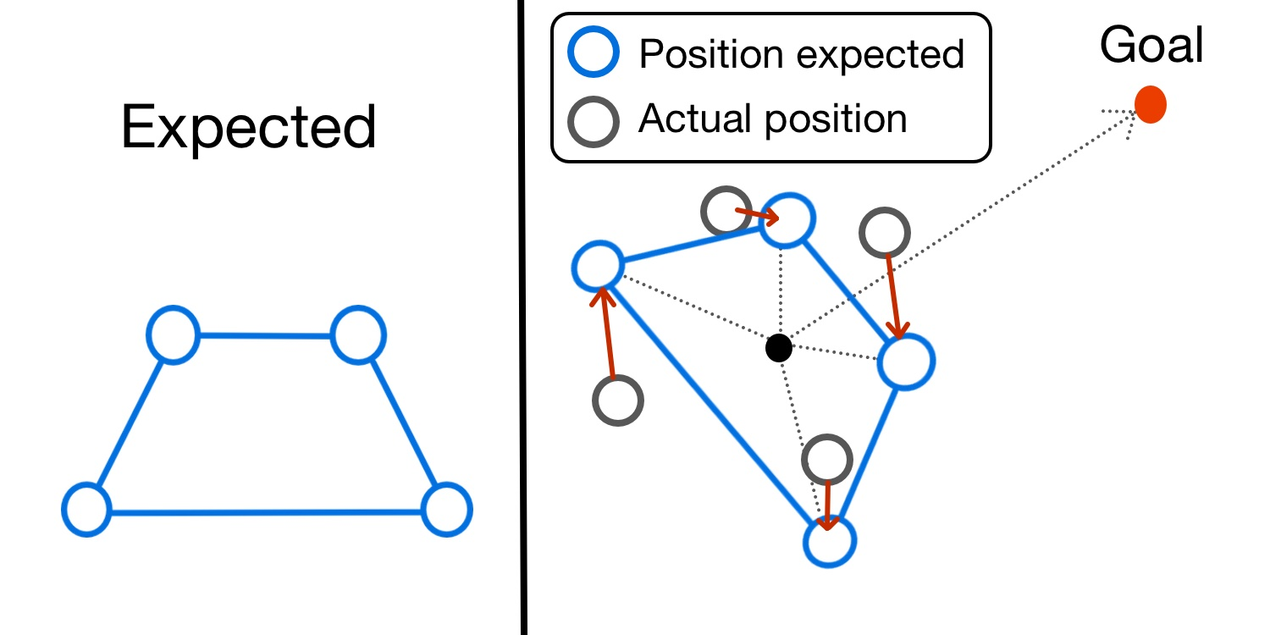
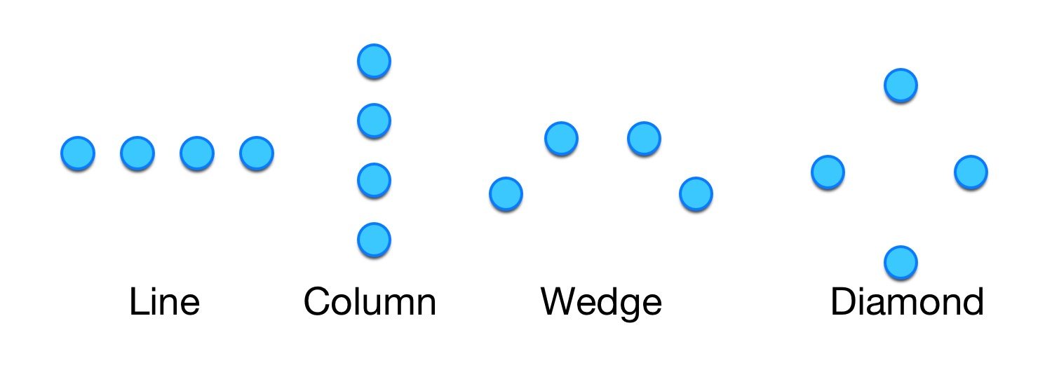
Introduction
Motor-schemas
Move to goal
Keep formation
Robot avoidance
- local communication
Obstacle avoidance
- supervisor
- distance sensors
Random walk
- noise generation frequency
- fading
Ondine Chanon, Nicolas Hubacher, Stefano Savarè
December, 16th 2015

Slide 6
Introduction
Anatomia: cuore e sistema di conduzione
Ondine Chanon, Nicolas Hubacher, Stefano Savarè
December, 16th 2015

Slide 7
Introduction
Anatomia: cuore e sistema di conduzione
Ondine Chanon, Nicolas Hubacher, Stefano Savarè
December, 16th 2015

Slide 8
Introduction
Anatomia: cuore e sistema di conduzione
Ondine Chanon, Nicolas Hubacher, Stefano Savarè
December, 16th 2015

Slide 9
Introduction
Anatomia: cuore e sistema di conduzione
Ondine Chanon, Nicolas Hubacher, Stefano Savarè
December, 16th 2015

Slide 10
Introduction
Anatomia: cuore e sistema di conduzione
Ondine Chanon, Nicolas Hubacher, Stefano Savarè
December, 16th 2015

Slide 11
Introduzione
Bibliography
C. Vergara, S. Palamara, D. Catanzariti, F. Nobile, E. Fag- giano, C. Pangrazzi, M. Centonze, M. Maines, A. Quarteroni, and G. Vergara Patient-specific generation of the purkinje network driven by clinical measurements of a normal propagation Med Biol Eng Comput, 2014
Palamara, C. Vergara, D. Catanzariti, E. Faggiano, M. Cen- tonze, C. Pangrazzi, M. Maines, and A. Quarteroni, Patient- specific generation of the purkinje network driven by clinical measurements: The case of pathological propagationsy Mox Report, 2014
P. Colli Franzone, L. Guerri, M. Pennacchio, e B. Taccardi Spread of excitation in 3-D models of the anisotropic cardiac tissue. II. Effec- ts of fiber architecture and ventricular geometry Math. Biosci, 1998.
S. Palamara, C. Vergara, E. Faggiano, and F. Nobile, An effective algorithm for the generation of patient-specific purkinje networks in computational electrocardiology Mox Report, 2013
Sethian Fast Marching Method SIAM Rev., 1999
Stefano Savarè
30 settembre 2014

