Slide 1
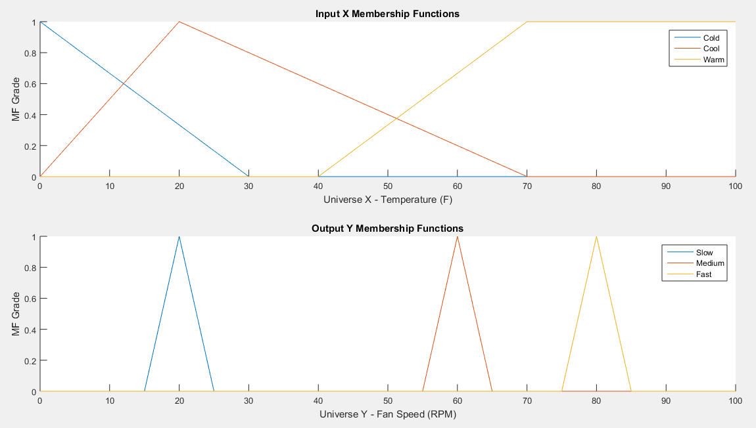

Slide 2
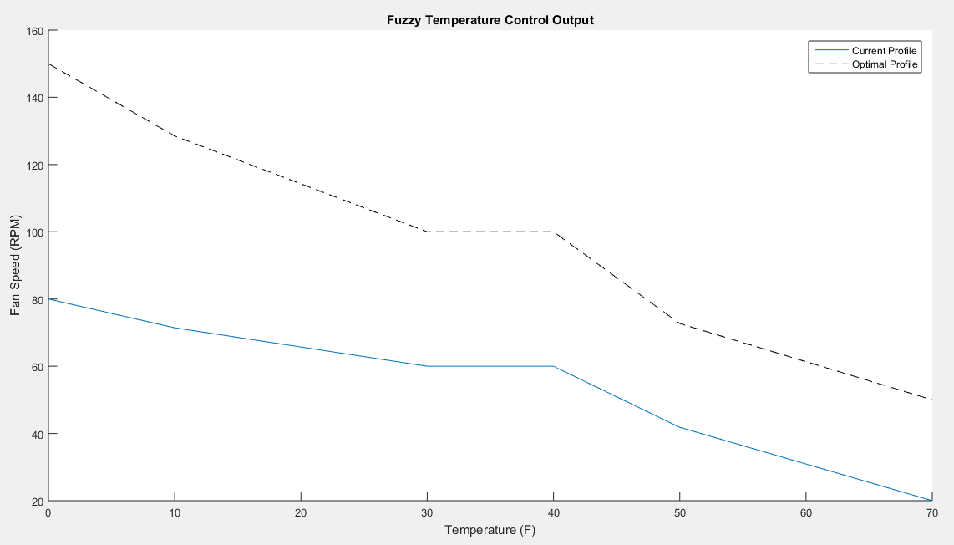

Slide 3
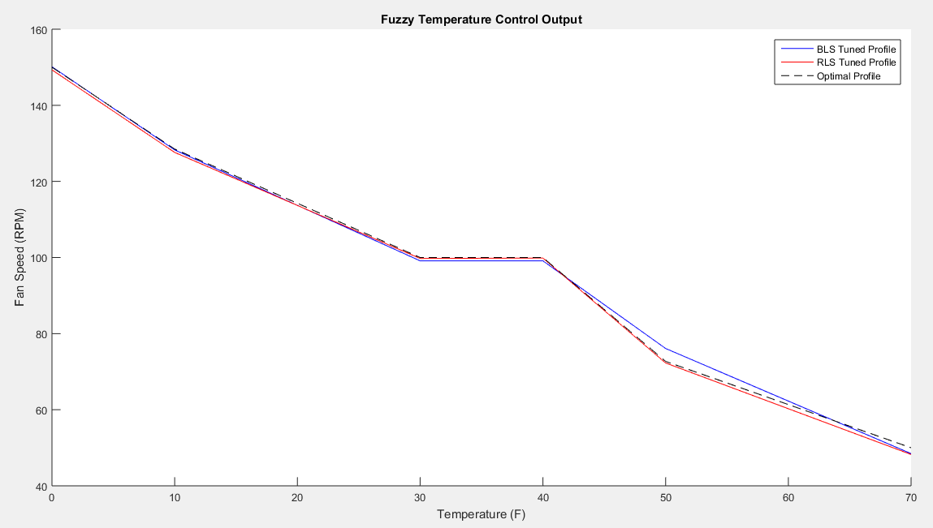

Slide 4
Batched Least Squares
fast_center = 150.1310
medium_center = 99.1236
slow_center = 48.4575
Recursive Least Squares
fast_center = 149.6220
medium_center = 99.0382
slow_center = 48.2410

