Slide 1
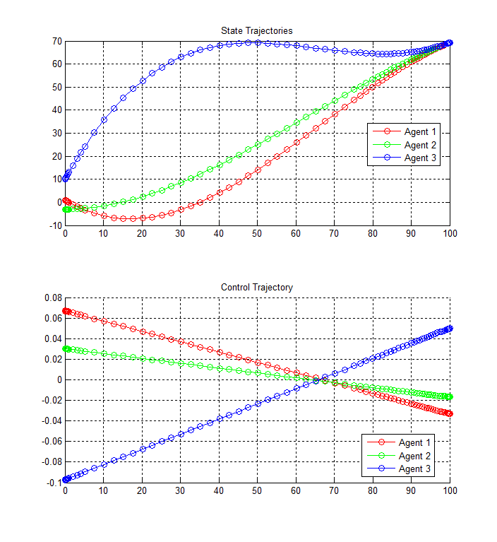
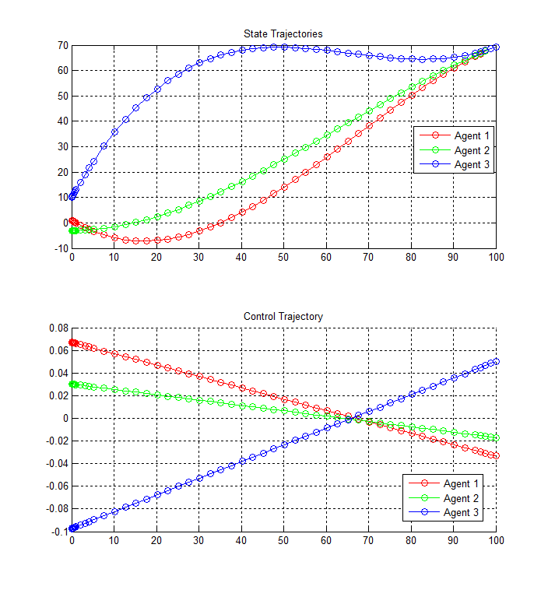
Closed-Loop Nash Equilibrium
Open-Loop Nash Equilibrium

