Slide 1
A Comparative Analysis of Multi-Robot System Strategies for the Automation of Green Wall Maintenance
Author: Sylvester Ndaiga.
Thesis Supervisor: Dr. Steven Hailes.

Slide 2
Introduction
This paper presents an analysis of two operational strategies of a UAV-based, Multi Robot System tasked with performing the robotic maintenance of a Green Wall System in simulation. Hypothesis testing is employed to present a statistical comparison of swarm-inspired vs generic lawn mower motion approaches to coverage path planning and cooperative control in the robot collective. Each agent localizes, classifies and acts upon randomly distributed coplanar targets, functionally symbolic of a plant-abundant, vertical wall planter. Global objectives are probabilistically respected by locally acting agents via limited sensing and communication techniques. Additionally, a data pipeline and in-simulation, sample dataset are provided for research posterity. Finally, an outline of open research questions and directions is laid out for future investigation.

Slide 3
Swarm-Inspired Coordination Strategy
Naive Lawn/Seed Spreader Strategy

Slide 4
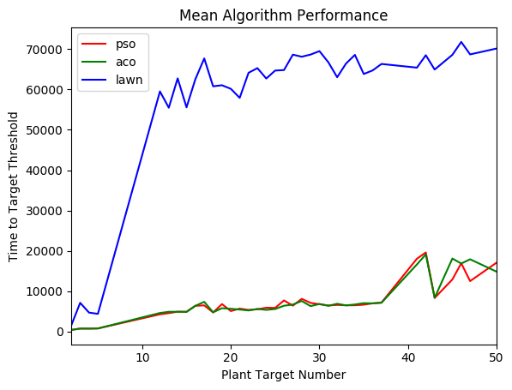
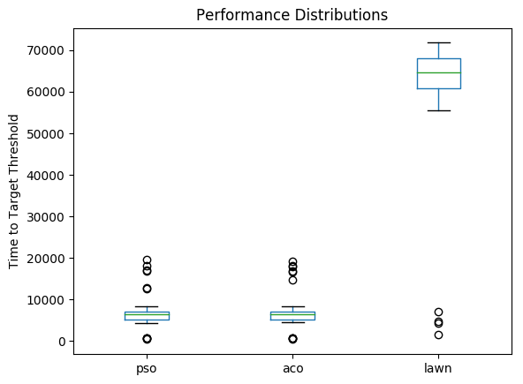
Results

Slide 5
Results
Using the Students’ t-test, we are able to perform significance testing and determine if there is a significant difference between the generated sample means. In the main, this means evaluating the t-tests’ p-value < 0.05.
In this project we determined the value to be … ;)

