Slide 1
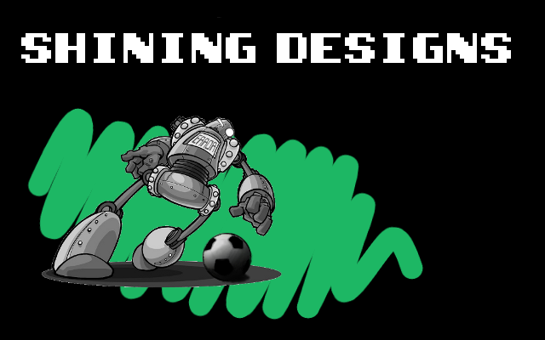
Group 9

Slide 2
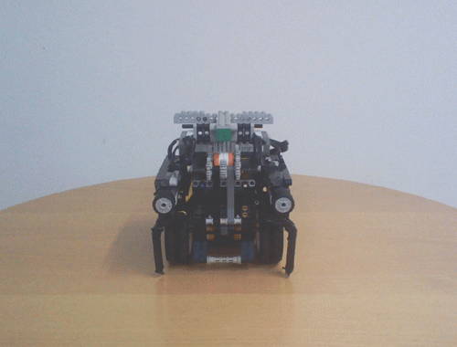
Roboto Carlos

Slide 3
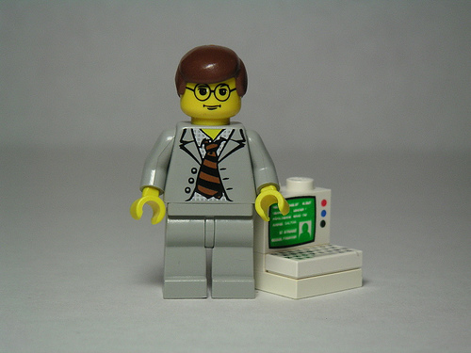
Software

Slide 4
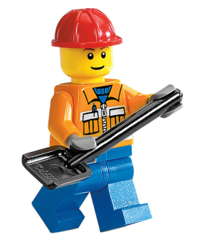
Hardware
Software

Slide 5
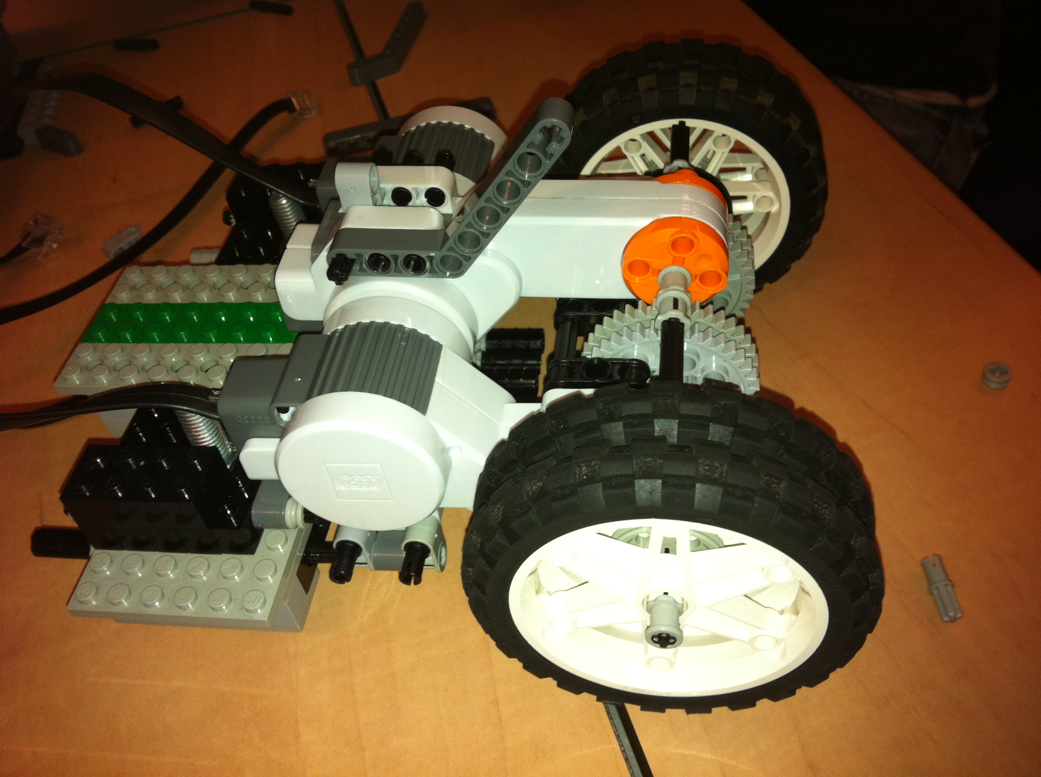
The Skeleton

Slide 6
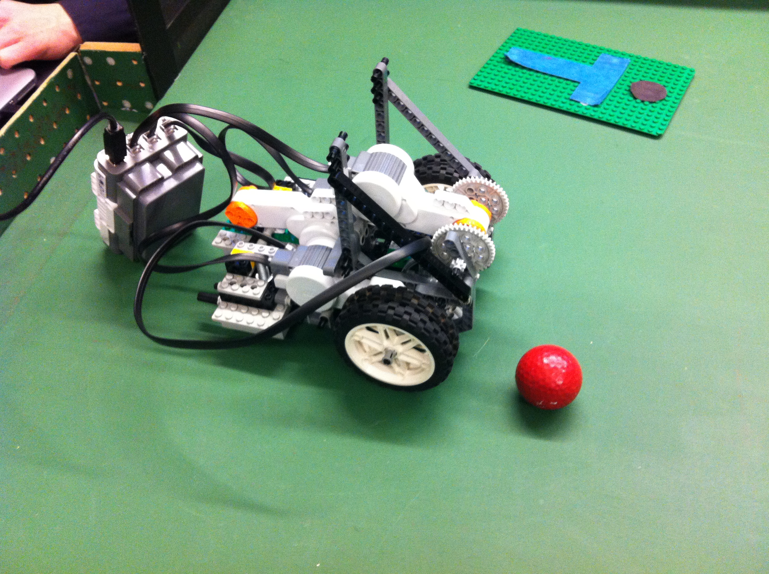
The Ball and Chain

Slide 7
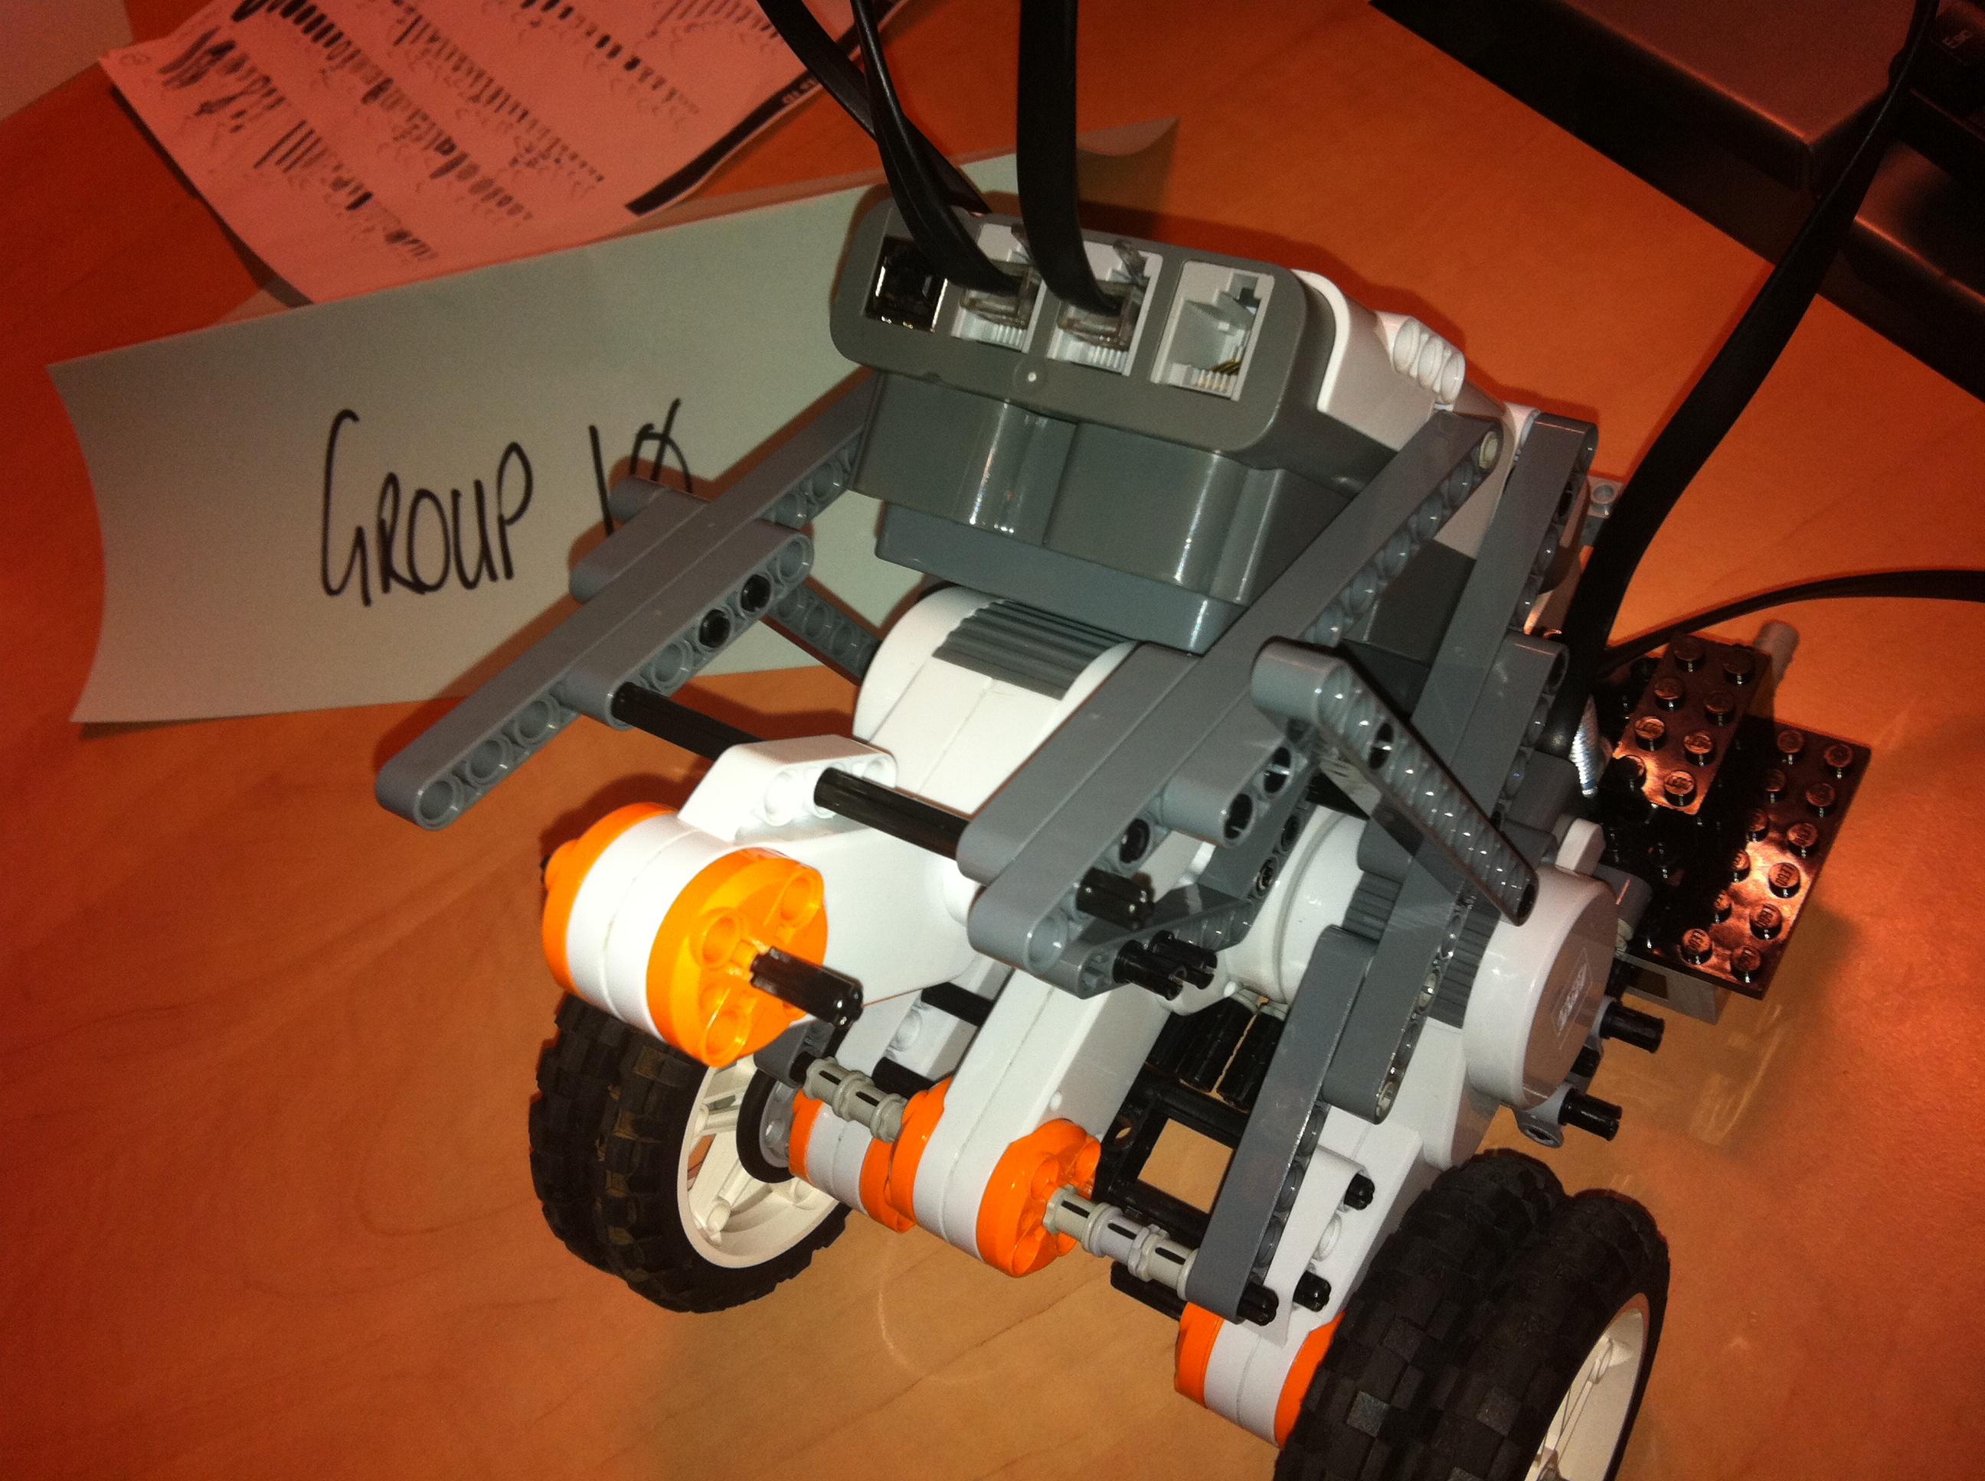
The Disaster

Slide 8
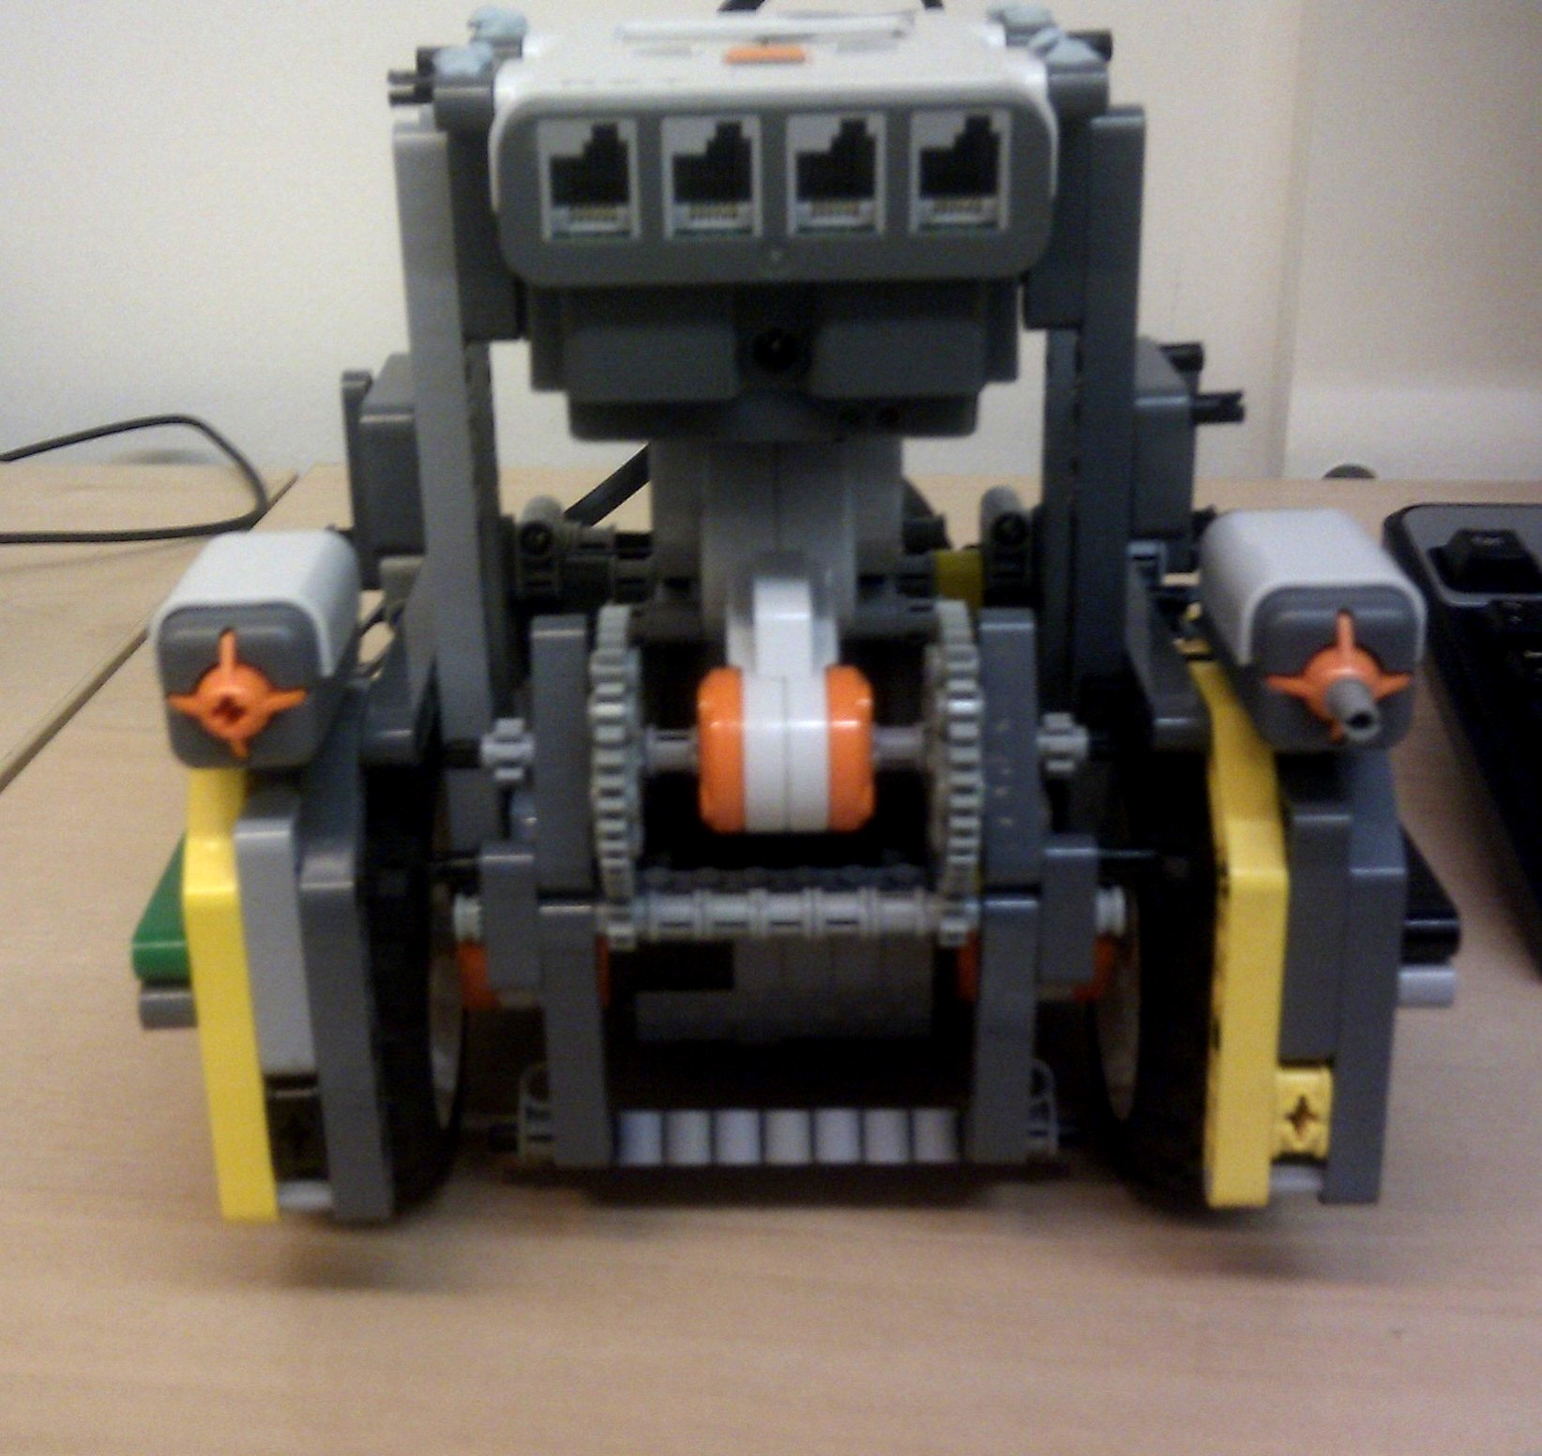
Milestone 1

Slide 9
Plate falling off GIF

Slide 10
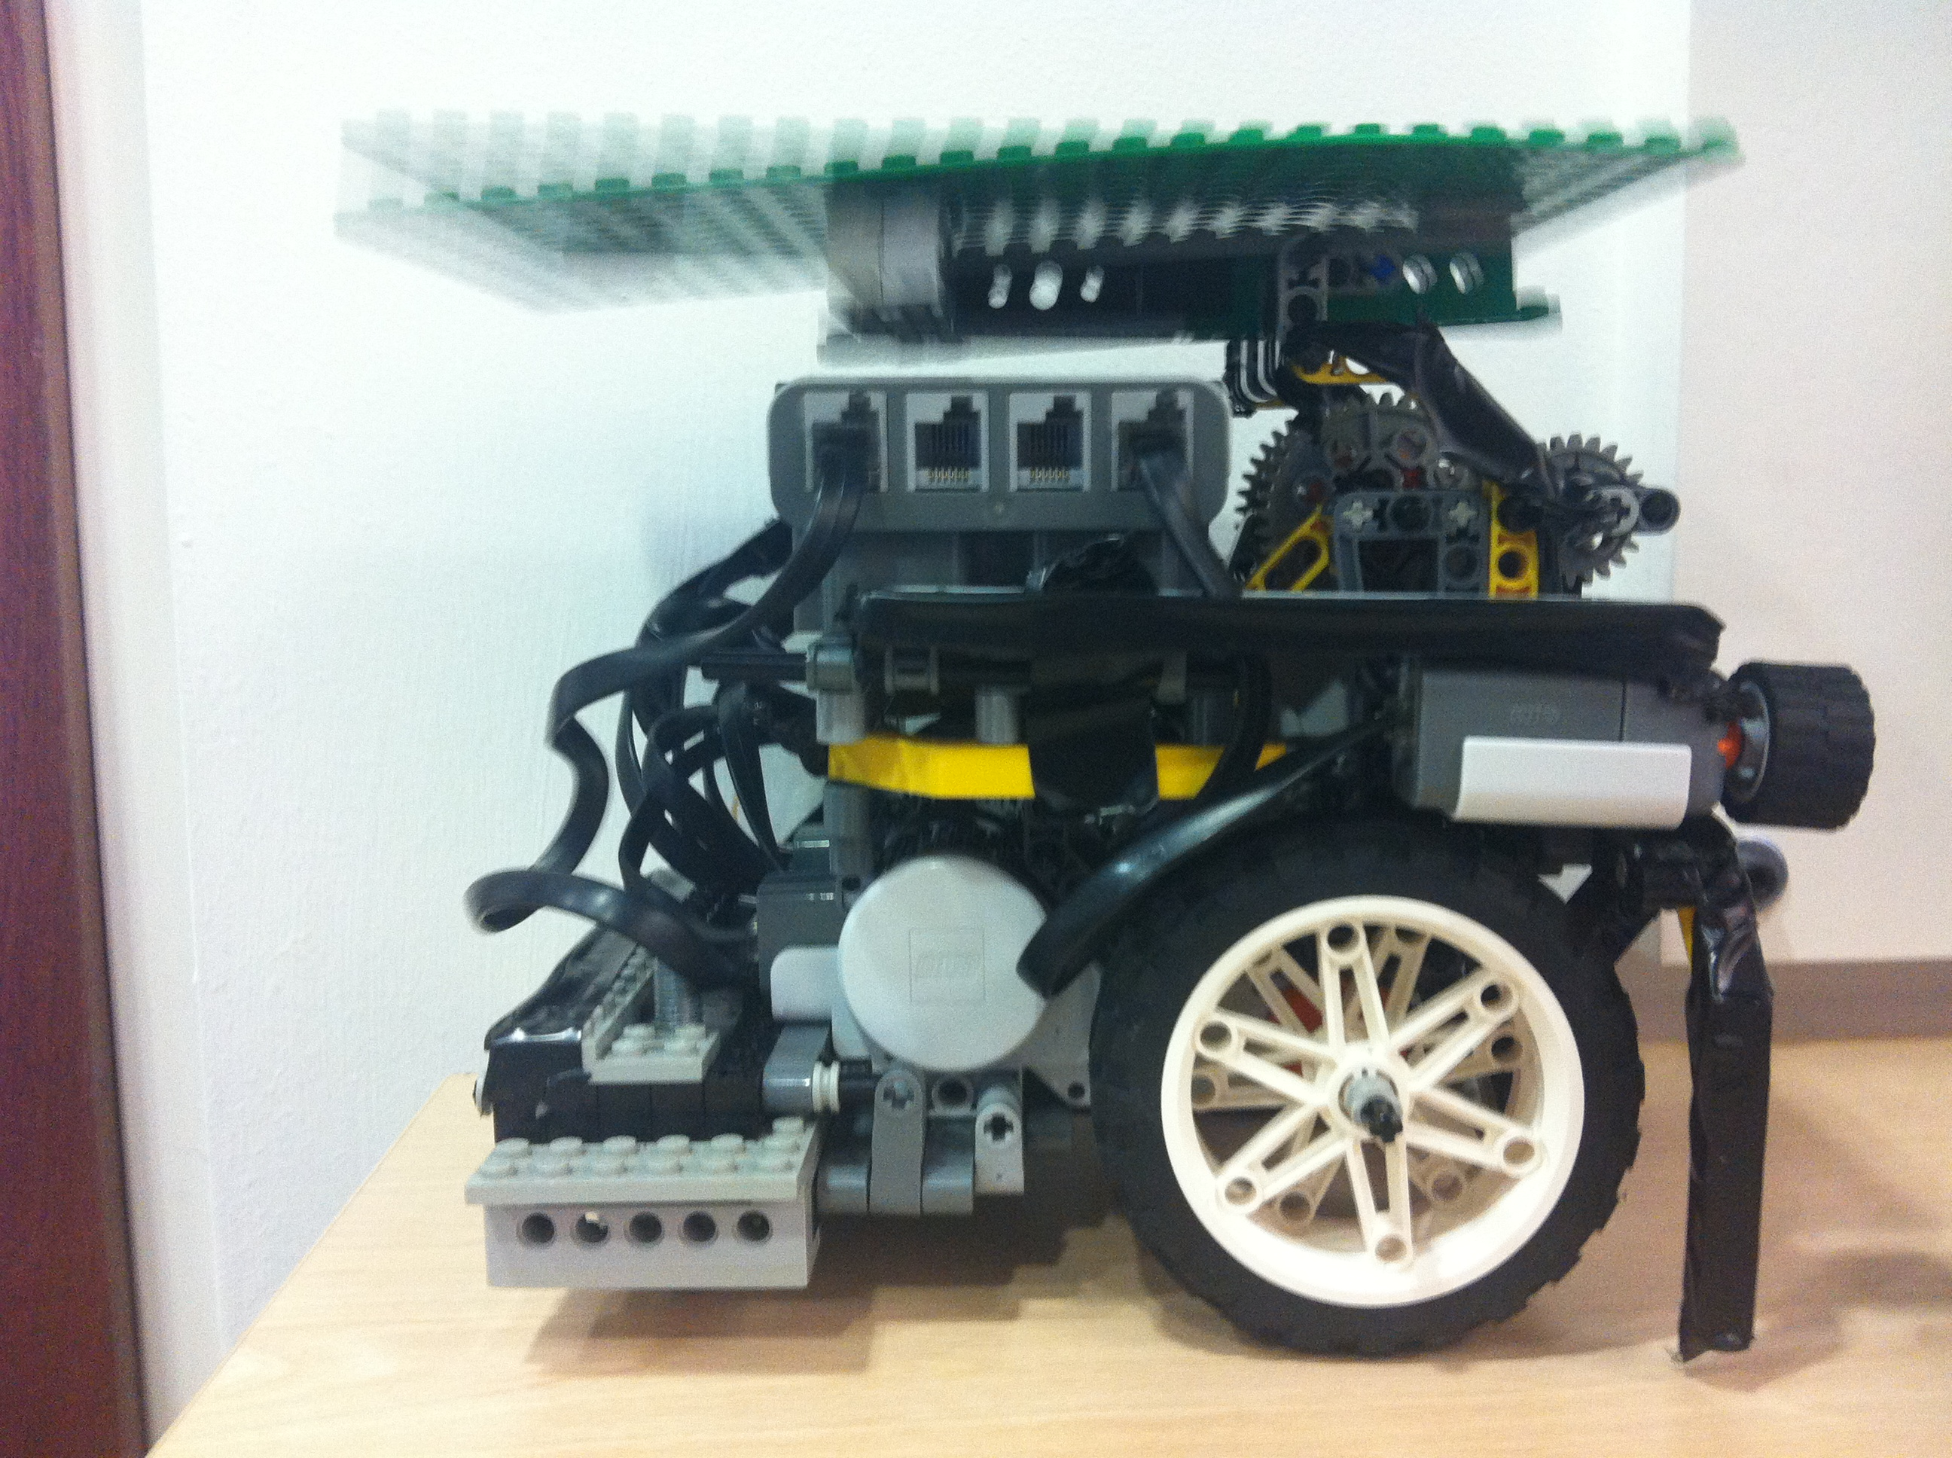
Floating Bracket

Slide 11
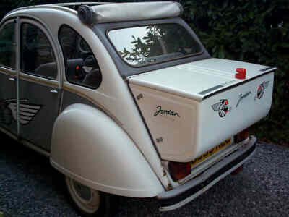
Length Issue

Slide 12
Roboto Carlos

Slide 13
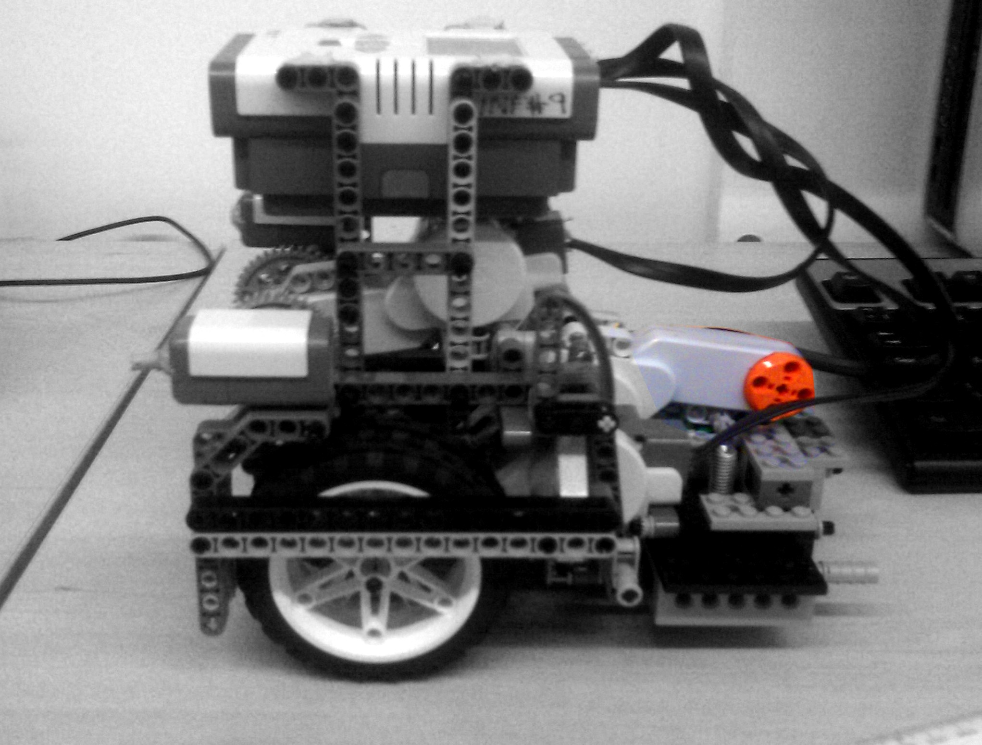

Slide 14
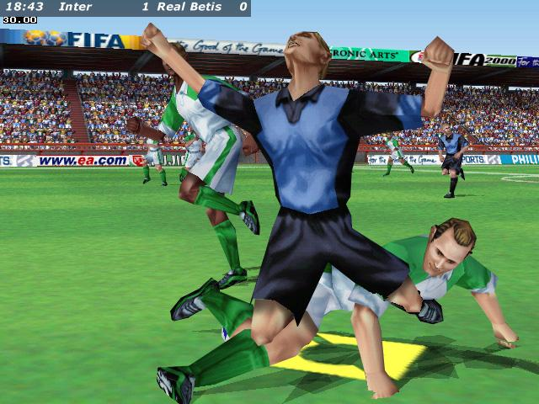

Slide 15
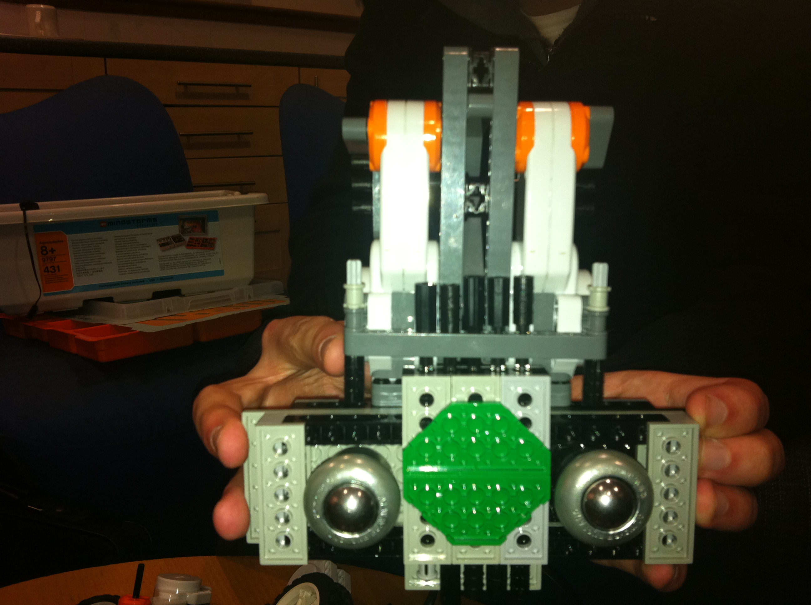

Slide 16
Roboto Carlos

Slide 17
Software

Slide 18
Software!

Slide 19
First Steps: Design

Slide 20
Time Compression
(200 hours * 11 people) / 5 minutes =
440 person-hours / minute
(that’s a compression rate of 0.23% - we seem to have produced only 265.9 KB * 0.23% = 626 bytes of useful information content)

Slide 21
First Steps: Communication
Two packet types: update wheel speeds & kick.
Wheel speeds updated every frame.
About ~100 ms PC-to-robot latency.

Slide 22
First Steps: Simulator
Simple physics
One keyboard controlled robot
One AI controlled robot

Slide 23
First Steps: GUI
Easy to add sliders to tweak parameters.
Easy to save/load parameters from files.
Essential for rapid prototyping.

Slide 24
Vision: Goal

Slide 25
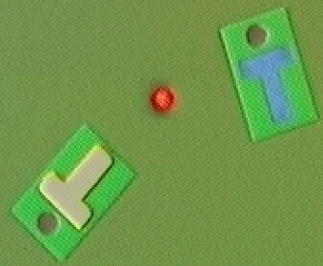
Vision: Goal
Original
Estimated Pose

Slide 26
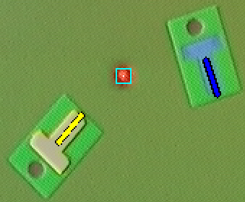
Vision: Goal
Original
Estimated Pose

Slide 27
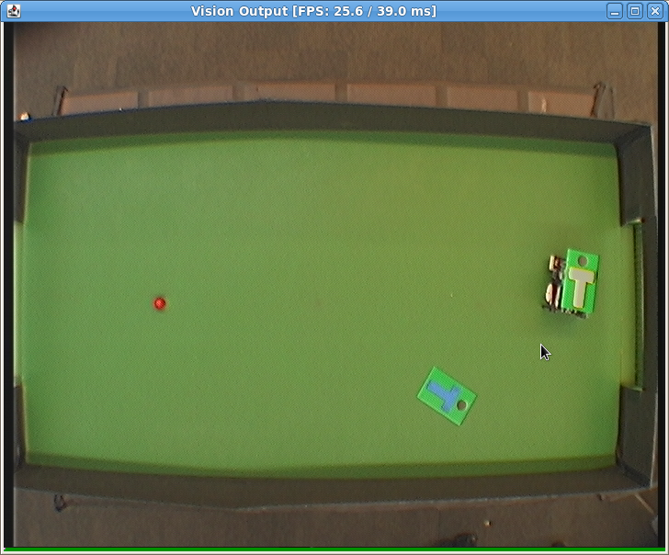
Vision: Detection - Raw

Slide 28
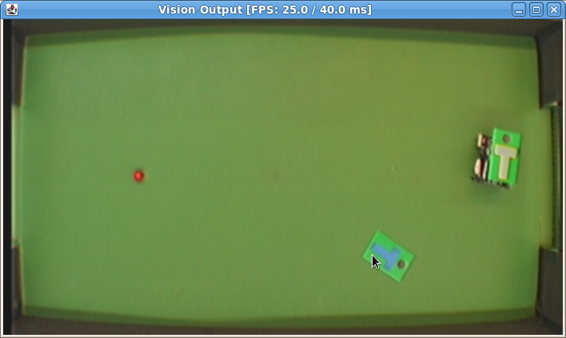
Vision: Detection - Preprocessed

Slide 29
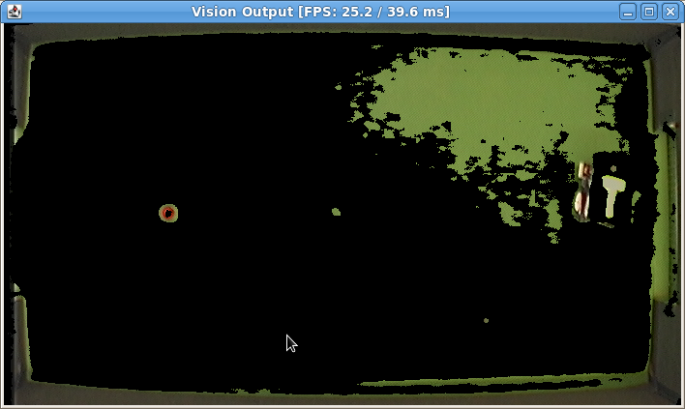
Vision: Detection – Hue

Slide 30
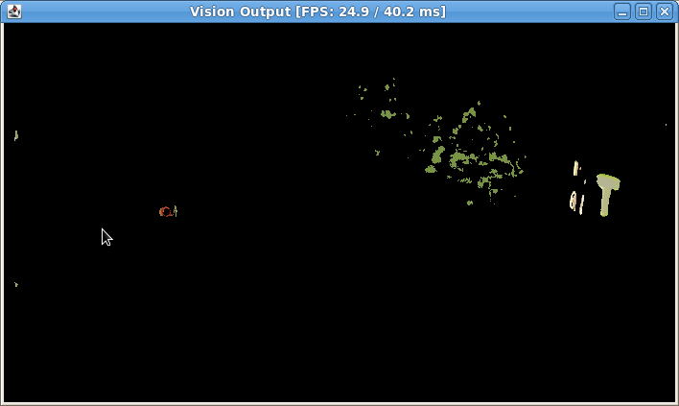
Vision: Detection – Hue + Value

Slide 31
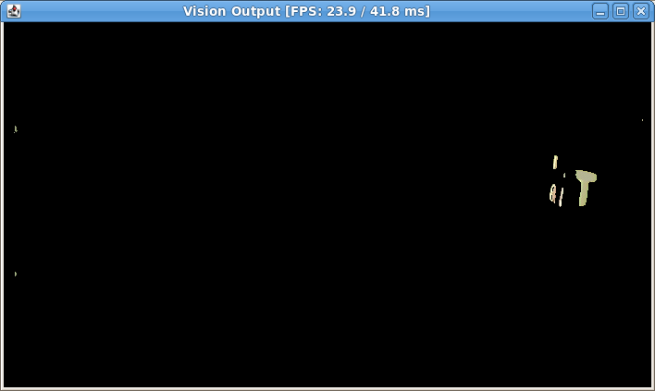
Vision: Detection – H, S and V

Slide 32
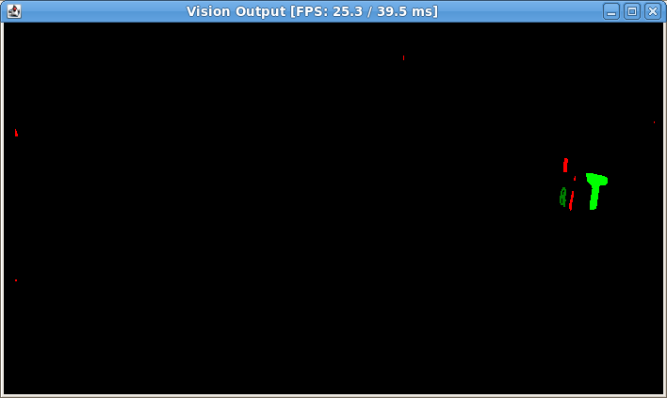
Vision: Detection – Shape Model

Slide 33
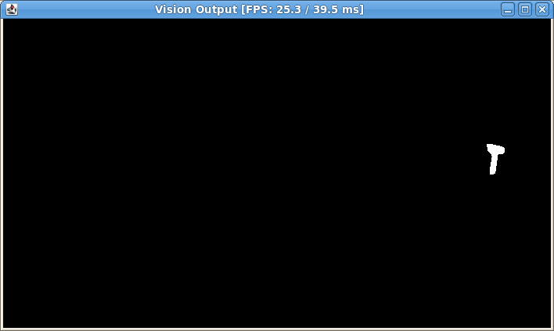
Vision: Detection – Final

Slide 34
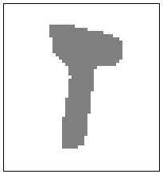
Vision: Pose Estimation
Estimate
Position (2-D vector)
Orientation (1 angle)

Slide 35
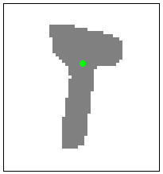
Vision: Pose Estimation
Position
Centroid – average pixel coordinates

Slide 36
Vision: Pose Estimation
Orientation
Find points on line:
Use black circle.
Use convexity defects.

Slide 37
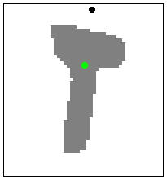
Vision: Pose Estimation
Orientation 1
Detect black circle.
Add black centroid to points.

Slide 38
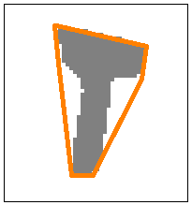
Vision: Pose Estimation
Orientation 2
Compute convex hull.

Slide 39
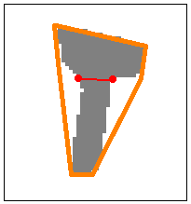
Vision: Pose Estimation
Orientation 2
Compute convex hull.
Find largest defects.

Slide 40
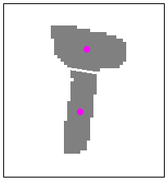
Vision: Pose Estimation
Orientation 2
Compute convex hull.
Find largest defects.
Split along defect line, add sub-centroids to the points.

Slide 41
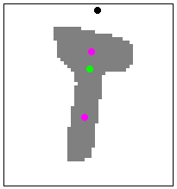
Vision: Pose Estimation
Orientation
Four points that should lie on line.
What method could we possibly use?

Slide 42
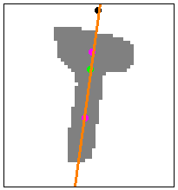
Vision: Pose Estimation
Orientation
Four points that should lie on line.
Linear regression, of course.

Slide 43
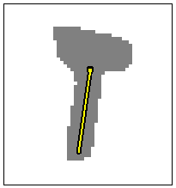
Vision: Pose Estimation
Ta-da!

Slide 44
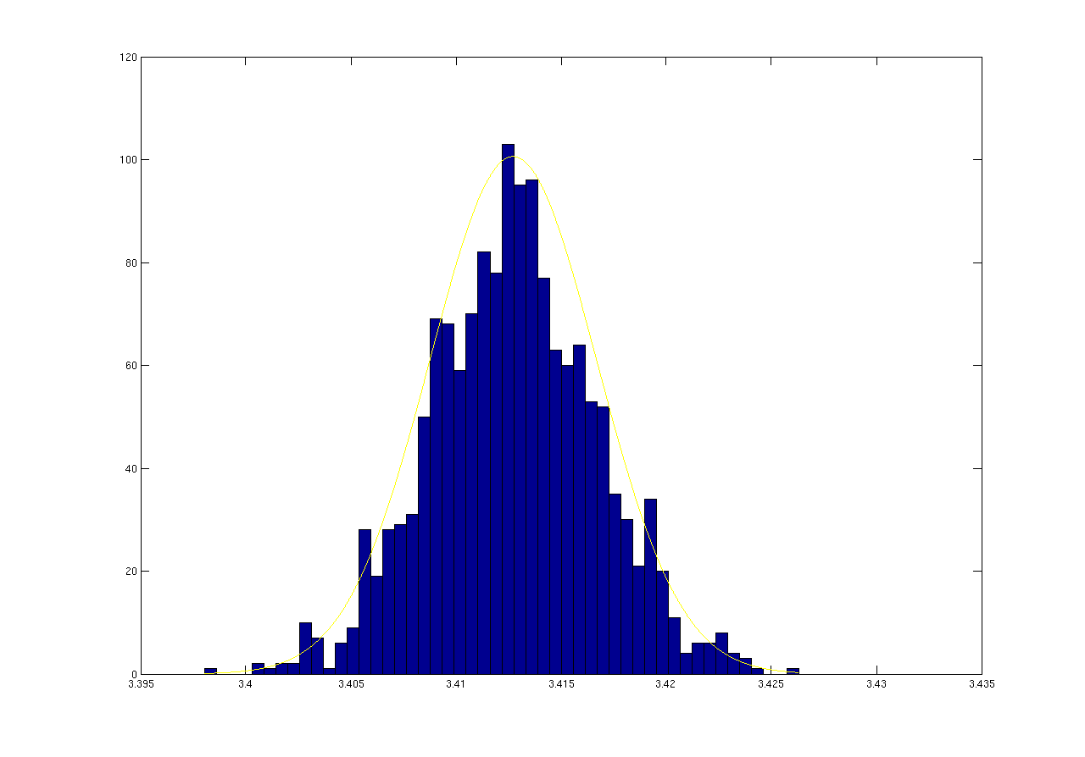
Vision: Estimation Error

Slide 45
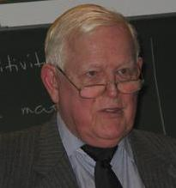
Vision: Pose Estimation
Kalman Filters
Feed measurements into a Kalman filter.
Use linear & angular velocity.

Slide 46
Vision: Pose Estimation
Kalman Filters
Feed measurements into a Kalman filter.
Use linear & angular velocity.
Mr Kalman – most representative figure I could think of.

Slide 47
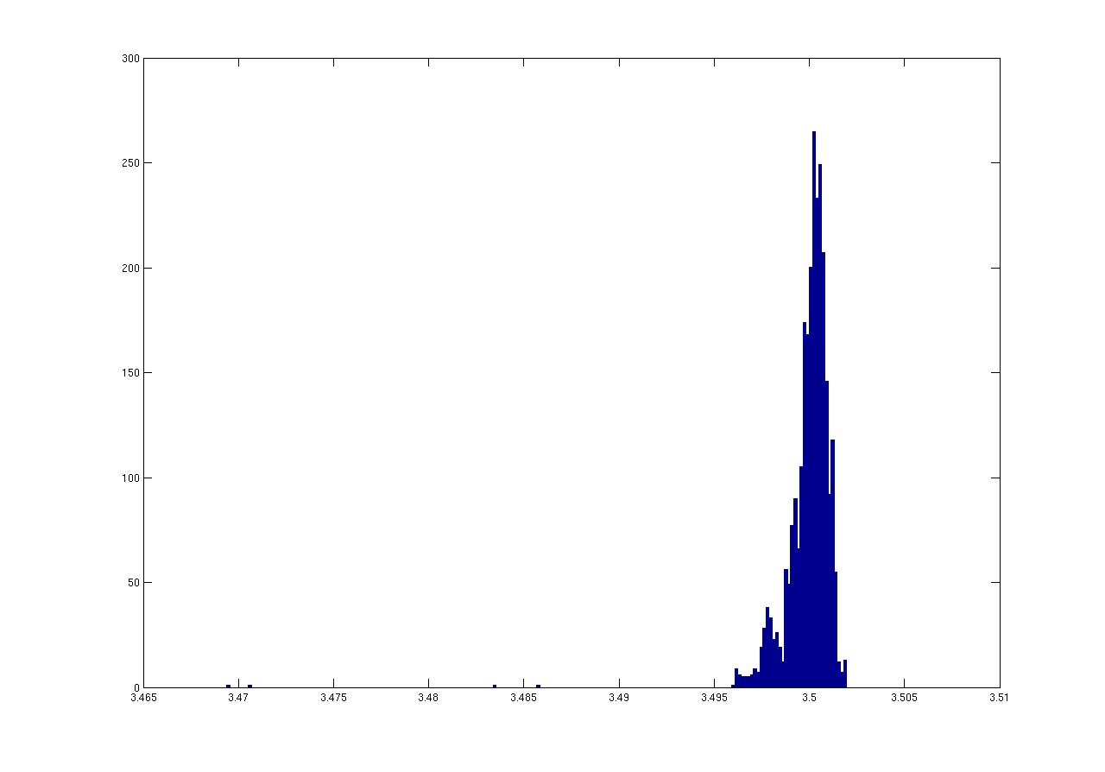
Vision: Error with Kalman Filters

Slide 48
Vision: In the End
Fast: ~25 FPS, limited by camera.

Slide 49
Vision: In the End
Fast: ~25 FPS, limited by camera.
Precise: ~2 degrees orientation error.

Slide 50
Vision: In the End
Fast: ~25 FPS, limited by camera.
Precise: ~2 degrees orientation error.
Robust: multiple methods, one can fail – still works.

Slide 51
Robot Control

Slide 52
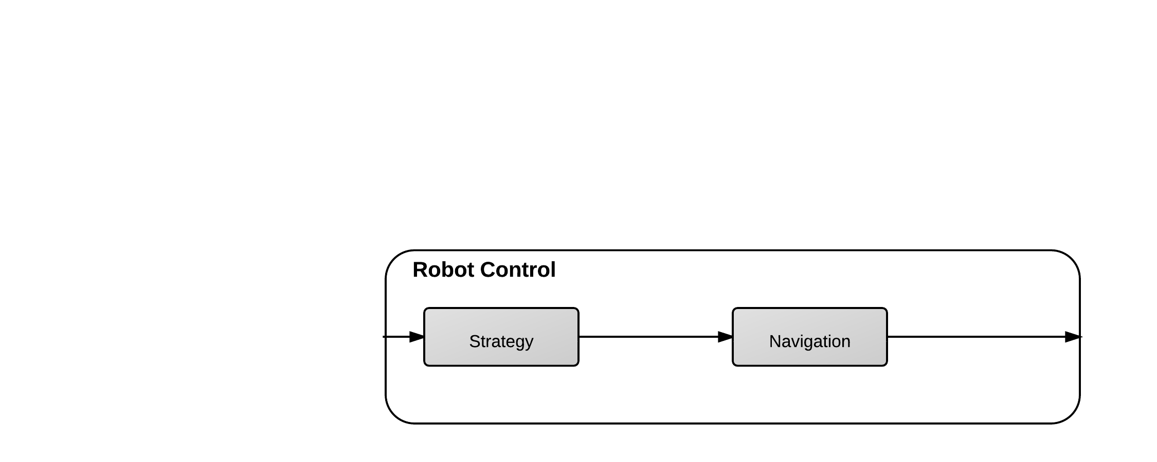
Robot Control

Slide 53
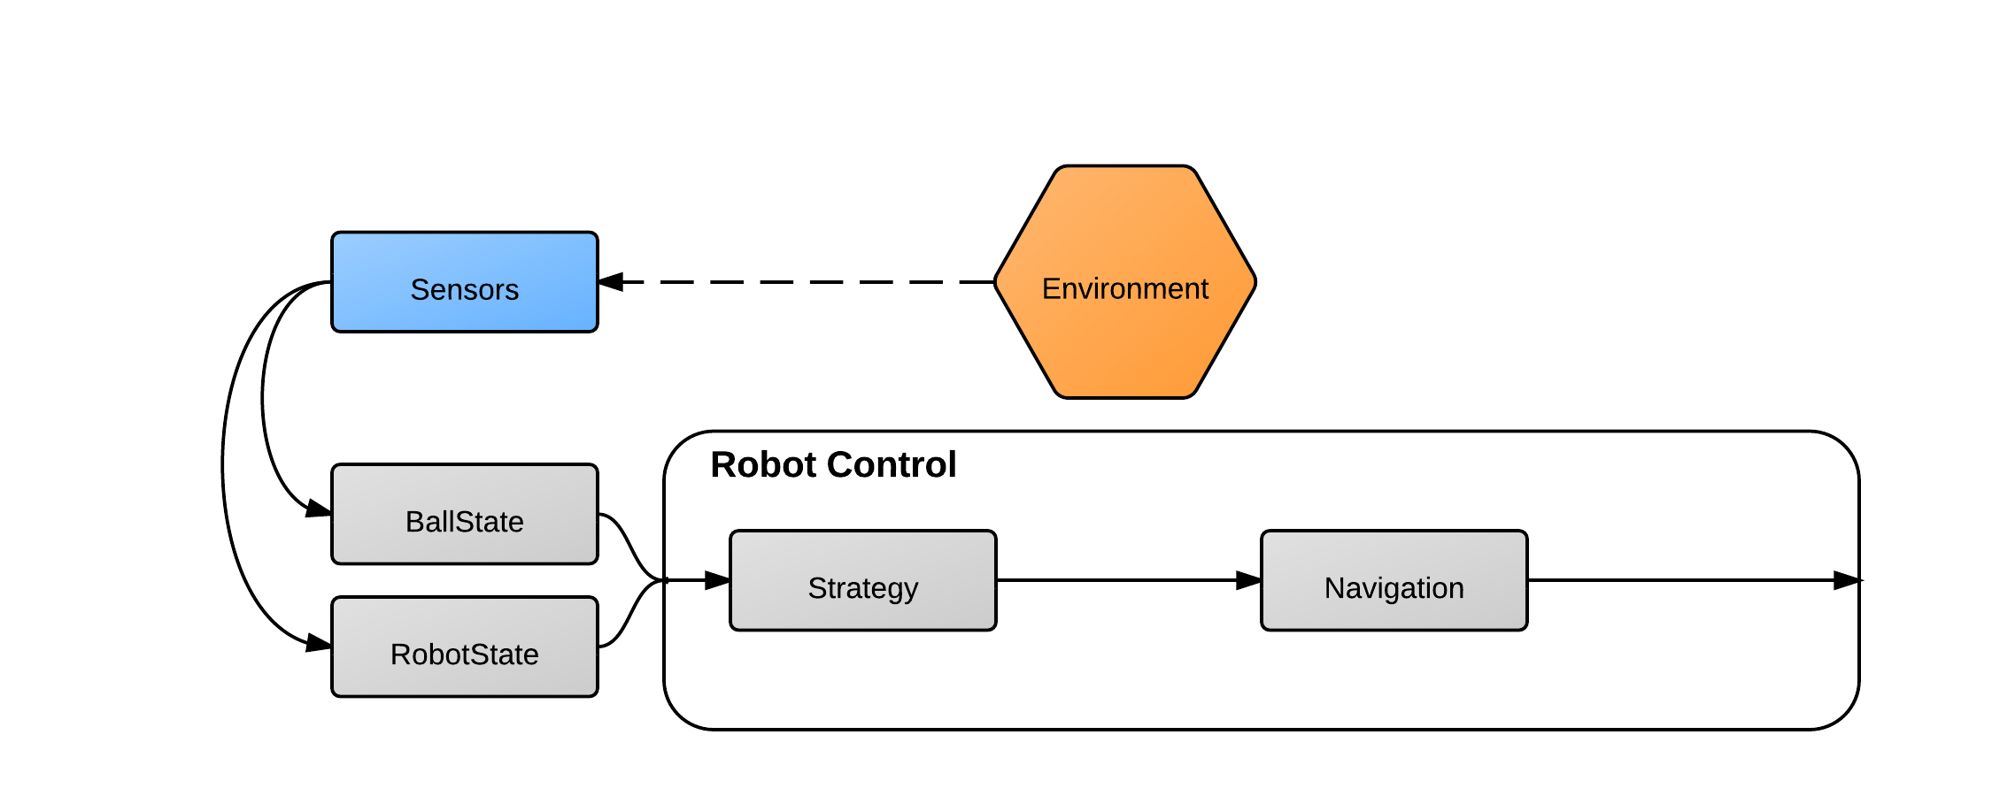
Robot Control

Slide 54
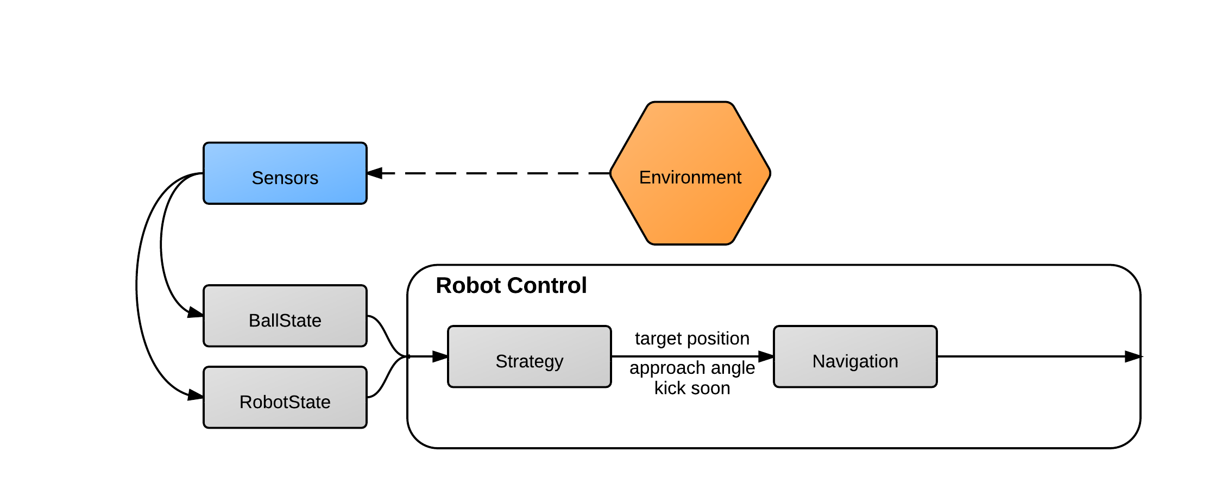
Robot Control

Slide 55
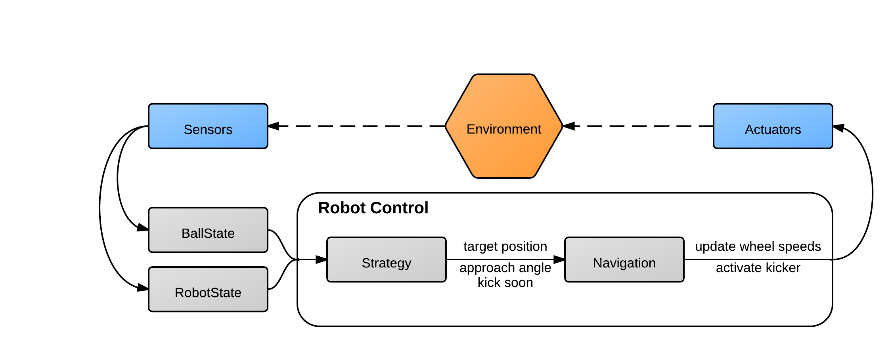
Robot Control

Slide 56
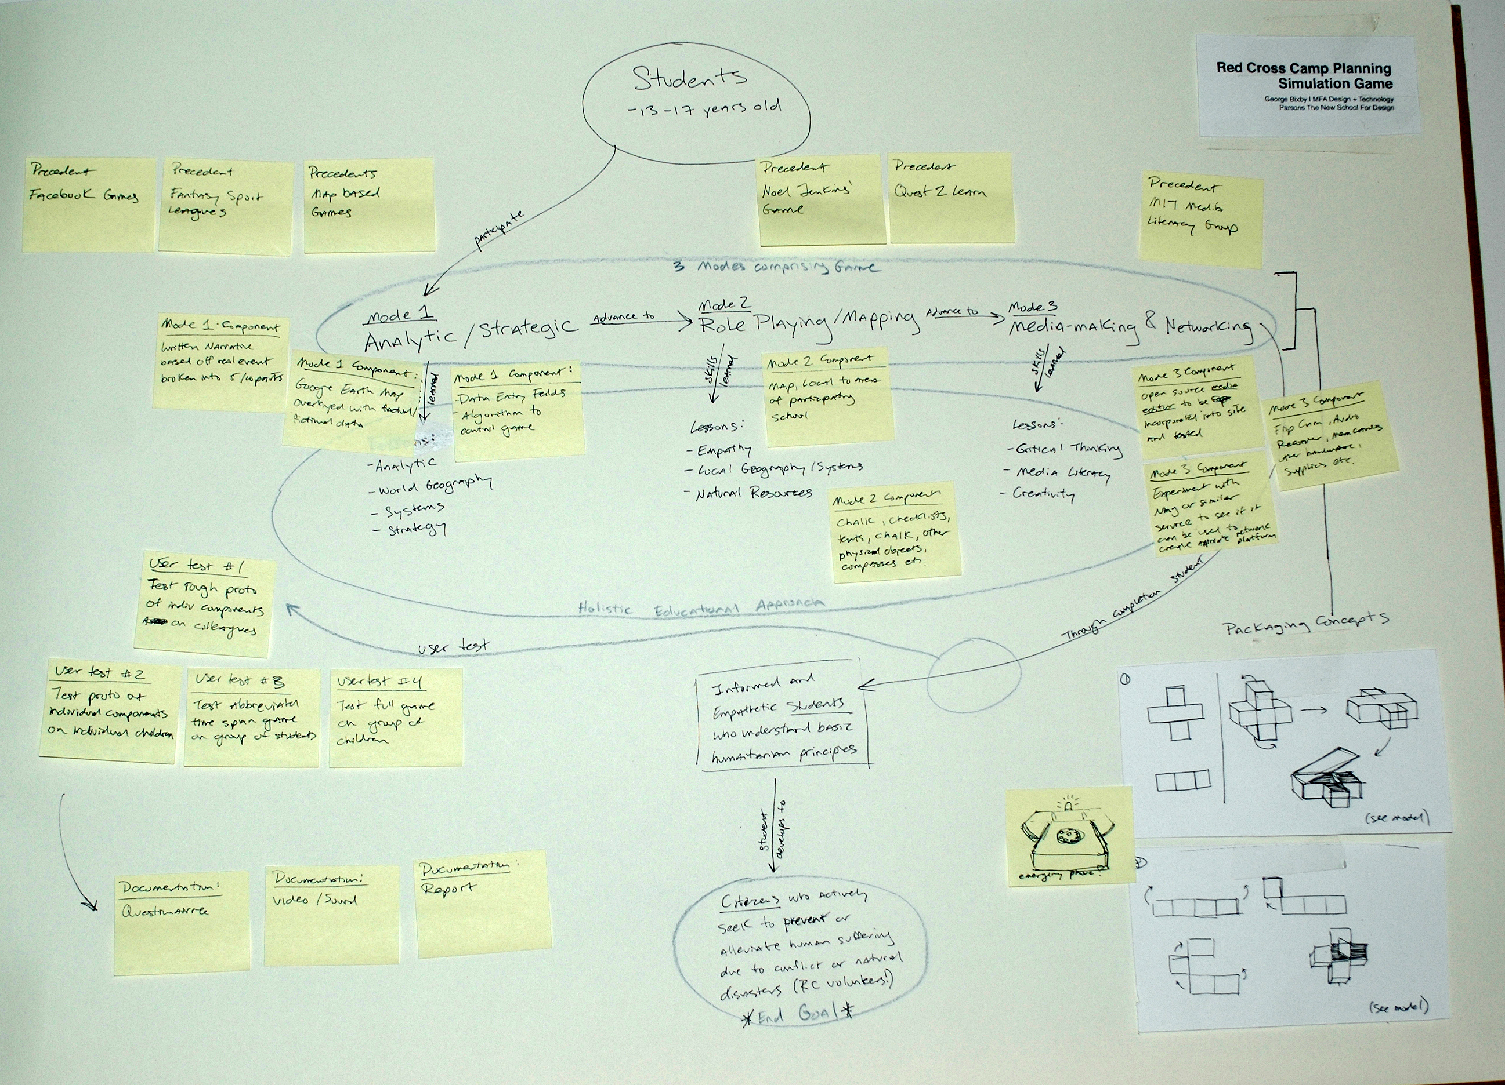
Robot Control
Strategy
Originally symbolic AI - states, actions, plans etc.

Slide 57
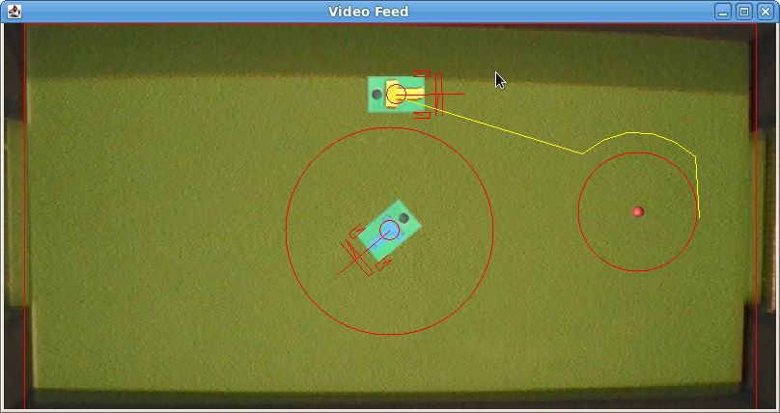
Robot Control
Strategy
Originally symbolic AI - states, actions, plans etc.
Great with milestones.
Milestone 3

Slide 58
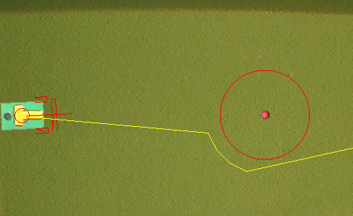
Robot Control
Strategy
Originally symbolic AI - states, actions, plans etc.
Great with milestones.
Games – not as good.

Slide 59
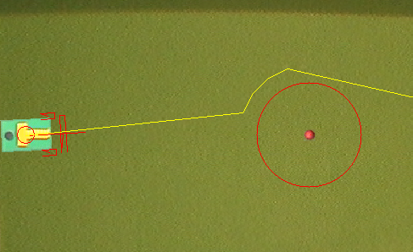
Robot Control
Strategy
Originally symbolic AI - states, actions, plans etc.
Great with milestones.
Games – not as good.
Problem: condition boundaries.

Slide 60
Robot Control
Strategy
On-line environment – just doesn’t work.

Slide 61
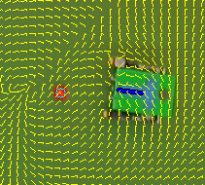
Robot Control
Strategy
On-line environment – just doesn’t work.
Redesigned as vector field.
Pure function – no state, no binary tests.

Slide 62
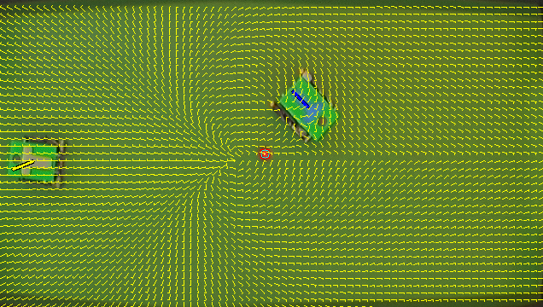
Robot Control

Slide 63
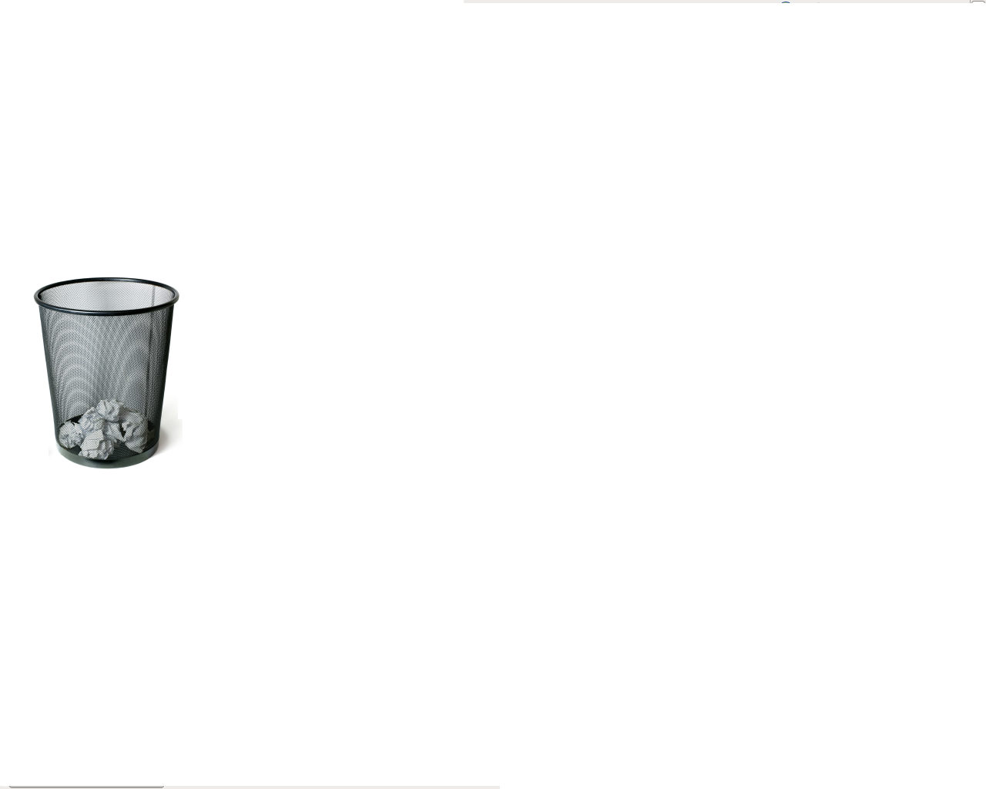
Robot Control: Lesson

Slide 64
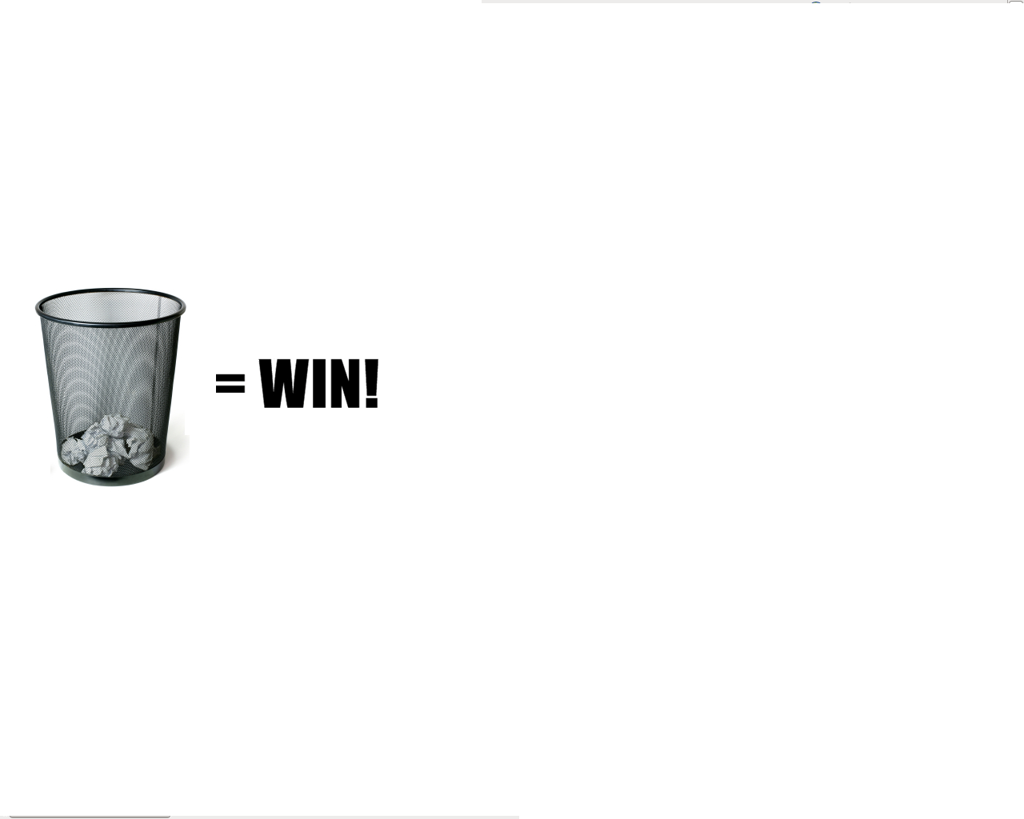
Robot Control: Lesson
Sometimes, throwing away work is the most productive thing you can do.

Slide 65


