Slide 1
02-601: Programming for Scientists
GoMol_3D Protein Analysis and Visualization Tool
Darin Boyes, Minhyek Jeon , Shivank Sadasivan, Tyler Katz,

Slide 2
CONTENTS
01_ Introduction to GoMol
02_ Model Architecture
03_ Program Simulation
04_ Conclusion

Slide 3
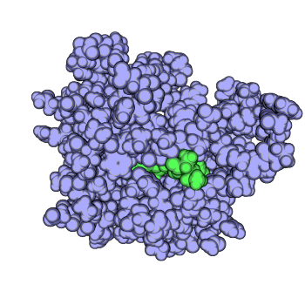
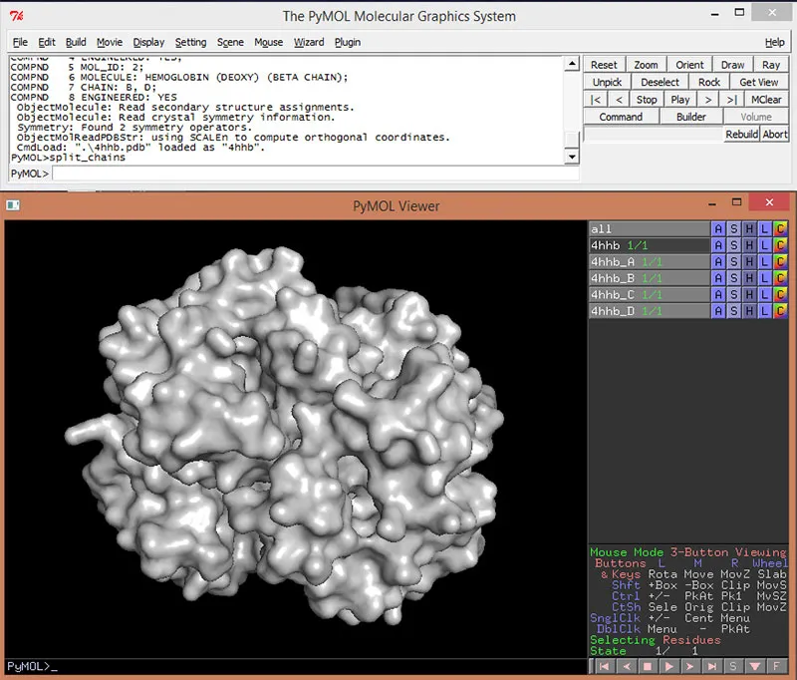
01_ Introduction to GoMol
“GoMol : A 3D Protein Analysis and Visualization Tool ”
Proteins are an integral part of all biological systems
Create a tool to compare sequence and 3D structure of protein
Develop the tool by mostly using Go programming language
02-601: Programming for Scientists
Notes:
꼭 바이오뱅크가 아니더라도 개별

Slide 4

02_ Model Architecture
RCSB PDB
“Needleman Wunsch Algorithm”
Parser
“ Kabsch Algorithm”
Sequence
Alignment
3D Structure Alignment
Visualization
02-601: Programming for Scientists
Notes:
꼭 바이오뱅크가 아니더라도 개별

Slide 5
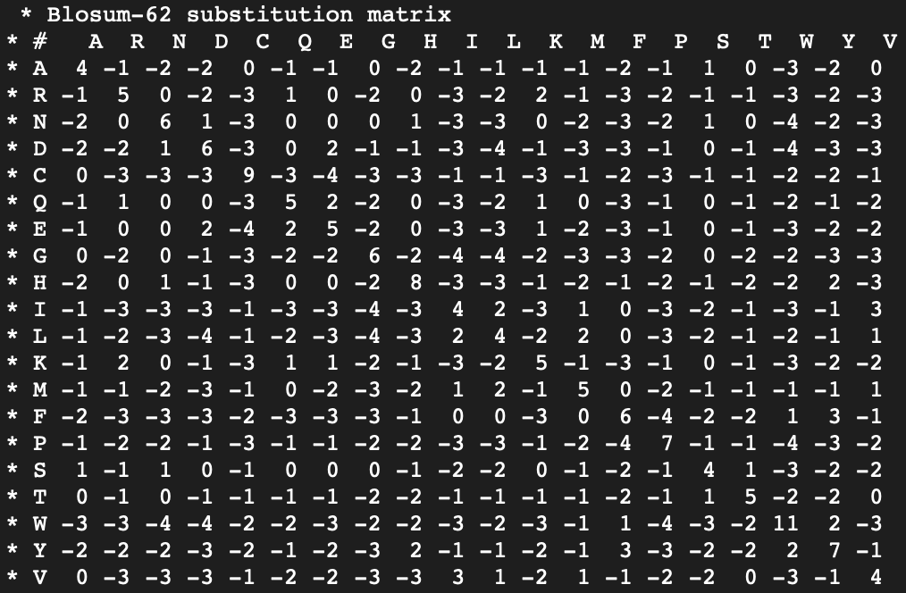
02_ Model Architecture
Sequence Alignment
To identify sequence of similarities and differences
Similar length and significantly similar (evolutionary wise)
Global Alignment
Needleman Wunsch Algorithm ( Dynamic Programming)
BLOSUM62 (Substitution Matrix)
02-601: Programming for Scientists
Notes:
꼭 바이오뱅크가 아니더라도 개별

Slide 6
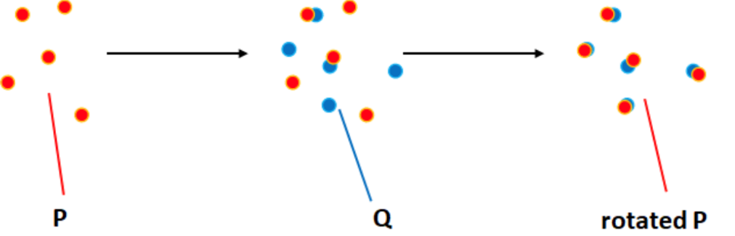
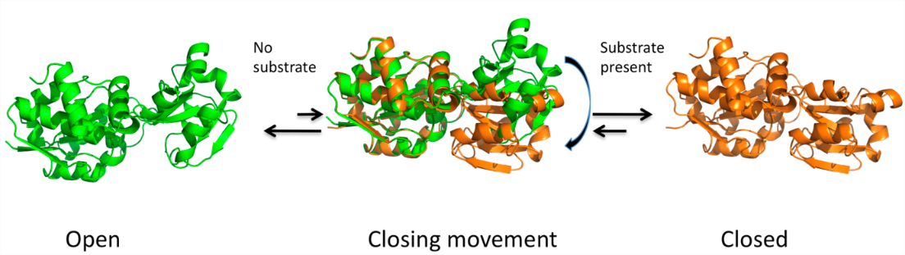
02_ Model Architecture
3D Alignment
「Kabsch Algorithm」
「Applications of Kabsch」
Comparison of two similar proteins by RMSD
Calculates optimal rotation matrix to minimize RMSD
Drug Discovery/Molecular Dynamics - Analysis of conformational states
Evolutionary Biology - structural comparison gives insight to conservation
02-601: Programming for Scientists
Notes:
꼭 바이오뱅크가 아니더라도 개별

Slide 7
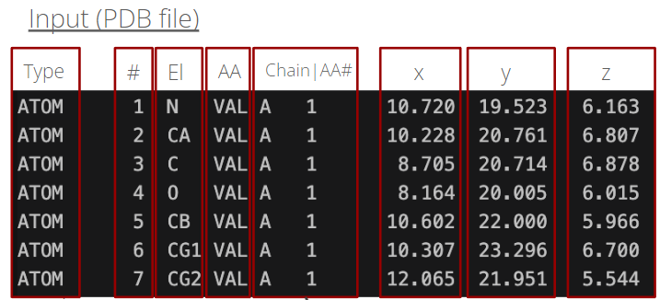
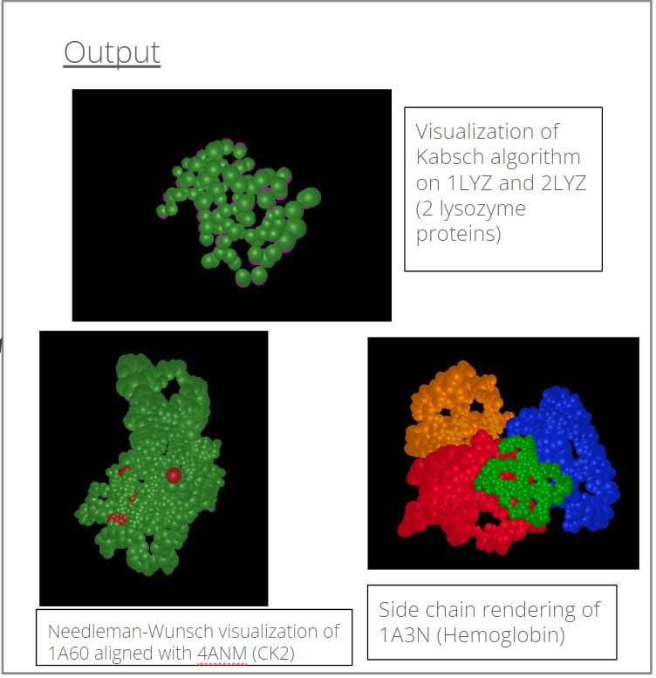
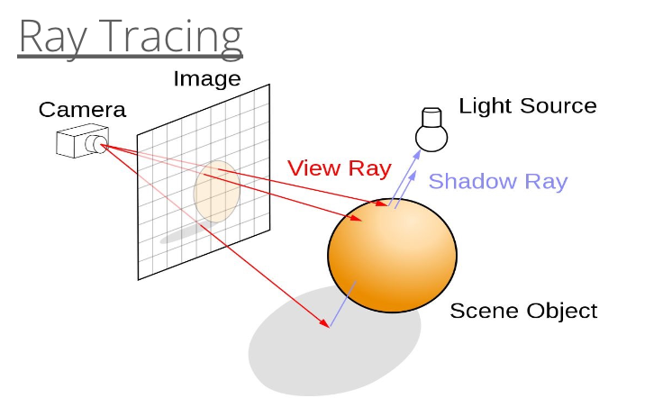
02_ Model Architecture
3D Visualization
02-601: Programming for Scientists
Notes:
꼭 바이오뱅크가 아니더라도 개별

Slide 8
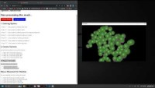
03_Program Simulation
Notes:
꼭 바이오뱅크가 아니더라도 개별

Slide 9
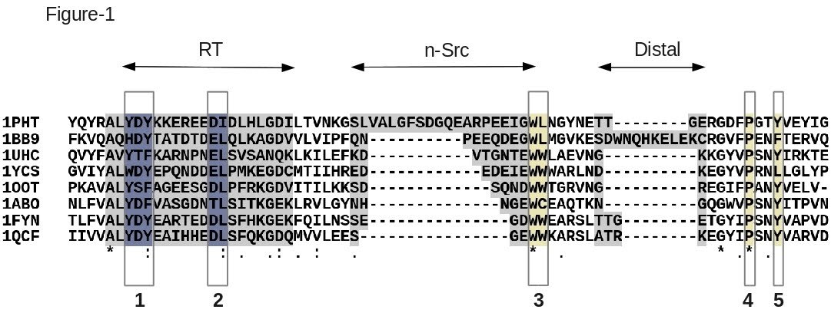
04_ Conclusion
Limitation & Future Directions
「Possible Improvements in Program 」
「Limitation of our Program」
Gap Costs
Leverage sequence alignment results to broaden potential inputs for Kabsch
Potentially include information about ligand binding sites from PDB
Slow Speed, pixel level
Protein Multiple Sequence Alignment Not possible
No Universal Parser
No Local alignment
02-601: Programming for Scientists
Notes:
꼭 바이오뱅크가 아니더라도 개별

Slide 10
04_ Conclusion
References
Libretexts. (2021, March 6). 9.5: Blosum62 scoring matrix for amino acid substitutions. Biology LibreTexts. https://bio.libretexts.org/Bookshelves/Cell_and_Molecular_Biology/Book%3A_Investigations_in_Molecular_Cell_Biology_(O%27Connor)/09%3A_Protein_Conservation/9.05%3A_BLOSUM62_scoring_matrix_for_amino_acid_substitutions
Libretexts. (2021b, March 17). 3.3: Global alignment vs. local alignment vs. semi-global alignment. Biology LibreTexts. https://bio.libretexts.org/Bookshelves/Computational_Biology/Book%3A_Computational_Biology_-_Genomes_Networks_and_Evolution_(Kellis_et_al.)/03%3A_Rapid_Sequence_Alignment_and_Database_Search/3.03%3A_Global_alignment_vs._Local_alignment_vs._Semi-global_alignment
NandiniUmbarkar. (2020, October 12). Needleman-Wunsch algorithm. Medium. https://medium.com/@nandiniumbarkar/needleman-wunsch-algorithm-7bba68b510db
Phong, B.. (1975, June 1). Illumination for computer generated pictures. Communications of the ACM. https://dl.acm.org/doi/10.1145/360825.360839
Compeau, P. (2022). Protein Structure Comparison. Biological Modeling. Retrieved December 3, 2023, from https://biologicalmodeling.org/coronavirus/accuracy
Kabsch algorithm. (2023). Wikipedia. Retrieved December 3, 2023, from https://en.wikipedia.org/wiki/Kabsch_algorithm
Vertrees, J. (2019, April 18). Kabsch. PyMOLWiki. Retrieved December 3, 2023, from https://pymolwiki.org/index.php/Kabsch
02-601: Programming for Scientists
Notes:
꼭 바이오뱅크가 아니더라도 개별

Slide 11
Thank you

