Slide 1
Predicting the position of nba players
David Brehm
DSC 530

Slide 2
Objective
Using 2020 NBA player data, I plan on investigating correlations between their per game stats and will build a regression model to see if these variables can predict a player’s position.

Slide 3
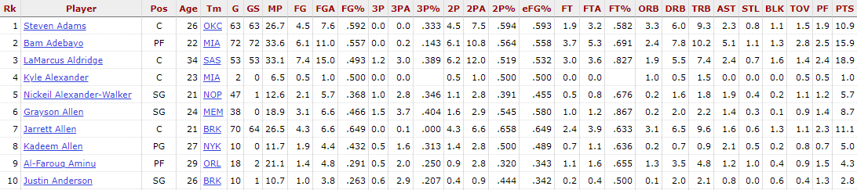
Data overview
This project is based on the 2020 NBA basic box score stats per game.
The data was obtained from basketball-reference. Below is how the data appears on the site.
The data was filtered down to a subset of players who started at least half of the season (GS of at least 36). I believed this would improve the observed relationships in the data.
These variables all have outliers which will be shown in the following slides, however from background knowledge on this data, these values are the averages from multiple games tracked by multiple statisticians. The outlier data is assuredly correct.

Slide 4
Feature selection
The initial dataset contained 29 variables.
For attempting to model player position, I chose seven predictors. These are what I believed would best represent a player’s role in their team.
Predictors
3P – Three pointers made per game
TRB – Total rebounds per game
AST – Assists per game
STL – Steals per game
BLK – Blocks per game
TOV – Turnovers per game
PTS – Points per game

Slide 5
Predictor variables summary

Slide 6
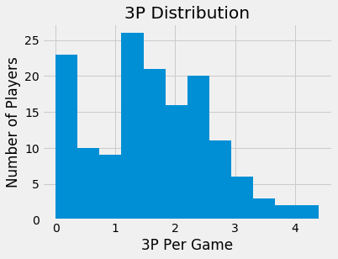
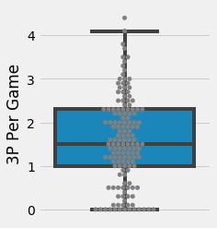
Three pointers per game
Mean: 1.58
Std: 1.00
Min: 0
Max: 4.4
Mode: 0
IQR: [1, 2.3]
Tail: Right

Slide 7
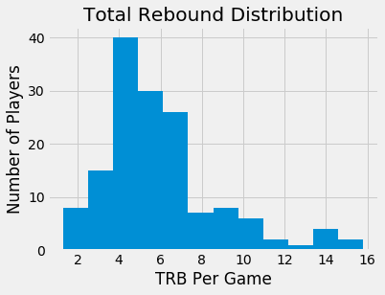
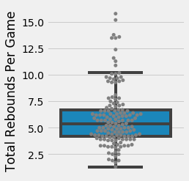
Total rebounds per game
Mean: 5.95
Std: 2.74
Min: 1.3
Max: 15.8
Mode: 3.9, 5.7
IQR: [4.2, 6.7]
Tail: Right

Slide 8
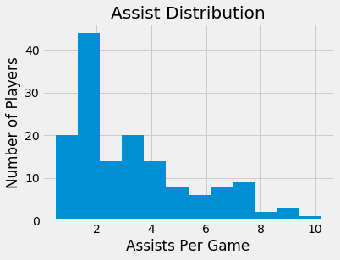
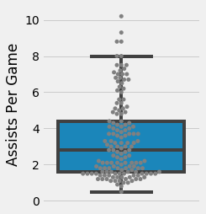
Assists per game
Mean: 3.38
Std: 2.17
Min: 0.5
Max: 10.2
Mode: 1.5
IQR: [1.6, 4.4]
Tail: Right

Slide 9
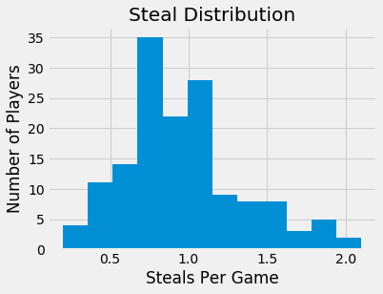
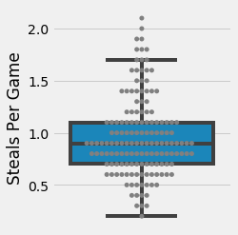
Steals per game
Mean: 0.96
Std: 0.38
Min: 0.2
Max: 2.1
Mode: 0.9
IQR: [0.7, 1.1]
Tail: Right

Slide 10
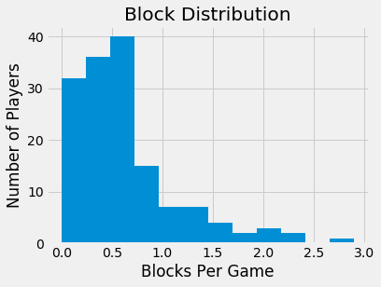
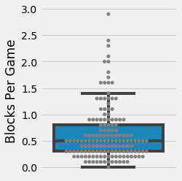
Blocks per game
Mean: 0.62
Std: 0.52
Min: 0
Max: 2.9
Mode: 0.3, 0.5
IQR: [0.3, 0.8]
Tail: Right

Slide 11
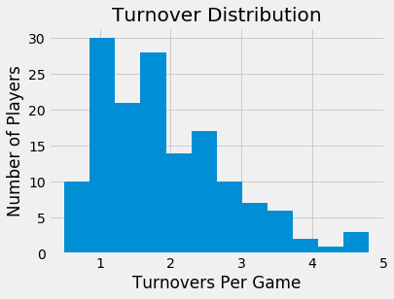
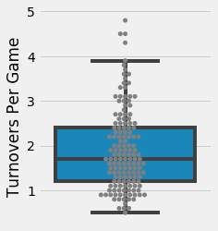
Turnovers per game
Mean: 1.91
Std: 0.91
Min: 0.5
Max: 4.8
Mode: 0.9
IQR: [1.2, 2.4]
Tail: Right

Slide 12
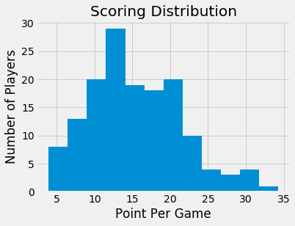
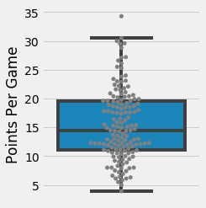
Points per game
Mean: 15.45
Std: 6.13
Min: 3.9
Max: 34.3
Mode: 17.6, 18.5, 12.3, 8.0, 19.6,
12.1, 12.2
IQR: [11.1, 19.6]
Tail: Right

Slide 13
Additional Plots and Distributions

Slide 14
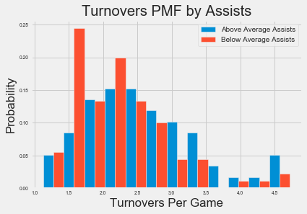
Turnover Scenario – High and Low Assists
To the right is a PMF of player turnovers per game by high and low assist marks. This was split by someone having at least average assists and below average assists.
The general distributions appear to be similar here, however we can see that the highest turnover bins are more likely to have higher assist players. Similarly, the lowest turnover bins are more likely to players with below average assists.

Slide 15
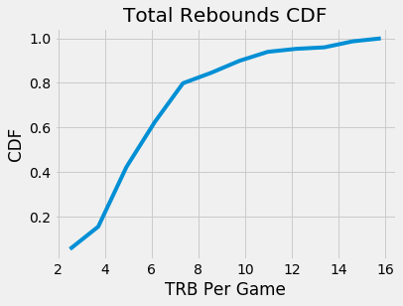
Total rebounds CDF
To the right is a CDF of player total rebounds per game.
We can see a sharp increase until around 7.5 TRB at 80% probability.
Ideally, this clear change in slope indicates a difference between player positions.

Slide 16
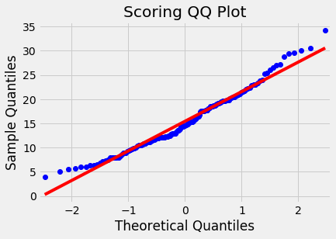
Points Per Game Normal Probability
To test whether the points per game data is normally distributed, we can use a QQ Plot (Quantile-to-Quantile).
If the dataset is normally distributed, it would appear as a straight line.
The points per game data appears to be close to normally distributed, but the points skew upwards and the ends. This would indicate that the distribution is slightly right skewed, which we could observe from the histogram earlier as well.

Slide 17
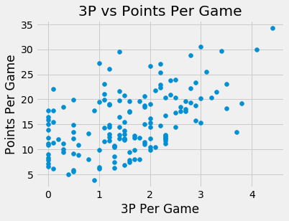
Comparing Scoring and three pointers
To the right is a scatter plot of 3P and Points Per Game.
From the graph, there appears to be a moderate positive correlation between the two variables. This would make sense as 3P directly contributes to a player’s overall points.
The covariance between 3P and Points Per Game is 3.17.
The Pearson correlation coefficient is 0.517 with a p-value of 1.54E-11. This implies that there is a moderate positive correlation and that it is statistically significant.

Slide 18
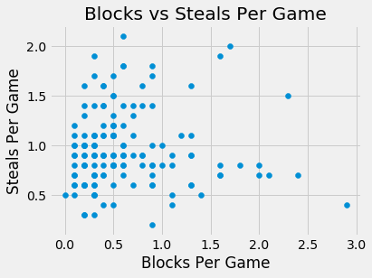
Comparing Blocks and Steals per game
To the right is a scatter plot of the defensive box score stats, Blocks and Steals Per Game.
From the graph, there doesn’t appear to be much of a relationship between these variables
The covariance between blocks and steals per game is 0.0016.
The Pearson correlation coefficient is 0.008 with a p-value of 0.922. This implies that there is minimal correlation and that it is not statistically significant.

Slide 19
Testing Correlation

Slide 20
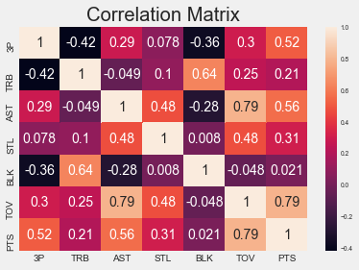
Assists and total rebounds correlation
Looking at the overall correlation matrix to the right, I decided to test the correlation between assists and total rebounds.
The null hypothesis was that there is no correlation between assists and total rebounds.
We test this by shuffling the assist values 1000 times and calculating these simulated correlations.
Below is a table of the statistically significant min and max simulated correlations. There appears to be a decently large range here. I’m not sure how to interpret what that means.
 | Pearson Correlation Coefficient | P-value
Min | -0.252 | 0.002
Max | 0.275 | 0.001

Slide 21
Regression model to predict position

Slide 22
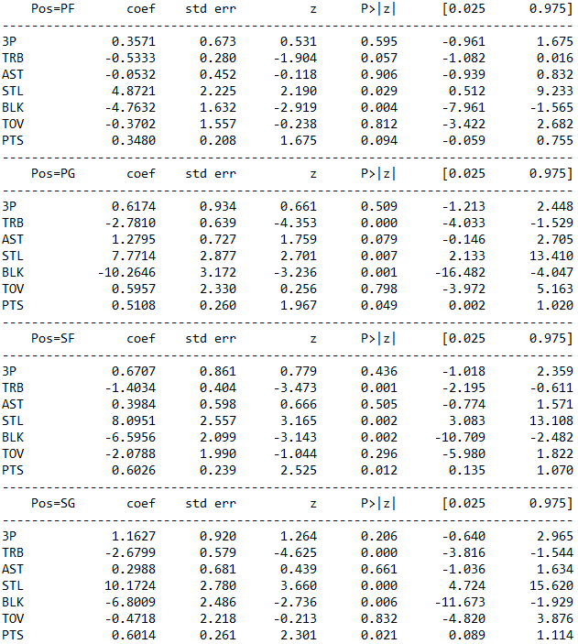
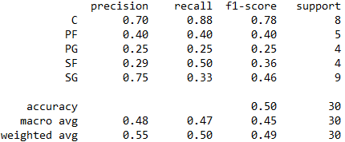
Regression Models
To the right is a multinominal logistic regression output. It appears that steals, blocks, and total rebounds are the strongest coefficients for every position.
Below is the classification report from predicting player position from a logistic regression. The overall accuracy here is only 50%.

