Slide 1
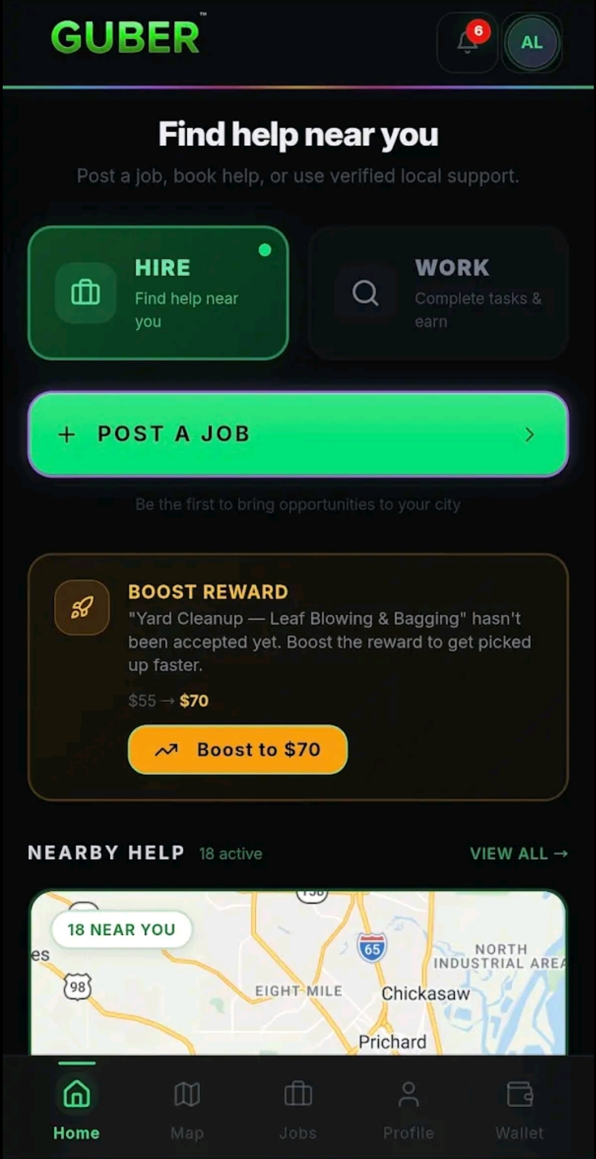
PRIVATE INVESTOR BRIEF · 2026
GUBER
Find Work. Hire Help. Verify Things.
Create Value In Yourself.
A trust-enforced platform connecting people who need work, help, or verification with verified locals who can deliver it. Live on web and Google Play.
● Live on Android
● Web App Live
● Stripe Connect
Confidential · GUBER Global LLC · guberapp.com · Guberapp.global@gmail.com
1

Slide 2
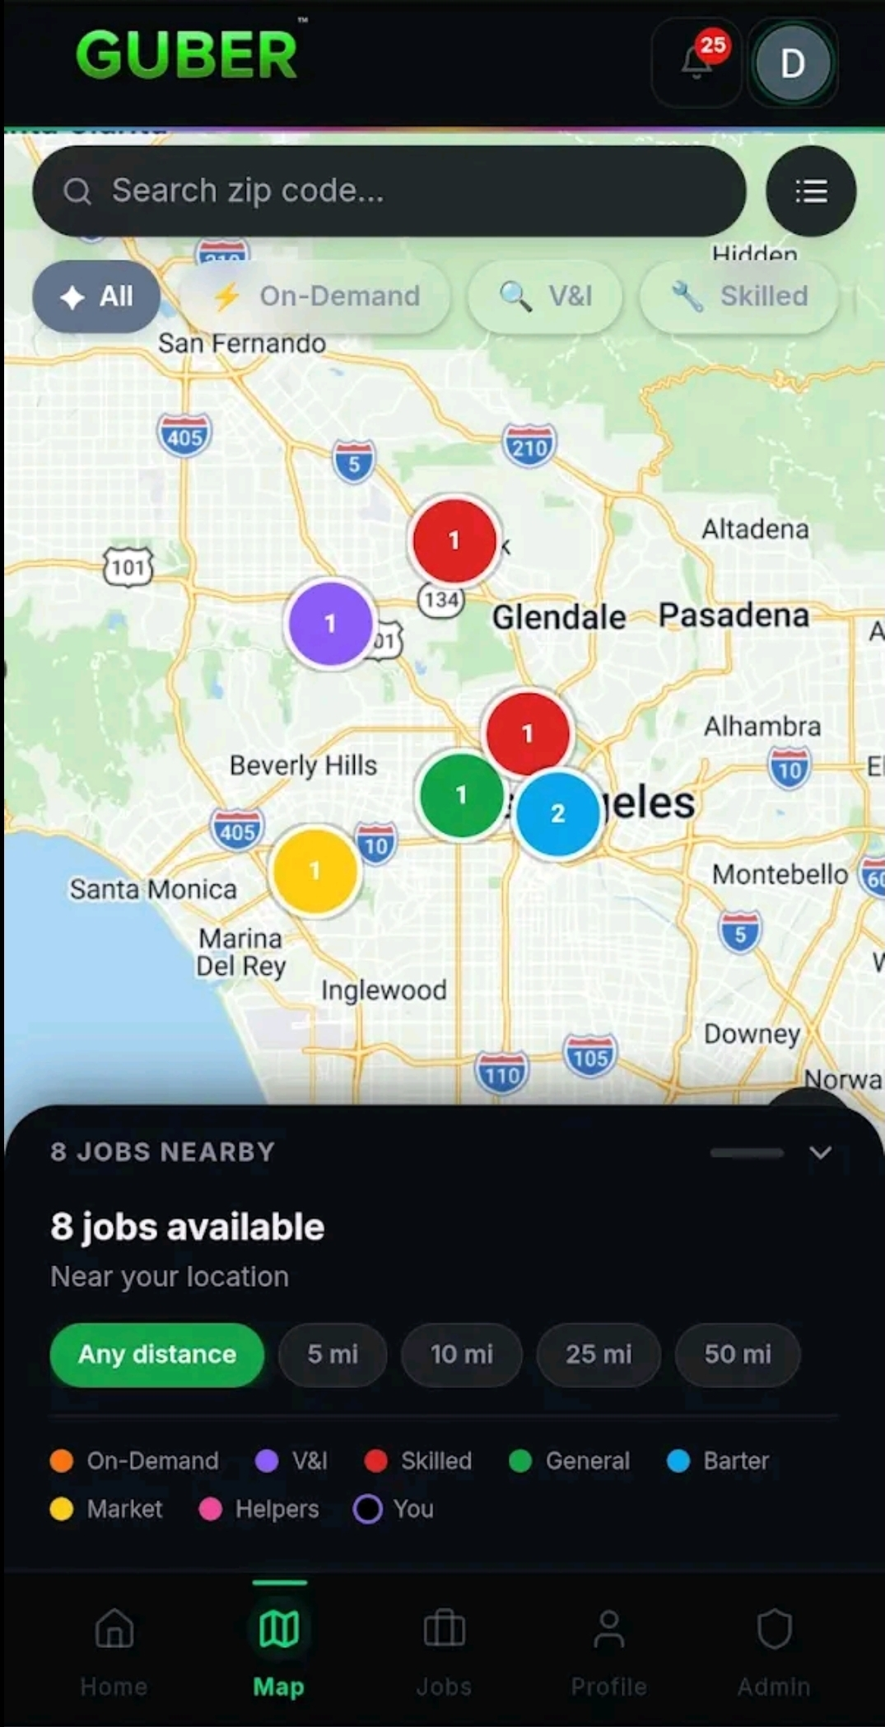
SLIDE 2 · THE PROBLEM
The Problem
Every day, people need three things:
Money
Help
Proof
A person needing work struggles to find opportunity.
A business needing help struggles to find reliable assistance.
A buyer making a large purchase struggles to verify what they are buying.
The need exists. The visibility does not.
Confidential · GUBER Global LLC · guberapp.com · Guberapp.global@gmail.com
2

Slide 3
SLIDE 3 · USE CASES
Real Problems. Real People.
Transmission Failed
GT500 Purchase
Airbnb Property
A transmission fails on Wednesday.
Payday is Friday.
The person needs money today.
A buyer is about to spend tens of thousands of dollars on a vehicle located hundreds of miles away.
They need proof before they buy.
A property owner lives in another state.
They need eyes on a property they cannot physically visit.
Different situations. Same problem. People need opportunity, help, and verification.
Confidential · GUBER Global LLC · guberapp.com · Guberapp.global@gmail.com
3

Slide 4
SLIDE 4 · THE EMOTIONAL CORE
Create Value In Yourself
GUBER does not judge people by assumptions.
GUBER documents what they do.
Every job completed becomes evidence. Evidence becomes reputation. Reputation becomes opportunity.
GUBER gives people a chance. Not a guarantee. A chance.
01
Complete jobs.
02
Help others.
03
Verify information.
04
Build credibility.
05
Earn trust.
Your profile becomes a reflection of your actions.
Confidential · GUBER Global LLC · guberapp.com · Guberapp.global@gmail.com
4

Slide 5
SLIDE 5 · THE PLATFORM
How GUBER Works
01
02
03
04
05
Post a task
Accept a task
Complete the task
Submit proof
Build credibility
→
→
→
→
Hirer picks a category, sets a budget, posts.
A verified local sees it and accepts.
Worker shows up, does the work.
GPS-stamped photos and checklist submitted.
Both sides rated. Record stays forever.
Simple. Repeatable. Scalable.
Confidential · GUBER Global LLC · guberapp.com · Guberapp.global@gmail.com
5

Slide 6
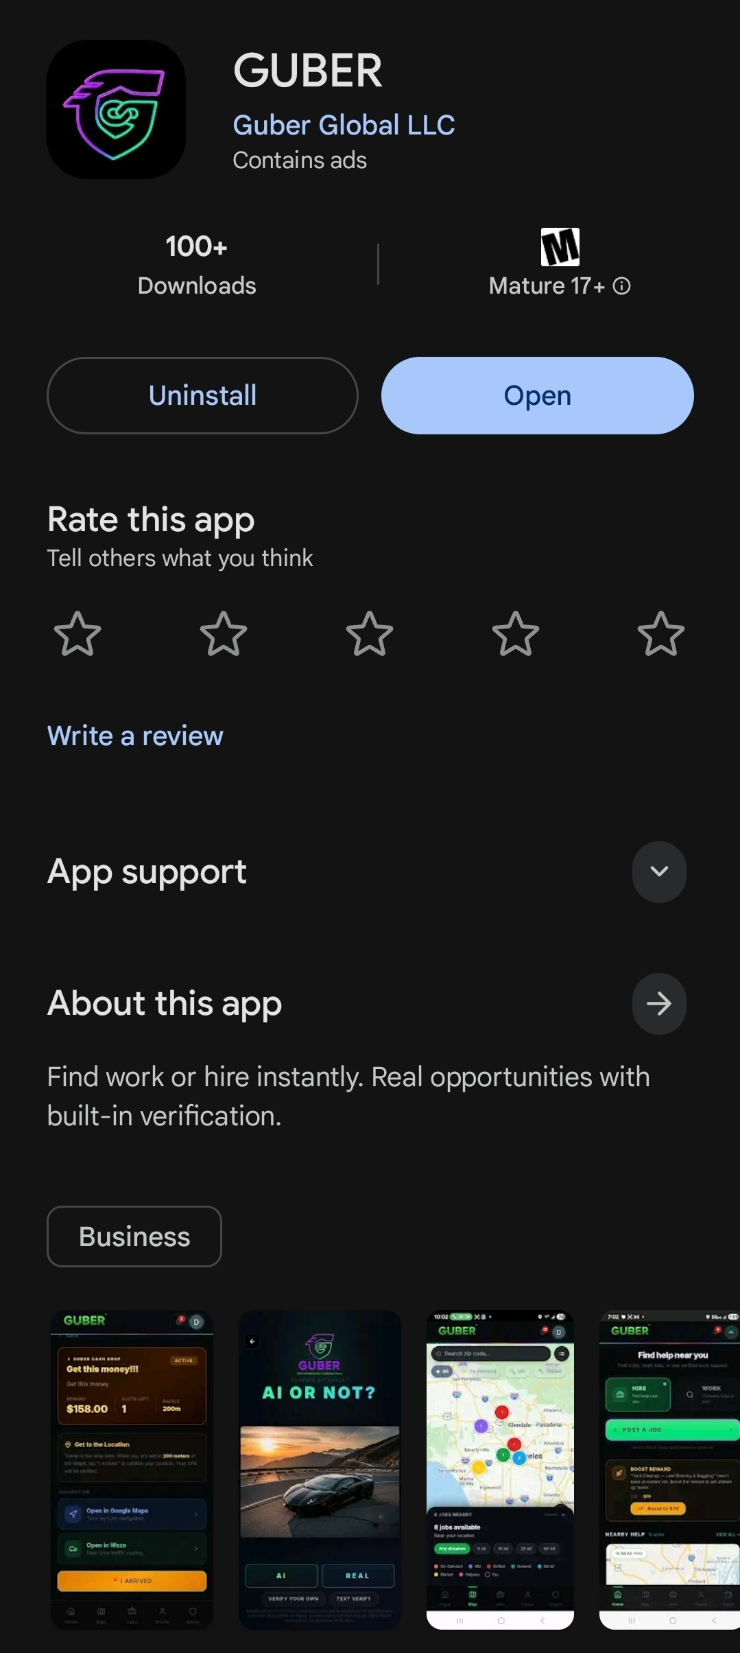
SLIDE 6 · TRACTION
Traction
▸ Android live on Google Play since April 8, 2026
This is not a pitch for a future product. GUBER is live today.
▸ Web PWA live at guberapp.com
100+
Live
Downloads
Web App
▸ Day-1 OG tier generating Stripe revenue today
Google Play · Zero paid acquisition
guberapp.com · Real users today
▸ Stripe Connect, escrow + ledger tested end-to-end
Active
27+
▸ iOS App Store submission in progress
Stripe Connect
Cash Drops
Escrow + payout working end-to-end
Deployed in market · Real cash paid out
▸ Founder-built: design, engineering, payments, native mobile
▸ All revenue streams live or flag-gated — no future build required
Confidential · GUBER Global LLC · guberapp.com · Guberapp.global@gmail.com
6

Slide 7
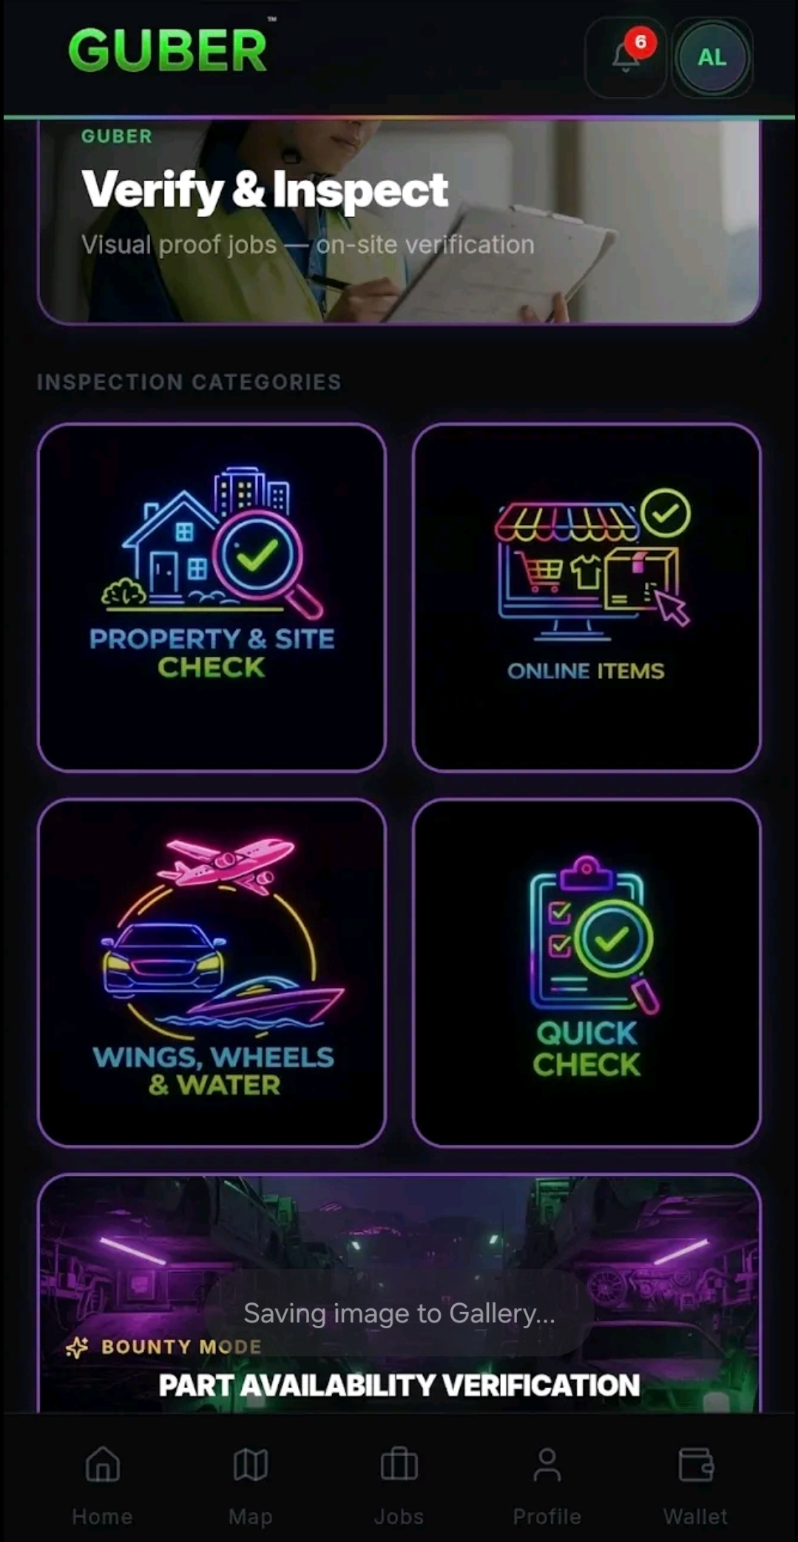
SLIDE 7 · TRUST & SAFETY
Trust Is Earned
Does GUBER let anyone do anything? No.
Anyone can start. Trust is earned.
✓ Completed jobs Every job on record.
✓ Ratings from both sides Hirer and worker both rate.
✓ GPS-verified proofs Proof submissions stamped to location + time.
✓ ID + selfie verification Government ID required on both sides.
✓ Consistency over time Trust compounds — can't be faked overnight.
GUBER documents trust. It does not assume trust.
Confidential · GUBER Global LLC · guberapp.com · Guberapp.global@gmail.com
7

Slide 8
SLIDE 8 · BUSINESS MODEL
Revenue Model
Platform Fees
Live
Verify & Inspect
Live
20% fee from helper share + 3.2% processing
Helpers earn $40–$120+. Platform takes 20%
Business Features
Live
Premium Services
Live
$99/mo Scout Plan (20 unlocks). $49 biz verification
$4.99/mo Trust Box. Studio packs $5–$200. Tiers $11–$99/mo
Sponsorships
Live
Future Expansion
Flag-gated
~60% margin on Cash Drop sponsor dollars. 27 drops live
B2B API fees. Observation marketplace. Instant cashout fees
Multiple revenue streams. One ecosystem. All live today.
Confidential · GUBER Global LLC · guberapp.com · Guberapp.global@gmail.com
8

Slide 9
SLIDE 9 · GROWTH
Distribution Strategy
Growth comes from community activation — not paid advertising.
Local Launches
Cash Drops
City-by-city rollout builds density before expanding.
Geo-targeted rewards drive real-world installs and word-of-mouth.
Referral Loops
Verify & Inspect Demand
Every completed job creates a story worth sharing.
B2B pull from buyers, dealers, insurers, and lenders.
Business Partnerships
Social Media
Local businesses unlock worker access through the Scout Plan.
Organic engagement across Facebook, TikTok, Instagram, LinkedIn, X.
Growth is driven by visibility, participation, and community activation.
Confidential · GUBER Global LLC · guberapp.com · Guberapp.global@gmail.com
9

Slide 10
SLIDE 10 · SCALE STRATEGY
Expansion Playbook
01
Start local. Launch in a single city. Build density.
A disciplined, asset-light expansion strategy.
The same platform that powers one city powers all of them.
No rebuild required.
No new engineering team required.
Just execution.
02
Prove repeatability. Document what works before scaling.
03
Expand city by city. Roll the playbook into new markets.
04
Expand region by region. Stack density across connected markets.
05
Expand nationally. The infrastructure is already built for it.
Already deployed nationally capable infrastructure.
Confidential · GUBER Global LLC · guberapp.com · Guberapp.global@gmail.com
10

Slide 11
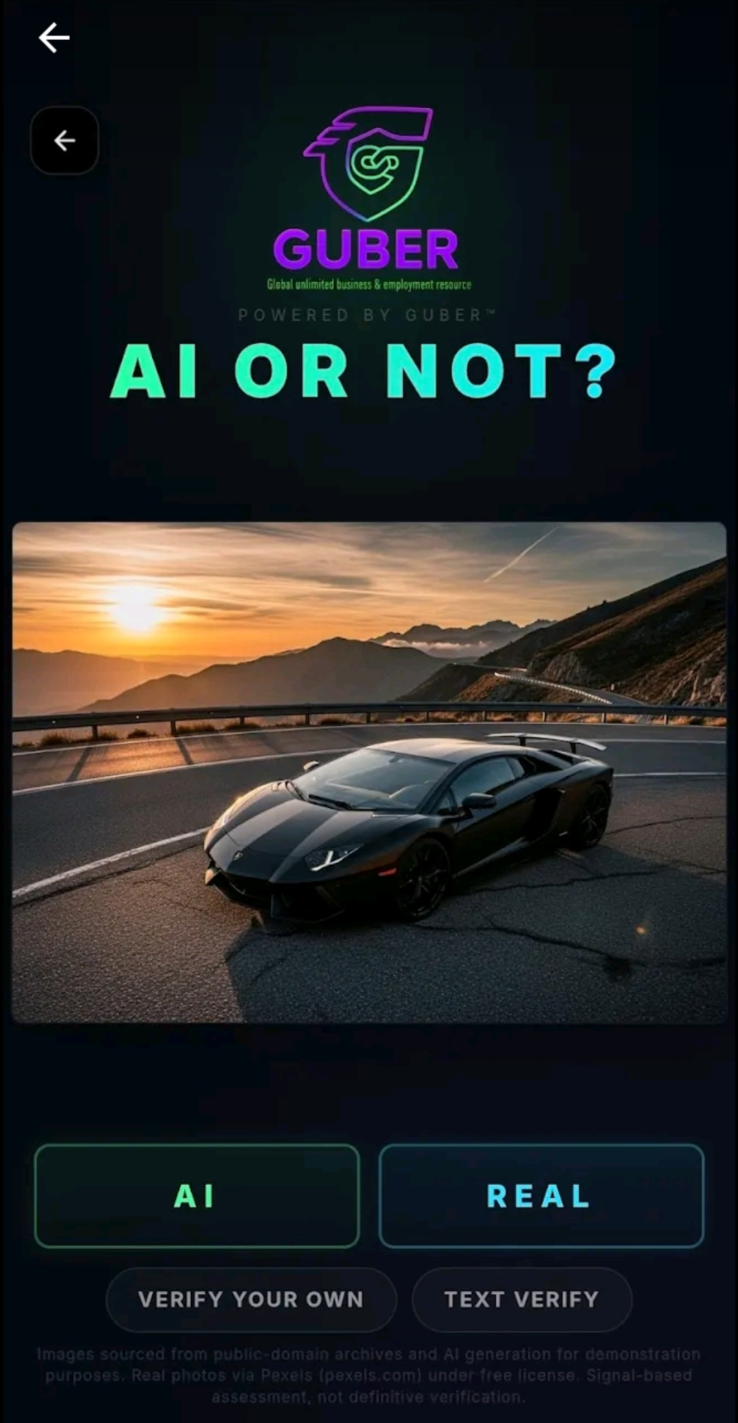
SLIDE 11 · WHY THIS SCALES
The Network Effect
Every completed task creates:
Proof
Reputation
Credibility
Accountability
The more activity that occurs, the more valuable the platform becomes.
More workers build credibility. More hirers trust the platform.
More businesses buy verification. More sponsors fund Cash Drops.
More data strengthens trust scores.
Trust is not purchased. It is built through action.
Confidential · GUBER Global LLC · guberapp.com · Guberapp.global@gmail.com
11

Slide 12
SLIDE 12 · COMPETITIVE POSITION
Why GUBER Can Win
✓ Existing demand — People already need work, help, and proof — no behavior change required.
✓ Multiple live revenue streams — Six streams live or flag-gated. None require future engineering.
✓ Asset-light software model — Infrastructure cost near zero at idle. Margin scales with volume.
✓ Local-first expansion — Density before breadth. Every city is a blueprint for the next.
✓ Compounding moat — Marketplace + verification advantages multiply with every new user.
✓ Trust grows with usage — Data layer becomes more valuable — and harder to replicate — over time.
✓ Human behavior is unchanged — People have always transacted locally. GUBER just makes it safer.
People already need work, help, and proof. GUBER simply makes it visible.
Confidential · GUBER Global LLC · guberapp.com · Guberapp.global@gmail.com
12

Slide 13
SLIDE 13 · THE LONG GAME
Vision
The long-term vision is simple:
Create a platform where opportunity, work, verification, and trust become visible in real time — in every community across the country.
◉ Every city.
◈ Every person.
◆ Real proof.
Not just tech hubs. Real communities.
Not just professionals. Anyone willing to show up.
Not just claims. Evidence that builds over time.
Helping people create value in themselves.
Confidential · GUBER Global LLC · guberapp.com · Guberapp.global@gmail.com
13

Slide 14
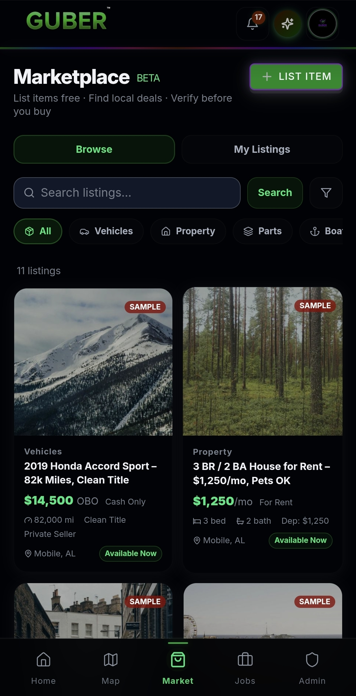
SLIDE 14 · THE OPPORTUNITY
Investment Opportunity
The corporate stack is already in place.
· Delaware LLC GUBER Global LLC
· Trademark U.S. application filed
· DUNS Number Issued
· 100% Founder-Owned No prior dilution
$1,000,000
Target raise over 18 months
$15M early-stage valuation framework
Capital goes to growth — not engineering. The product is already built.
USE OF FUNDS
Product Development & Engineering
30% $300K
Marketing, Growth & Community
25% $250K
Operations, Compliance & Trust
15% $150K
Business Development & Partnerships
10% $100K
Customer Support & Quality Control
10% $100K
Infrastructure & Platform Scaling
5% $50K
Working Capital & Contingency
5% $50K
Confidential · GUBER Global LLC · guberapp.com · Guberapp.global@gmail.com
14

Slide 15
SLIDE 15 · CONTACT
Less talk. Straight action.
GUBER
Every serious inbound gets a serious reply — same hour, same day.
Company
GUBER Global LLC
Email
Guberapp.global@gmail.com
Phone
(251) 284-9412
Web
guberapp.com
Google Play
GUBER — Guber Global LLC
LinkedIn · linkedin.com/company/guber-global · Facebook · facebook.com/guberapp · TikTok · @guberapp · X · @guberapp
Confidential — for invited investors only. Do not redistribute.
15

