Slide 1
R + Google Analytics = Improved SEO
Using R to tap into Google's Search Console API and Analytics Reporting API to improve your search engine optimization and increase your monetization

Slide 2
Contents
0. Business goals
1. Limitations of Google Analytics dashboard
2. Capabilities of Google Search Console & Analytics Reporting APIs
3. Tapping into an API with Python
4. Tapping into an API with R
5. R library security issue
6. Gathering data
7. Exporting data
8. Data analysis and visualization

Slide 3
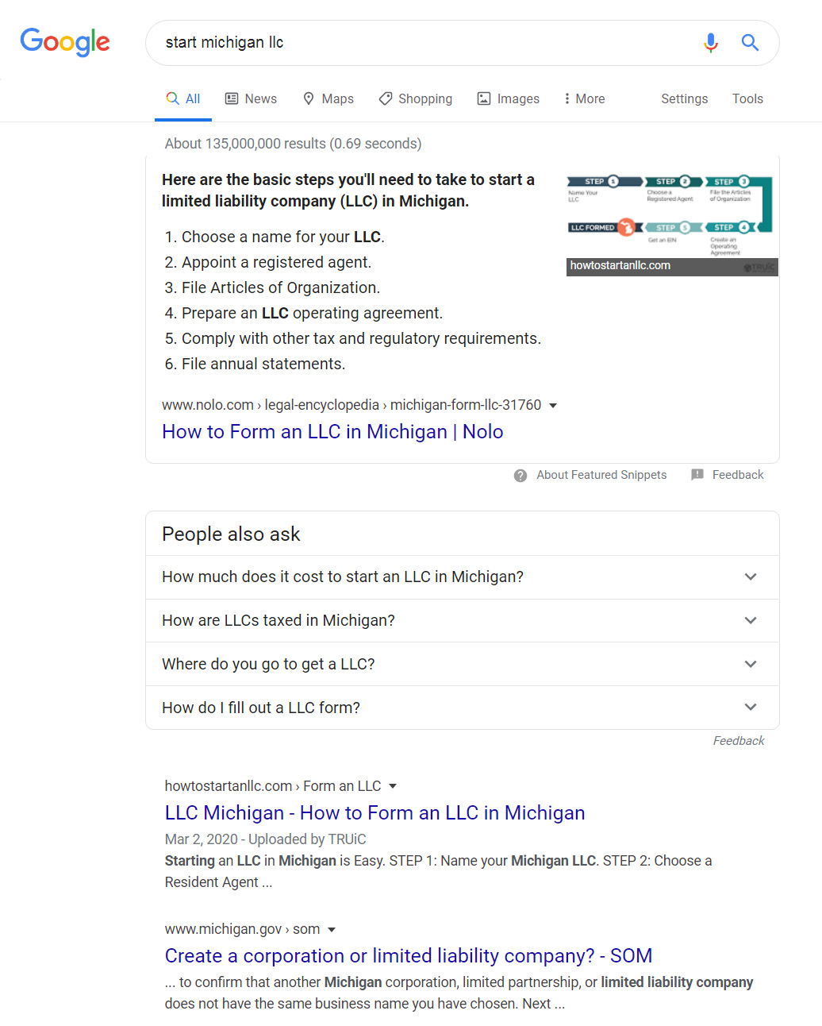
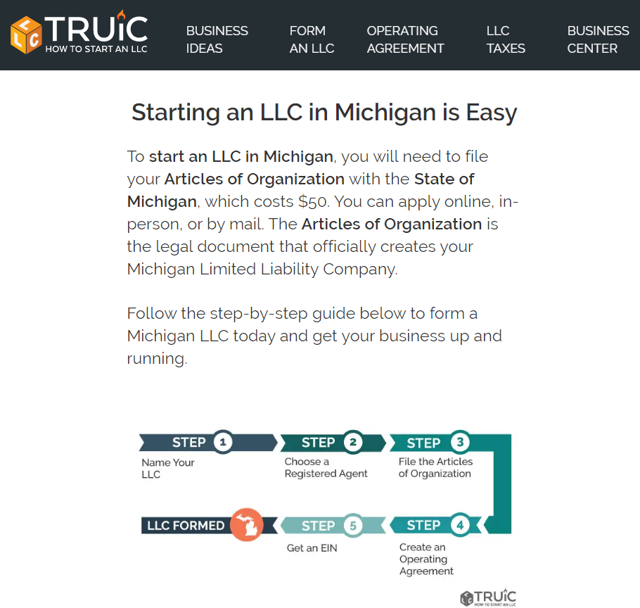
0. Business goals of HowToStartAnLLC.com
Goals:
Increase Google rankings
Increase monetization
How to reach goals?
User search engine data
User website action data

Slide 4
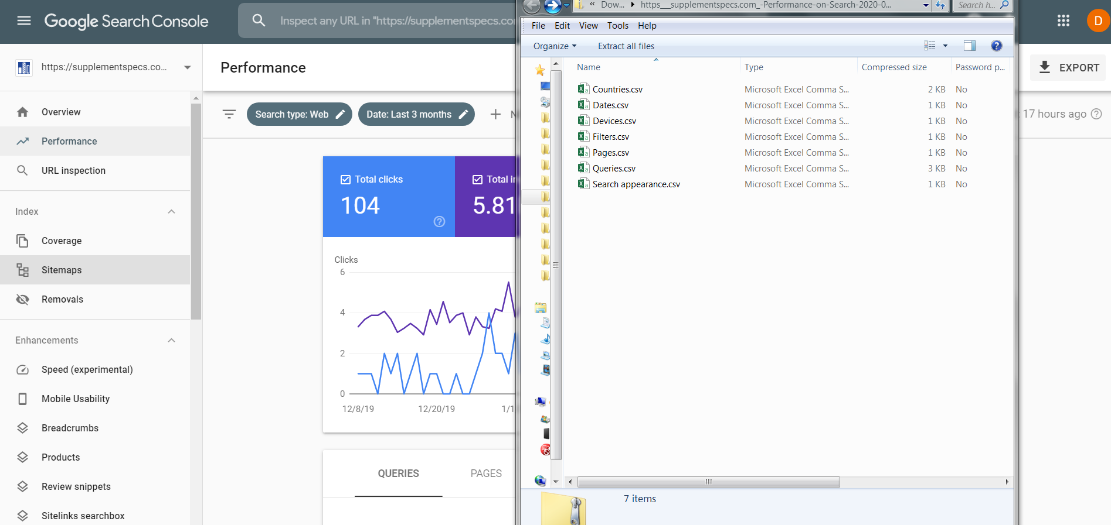
1. Limitations of Google Analytics dashboard
Problem:
Limited amount and speed of data through Analytics Dashboard
Solution:
Tap into the APIs!

Slide 5
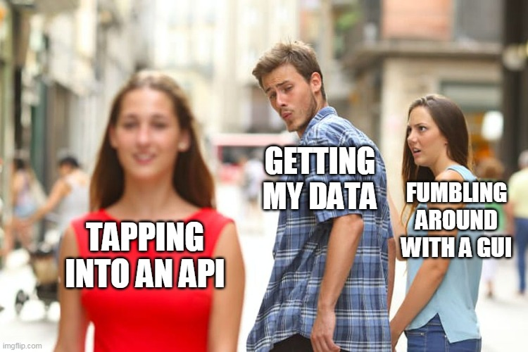
2. Capabilities of Google Search Console & Analytics Reporting APIs
Far less limitations for speed and volume of data
Freedom of choice in data extraction
Metrics – What you need to measure (sessions, pageviews, etc.)
Dimensions – Categorization of metrics (country, browser, etc.)

Slide 6
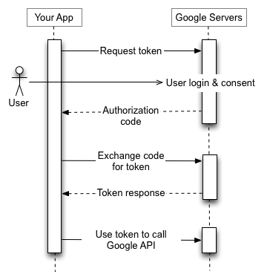
3. Tapping into an API with Python
Oauth2 credentials needed for API access:
1. Obtain OAuth 2.0 credentials from the Google API Console.
2. Obtain an access token from the Google Authorization Server.
3. Examine scopes of access granted by the user.
4. Send the access token to an API.
5. Refresh the access token, if necessary.

Slide 7
4. Tapping into an API with R
(See Script)

Slide 8
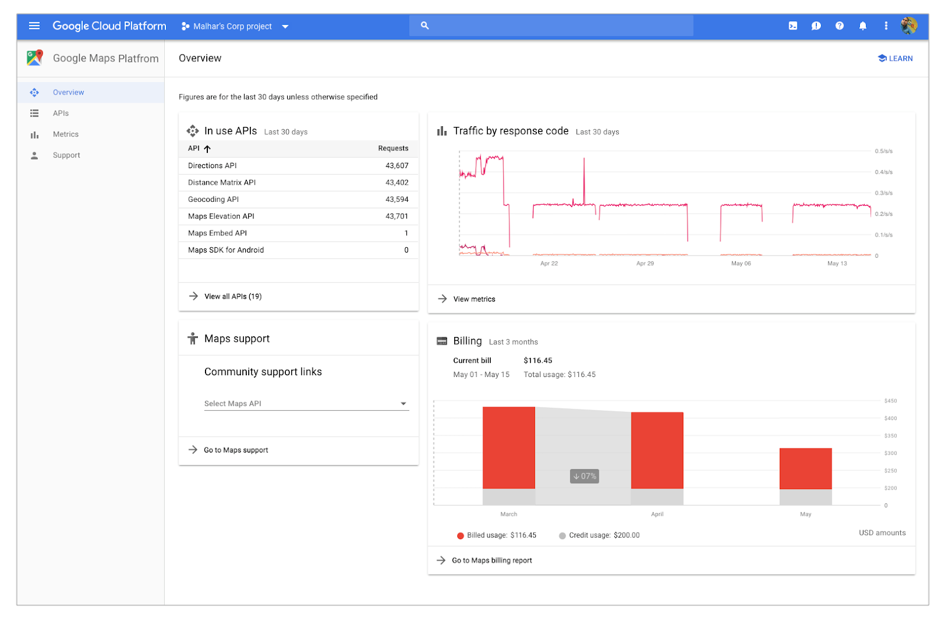
5. R library security issue
OAuth2 credentials included with library
“R\win-library\3.4\searchConsoleR\clients”
native.json
web.json

Slide 9
6. Gathering data
(See Script)

Slide 10
7. Exporting data
csv, Excel, SQL

Slide 11
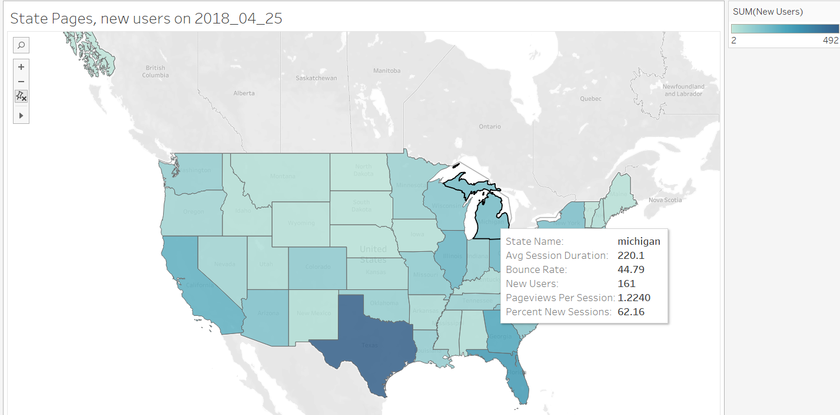
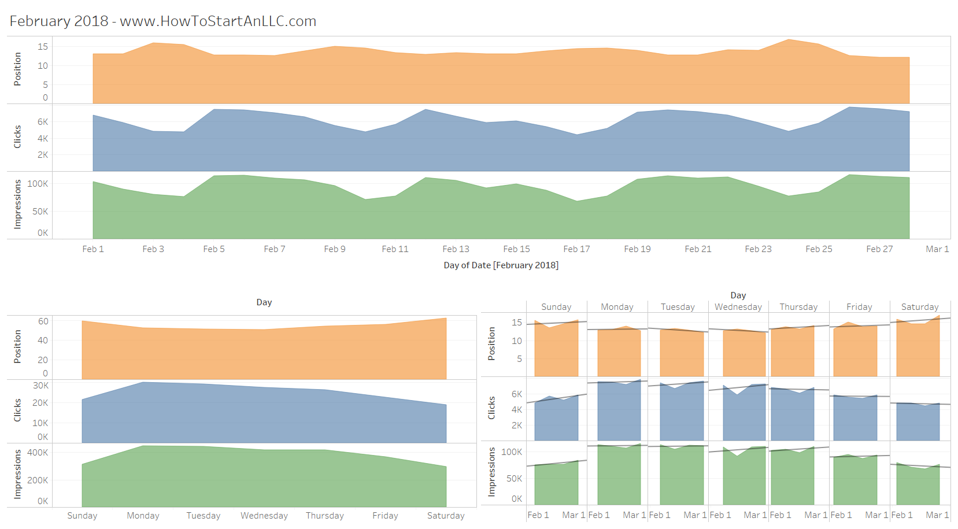
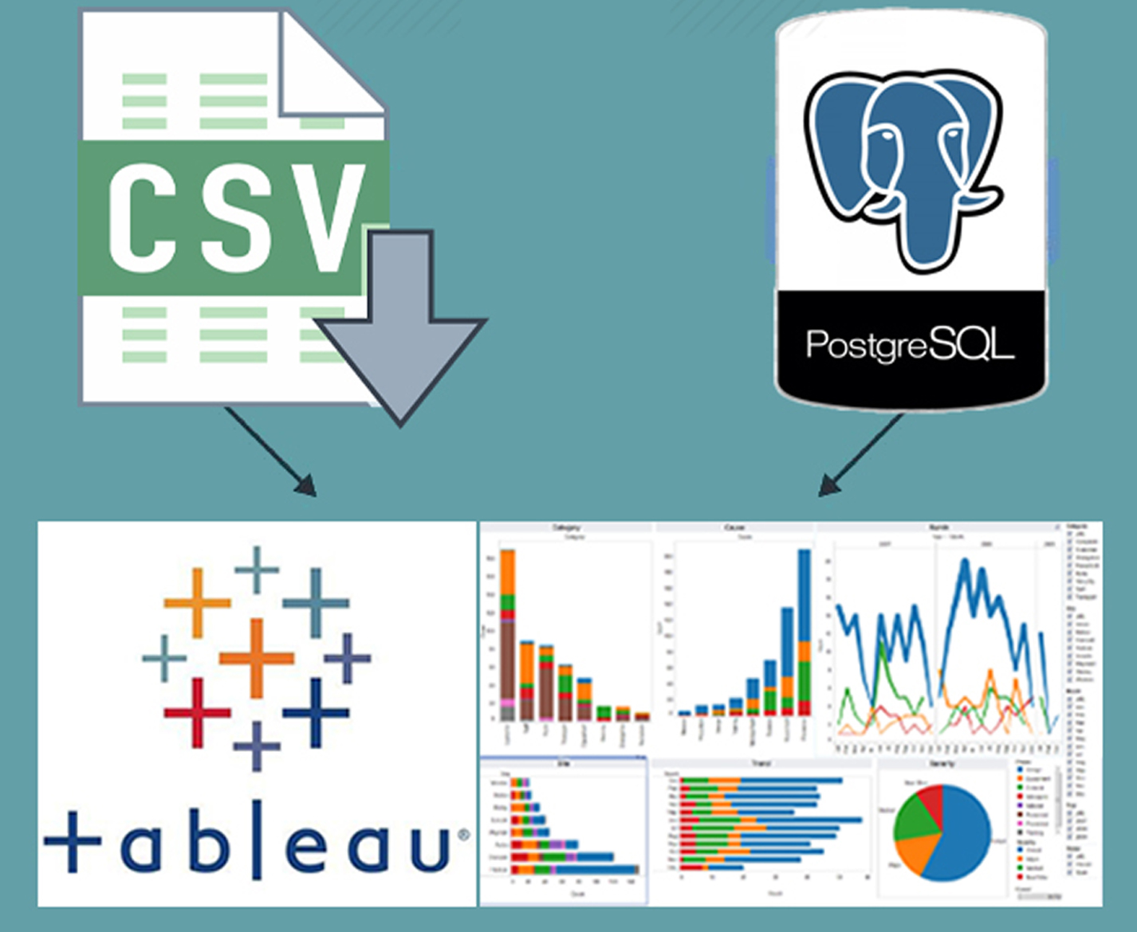
8. Data analysis and visualization

Slide 12


Thank you Barry DeCicco, A² RUG, & SPARK!
Dan Thomas, dan@dataconcord.com, 734-239-0447
200 E. Liberty #8317 Ann Arbor, MI 48107
www.dataconcord.com

