Slide 1
PageRank Project
Zecheng Xu (zx78)
Shuo Xiong (sx78)
Qianying Zhang (qz226)

Slide 2
Implemented PageRank
Simple (node-by-node) computation
Jacobi Blocked computation
Gauss-Seidel computation
Random Partition computation

Slide 3
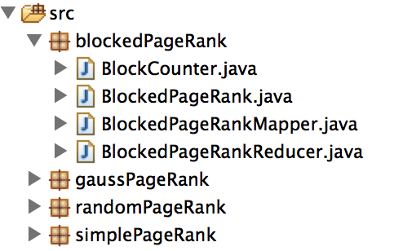
Structure of Source Code
Use Counter to compute average residual error

Slide 4
Data Pre-processing
+
Reject edges based on netID:zx78
rejectMin: 0.87*0.99=0.8613
rejectLimit:0.87*0.99+0.01=0.8713
number of edges selected:7524770
The format of each line of the new file:
<Node+PageRank+0> , if Degree=0
<Node+PageRank+Degree+NeighborNodes> ,else

Slide 5
Simple PageRank
+
There are four classes:
SimplePageRank:
main method
MapReduce job configuration
Stores intermediate results in HDFS to improve efficiency
SimplePageRankMapper:
Node information:
<srcNode,”preNodeInfo”+PageRank+srcDegree> srcDegree=0
<srcNode,”preNodeInfo”+PageRank+srcDegree+dstNodes>
PageRank:
<dstNode,srcPageRank/srcDegree>

Slide 6
SimplePageRank
+
Continue...
SimplePageRankReducer:
reconstructs the node graph and computes PageRank value of this node
increments the RESIDUAL_COUNTER in Counter class
Counter:
every reducer increments RESIDUAL_COUNTER after computing residual error.
Finally output average residual error in PageRank class at the end of each pass.

Slide 7
Result of SimplePageRank
Iteration 0 Avg. residual error: 2.3385827422062664
Iteration 1 Avg. residual error: 0.3229186718255184
Iteration 2 Avg. residual error: 0.19205372241145308
Iteration 3 Avg. residual error: 0.09416565085445763
Iteration 4 Avg. residual error: 0.06287620062460779
Iteration 5 Avg. residual error: 0.03389726990207667

Slide 8
Blocked (Jacobi) PageRank
BlockedPageRank
BlockedPageRankMapper
BlockedPageRankReducer
BlockCounter

Slide 9
Blocked (Jacobi) PageRank
block boundaries are hard-coded
blockIDofNode runs in constant time
use Counter to compute Avg. residual error
use Coutner to compute Avg. iteration times

Slide 10
Blocked PageRank Mapper
If srcDegree = 0: <srcBlock, “prevNodeInfo” + srcNode + pageRank + srcDegree> otherwise: <srcBlock, “prevNodeInfo” + srcNode + PageRank + srcDegree + dstNodes>
For edges within block, {<u,v>|u∈B∧u→v}
<dstBlock, “BE” + srcNode(u) + dstNode(v)>
For edges entering, {<u,v,R>|u∈B∧v∈B∧u→v∧R=PR(u)/deg(u)}
<dstBlock, “BC” + dstNode(v) + srcPR(u)/deg(u)>

Slide 11
Data Structure in Reducer
HashMap<Integer, Float> oldPageRanks
HashMap<Integer, Float> newPageRanks
HashMap<Integer, Integer> nodeDegrees
HashMap<Integer, ArrayList<Integer>> outNodes
HashMap<Integer, ArrayList<Integer>> beMap
HashMap<Integer, ArrayList<Float>> bcMap
ArrayList<Integer> nodeList

Slide 12
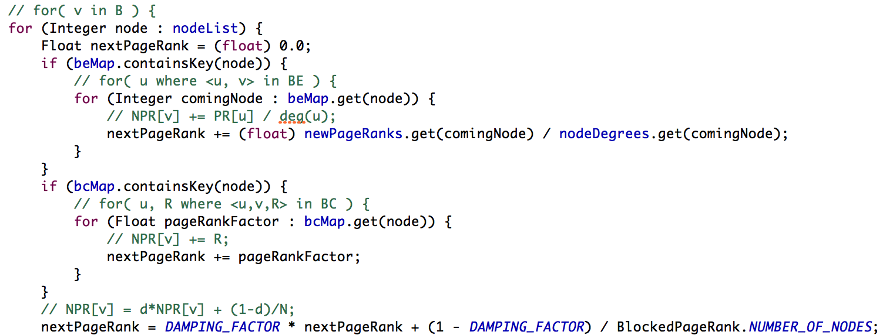
Implementation of IterationBlockOnce

Slide 13
Blocked PageRank Reducer
The termination condition in reducer is while the nodes within the block are converged.
After termination,increase counter:
REDUCER_COUNTER by 1
INNER_ITERATION_COUNTER by # of iterations of IteratorBlockOnce
RESIDUAL_COUNTER by the total residual errors in the block
corresponding PAGERANK[blockID] by the pagerank of the highest numbered nodes in block.

Slide 14
Blocked PageRank Counter
RESIDUAL_COUNTER: sum of residual errors
REDUCER_COUNTER: # of reducers
INNER_ITERATION_COUNTER: sum of iterations within blocks
Avg iterations = INNER_ITERATION_COUNTER / REDUCER_COUNTER
PAGERANK0 – PAGERANK67: store pagerank of highest numbered nodes in the corresponding block

Slide 15
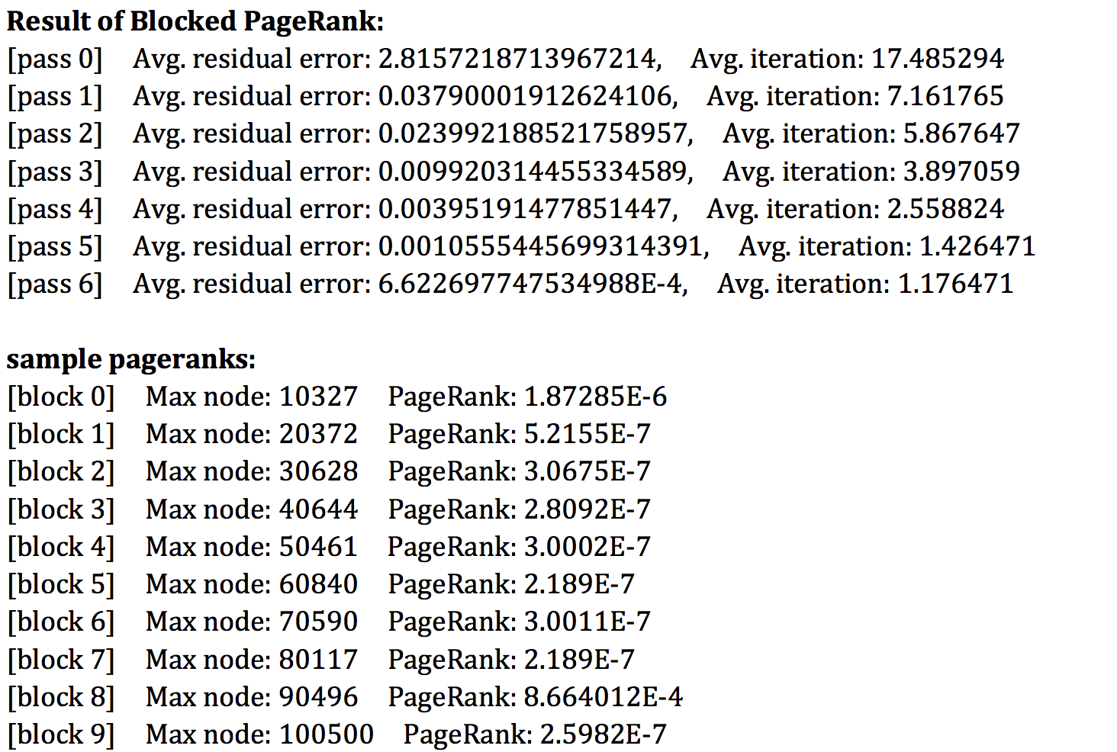
Blocked PageRank Result

Slide 16
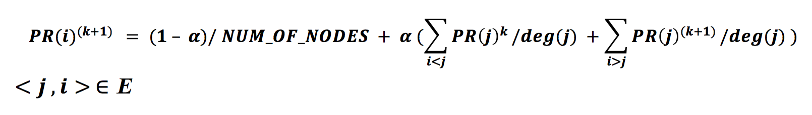
Gauss-Seidel Iteration
Gauss-Seidel iteration uses the most recent PageRank values wherever possible.
Following equation defines the PageRank value using Gauss-Seidel method:
Nodes need to be sorted when doing the Block computation.

Slide 17
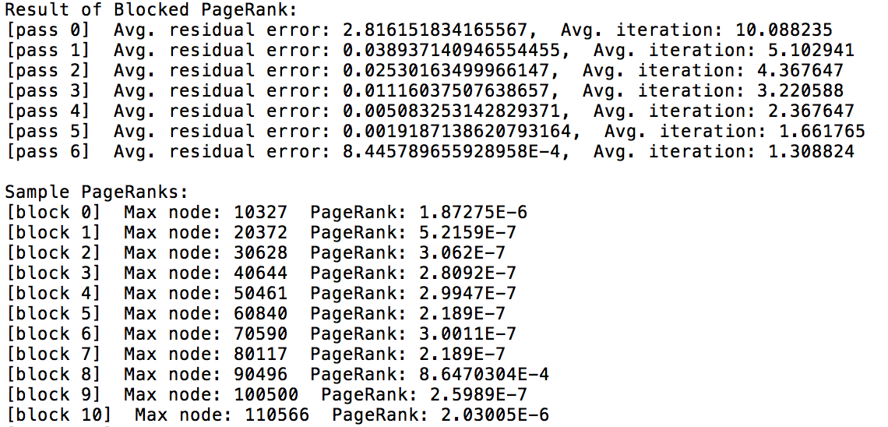
Result

Slide 18
Jacobi & Gauss-Seidel Iteration
Residual Error
Average Iteration
Pass | Jacobi | Gauss-Seidel
0 | 2.815721871 | 2.816151834
1 | 0.037900019 | 0.038937141
2 | 0.023992189 | 0.025301635
3 | 0.009920314 | 0.011160375
4 | 0.003951915 | 0.005083253
5 | 0.001055545 | 0.001918714
6 | 6.62E-04 | 8.45E-04
Pass | Jacobi | Gauss-Seidel
0 | 17.485294 | 10.088235
1 | 7.161765 | 5.102941
2 | 5.867647 | 4.367647
3 | 3.897059 | 3.220588
4 | 2.558824 | 2.367647
5 | 1.426471 | 1.661765
6 | 1.176471 | 1.308824

Slide 19
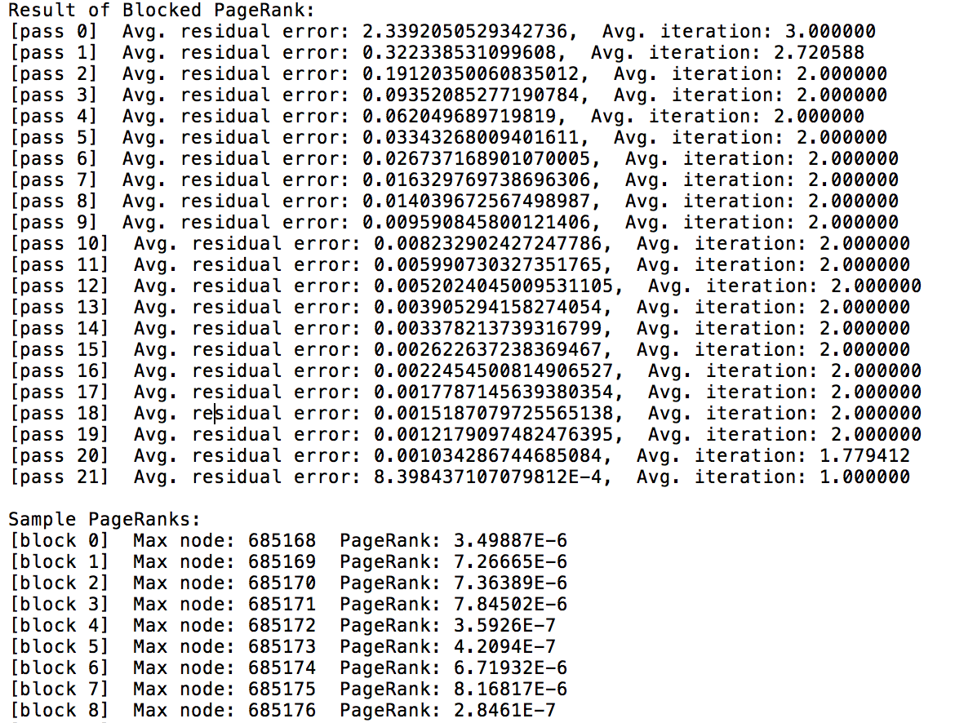
Random Block Partition
Random Hash Function
Hash(nodeID) = nodeID % NUM_OF_BLOCKS

Slide 20
Result & Comparison
Residual Error
Average Iteration
Pass | Blocked | Random Blocked
0 | 2.815721871 | 2.339205053
1 | 0.037900019 | 0.322338531
2 | 0.023992189 | 0.191203501
3 | 0.009920314 | 0.093520853
4 | 0.003951915 | 0.06204969
5 | 0.001055545 | 0.03343268
6 | 6.62E-04 | 0.026737169
Pass | Blocked | Random Blocked
0 | 17.485294 | 3
1 | 7.161765 | 2.720588
2 | 5.867647 | 2
3 | 3.897059 | 2
4 | 2.558824 | 2
5 | 1.426471 | 2
6 | 1.176471 | 2

Slide 21
Thank you

