Slide 1
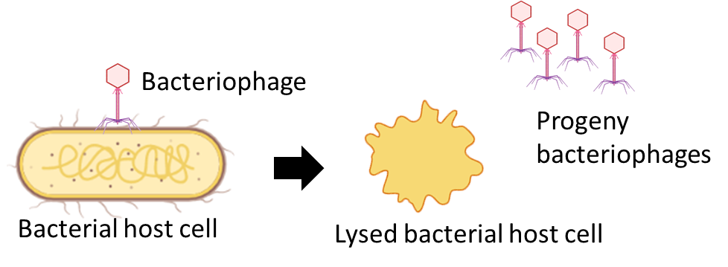
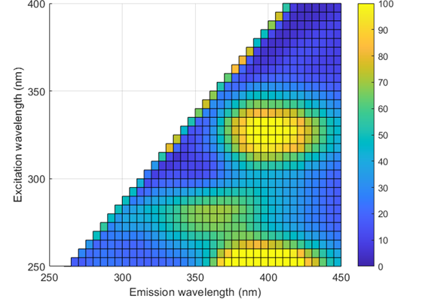
Bacteriophage-based bacteria detection
Bacteriophage specific infection on bacteria
Detection of bacteriophage induced bacterial cells lysis using fluorescence spectroscopy
Excitation: 250-400 nm
Emission: 260-450 nm
Excitation-Emission Matrix (EEM)

Slide 2
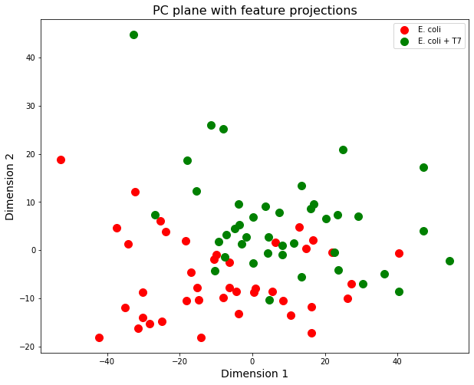
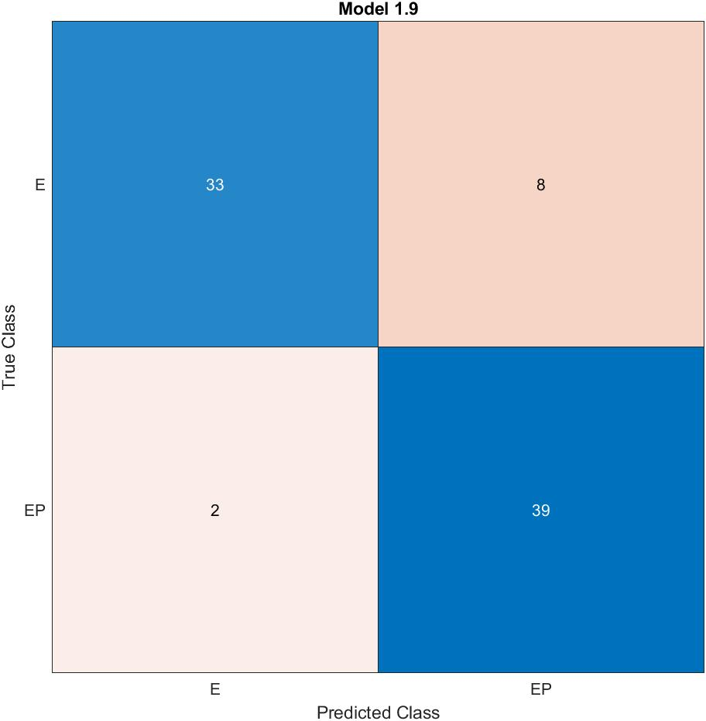
E. coli - mono culture
E. coli
E. coli + T7 phage
Linear SVM (87.8% accuracy)
0.16
0.67

Slide 3
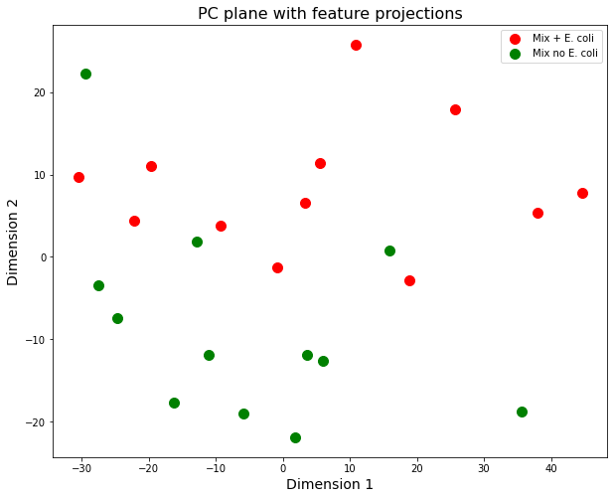
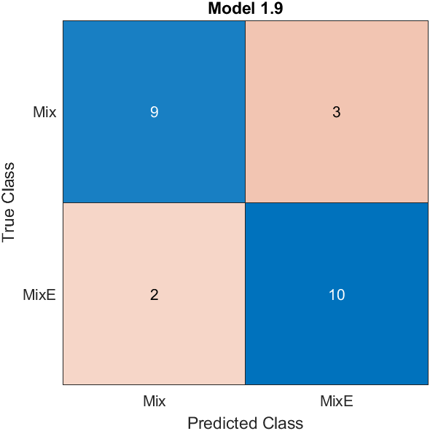
Mixed culture
L. innocua, B. subtilis, S. epidermidis E. coli + T7 phage
L. innocua, B. subtilis, S. epidermidis no E. coli + T7 phage
Linear SVM (79.2 % accuracy)
[0.22470373]
[0.61010552]

Slide 4
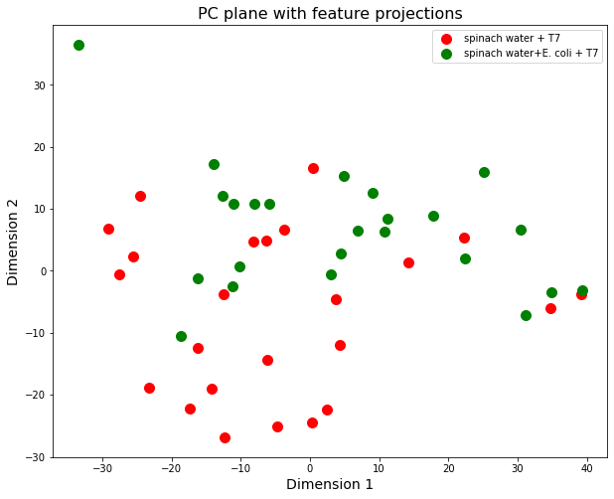
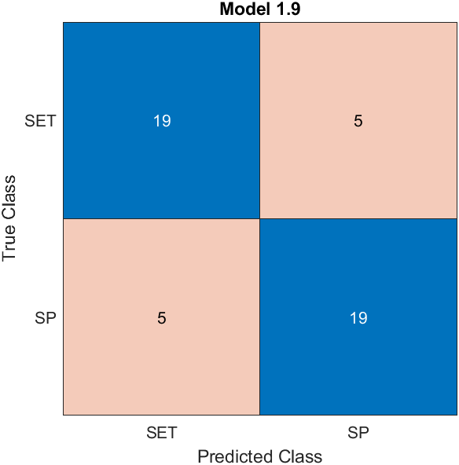
Spinach wash water
Spinach water + T7 phage
Spinach water + E. coli BL21 + T7 phage
Linear SVM (79.2 % accuracy)
[0.22644891]
[0.48238254]

Slide 5
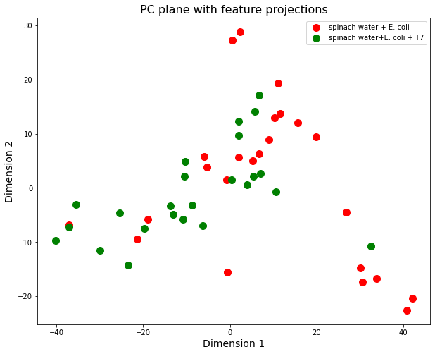
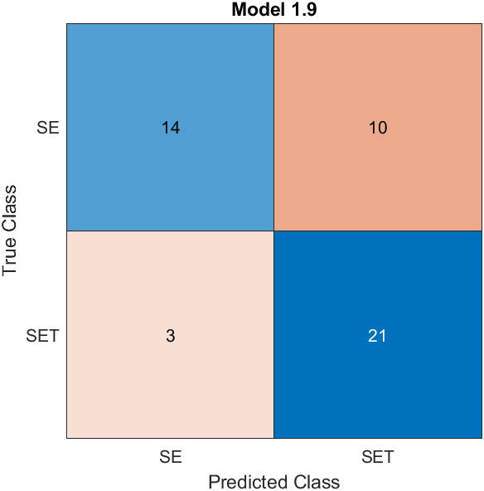
Spinach wash water
Spinach water + E. coli BL21
Spinach water + E. coli BL21 + T7 phage
Linear SVM (72.9 % accuracy)
0.18
0.55

Slide 6
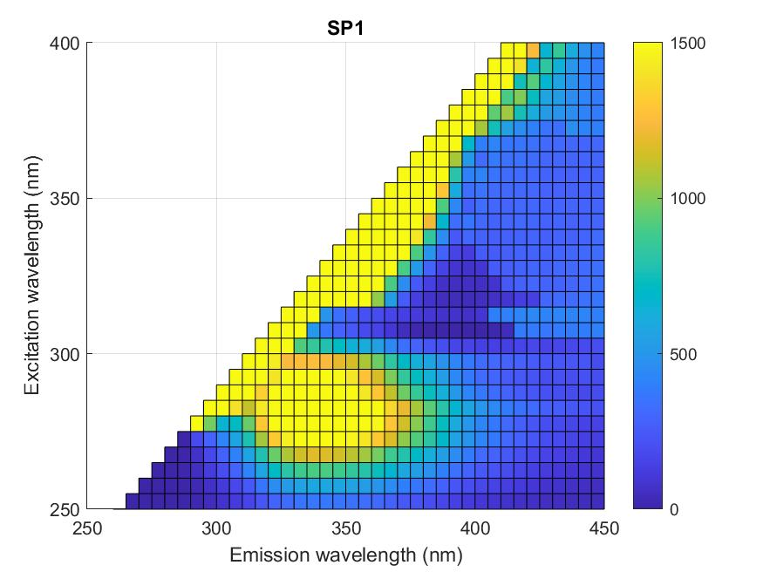
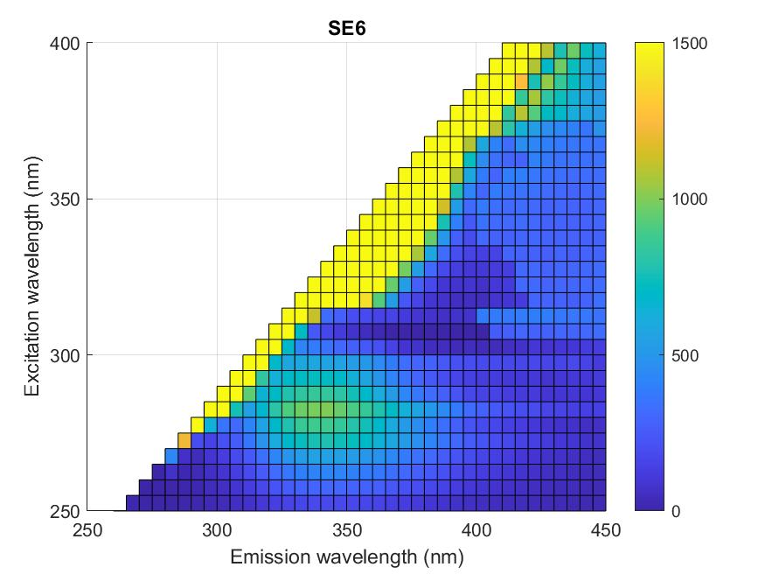
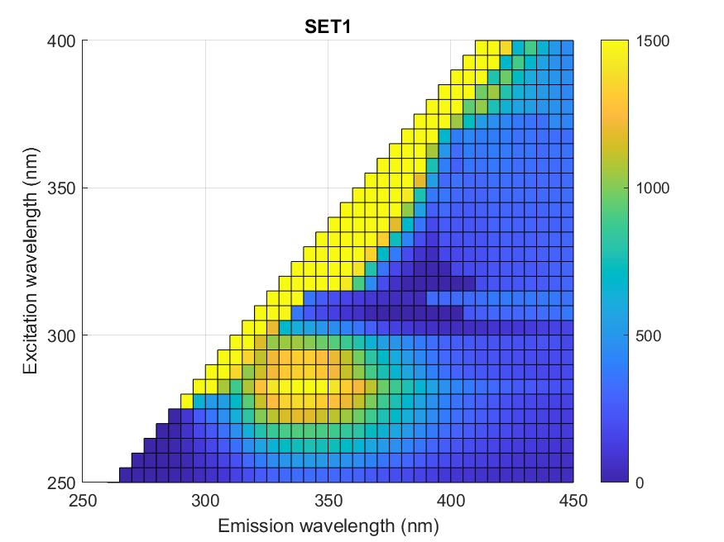
Spinach water with T7
Spinach water + E. coli BL21
Spinach water + E. coli BL21 with T7

