Slide 1
Use Case: Graph-based business Intelligence
Business intelligence usually based on relational data warehouses
enterprise data is integrated within dimensional schema
analysis limited to predefined relationships
no support for relationship-oriented data mining
Graph-based approach (BIIIG)
Integrate data sources within an instance graph by preserving original relationships between data objects (transactional and master data)
Determine subgraphs (business transaction graphs) related to business activities
Analyze subgraphs or entire graphs with aggregation queries, mining relationship patterns, etc.

Slide 2
End-to-end Graph Analytics
Data Integration
Graph Analytics
Visualization
integrate data from one or more sources into a dedicated graph store with common graph data model
definition of analytical workflows from operator algebra
result representation in meaningful way

Slide 3
Data integration and Analysis workflow
„Business Intelligence on Integrated Instance Graphs (BIIIG)“ (PVLDB 2014)
(1) Graph transformation
(3) Subgraph
Isolation
(2) Graph integration
Data Sources
Integrated Instance Graph
meta
data
Business Transaction Graphs
Domain expert

Slide 4
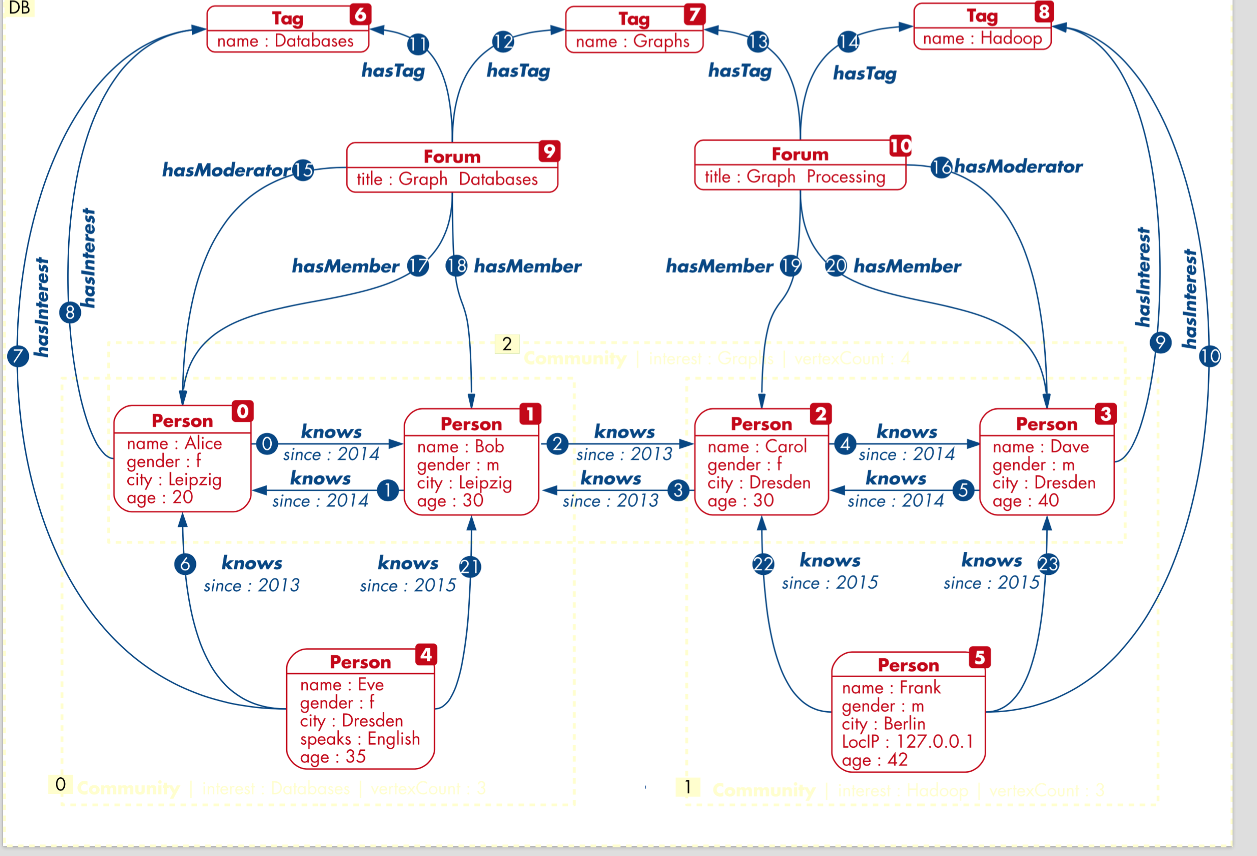
Extended Property Graph Model
Partitioned Directed Labeled Attributed Multigraph
Notes:
Graphdatenbank kann aus vielen semantisch unabhaengigen Graphen bestehen
In vielen Domains anwendbar: Communities, Geschaeftsprozesse, biologische Prozesse, Regionen
Beziehungen zwischen Graphen vorstellbar

Slide 5
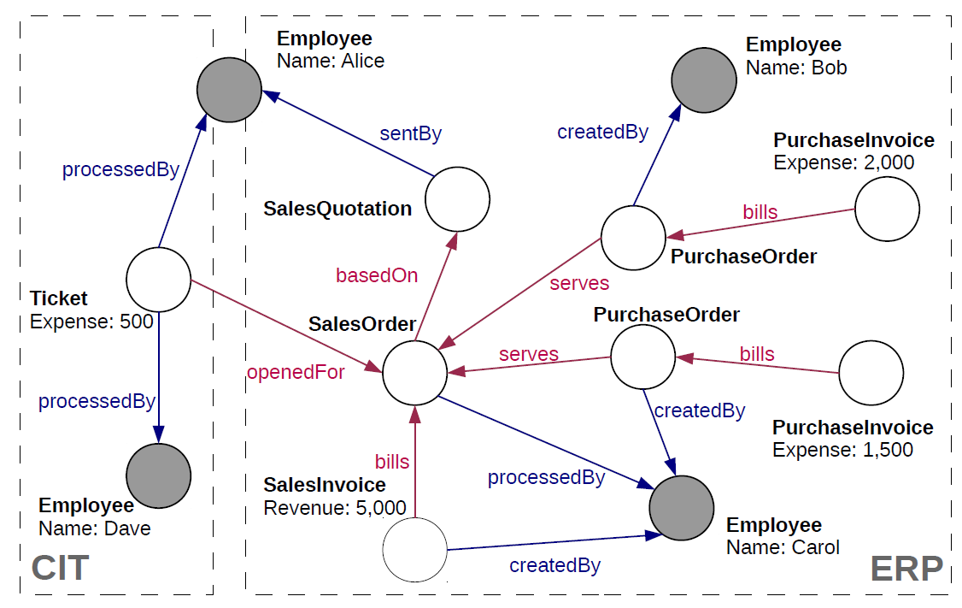
Sample Graph

Slide 6
Extended Property Graph Model (EPGM)
includes PGM as special case
support for collections of logical graphs / subgraphs
can be defined explicitly
can be result of graph algorithms / operators
support for graph properties
powerful operators on both graphs and graph collections
Graph Analytical Language – GrALa
domain-specific language (DSL) for EPGM
flexible use of operators with application-specific UDFs
plugin concept for graph mining algorithms

Slide 7
Operators
Algorithms
Unary
Binary
Aggregation
Combination
Gelly Library
Pattern Matching
Overlap
BTG Extraction
Transformation
Exclusion
Adaptive Partitioning
Logical Graph
Grouping
Equality
Subgraph
Call *
Selection
Union
Frequent Subgraphs
Distinct
Intersection
Sort
Difference
Graph Collection
Limit
Equality
Apply *
Reduce *
Call *
* auxiliary

Slide 8
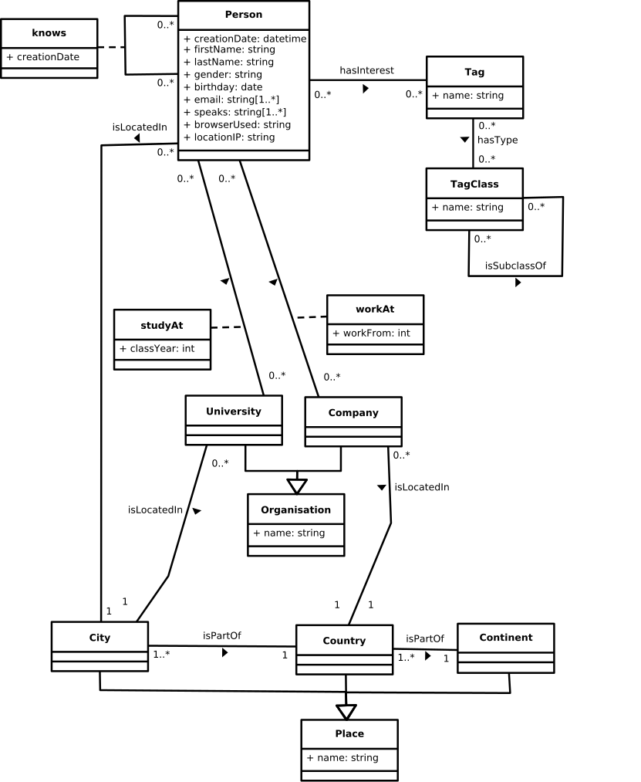
Test Workflow: Summarized communities
Extract subgraph containing only Persons and knows relations
Transform Persons to necessary information
Find communities using Label Propagation
Aggregate vertex count for each community
Select communities with more than 50K users
Combine large communities to a single graph
Group graph by Persons location and gender
Aggregate vertex and edge count of grouped graph
http://ldbcouncil.org/

Slide 9
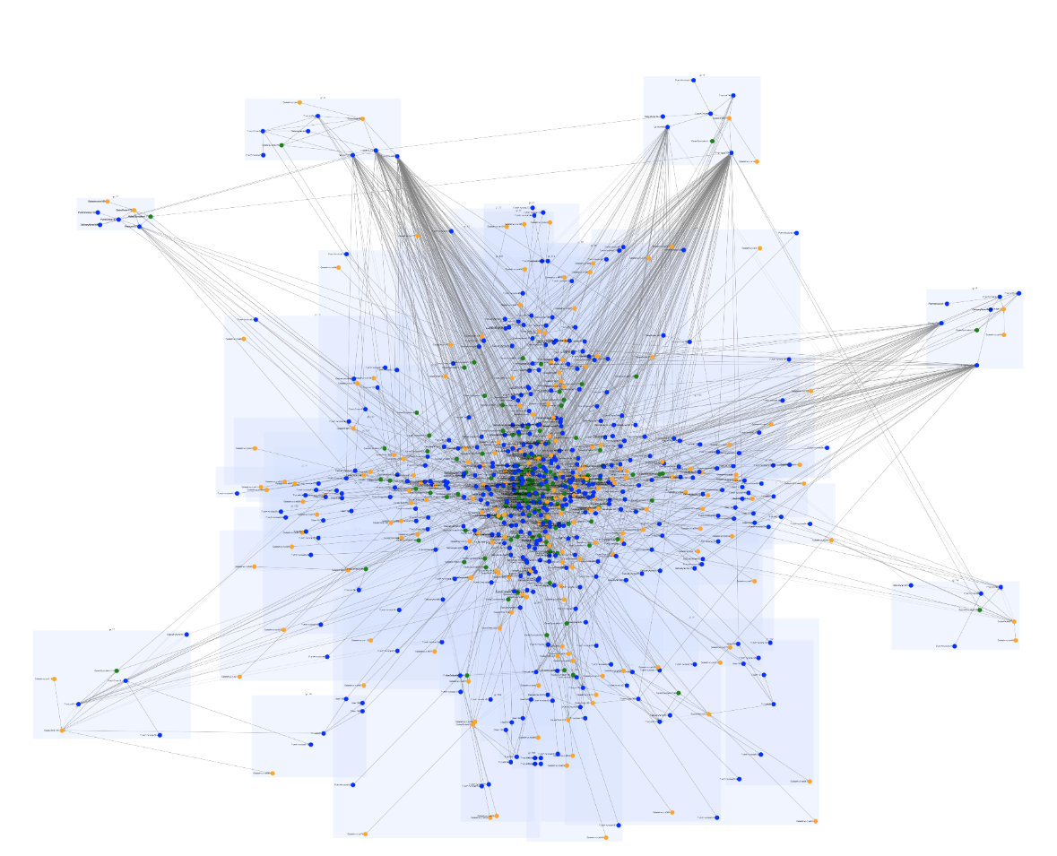
Visualization Requirements
Evaluation of existing web-based graph-visualization frameworks:
implementing poc - what runs and what not
where is extension needed
development of simple extensions

Slide 10
Requirements from EPGM:
labeled graph
properties at nodes and edges
multiple (directed) edges, self-edges
groups of nodes build logical graphs
logical graphs overlap can be contained in each other
links between logical graphs and nodes and logical graphs are possible

Slide 11
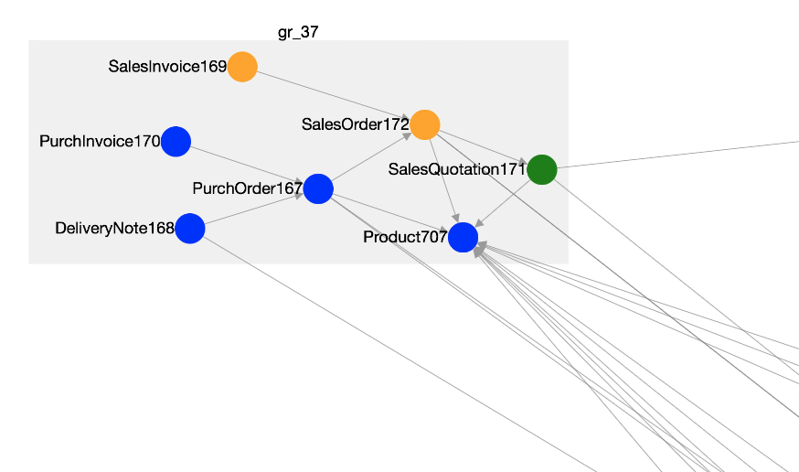
Cytoscape

Slide 12
Cytoscape – Inital Eval
slow rendering 5000 nodes and dense edges
selection of layout-algorithm _> cose? not working - parameters to set is not clear..
simple layouts are useless like gird, circle
hierarchic layouts -> layouting the components internally and then externally?
modification of styles on the fly
rendering of labels and properties at the labels
rendering graph oder a map -> in particular for georeferenced data

Slide 13
Bsp: Cose Bilkent
list of 30 parameters, force, iterations, padding.. edge length.. no idea what the individual parameters influence.
Alternative: cola layout – other parameters
playing and finding the right parameters is very time-consuming without background knowledge.
for small graphs layouts look nice - for larger graphs.. the problems occur

Slide 14
FURTHER Needs
mark embeddings of found patterns in the graph
zooming in and out
fixing position of nodes - in case of recomputations or incremental addition of nodes and edges.
Exploids:
dynamic graphs (vizalize changes and snapshots.)

Slide 15
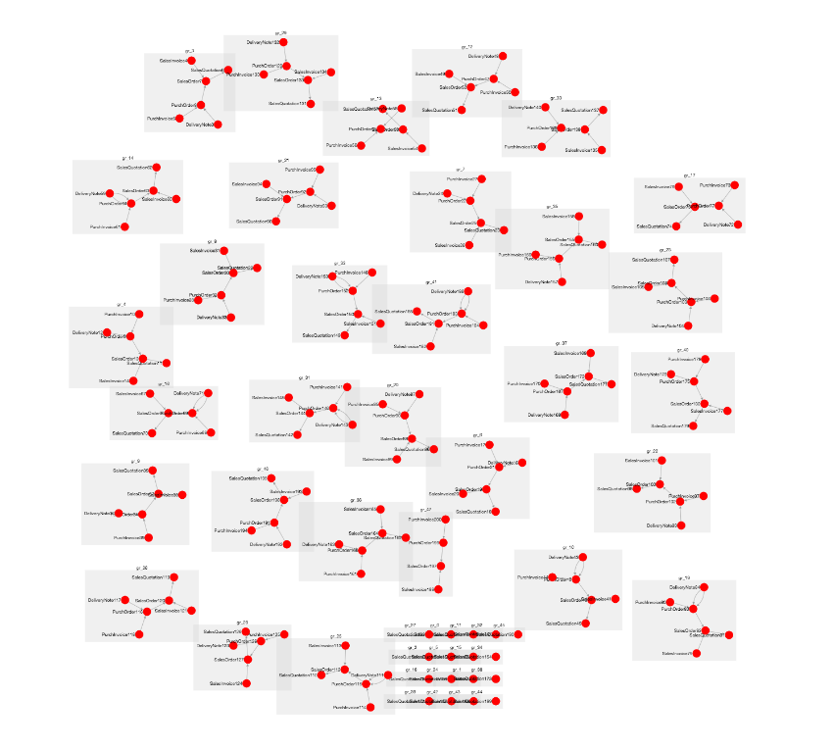
Beispiel – Transaktional Graphs
Needs
Zoom in/out
Select/Filter
Mark/Color
Order

