Slide 1


Modeling Complex Random Memristor Networks
model networks
understand behavior
use for computation
Daniel Teal, NNCI Intern, Summer 2018
Nano Functionality Integration Group at NIMS

Slide 2
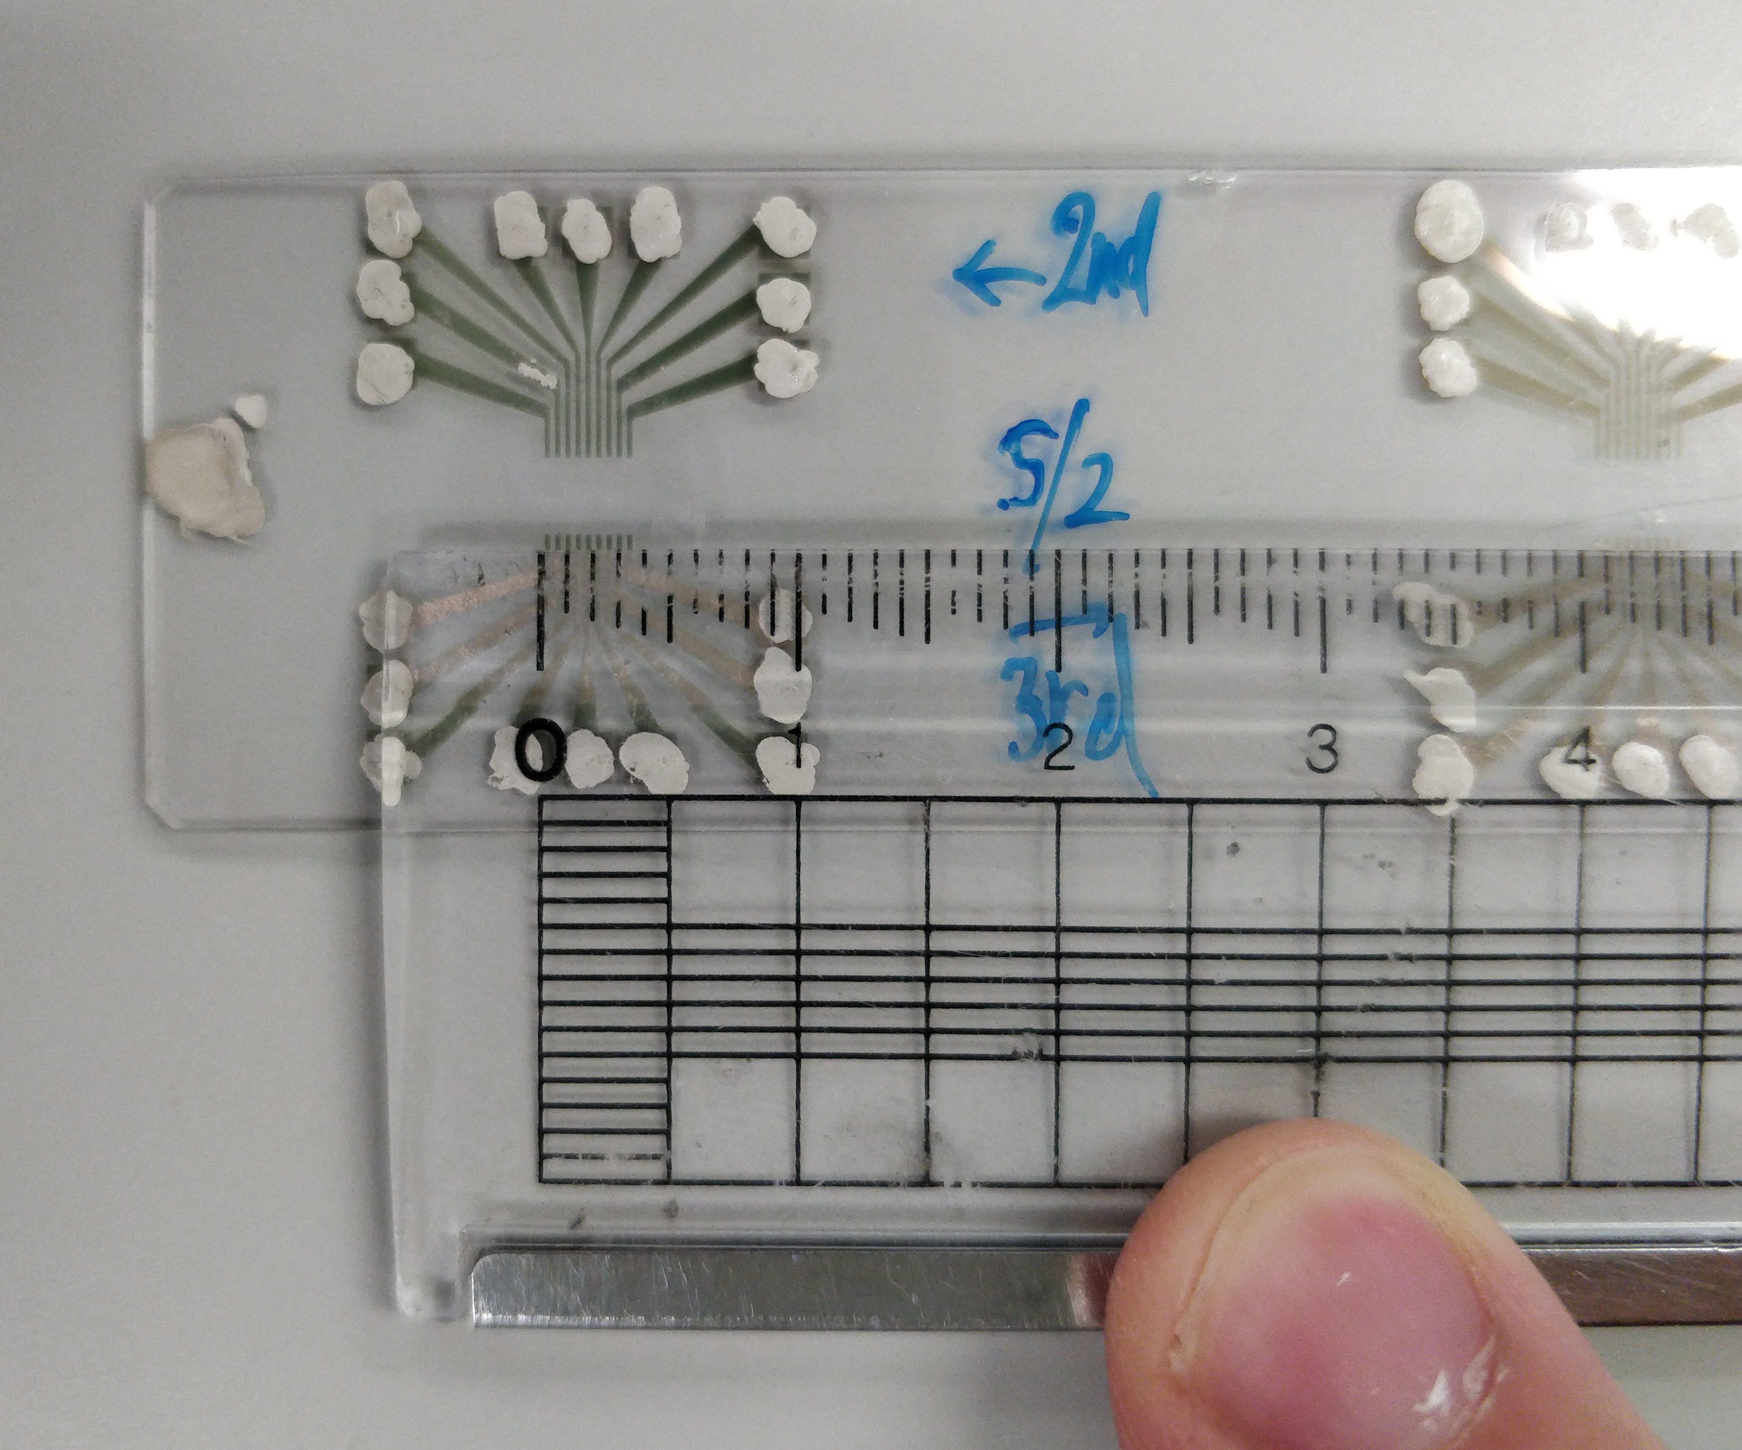
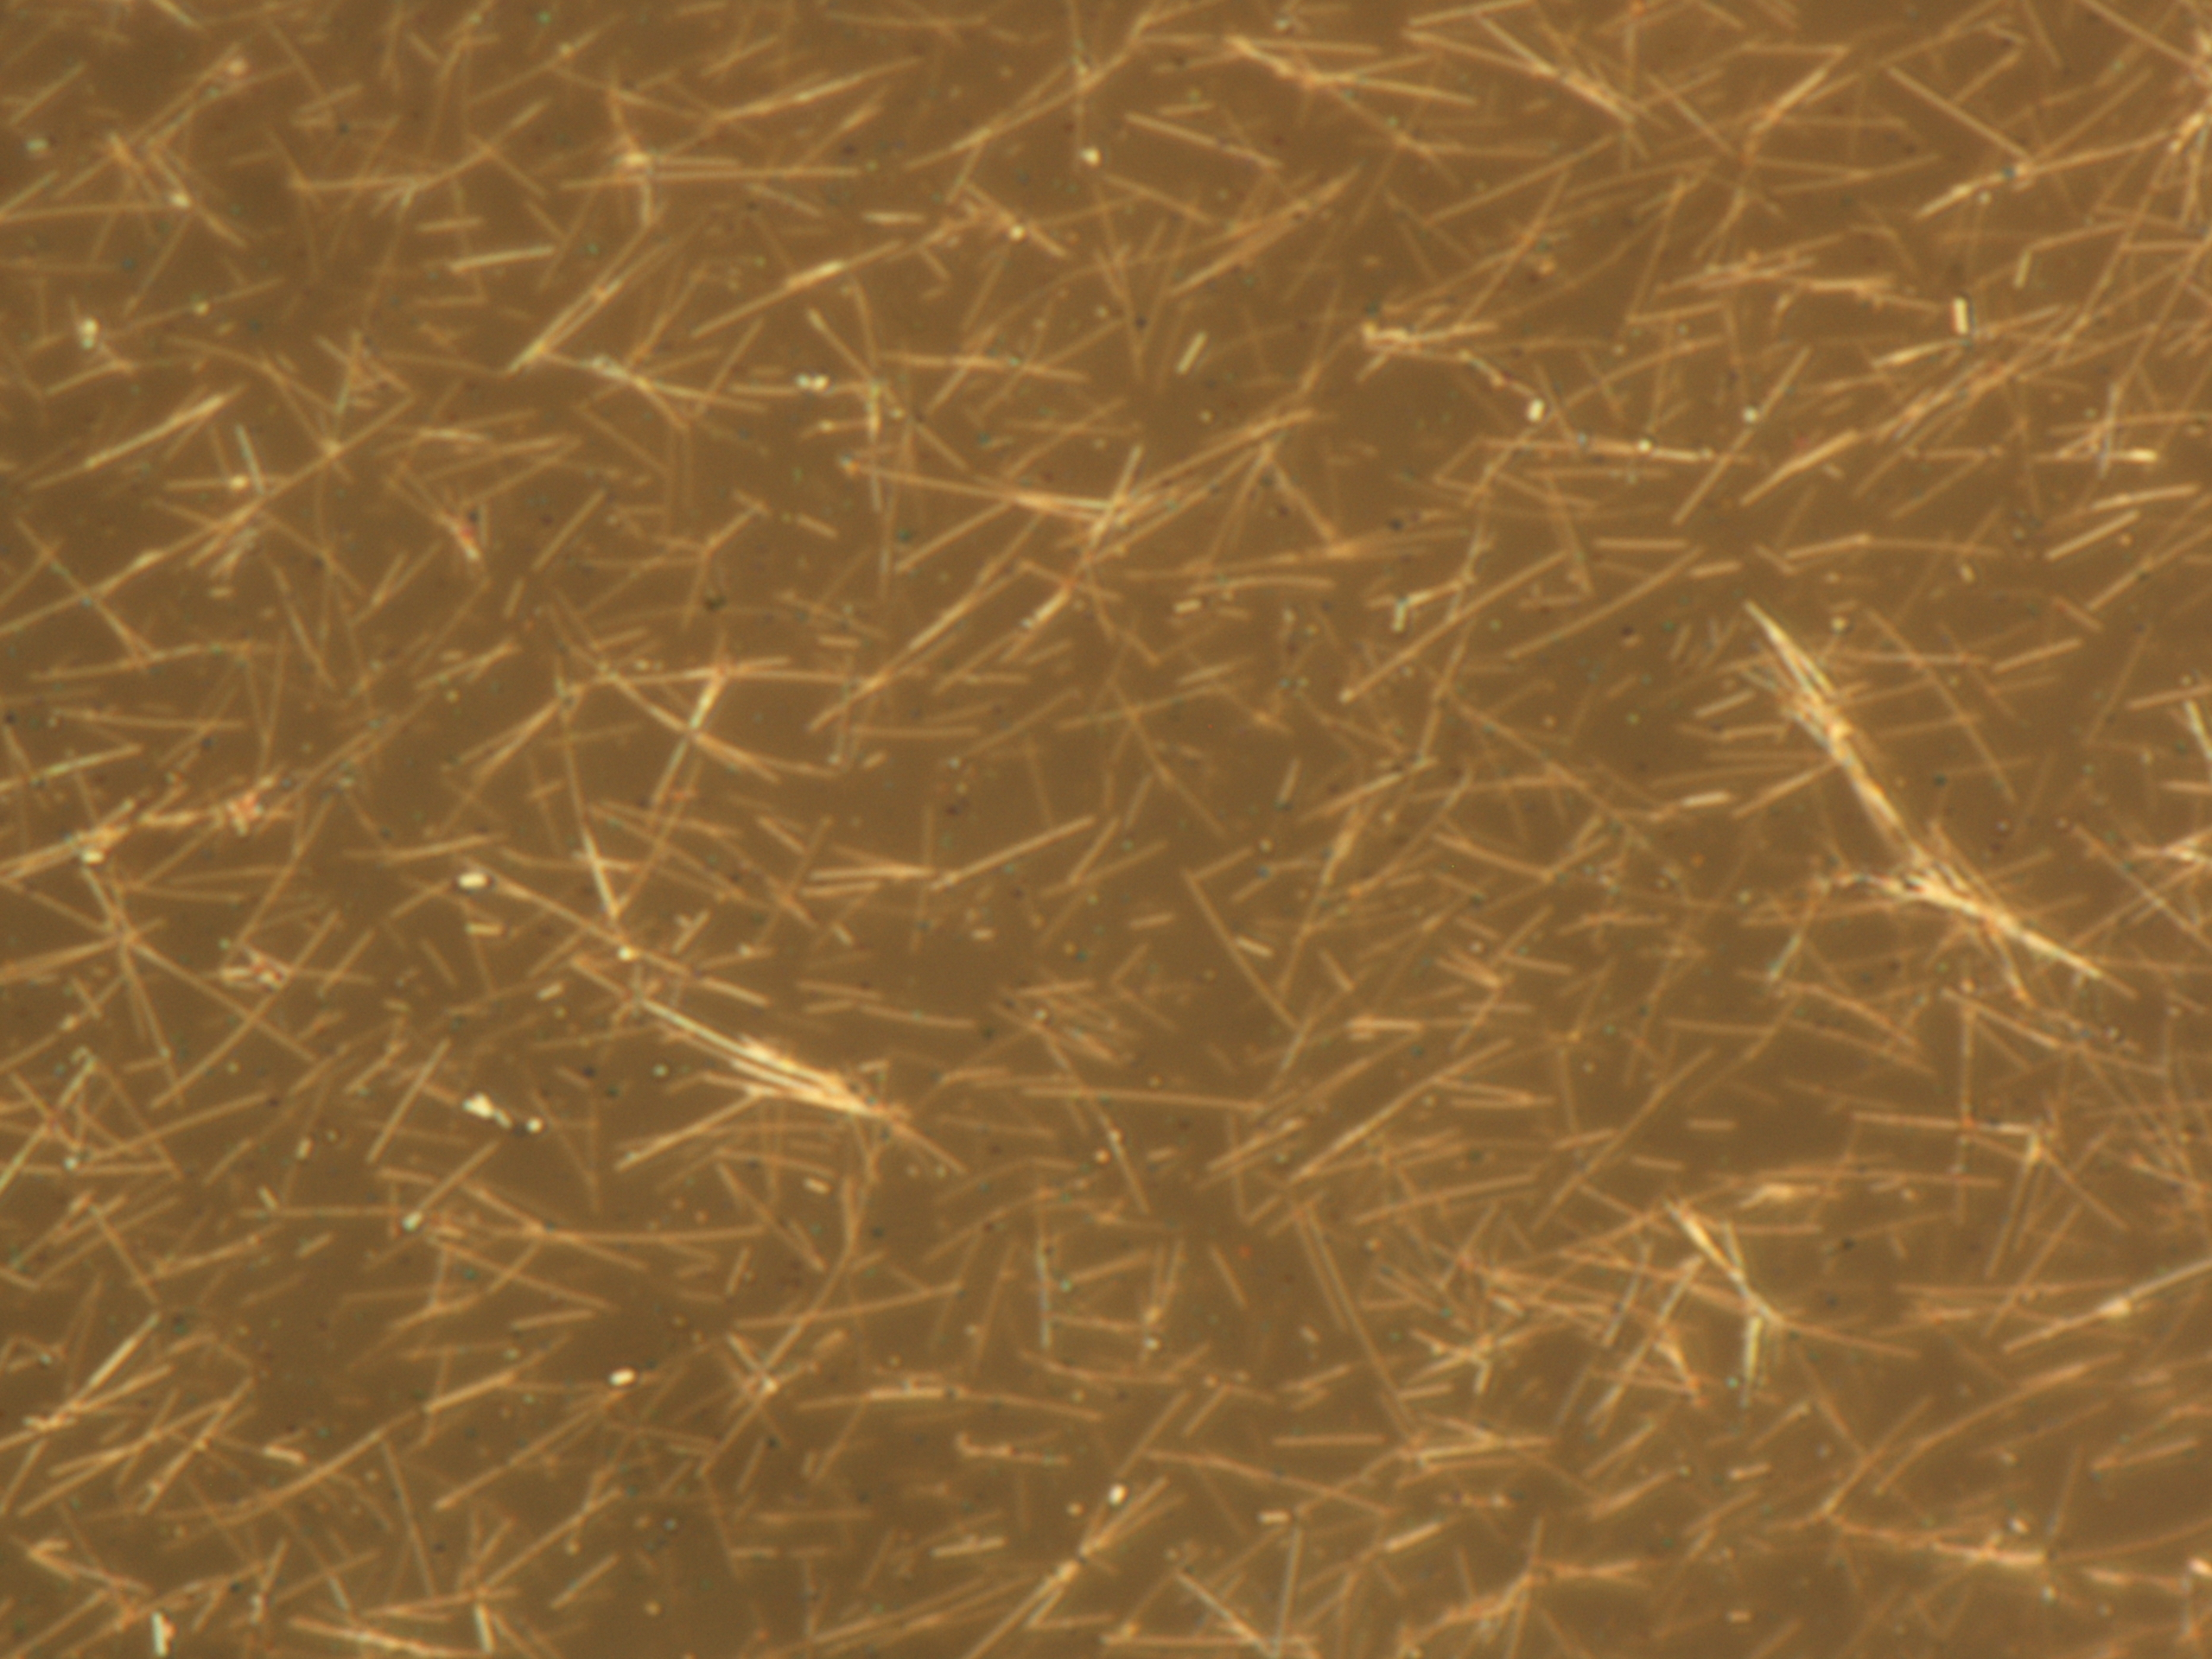
Physical Network
PVP@Ag nanowires
network electrodes
10 µm

Slide 3
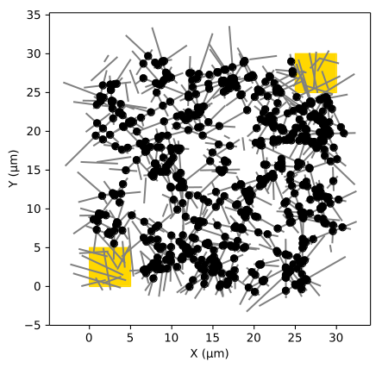
Network Model
PVP@Ag nanowires
representative computer model

Slide 4




Junction Memristor Model

Slide 5
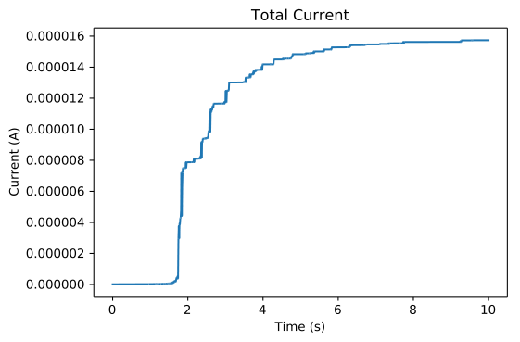
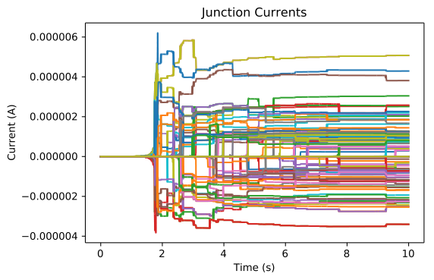
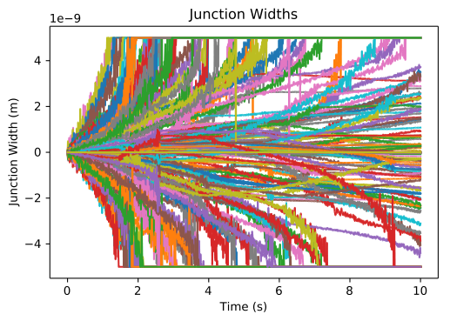
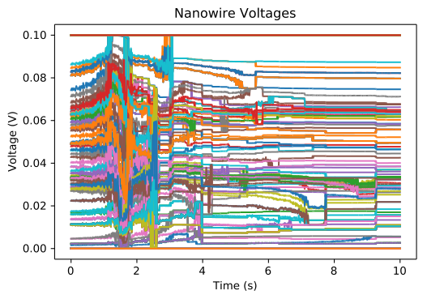
Network Time Response

Slide 6
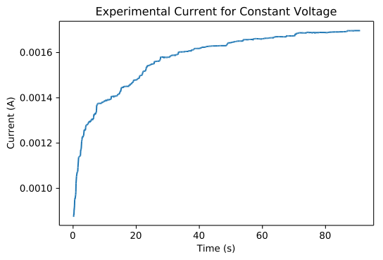
Experimental Confirmation
current from zero width
simulation
experiment

Slide 9
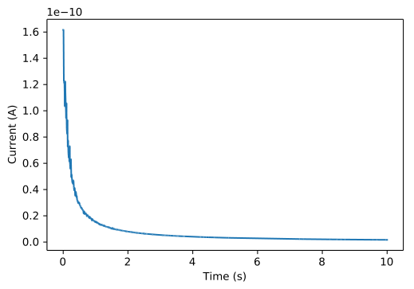
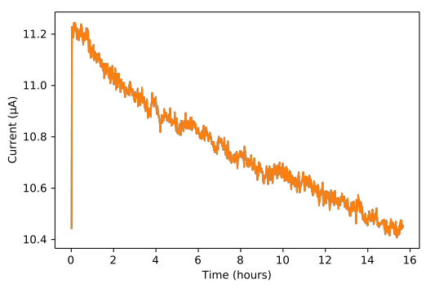
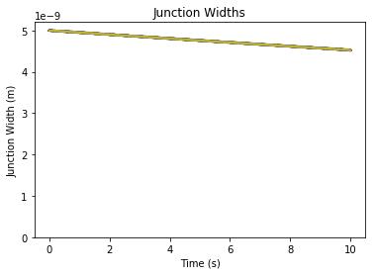
Network Decay
width decay, measured by current
simulation (100s time constant)
experiment
time constant ~ 1 week
representative computer model

Slide 10
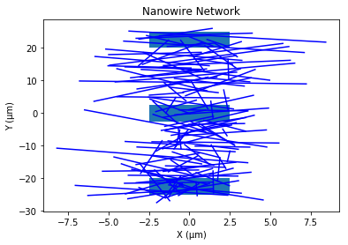
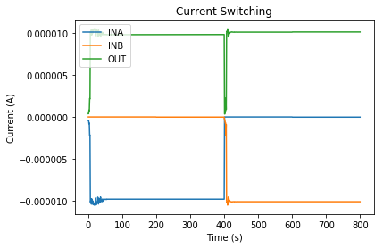
Finite State Machine
1
1
0
network
0
1
0
0
1
1
0
1
0
switching behavior

Slide 11
Conclusions
behavior reaches a steady state
low time constant - more complexity
as-is, not very useful
ephemeral memory
finite state machine

