Slide 1
Creating your Own Chatbot with Dialogflow
Vignesh Ram
Ai Engineer, Dteam

Slide 2
About DTeam
AI Company
JS, Python
Based in Chennai
Enlightenment

Slide 3
About Me
BE - Electronics & Communication - ACT, Thalambur, Chennai
AI Engineer @ DTeam
AI
Twitter: @vigneshtamizh
Github : https://github.com/vigneshram95

Slide 4
What is DialogFlow?
Give users new ways to interact with your product by building engaging voice and text-based conversational interfaces, such as voice apps and chatbots, powered by AI.
Dialogflow Connect with users on your website, mobile app, the Google Assistant, Amazon Alexa, Facebook Messenger, and other popular platforms and devices.
Dialogflow is a complete closed source product with API and web interface.
Dialogflow was previously known as api.ai and got acquired by Google in 2016.

Slide 5
Why DialogFlow?
Powered by Google’s Machine Learning
Built on Google Infrastructure
Optimized for google assistant
One click integration
It’s Easy to use

Slide 6
Context
Agent
Intent
Entities
Context
Events
Fulfillment
Training

Slide 7
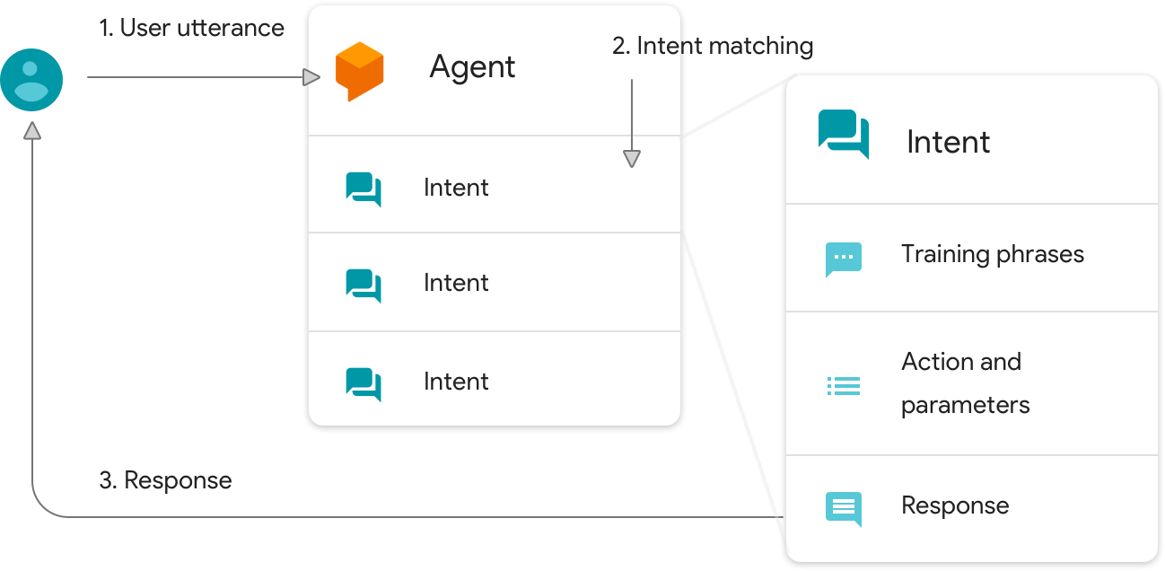
AGENT

Slide 8
Agent
Agents are our Natural Language Understanding (NLU) Modules.
These modules translates text or spoken user request into actionable data
This translation occurs when a user utterance matches an intent within your agent.
Matched intents delivers a response back to user.

Slide 9
Creating our own agent

Slide 10
Creating our own agent
New users: Click on Create new agent in the left menu.
Enter a name for your agent
Choose default language
Choose default time zone
Choose an existing Google project or leave the option on Create a new Google project.
Click create project

Slide 11
Pre-built Agents and small talks
Prebuilt Agents are a collection of agents developed by the Dialogflow team that are aimed at covering specific use cases.
These can be used to establish a base for building conversations that cover specific topics, like dining out, hotel booking, and navigation.
Prebuilt Agents include intents and entities that cover the agent's topic.
You need to provide responses since they may depend on particular use cases or need to be retrieved from external sources (webhook or third-party API).

Slide 12
Importing a pre-built Agent
To add a Prebuilt Agent to your account,
Click Pre-built Agents left in the menu
Click on a Prebuilt Agent tile to get more information.
Click Import
Either create a new Google project or choose an existing one
Click OK

Slide 13
Small Talk
Small Talk is used to provide responses to casual conversation. This feature can greatly improve the user experience by covering common questions that may not pertain to your agent's intents you built.
Enable Small Talk for an agent:
Click Small talk on the left menu
Click on the switch to enable
Click on Save

Slide 14
Customize small talk in the left menu
Once enabled, Small Talk responses can be customized to fit your branding or product needs. Each response category is organized in folders.
Click Small talk in left menu
Click on a response category folder
Add new or edit existing response
Click Save

Slide 15
Export, import, and restore
Agents can be exported, imported, and restored in the Dialogflow console. Import, export, and restore should be used for backing up agents or transferring them from one account to another.
Import, export and restore options are in the agent’s settings (the gear icon settings next to the agent’s name) under the export and import tab.

Slide 16
Export
To export an Agent follow these steps:
Click on the gear icon next to the agent name in the left menu
Click on the Export and Import tab
Click Export as Zip

Slide 17
Import
Importing an agent adds intents and entities to the current agent from the supplied ZIP file.
Click on the gear icon next to the agent name in the left menu
Click the Import and Export tab.
Click IMPORT FROM ZIP
Navigate to and open the ZIP file you want to import
Type “IMPORT” into the text field to confirm
Click IMPORT

Slide 18
Machine learning
Dialogflow agents use machine learning algorithms to understand natural language utterances, match them to intents, and extract structured data.
An agent learns both from training phrases that you provide and the language models built into Dialogflow.
Based on this data, it builds an algorithm for making decisions about which intent should be matched to a user utterance. This algorithm is unique to your agent.
Dialogflow updates your agent's machine learning algorithm every time you make changes to intents and entities, import or restore an agent, or train your agent.

Slide 19
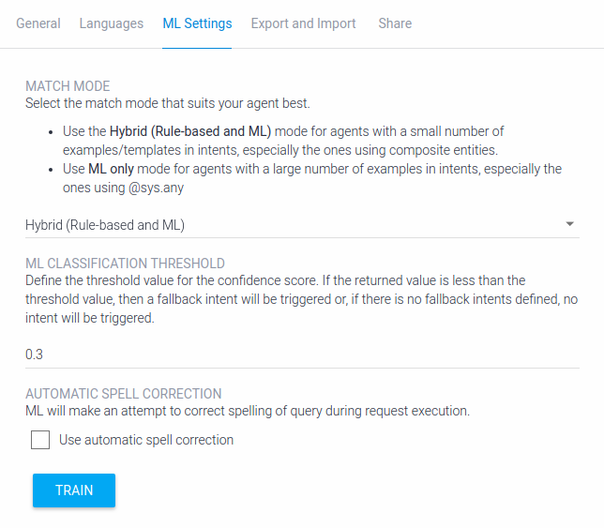

Slide 20
Intents - Overview
In Dialogflow, the basic flow of conversation involves these steps:
The user giving input
Your Dialogflow agent parsing that input
Your agent returning a response to the user

Slide 21
Intents
To define how conversations work, you create intents in your agent that map user input to responses.
In each intent, you define examples of user utterances that can trigger the intent, what to extract from the utterance, and how to respond.

Slide 22
Intents
Intents consist of four main components that allow you to map what your user says to what your agent responds with.
Intent name
Training Phrases
Action and Parameters
Responses
Intent Name:
The name of the intent.
The intent name is passed to your fulfillment and identifies the matched intent.

Slide 23
Training Phrases
Training phrases are collections of possible utterances that users might say to match an intent.
You'll need to add multiple training phrases within an intent (20 or more examples) so your agent can recognize a greater variety of user input.
For example, a training phrase like "I want pizza" trains your agent to recognize similar input, like "Get a pizza" or "Order pizza".
As you create intents and training phrases for your agent, Dialogflow constructs a dynamic model behind the scenes to make decisions about how to handle user input.

Slide 24
Entities
Entities represent categories of things— for example, colors, cities, and numbers— and annotation refers to the linking of words or values within training phrases to their corresponding entities.
Dialogflow defines system entities, which are pre-built entities that correspond to commonly used categories like color, time, and city names.
You can also create developer-defined entities when you want Dialogflow to recognize a certain category of things that isn't represented by a system entity

Slide 25
Actions and Parameters
Within each intent, there is a table under the training phrases section entitled Action and parameters. Once you annotate your training phrases, the corresponding parameters automatically appear in this table. This section also contains a text field named "action".
VALUES:
The value of a parameter can be used in responses to refer to that parameter. The value is like a placeholder or the variable assigned to the parameter. For more information on using these in responses, see the extract parameter values section below.

Slide 26
Extract Parameter Values
When you define responses, you can reference extracted parameter values and include them in the response. This is helpful for recapping information provided by the user.
COMPOSITE ENTITIES:
Composite entities are single entities that reference two or more other entities.

Slide 27
Responses
Every intent must define a response that's returned to the user. There are two primary ways you can return a response to the user — either with a pre-defined, static response or with a response generated from a webhook. In both of these cases, you can use extracted parameters in the response.
As a general rule, your responses to users should prompt them to provide input that will match one of your other intents

Slide 28
Static Text Responses
In the Responses section of your intent, you can define one or more static text responses that will be returned when a user's input matches that particular intent. If you have more than one text response defined, your agent will select responses to return at random (but never use a variation twice in a row) until all responses have been used.
We recommend adding several varieties of text responses to make your agent more conversational.
You can also specify that a parameter extracted from the user's input be used in your response

Slide 29
Dynamic Responses
If you want to return dynamic responses to the user, you must use fulfillment, which is code that is deployed as a webhook and responds to HTTP requests from Dialogflow.

Slide 30
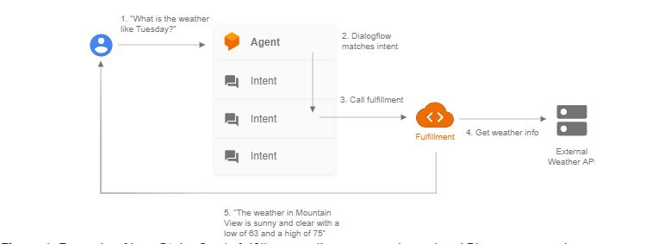
Example of how Dialogflow's fulfillment calls an external weather API to construct the response to the user.

Slide 31
Default Intents
When you create an agent, there are two intents already created and configured for you— the Default Welcome Intent and the Default Fallback Intent.
The Default Welcome Intent is called whenever the user begins a conversation with your agent via supported one-click integrations, and should return a response that lets users know what your agent does or what users can say to begin a conversation.
The Default Fallback Intent is matched if your agent doesn't recognize user input.

Slide 32
Rich Messages
In the Response section, you can add tabs for some of our supported integrations.
This allows you to define default or integration-specific responses. In each tab, you can add up to 10 of the same or different message types.
The DEFAULT tab and the integration tabs offer different message types. The integration tabs allow you to add images, cards, and quick replies.
Your agent’s response can consist of up to 10 sequential messages that you can reorder in the UI. If you create intents via the /intents endpoint, the order of messages will correspond to the messages array elements order.

Slide 33
Types of Responses
Text Response
Image Response
Card Response
Text Response:
Text responses are available in all platforms. Your agent can send up to 10 sequential text messages in response to a user input (assuming no other message types are defined in the intent).

Slide 34
Image Response
The image message type lets your agent send images in integrations for Facebook Messenger, Kik, LINE, Skype, Slack, Telegram, and Viber.
All you need to do is to store the image and provide the public URL in the response for the agent.
Card Response:
Cards consist of an image, a card title, a card subtitle, and interactive buttons (for sending user queries or opening links). These elements can be combined depending on the platform's requirements:

Slide 35
Quick Replies
Quick replies are displayed in messengers as clickable buttons with predefined user responses. When clicked, the button text is sent to the agent as a user query.
Requirements/Limitations:
One quick reply element per intent
Maximum of 10 replies
20 characters per limit

Slide 36
Custom Payload
You can also send a custom payload to self-developed integrations. It won’t be processed by Dialogflow, so you'll need to handle it in your own business logic.

Slide 37
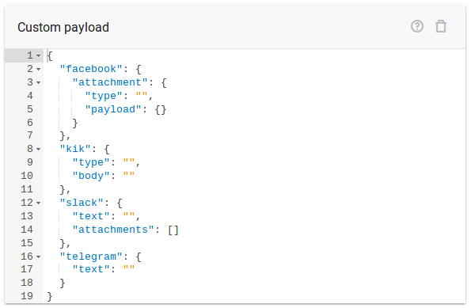

Slide 38
Entities
Entities are Dialogflow's mechanism for identifying and extracting useful data from natural language inputs.
While intents allow your agent to understand the motivation behind a particular user input, entities are used to pick out specific pieces of information that your users mention — anything from street addresses to product names or amounts with units. Any important data you want to get from a user's request will have a corresponding entity.

Slide 39
Types of Entities:
System Entities
Developer Entities
Session Entities

Slide 40
Create and Manage Entities
When setting up your agent, it's best to define your entities prior to adding the training phrases to your intents.
This will ensure the correct words are annotated when the training phrases are supplied. You can create entities afterwards, but you'll need to manually annotate the training phrases in each intent.

Slide 41
Create developer entities:
In the left menu, click Entities.
Click CREATE ENTITY.
Enter a name for the entity at the top of the page.
Click in the first row and enter an entry.
Click in the next column or press Enter and enter related synonyms for the initial entry.
Continue adding entries and synonyms.
Click SAVE.

Slide 42
Events
Events allow you to invoke intents based on something that has happened instead of what a user communicates.
Dialogflow supports events from several platforms (like Google Assistant, Slack, and more) based on actions users take on those platforms.

Slide 43
Add an event to an intent
Go to the Events section of the intent
Type the name of the event you’d like your intent to respond to.
Press Enter
Click SAVE

Slide 44
Fulfillment
Fulfillment is code that's deployed as a webhook that lets your Dialogflow agent call business logic on an intent-by-intent basis.
During a conversation, fulfillment allows you to use the information extracted by Dialogflow's natural language processing to generate dynamic responses or trigger actions on your back-end.
The following are some example cases where you can use fulfillment to extend an agent:
To generate dynamic responses based on information looked up from a database.
To place orders based on products a customer has asked for.
To implement the rules and winning conditions for a game.

Slide 45
Training
There are three main use cases for real world data within Dialogflow:
Building a new DialogFlow agent using logs of existing customer interactions
Use training to add existing data to training phrases
Improving the performance of a live Dialogflow agent using its own logs.
Use training to add additional data to training phrases
Understanding the performance of a live Dialogflow agent to inform your design decisions.
Use analytics to assess performance of agent.

Slide 46
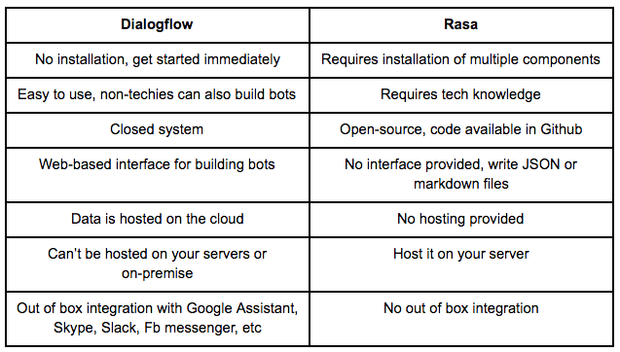
Comparison of DialogFlow and Rasa

Slide 47
Queries?

