Slide 1
WEATHER-BOT

Slide 2
CONTENTS:
Retrieval based chatbot - Intro
References
Stack
Architecture
Data I/P format
Expected Results
Inspiration Samples
Code Walkthrough
Future Progress

Slide 3
RETRIEVAL BASED CHATBOT
Retrieval-based models have a repository of predefined responses they can use, which is unlike generative models that can generate responses they’ve never seen before.
In a retrieval-based model AI is going to select the best pre-defined response, whereas in Generative based model, we will not define any responses. It is going to generate a best response for context or question.
For example if we give two response like hello, how can i help you ? and good bye, if a user say about context of greetings, AI is going to select the greeting response from the above two response.

Slide 4
REFERENCES
For SLACK
https://www.youtube.com/watch?v=xu6D_vLP5vY&t=3938s (RASA NLU v0.12.3, CORE v0.9.8)
For GOOGLE-ASSISTANT
http://blog.rasa.com/going-beyond-hey-google-building-a-rasa-powered-google-assistant/
Code reference :
https://github.com/JustinaPetr/Weatherbot_Tutorial

Slide 5
Contd.,
https://towardsdatascience.com/a-chatbot-from-future-building-an-end-to-end-conversational-assistant-with-rasa-ai-51a1c93dabf2

Slide 6
TECH STACK
RASA STACK
RASA NLU (v0.13.8)
RASA CORE (v0.12.3)
2. MESSAGING PLATFORM
SLACK
GOOGLE ASSISTANT
3. NGROK - Tunnels to localhost webhook

Slide 7
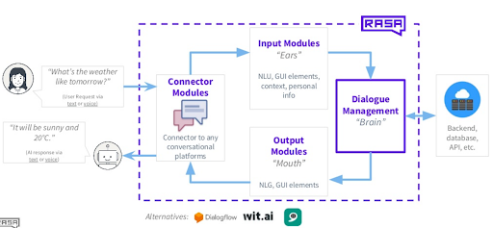
ARCHITECTURE

Slide 8
MESSAGING PLATFORMS
FACEBOOK
SLACK
TELEGRAM
CISCO WEBEX TEAMS
MATTERMOST
MICROSOFT BOT FRAMEWORK
TWILIO
CUSTOM - Apart from these we can code for custom connectors in any language.

Slide 9
CONNECTOR MODULES
CONNECTOR module is a connector between rasa stack and Messaging Platforms

Slide 10
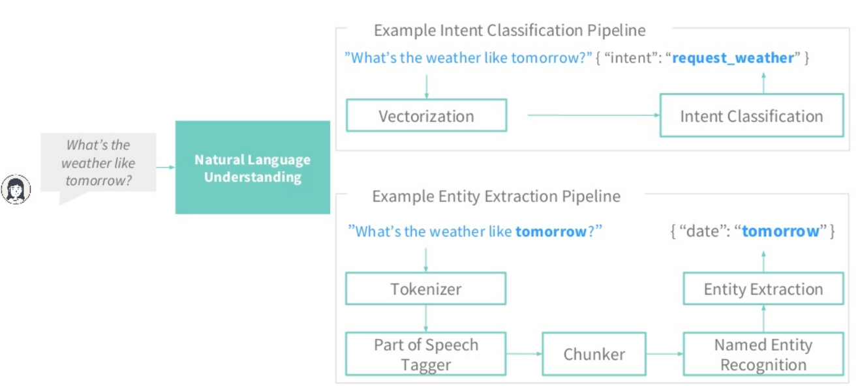
INPUT MODULES
RASA NLU - PIPELINE
RASA NLU process is intent classification and entity extraction

Slide 11
What do different Parts mean ?
INTENTS : things you expect user to say.
ACTIONS : Things your bot can do and say
TEMPLATES : templates strings for things your bot can say
ENTITIES : piece of info you want to extract from your message.
SLOTS : Information to keep track of during a conversation. For example (user-age)

Slide 12
RASA NLU
Rasa NLU is an open-source natural language processing tool for intent classification and entity extraction in chatbots.
And returning a structured data like this:

Slide 13
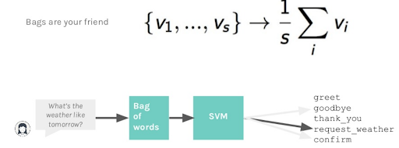

Slide 14
PIPELINE USED IN WEATHER BOT NLU
In general rasa provides spacy-sklearn, tensorflow embeddings, MITIE, MITIE-Sklearn, and we can build our own customized pipeline
IN RASA NLU - we have used tensorflow embedding pipeline
TENSORFLOW EMBEDDING PIPELINE
- name: "tokenizer_whitespace" - name: "ner_crf" - name: "ner_synonyms" - name: "intent_featurizer_count_vectors" - name: "intent_classifier_tensorflow_embedding"

Slide 15
Contd.,
In future we are going to try BERT NER (Number one place in NLP model) and also we are going to use LOOKUP TABLE which will increase the performance of the entity recognition process.

Slide 16
Contd.,
Ner_crf requires sklearn-crfsuite which has conditional random field model and it is good for training custom entities

Slide 17
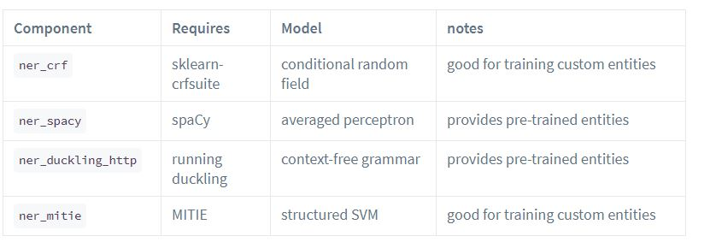
ENTITIES TYPES

Slide 18
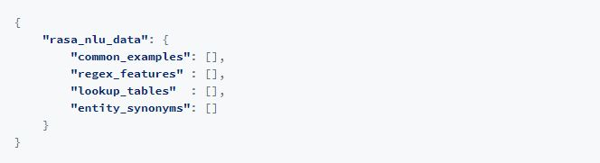
TRAINING DATA FORMAT

Slide 19
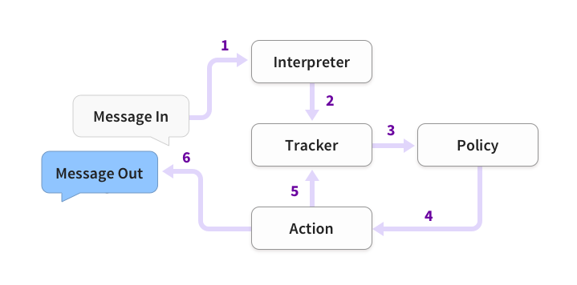
DIALOGUE MANAGEMENT MODEL

Slide 20
INTERPRETER
Interpreter - a block of RASA NLU, here raw text arrives. It throws out the intention of the user along with some meaningful entities.
We will save the entities as slots that will drive the conversation.

Slide 21
TRACKER
All conversations are stored within a tracker store. Rasa Core provides implementations for different store types out of the box. If you want to use another store, you can also build a custom tracker store by extending the TrackerStore class.
Tracker Stores
InMemoryTrackerStore (default)
RedisTrackerStore
MongoTrackerStore
Custom Tracker Store

Slide 22
Contd.,
If this is the first message of the conversation, rasa core will create a tracker object with the key — sender_id which is the incoming identifier of the user. In future we can identify the user with this id,hence using past conversation we can identify the user’s details. so that further conversation can be carried out easily

Slide 23
POLICY
The rasa_core.policies.Policy class decides which action to take at every step in the conversation.
There are different policies to choose from, and you can include multiple policies in a single rasa_core.agent.Agent. At every turn, the policy which predicts the next action with the highest confidence will be used.
POLICIES WILL BE CONFIGURED USING CONFIGURATION FILE.

Slide 24
Contd.,
Policies
Keras Policy
Memoization Policy
Fallback Policy
In future we are going to implement REPD Policy, which is in experiment stage, will update soon

Slide 25
ACTIONS
Actions are the things your bot runs in response to user input. There are three kinds of actions in Rasa Core:
Default actions - (action_listen, action_restart,action_default_fallback)
Utter actions - starting with utter_, which just sends a message to the user
Custom actions - any other action, these actions can run arbitrary code

Slide 26
TRAINING DATA - ARCHITECTURE
Training Data
Generate story Graph
Load Data
Train
Persist
Config
Load Agent
Policies
Featurizers
Parameters

Slide 27
TRAINING DATA
Questions and Answers
(conversation)
STORIES.MD

Slide 28
Contd.,
Questions and Answer session will hold the conversations
All these conversations will be stored as a md file

Slide 29
GENERAL ARCHITECTURE
With (lookup table)
connector
RASA NLU
DIALOGUE MANAGEMENT MODEL
Messaging platform
LOOKUP TABLE
connector
O/P MODULE

Slide 30
NGROK
RASA STACK LOCAL SERVER
NGROK
MESSAGING PLATFORM
ESTABLISHeS A LINK BETWEEN LOCAL SERVER

Slide 31
INSPIRATIONAL SAMPLE
SARA : Chatbot available at rasa.com
Link below : https://rasa.com/docs/get_started_step1/

Slide 32
CODE
NLU MODEL
nlu_model.py
Data.json
Config.yml
RASA CORE
Stories.md
domain.yml
Train_init.py
train_online.py
Dialogue_management_model.py
Connectors
Custom connector
Default connector

Slide 33
Contd.,
Custom Actions
Endpoints
Action.py

Slide 34
STEPS TO DEPLOY RASA CHATBOT
First start the custom action server :
“python -m rasa_core_sdk.endpoint --actions actions”
Second start the RASA stack :
“python -m rasa_core.run --enable_api -d models/dialogue -u models/nlu/default/weathernlu --credentials credentials.yml --endpoint endpoints.yml”
Third start the NGROK
“ngrok http 5005”
Copy the NGROK URL to the messaging platform (settings)

Slide 35
FUTURE IMPLEMENTATION
BERT NER -> TRIAL & ERROR METHOD
LOOKUP TABLE -> TRIAL & ERROR METHOD
EMBEDDED POLICY (REDP)
FALLBACK POLICY

