Slide 1
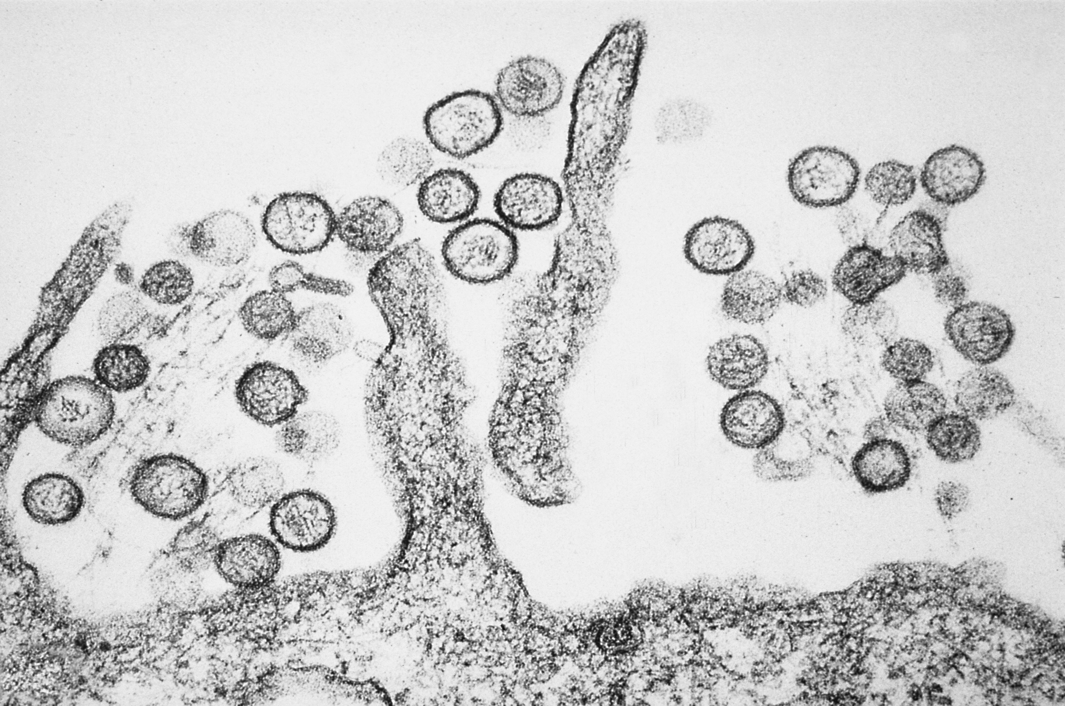
PATHOGEN
DISPATCH
HANTAVIRUS OUTBREAK
The Edge
of Epi
SITUATION BRIEF #1
4 May 2026
1
HIGHLIGHTS:
• WHO reports one lab-confirmed hantavirus case and five suspected cases.
• Of six affected people, three have died; one person is in intensive care in South Africa.
CONFIRMED
• Route signal: MV Hondius travelled from Ushuaia, Argentina, to Cabo Verde.
CASE
• ECDC is monitoring with national public health authorities and WHO.
• Sequencing is ongoing; the specific hantavirus strain has not yet been publicly clarified.
5
Reported Hantavirus-Associated Illness Status, MV Hondius 2026
SUSPECTED
5
CASES
3
0
confirmed
suspected
deaths
ICU
3
Investigation Questions to Resolve
DEATHS
sequencing
environment
transmission
REPORTED
1
strain
source
crew
timeline
contacts
rodents
IN ICU
RESPONSE ACTIVITIES:
S. AFRICA
• Medical care, evacuation planning, and support for affected passengers and crew are ongoing.
• Public health authorities are assessing shipboard risk, exposure history, and possible source.
• Laboratory testing and sequencing are expected to clarify the virus and containment needs.
• Contact tracing should focus on symptom timing, close contacts, and shared exposure spaces.
PUBLIC RECOMMENDATIONS:
• Wider public risk has been described by WHO Europe as low; no panic or broad travel restrictions.
• Avoid exposure to rodent urine, feces, saliva, and dust in enclosed or poorly ventilated spaces.
• Seek urgent medical care for fever plus worsening respiratory symptoms after possible exposure.
• Watch for sequencing updates: Andes virus would raise different transmission concerns.
HANTAVIRUS
SYMPTOMS:
• Fever/chills
• Muscle aches
• GI symptoms
• Cough or dyspnea
• Rapid worsening
CDC PHIL #1136: Sin Nombre hantavirus TEM
Rodent-contaminated spaces
SEVERE:
low oxygen, shock
For suspected exposure with respiratory symptoms, seek medical care urgently.
Sources: WHO reporting via UN Geneva; ECDC news release; CDC hantavirus guidance and PHIL image library.
Numbers reflect public reporting available on 4 May 2026 and may change as the investigation develops.

