Slide 1
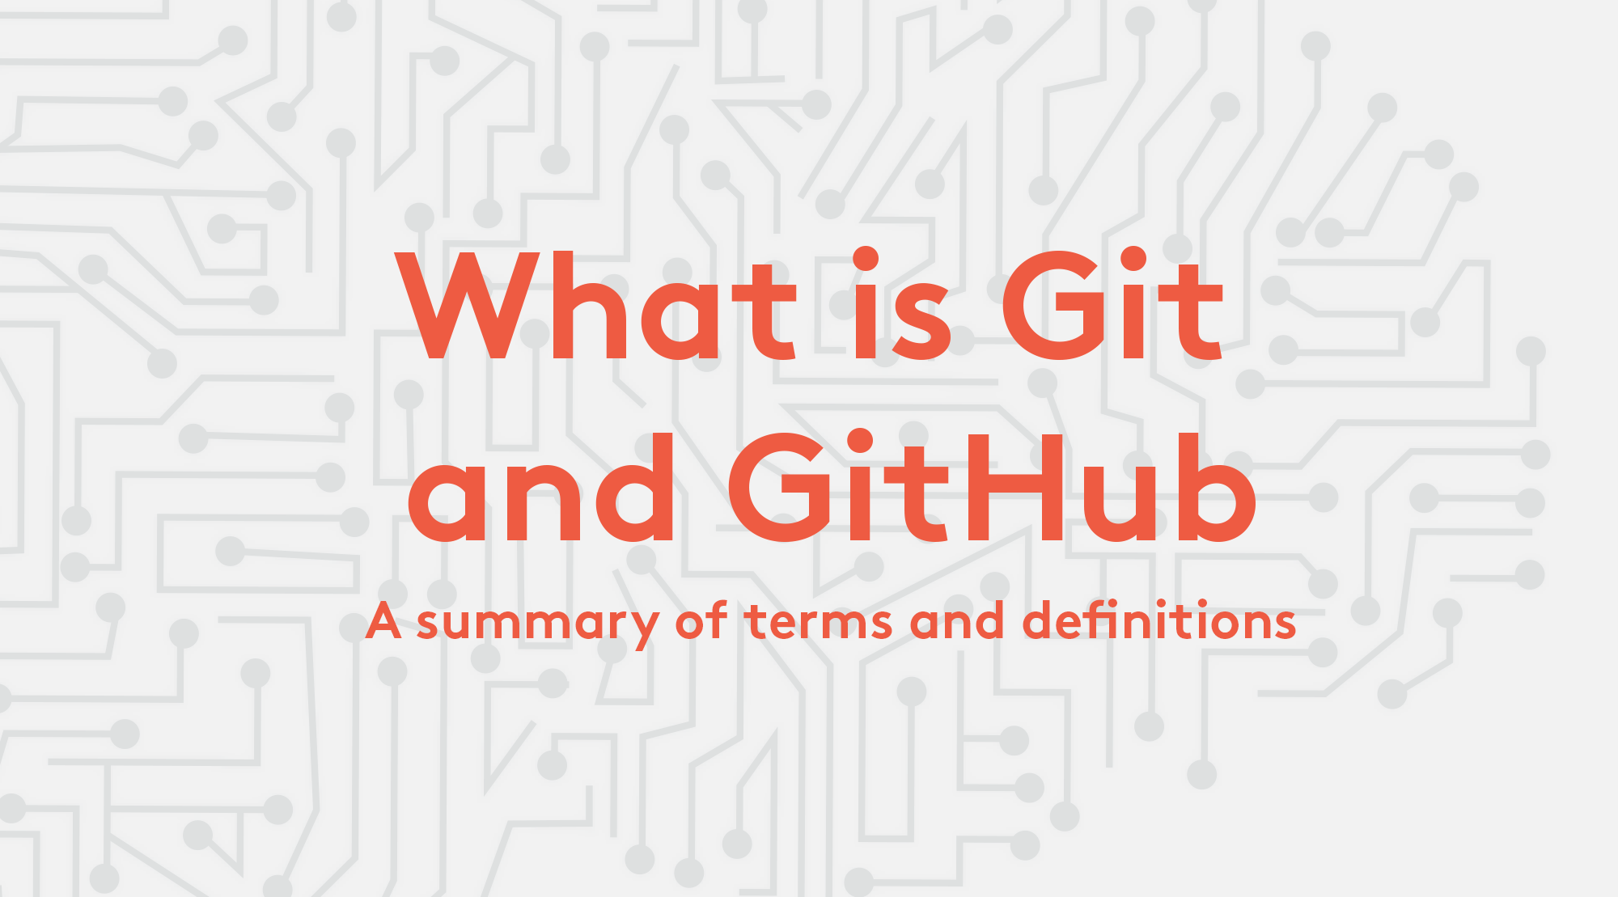

Slide 2
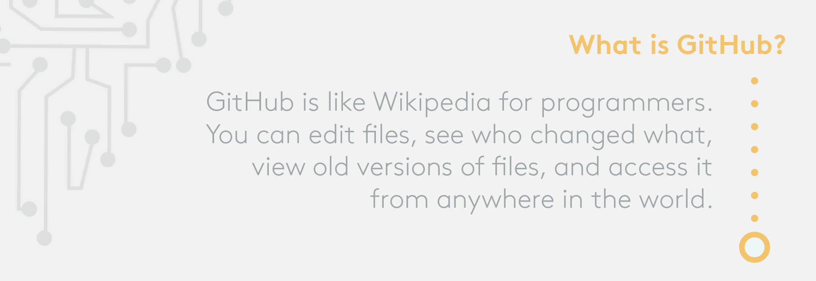

Slide 3
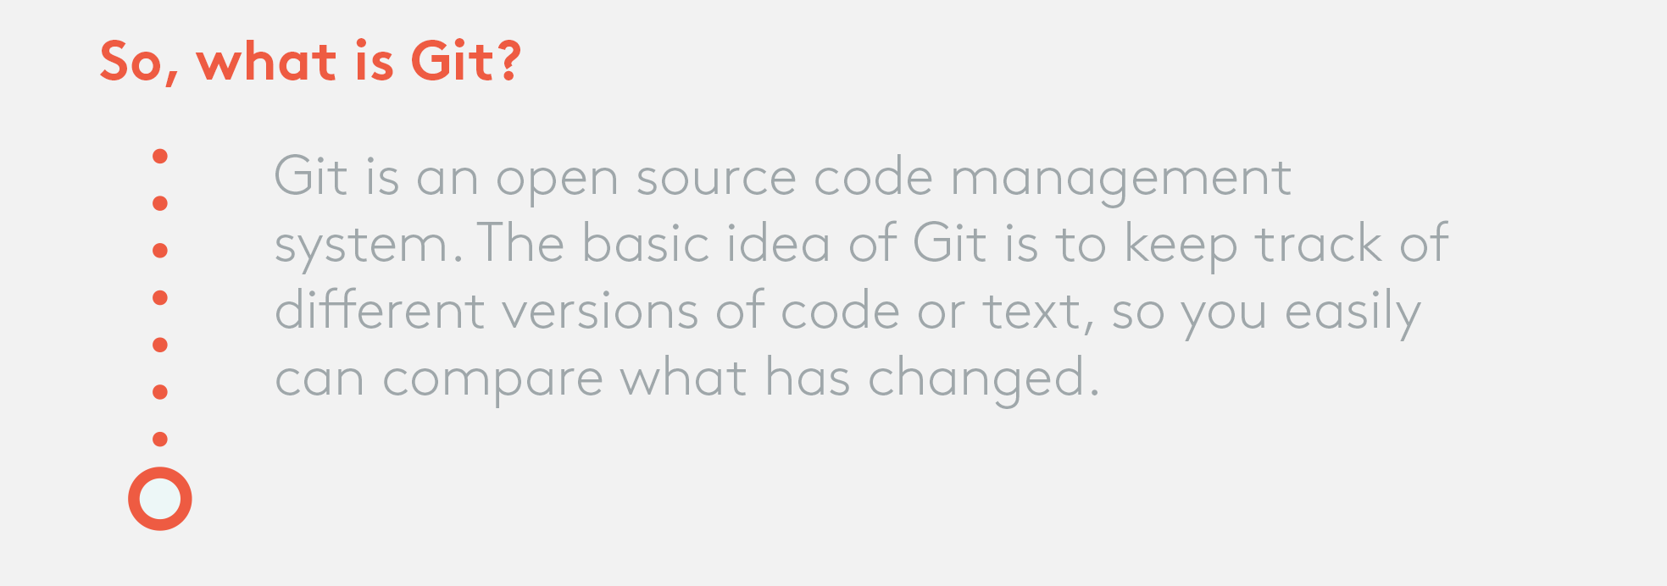

Slide 4
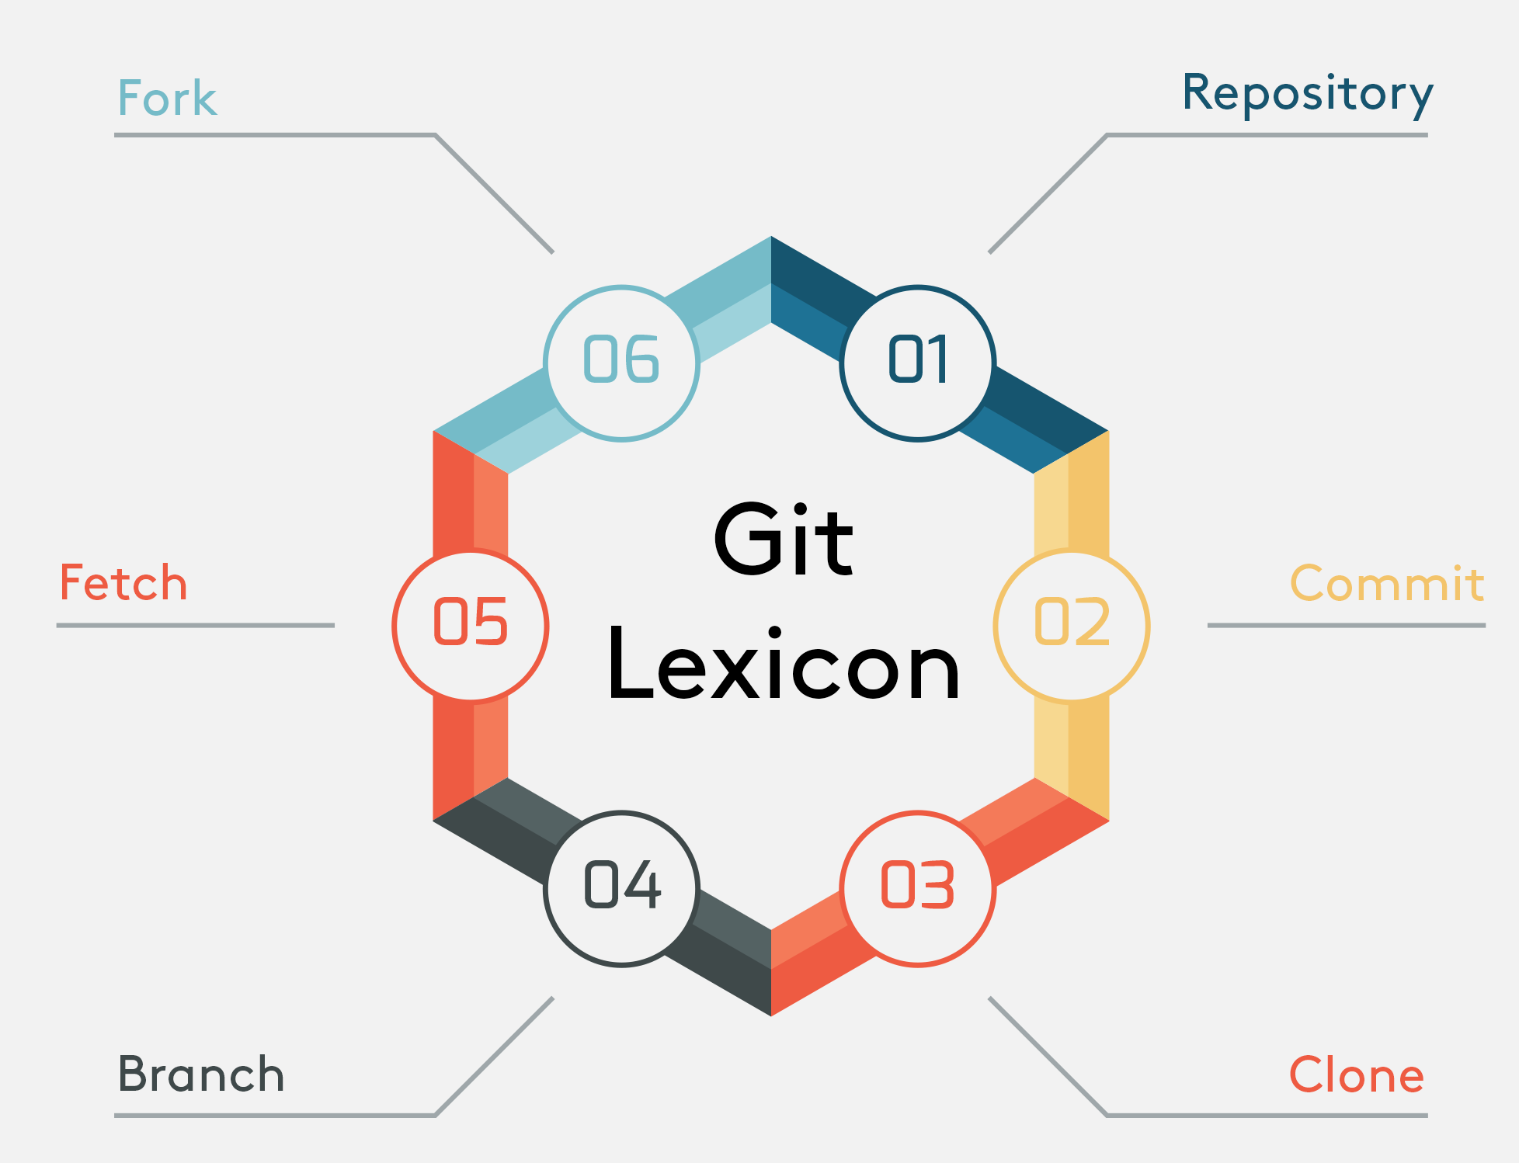

Slide 5
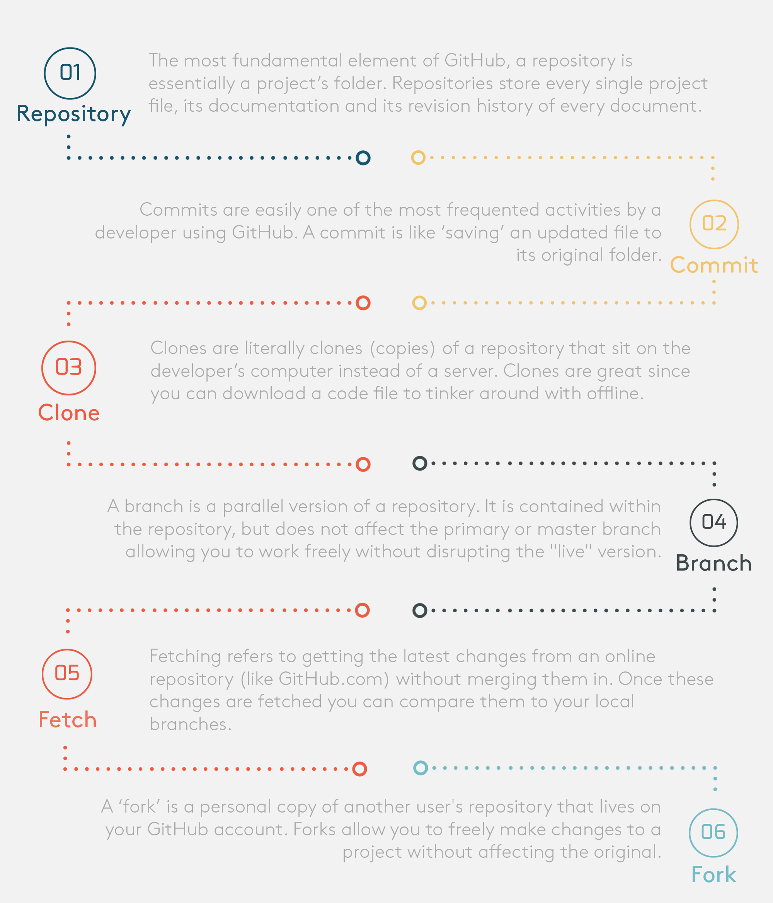
Notes:
A forked repository differs from a clone in that a connection exists between your fork and the original repository itself. In this way, your fork acts as a bridge between the original repository and your personal copy where you can contribute back to the original project using Pull Requests 554.
So, unlike a branch, a fork is independent from the original repository. If the original repository is deleted, the fork remains. If you fork a repository, you get that repository and all of its branches.

Slide 6
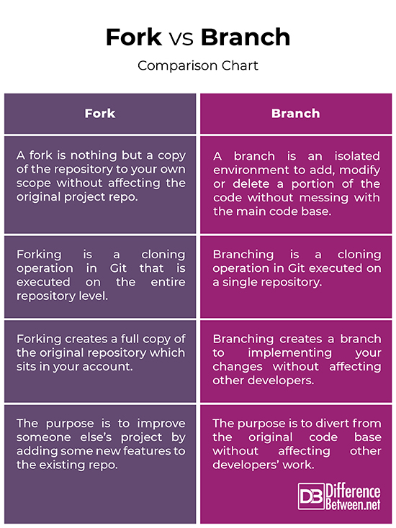

Slide 7
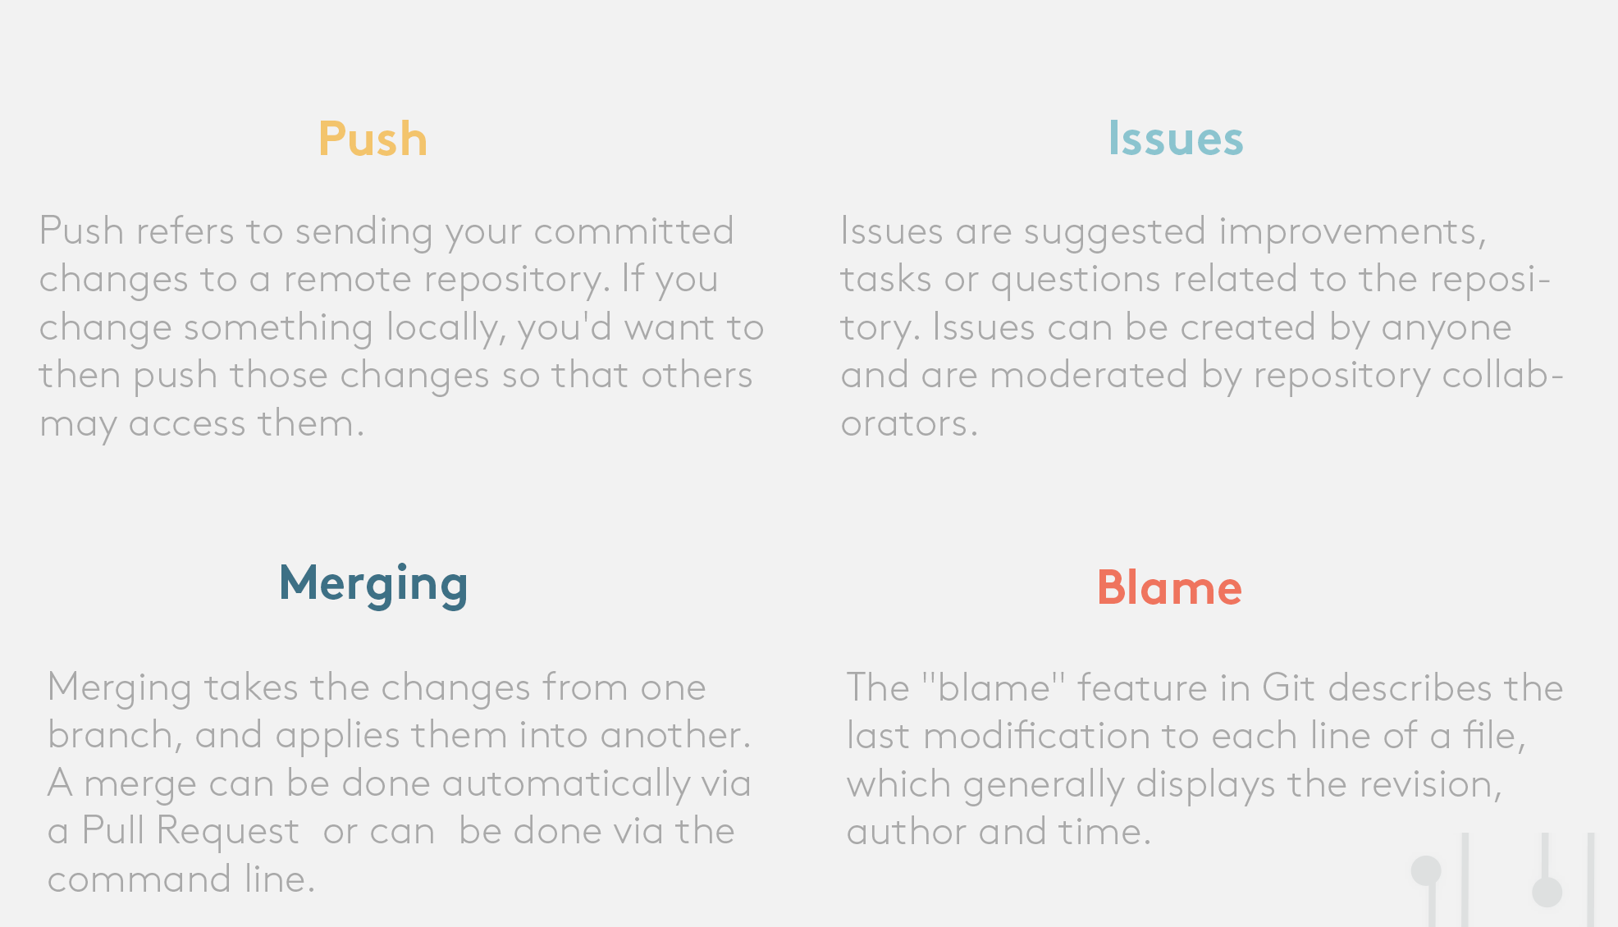

Slide 8
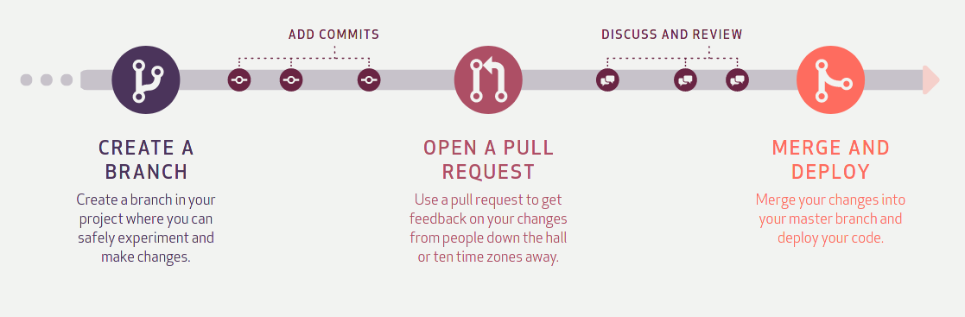

Slide 9
MERGE CONFLICT?
A merge conflict is an event that occurs when Git is unable to automatically resolve differences in code between two commits. When all the changes in the code occur on different lines or in different files, Git will successfully merge commits without your help.

Slide 10
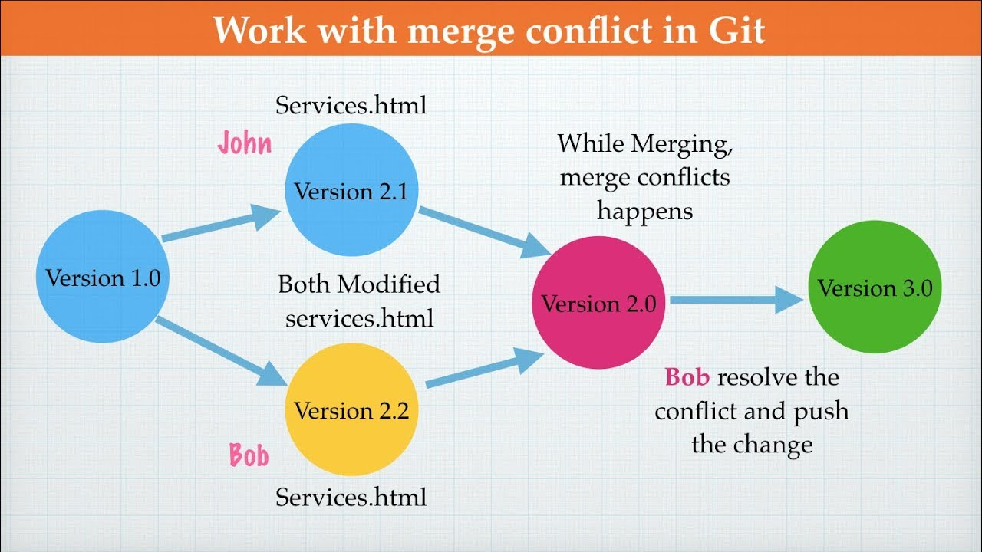

Slide 11
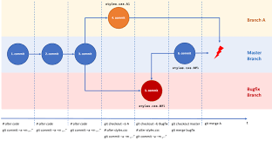

Slide 12
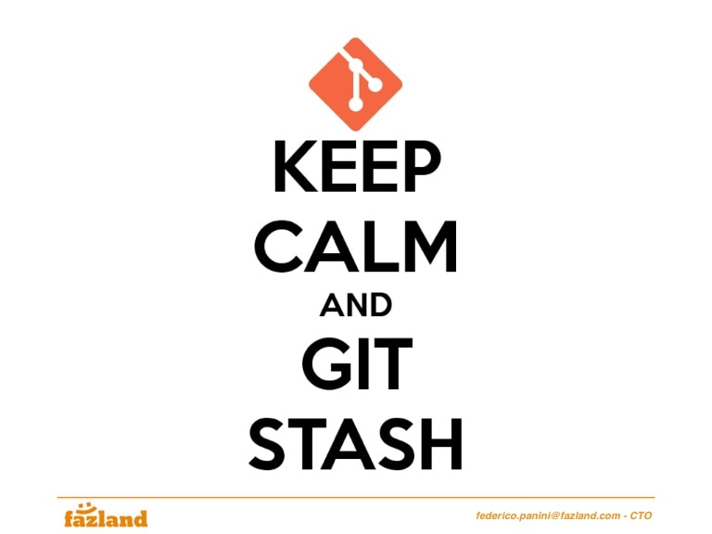
What if I have to change branches without committing my changes?

Slide 13
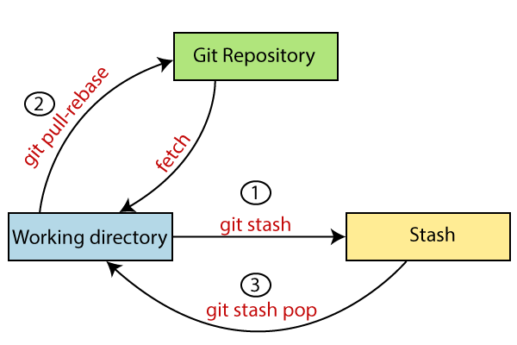

Slide 14
Stashing vs. Shelving
Stashes are generated by Git, and can be applied from within IDE, or outside it.
Patches with shelved changes are generated by IDEand are also applied through the IDE. Also, stashing involves all uncommitted changes, while when you put changes to a shelf, you can select some of the local changes instead of shelving them all.

Slide 15
Thanks for listening!

