Slide 1
Open Source Licenses

Slide 2
What is open source software?
Open-source software is software with source code that anyone can inspect, modify, and enhance.

Slide 3
What is open-source license?
Open-source licenses are legal and binding contracts between the author and the user of a software component, declaring that the software can be used in commercial applications under specified conditions.
The license is what turns code into an open-source component.
Without an open-source license, the software component is unusable by others, even if it has been publicly posted on GitHub.

Slide 4
Can open-source software be used for commercial purposes?
Absolutely. All open-source software can be used for commercial purpose. You can even sell open-source software.
However, note that commercial is not the same as proprietary. You cannot place further restrictions on people who receive the software from you.

Slide 5
Can I stop "evil people" from using my program?
No. The open-source definition specifies that open-source licenses may not discriminate against persons or groups. Giving everyone freedom means giving evil people freedom, too.

Slide 6
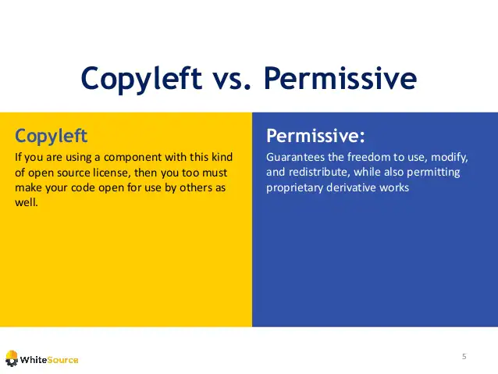
Two Main Types

Slide 7
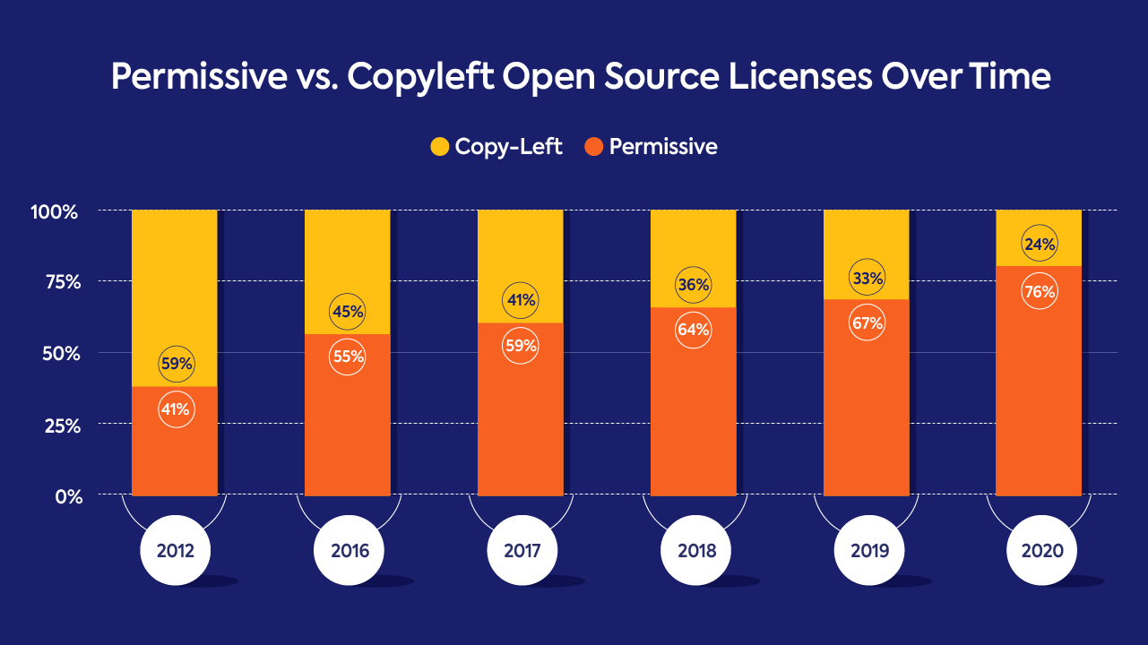

Slide 8
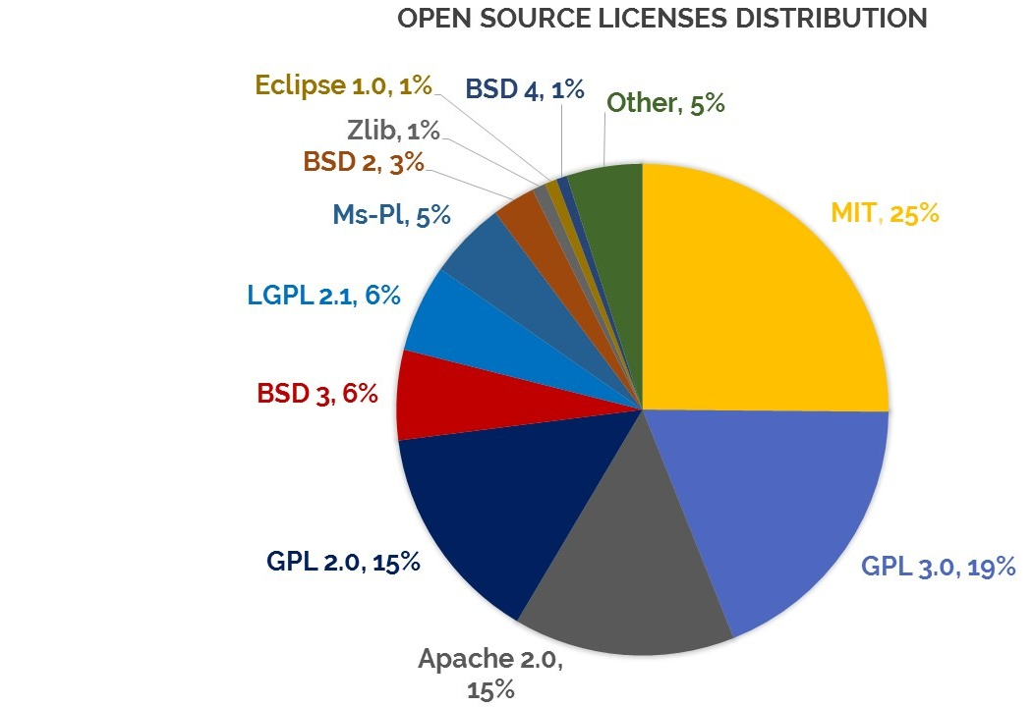
Distribution

Slide 9

MIT License
Basically, you can do whatever you want with software licensed under the MIT license — as long as you add a copy of the original MIT license and copyright notice to it.

Slide 10

The Apache License
You can freely use, modify, distribute and sell a software licensed under the Apache License without worrying about the use of software: personal, internal or commercial.
Rights to users that can be applied to both copyrights and patents, unlike other permissive licenses that are applicable only to copyrights and not patents. The rights given are perpetual, worldwide, irrevocable, but also non-exclusive — so you can use the licensed work, and so can anyone else.

Slide 11
The Apache License
It requires you to explicitly list out all the modifications that you’ve done in the original software, i.e., you’re required to preserve modification notices.
You can’t name your product in any way that hints at the product being endorsed by Apache. “SuperWonderServer powered by Apache” “Apache SuperWonderServer”.
You must not name your product in a way that it looks like an endorsement from Apache. You must also not use any of the Apache marks (like the multi-colored feather) anywhere in your product or its documentation.

Slide 12

General Public License (GPL)
COPY-LEFT !!!
Any software that is written based on any GPL component must be released as open source.
Any software that uses any GPL open- source component (regardless of its percentage in the entire code) is required to release its full source code and all of the rights to modify and distribute the entire code.

Slide 13
General Public License (GPL)
If you use GPL-licensed code in your program that you wish to distribute to others, then you must also license your program under the GPL.
For example, if a developer writes and distributes Program A that incorporates a third party’s Library B which is licensed under the GPL, Program A must also be licensed under the GPL. It should be noted that Program A does not automatically become licensed under the GPL just because it incorporates Library B, but it would breach the terms of Library B’s licence if Program A was distributed under a non-GPL licence.

Slide 14
Thank you! Dilara Tekinoğlu

