Slide 1
POLYMORPHISM

Slide 2
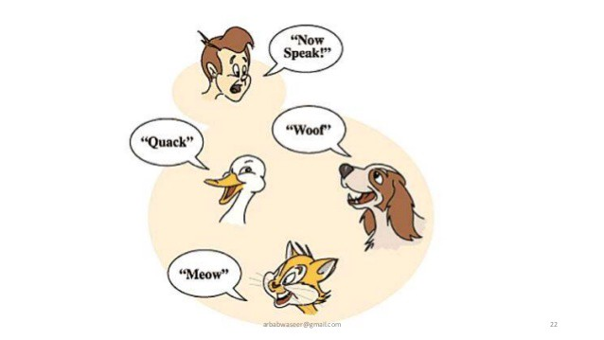

Slide 3
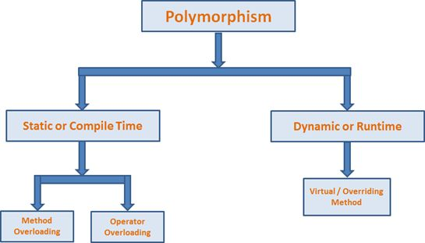

Slide 4
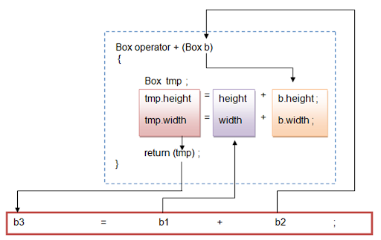
Operator Overloading

Slide 5
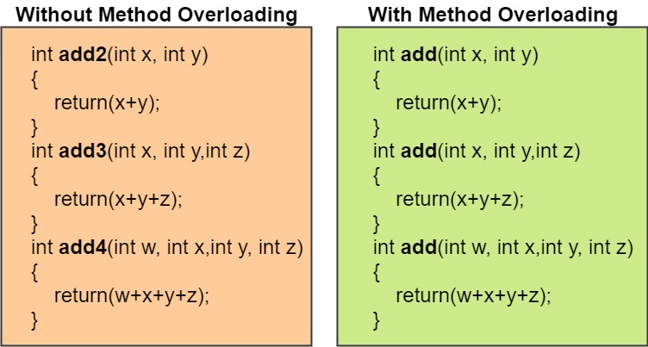
Method Overloading

Slide 6
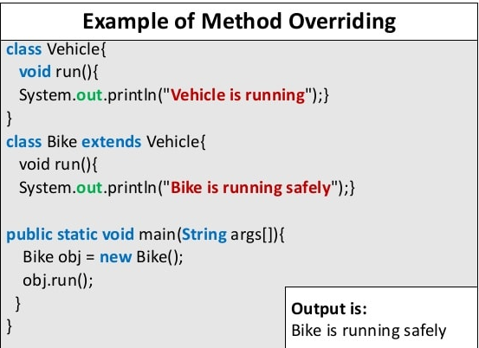
Method Overriding

Slide 7


Slide 8
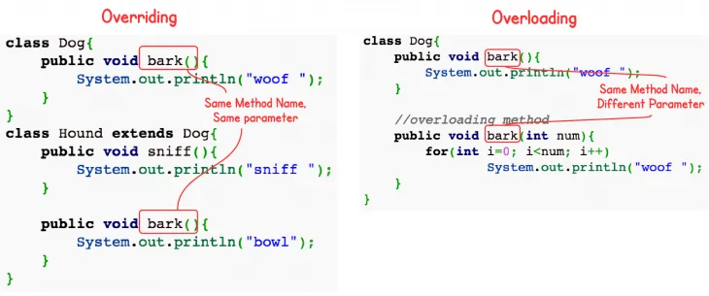

Slide 9
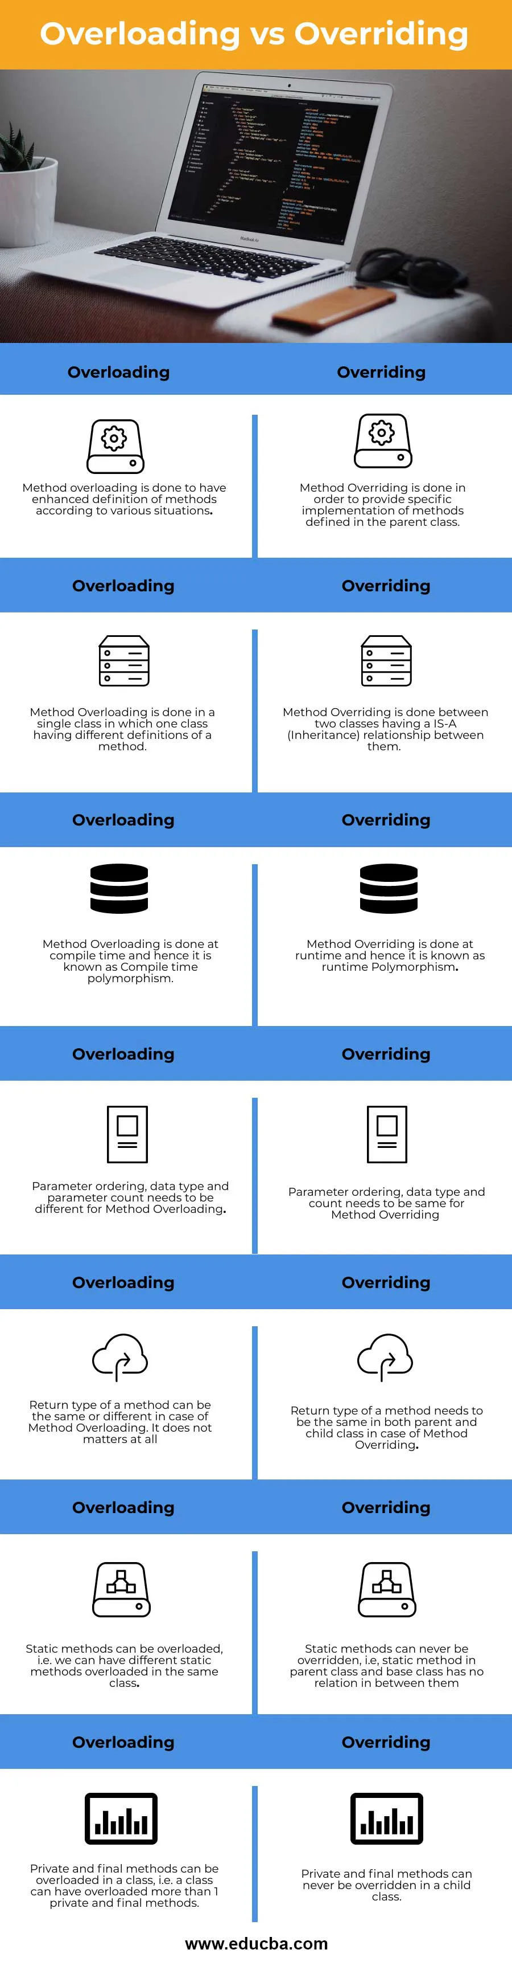

Slide 11
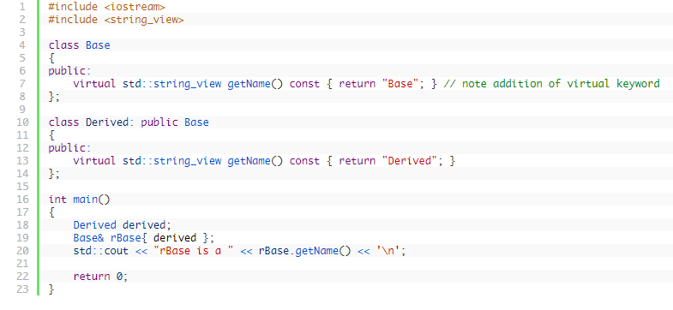
Virtual Functions
OUTPUT: «rBase is a Derived»

Slide 12
Thank you!

