Slide 1

OPEN-CLOSED PRINCIPLE

Slide 2
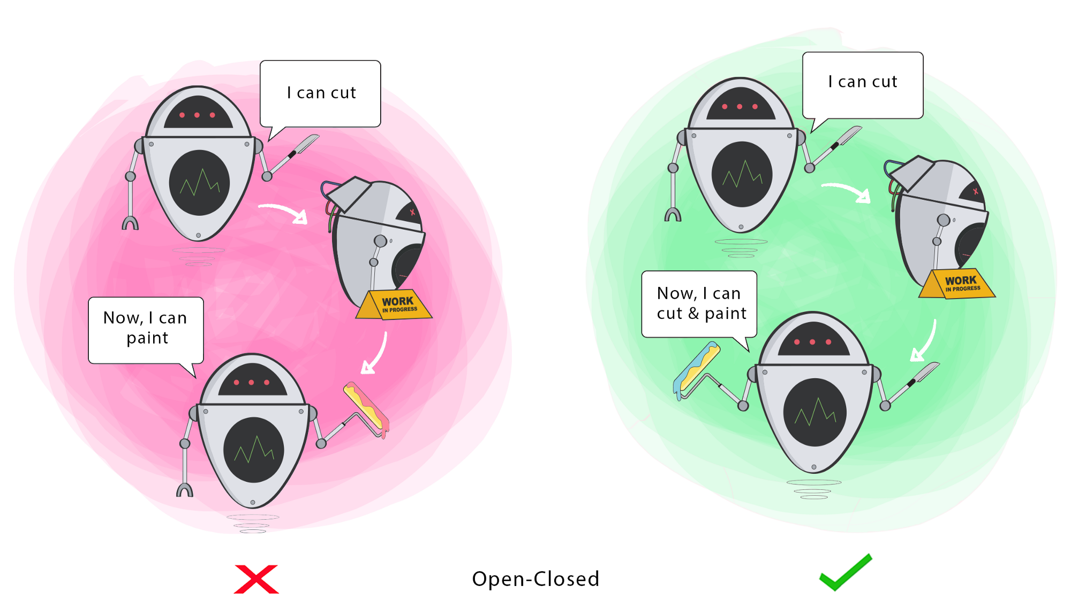
Classes should be open for extension, but closed for modification

Slide 3
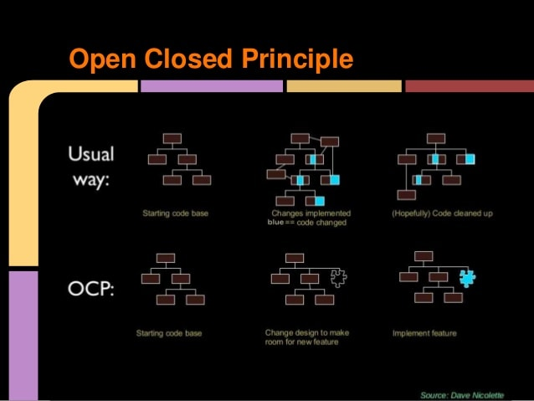

Slide 4
Bad Example
public class AreaCalculator {
public double Area(Object shape) {
double area = 0;
if (shape instanceof Rectangle) {
area = ((Rectangle) shape).getWidth() * ((Rectangle) shape).getHeight();
} else {
Circle circle = (Circle)shape;
area += circle.getRadius()* circle.getRadius() * Math.PI;
}
return area;
}
}
public class Circle {
private double Radius;
public double getRadius() {
return Radius;
}
public void setRadius(double radius) {
Radius = radius;
}
}

Slide 5
Good Example
public abstract class Shape
{
public abstract double Area();
}
Public class Circle extends Shape {
@Override
public double Area() {
return radius*radius*Math.PI;
}
Public class Regtangle extends Shape {
@Override
public double Area() {
return //;
}
Public class Triangle extends Shape {
@Override
public double Area() {
return //;
}

Slide 6
Teşekkürler!

