Slide 1

CUSTOMER SUCCESS ASSOCIATE
Daniel Tello Gaete

Slide 2
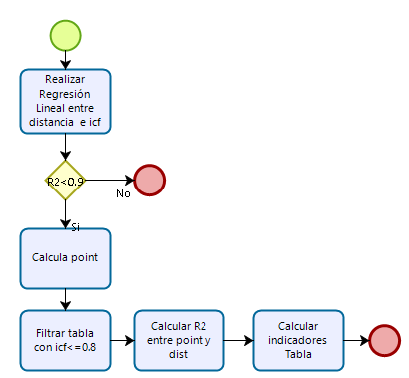
Unidad de negocio | N° obs | R² | N° obs 80 | N° obs 80 % | Dist. Total (km) | Point | R² | Dist máx 80/20 | Dist máx 80/20
U2 | 70202 | 0.01361 | 5258 | 7.48 | 19.92 | 67.49 | 0.39 | 36.61 | 9.06
U3 | 119206 | 0.00327 | 2688 | 2.25 | 14.48 | 48.15 | 0.40 | 41.68 | 8.02
U4 | 73737 | 0.00302 | 5009 | 6.79 | 21.03 | 65.11 | 0.40 | 38.46 | 10.59
U5 | 66009 | 0.00158 | 537 | 0.81 | 14.73 | 51.72 | 0.37 | 57.22 | 8.06
U6 | 79625 | 0.00009 | 1958 | 2.45 | 10.68 | 39.38 | 0.33 | 31.26 | 5.07
U7 | 46068 | 0.00042 | 308 | 0.66 | 13.22 | 32.19 | 0.16 | 49.38 | 9.96
Metodología
Supuesto: los icf son considerados deficientes si son menores a 0.80
$$point=(\left|{SO}_{SSPD}−{SP}_{SSPD}\right|) ∗distance) ∗(1−{ICF}_{SSPD})$$

