Slide 1
Analyzing News Bias

Slide 2
Libraries
Data Collection | Data Wrangling | Analysis | Plotting | Presentation
feedparser | spaCy | gensim | pyLDAvis | Jupyter
 | nltk.stem | scikit-learn | plot.ly
 | BeautifulSoup
 | re

Slide 3
Problem
The difference between news and opinions?
How to judge whether a particular source of information is providing biased news stories or not?

Slide 4
Metadata Description
103 RSS Feeds (> 50 Sources)
Including: Reuters, NY Times, Freakonomics, Ars Technica, BBC, NPR, Sports Illustrated, Rolling Stone, Politico, CNN
Each feed contains multiple articles updated independently
Each feed added to master list with (id, url, name, is_blog)
id (int) – local id number
url (str) – absolute url location of the feed
name (str) – a combined value in the format of source+feed_name (e.g. “Rolling Stone - Entertainment”)
is_blog (bool) – determined by biased allocation method

Slide 5
Method
The inconsistent formatting of the different feeds – required the construction of an “artificial feature set”.
Feature set was constructed using an Latent Dirchilet Allocation (LDA) method
Each feed was assigned a value of ”not blog”/”blog” (0/1) based on past experience or expectation.
Probabilities from LDA model were used in Logit and Decision Tree models as features and (‘blog’/’not blog’) as the response variable.

Slide 6
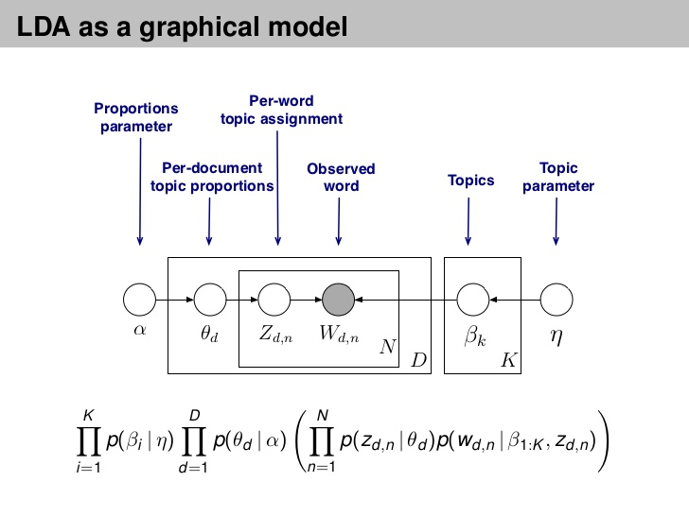
LDA
Source: https://www.slideshare.net/hustwj/probabilistic-topic-models

Slide 7
Metadata Description (Continued)
Articles contain non-uniform set of fields, though most common are:
Title – title of the article
Pubdate – date of publication
Interest issues with date format, if undetectable today function applied
Author – author of the article
If not included “staff writer” was applied as a default value
Summary – article summary
Tags – article topics
If not included in article a list of top 10 most common keywords in summary was used as a substitute
Link – absolute url of article

Slide 8
Munging, Wrangling, Curating
'<img width="680" height="453" src="https://tctechcrunch2011.files.wordpress.com/2018/03/final-muspace-blue-press.jpg?w=680" class="attachment-large size-large wp-post-image" alt="" srcset="https://tctechcrunch2011.files.wordpress.com/2018/03/final-muspace-blue-press.jpg?w=680 680w, https://tctechcrunch2011.files.wordpress.com/2018/03/final-muspace-blue-press.jpg?w=1360 1360w, https://tctechcrunch2011.files.wordpress.com/2018/03/final-muspace-blue-press.jpg?w=150 150w, https://tctechcrunch2011.files.wordpress.com/2018/03/final-muspace-blue-press.jpg?w=300 300w, https://tctechcrunch2011.files.wordpress.com/2018/03/final-muspace-blue-press.jpg?w=768 768w" sizes="(max-width: 680px) 100vw, 680px" />&nbsp;Jeff Bezos&#8217; New Glenn rocket, the reusable launch vehicle created by Blue Origin to put people and large cargo into orbit, has a new confirmed payload for one of its first missions: mu Space. The Thai satellite startup announced it would be working with Blue Origin late last year, but now it has confirmed that the agreement is in place, with a launch window that opens in late 2020.&hellip; <a href="https://techcrunch.com/2018/03/13/mu-space-targets-2020-launch-of-first-satellite-about-blue-origins-new-glenn/?ncid=rss">Read More</a><div class="feedflare">\n<a href="http://feeds.feedburner.com/~ff/Techcrunch?a=QH4nQGnPVKw:oQEqidSmltA:2mJPEYqXBVI"><img src="http://feeds.feedburner.com/~ff/Techcrunch?d=2mJPEYqXBVI" border="0"></img></a> <a href="http://feeds.feedburner.com/~ff/Techcrunch?a=QH4nQGnPVKw:oQEqidSmltA:7Q72WNTAKBA"><img src="http://feeds.feedburner.com/~ff/Techcrunch?d=7Q72WNTAKBA" border="0"></img></a> <a href="http://feeds.feedburner.com/~ff/Techcrunch?a=QH4nQGnPVKw:oQEqidSmltA:yIl2AUoC8zA"><img src="http://feeds.feedburner.com/~ff/Techcrunch?d=yIl2AUoC8zA" border="0"></img></a> <a href="http://feeds.feedburner.com/~ff/Techcrunch?a=QH4nQGnPVKw:oQEqidSmltA:-BTjWOF_DHI"><img src="http://feeds.feedburner.com/~ff/Techcrunch?i=QH4nQGnPVKw:oQEqidSmltA:-BTjWOF_DHI" border="0"></img></a> <a href="http://feeds.feedburner.com/~ff/Techcrunch?a=QH4nQGnPVKw:oQEqidSmltA:D7DqB2pKExk"><img src="http://feeds.feedburner.com/~ff/Techcrunch?i=QH4nQGnPVKw:oQEqidSmltA:D7DqB2pKExk" border="0"></img></a> <a href="http://feeds.feedburner.com/~ff/Techcrunch?a=QH4nQGnPVKw:oQEqidSmltA:qj6IDK7rITs"><img src="http://feeds.feedburner.com/~ff/Techcrunch?d=qj6IDK7rITs" border="0"></img></a>\n</div><img src="http://feeds.feedburner.com/~r/Techcrunch/~4/QH4nQGnPVKw" height="1" width="1" alt=""/>'

Slide 9
Munging, Wrangling, Curating
'<img width="680" height="453" src="https://tctechcrunch2011.files.wordpress.com/2018/03/final-muspace-blue-press.jpg?w=680" class="attachment-large size-large wp-post-image" alt="" srcset="https://tctechcrunch2011.files.wordpress.com/2018/03/final-muspace-blue-press.jpg?w=680 680w, https://tctechcrunch2011.files.wordpress.com/2018/03/final-muspace-blue-press.jpg?w=1360 1360w, https://tctechcrunch2011.files.wordpress.com/2018/03/final-muspace-blue-press.jpg?w=150 150w, https://tctechcrunch2011.files.wordpress.com/2018/03/final-muspace-blue-press.jpg?w=300 300w, https://tctechcrunch2011.files.wordpress.com/2018/03/final-muspace-blue-press.jpg?w=768 768w" sizes="(max-width: 680px) 100vw, 680px" />&nbsp;Jeff Bezos&#8217; New Glenn rocket, the reusable launch vehicle created by Blue Origin to put people and large cargo into orbit, has a new confirmed payload for one of its first missions: mu Space. The Thai satellite startup announced it would be working with Blue Origin late last year, but now it has confirmed that the agreement is in place, with a launch window that opens in late 2020.&hellip; <a href="https://techcrunch.com/2018/03/13/mu-space-targets-2020-launch-of-first-satellite-about-blue-origins-new-glenn/?ncid=rss">Read More</a><div class="feedflare">\n<a href="http://feeds.feedburner.com/~ff/Techcrunch?a=QH4nQGnPVKw:oQEqidSmltA:2mJPEYqXBVI"><img src="http://feeds.feedburner.com/~ff/Techcrunch?d=2mJPEYqXBVI" border="0"></img></a> <a href="http://feeds.feedburner.com/~ff/Techcrunch?a=QH4nQGnPVKw:oQEqidSmltA:7Q72WNTAKBA"><img src="http://feeds.feedburner.com/~ff/Techcrunch?d=7Q72WNTAKBA" border="0"></img></a> <a href="http://feeds.feedburner.com/~ff/Techcrunch?a=QH4nQGnPVKw:oQEqidSmltA:yIl2AUoC8zA"><img src="http://feeds.feedburner.com/~ff/Techcrunch?d=yIl2AUoC8zA" border="0"></img></a> <a href="http://feeds.feedburner.com/~ff/Techcrunch?a=QH4nQGnPVKw:oQEqidSmltA:-BTjWOF_DHI"><img src="http://feeds.feedburner.com/~ff/Techcrunch?i=QH4nQGnPVKw:oQEqidSmltA:-BTjWOF_DHI" border="0"></img></a> <a href="http://feeds.feedburner.com/~ff/Techcrunch?a=QH4nQGnPVKw:oQEqidSmltA:D7DqB2pKExk"><img src="http://feeds.feedburner.com/~ff/Techcrunch?i=QH4nQGnPVKw:oQEqidSmltA:D7DqB2pKExk" border="0"></img></a> <a href="http://feeds.feedburner.com/~ff/Techcrunch?a=QH4nQGnPVKw:oQEqidSmltA:qj6IDK7rITs"><img src="http://feeds.feedburner.com/~ff/Techcrunch?d=qj6IDK7rITs" border="0"></img></a>\n</div><img src="http://feeds.feedburner.com/~r/Techcrunch/~4/QH4nQGnPVKw" height="1" width="1" alt=""/>'

Slide 10
Notebook
link

