Slide 1

CSMS
Contractor Safety Management System
By. Bambang Cahyono, SKM, MK3
March 2011

Slide 2
Contractor Safety Management System
Sistem kontrol terhadap aspek pengelolaan Keselamatan,
Kesehatan Kerja dan Perlindungan Lingkungan bagi Kontraktor
yang bekerja di seluruh daerah operasi kontraktor KKS(Kontrak
Kerja sama)/JOB (Joint Operating Body)
Part of bid process
References :
BPMIGAS KPTS-13/BP00000/2006-S8 – Contractor Safety Management System
OGP 291/1999 HSE Management – Guidelines for Working Together in a Contract Environment

Slide 3
CSMS Objectives:
Meningkatkan performance HSE di lingkungan kerja oleh perusahaan/client dan contractor dengan pengelolaan HSE Management System yang effective
Membantu Contractor dalam pengelolaan program – program HSE yang consistent sesuai dengan harapan dari perusahaan/Client
Memfasilitasi gap antara HSE MS Contractor, sub-contractor dan contractor lain yang bekerja di area perusahaan/client.

Slide 4
CSMS Purposes
MAN
REPUTATION
CSMS
ENVIRONMENT
ASSET

Slide 5
CSMS Background
The Loss Caution Model
THRESHOLD
LIMIT
Lack of Control
Basic Causes
Immediate Causes
Incident
Loss
Inadequate
System
Standard
Compliance
Personal Factors
Job/System Factors
Substandard Acts/Practices
Substandard Conditions
Event
or
Near Miss
Unintended Harm
or
Damage
Measurement of Control
Measurement of Causes
Measurement of Consequence
Sistem diatas sangat penting untuk mengetahui penyebab – penyebab dasar ...

Slide 6
CSMS Background Continue…..
TOTAL INJURY & TRAFFIC ACCIDENT DATA 1995-2003 YTD

Slide 7
CSMS Background Continue…..
DESCRIPTION | COMPANY |  | CONTRACTOR
 | 2009 | 2010 | 2009 | 2010
Work Force | 430 | 444 | 447 | 344
Man Hours | 1,497,475 | 1,620,610 | 1,666,254 | 1,301,226
LTA | 0 | 0 | 3 | 1
Medical Treatment | 1 | 2 | 24 | 2
First Aid | 4 | 6 | 12 | 9
Traffic Incident | 8 | 12 | 8 | 2
Spillage | 0 | 2 | 1 | 0

Slide 8

CSMS Background Continue…..
The Cause of Injuries
98%of Accident is due to
unsafe Acts.

Slide 9


Slide 10
CSMS Structure
Contracted Work
Admin
Administration Phase: Select A Qualified Contractor
Pre-Qualification
CSMS
Risk Assessment
Selection
Contract Award
Field
Data Bank
Field Implementation Phase: Ensure Field Safe Work
Pre Job Activity
Work In Progress
Final Evaluation

Slide 11
CSMS Distribution of Responsibility
Risk Assessment
Pre
-
Qualification
Selection
End User (Contract
C&P Dept. and
End User
Client
End user
Initiator)
Prepare the
Submit Bid
Contractor
None
administrative
Documents
Pre
-
Job Activity
Work In Progress
Final Evaluation
Client
End User together
Reviewer (End User)
with contractor
End User initiate
End User together
Review together with
Contractor
Preparation
with contractor
Contractor

Slide 12
Pekerjaan yg
dikontrakkan
Aktivitas awal
dibutuhkan?
Tidak
Penilaian Risiko
Tahap Pelaksanaan
Pra_qualifikasi
dibutuhkan?
ya
Tidak
Tahap Administrasi
Aktivitas Awal
ya
Pekerjaan
berlangsung
dibutuhkan?
Pra-kualifikasi
Tidak
Mekanisme
Umpan Balik
ya
Dibutuhkan
seleksi?
Tidak
ya
Pekerjaan
berlangsung
ya
Evaluasi Akhir
Seleksi
Bank Data
Penandatanganan
kontrak
Struktur&Prosedur

Slide 13
Tahap Administrasi
Risk Assessment – Penilaian Risiko
Prosedur untuk meneliti risiko pekerjaan yang akan dikontrak-kan dan menentukan kategorinya (Low/ medium/ High).
Menentukan perlu atau tidaknya langkah – langkah Pengelolaan K3LL
Client bertanggung jawab terhadap penilaian awal risiko K3LL
Pra – Kualifikasi
Meneliti kualifikasi Contractor dalam hal K3LL
K3LL Questionnaire
Contractor assessment
Pemilihan/Seleksi
Memilih Contractor terbaik diantara Contractor yang mengikuti tender

Slide 14
Risk Assessment in CSMS
Risk Assessment
Contracted Work
Administration Phase: Select A Qualified Contractor
Pre-Qualification
CSMS
Risk Assessment
Selection
Contract Award
Data Bank
Field Implementation Phase: Ensure Field Safe Work
Pre Job Activity
Work In Progress
Final Evaluation

Slide 15
Risk Assessment
Nature of the work/Sifat Pekerjaan
Work location/Lokasi Pekerjaan
Equipment Using/perlengkapan yg digunakan
Potential Exposure to Work Site Hazards/paparan potensi bahaya thd tempat kerja
Potential Exposure to Personnel Hazards/paparan bahaya thd pekerja
Simultaneous work by different/several contractors/pekerjaan yg dilakukan secara simultan oleh beberapa Contractors di tempat yg sama
Work duration / lamanya pekerjaan
Experience and competency of Contractors/pengalaman&keahlian Contractor
Social and Environmental Negative Impacts/dampak negatif thd masyarakat&lingkungan

Slide 16
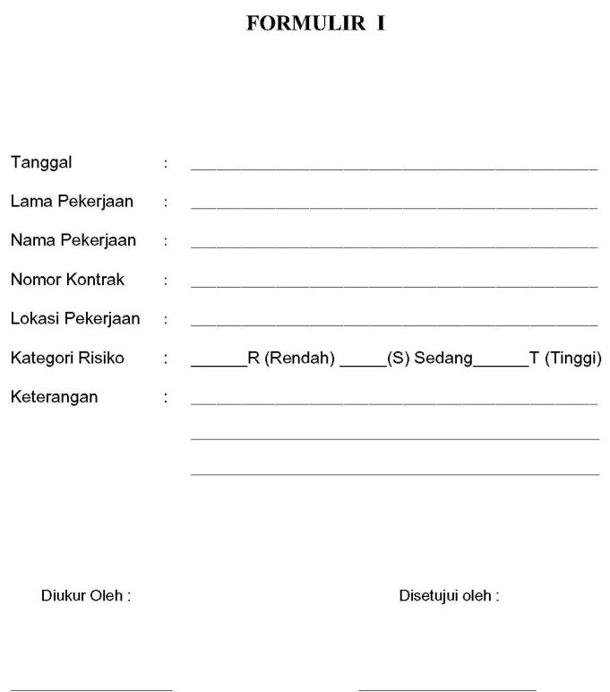
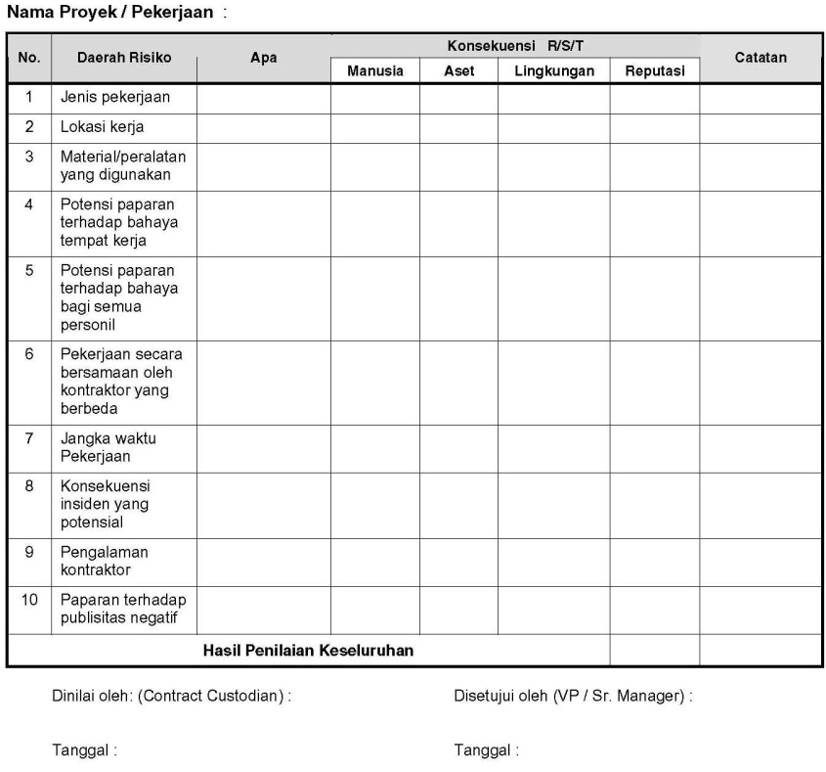
Risk Assessment Process
Menentukan Persyaratan
Mengidentifkkasi
Risiko dan mengisi
Form No.1
Pengesahan Formulir
oleh Project Mgr
Menentukan
Persyaratan
Diperlukan
Verifikasi K3LL?
Ya
Memeriksa
Penilaian Risiko
Tidak
Persetujuan
Asset Mgr
Disetujui?
Ya
Menyusun Rekuisisi
Kontrak

Slide 17
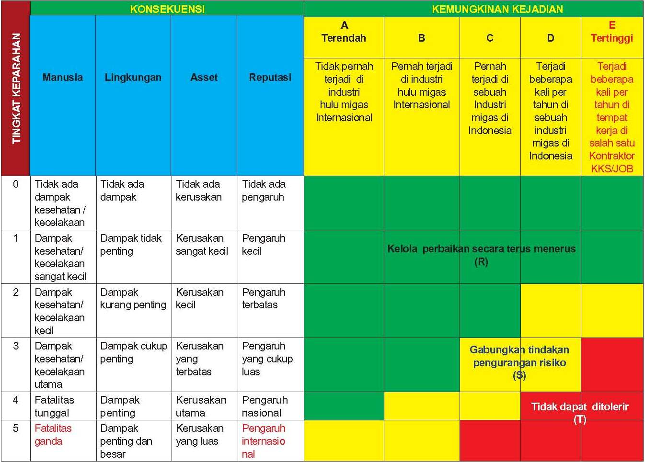
Risk Assessment Matrix

Slide 18
Risk Assessment
ASSESSED RISK OF WORK
PHASE
LOW
MEDIUM
HIGH
RISK ASSESSMENT
REQUIRED
REQUIRED
REQUIRED
PRE-QUALIFICATION
OPTIONAL
OPTIONAL
REQUIRED
SELECTION
OPTIONAL
OPTIONAL
REQUIRED
PRE-JOB ACTIVITIES
OPTIONAL
REQUIRED
REQUIRED
WORK IN PROGRESS
OPTIONAL
REQUIRED
REQUIRED
FINAL EVALUATION
REQUIRED
REQUIRED
REQUIRED

Slide 19
TYPICAL JOB VS RISK ASSEMENT

Slide 20
Pre-Qualification in CSMS
Administration
Contracted Work
Qualification Phase: Select A Qualified Contractor
Pre-Qualification
CSMS
Risk Assessment
Selection
Contract Award
Data Bank
Field Implementation Phase: Ensure Field Safe Work
Pre Job Activity
Work In Progress
Final Evaluation

Slide 21
Pre-Qualification
First Screen to allow only safe candidates follow tender
Unsafe Contractors:
No !

