Slide 1
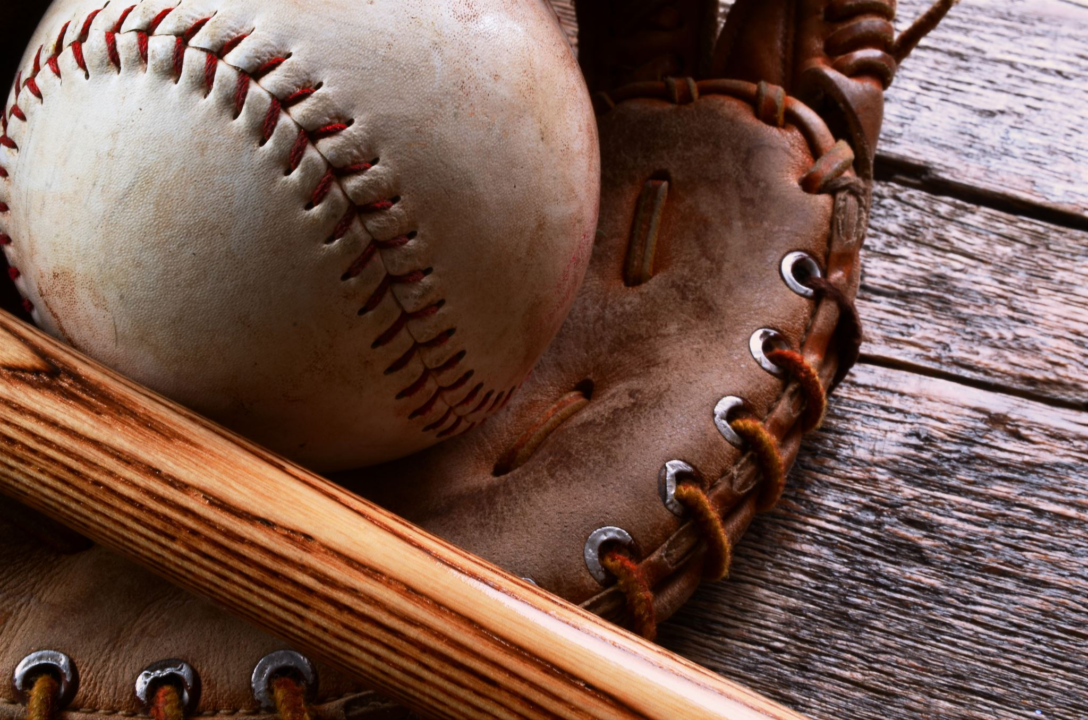
Pitch Framing in Major League Baseball
David Teuscher
Stat 637
December 7, 2021

Slide 2
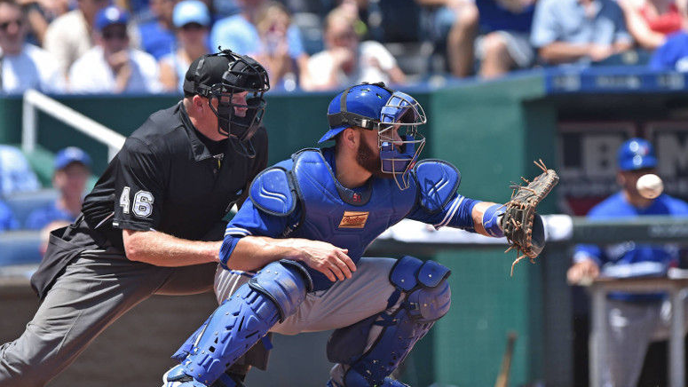
Background
Human error from umpires leads to variation in strike calls
Catchers can “frame” a pitch to make a pitch appear to be a strike when it isn’t

Slide 3
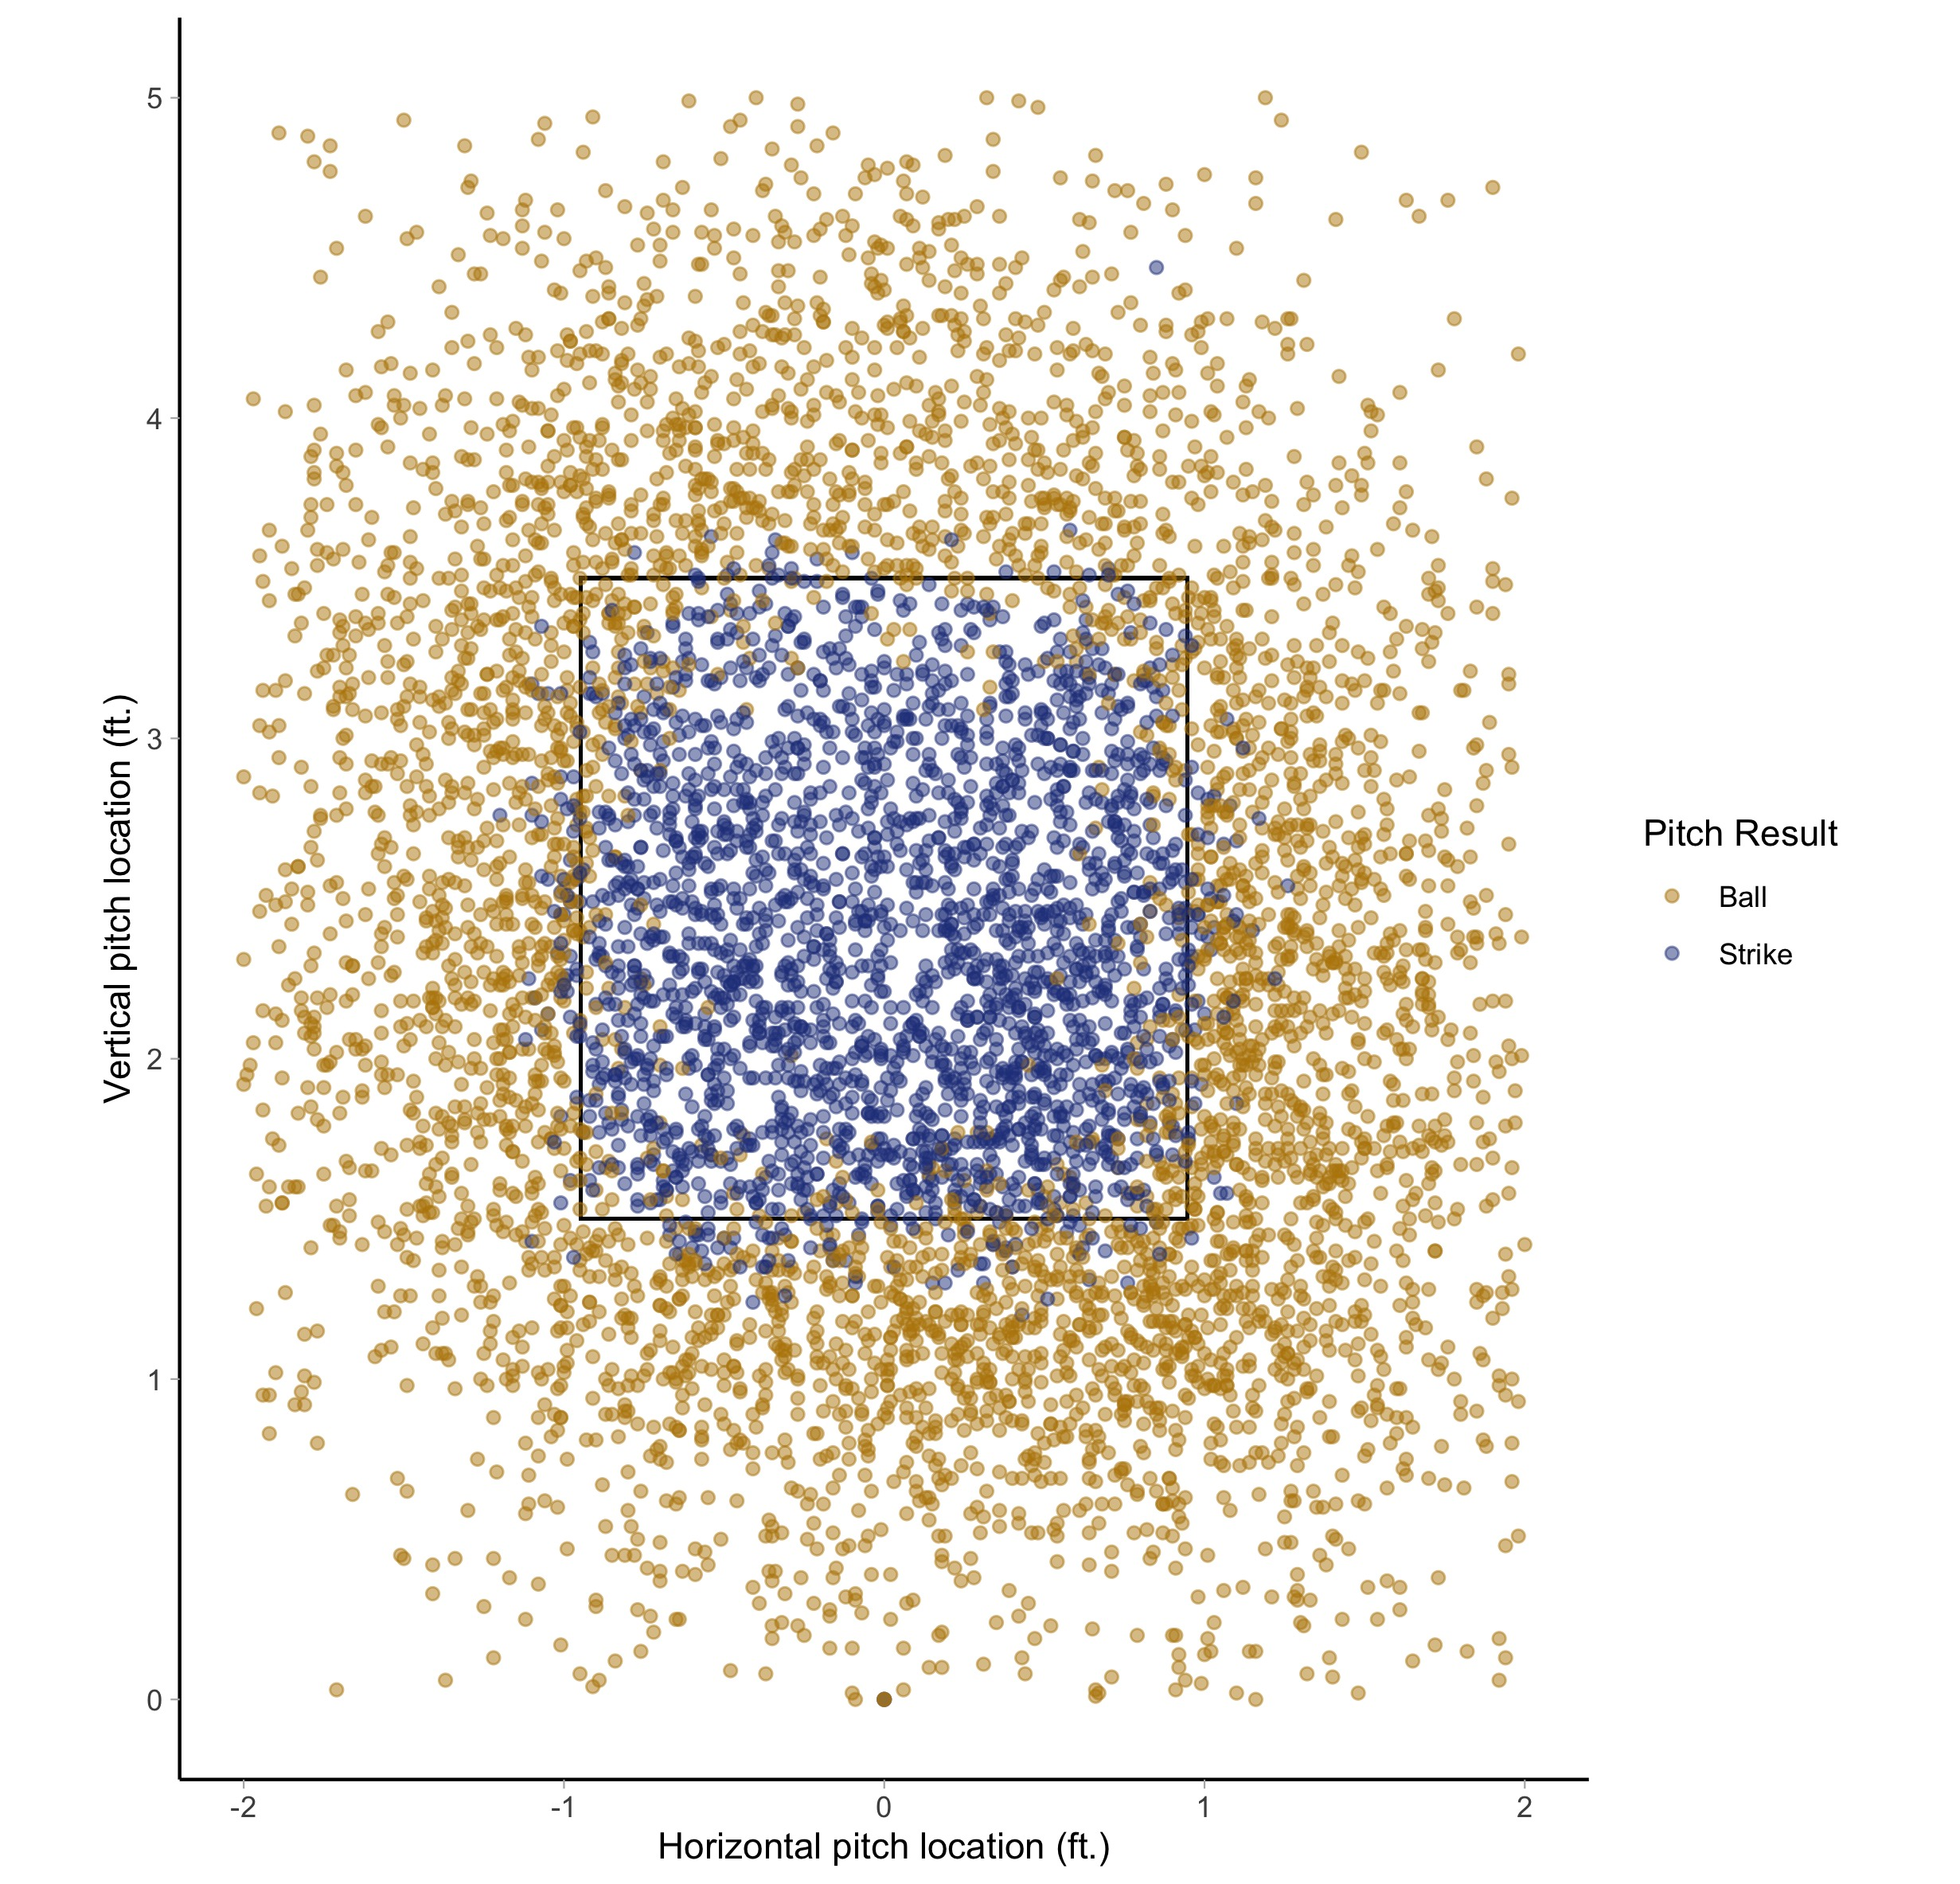
Variation in Strike Calls
Despite a defined strike zone, strike calls vary, especially around the edge of the strike zone
On the edge, umpires and catchers can impact the probability of a pitch being called a strike

Slide 4
Goals
Model the probability of a pitch being a strike
Model the effects that catchers and umpires have on a pitch being a strike

Slide 5
Generalized Additive Models
Generalized Linear Model
Systematic component consists of smoothing functions on covariates
Often a mix of smoothing functions and coefficients are used

Slide 6
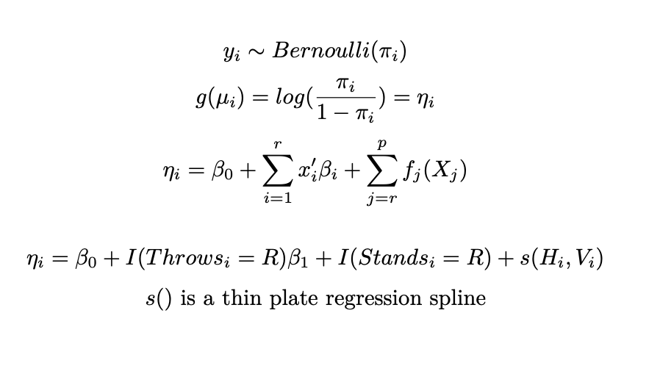
Model

Slide 7
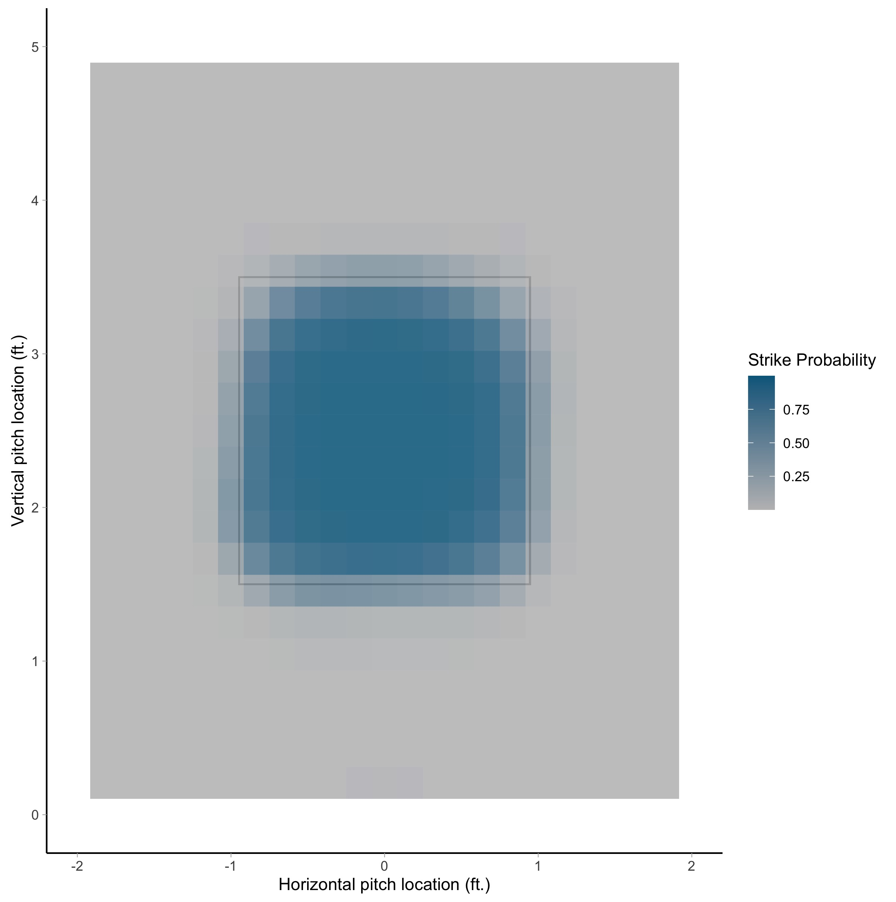
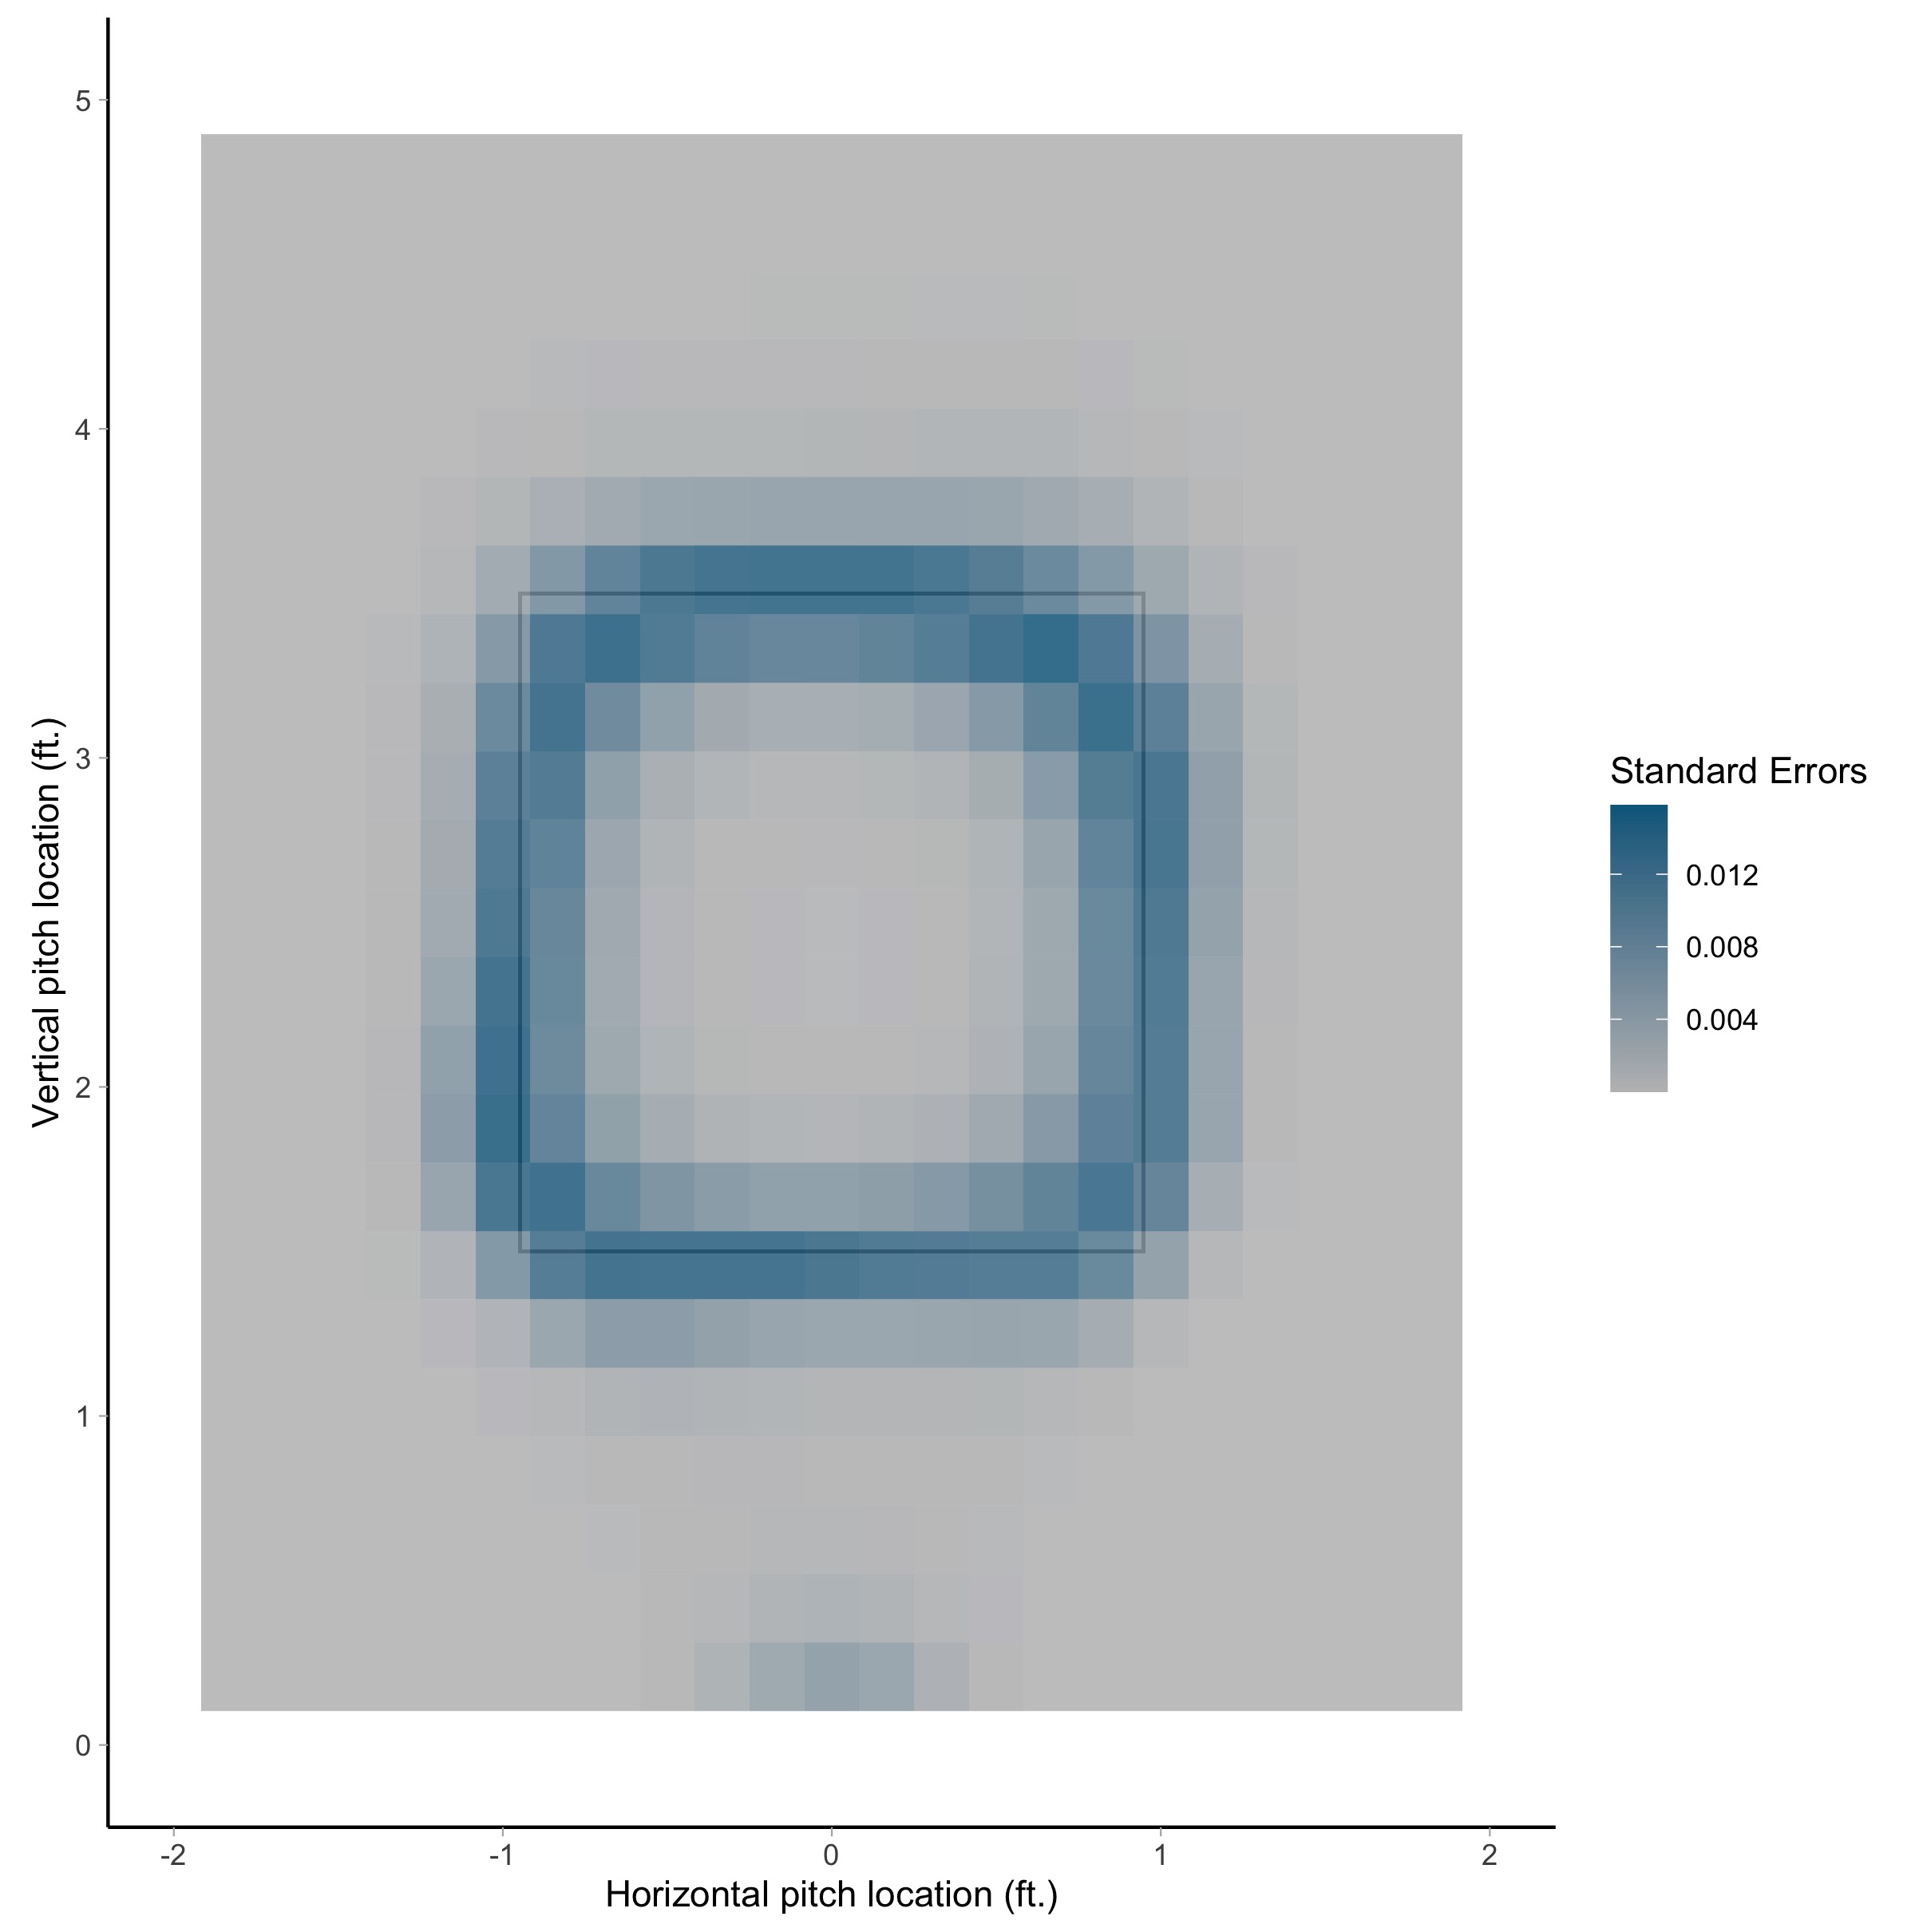

Slide 8
Generalized Linear Mixed Models
Allow for variation among groups
Random effects can indicate the individual contribution of a subject
Framework allows for the league average, while exploring the individual contributions of a player

Slide 9
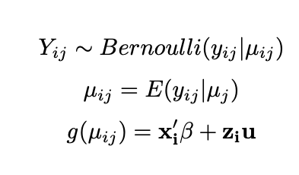
Generalized Linear Mixed Model
Fixed effect for probability of being a strike
Random effects for the pitcher, catcher, and umpire

Slide 10
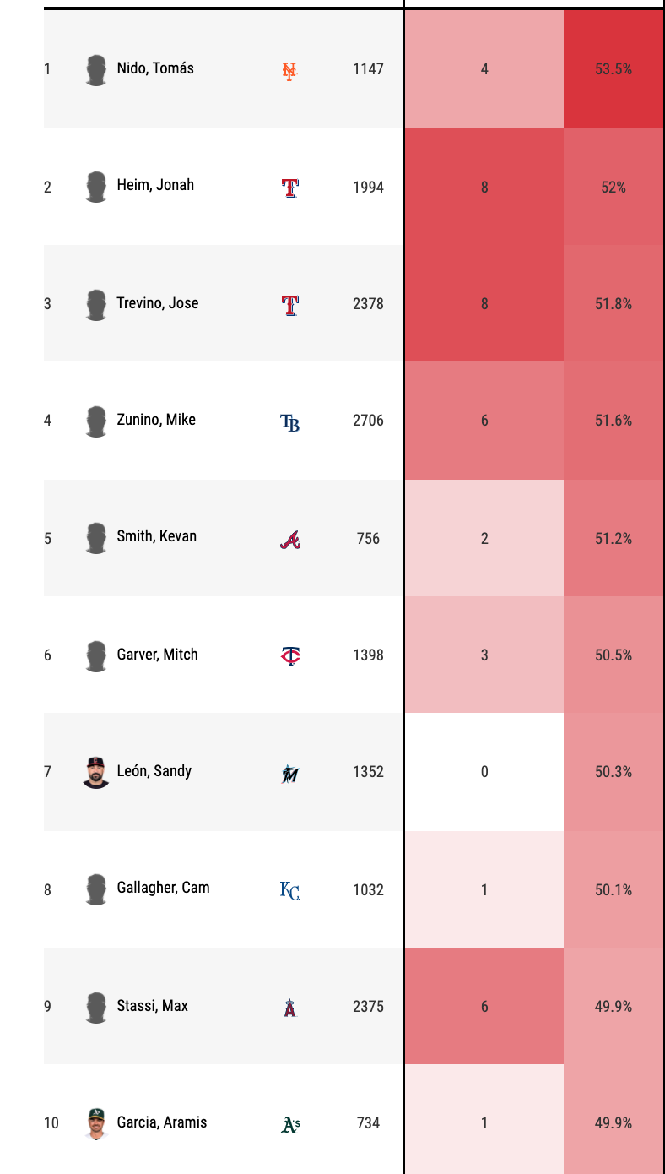
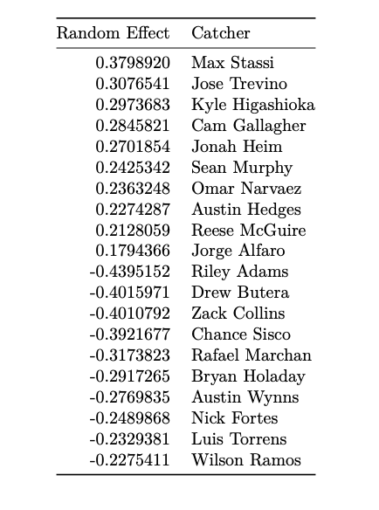
Catchers

Slide 11
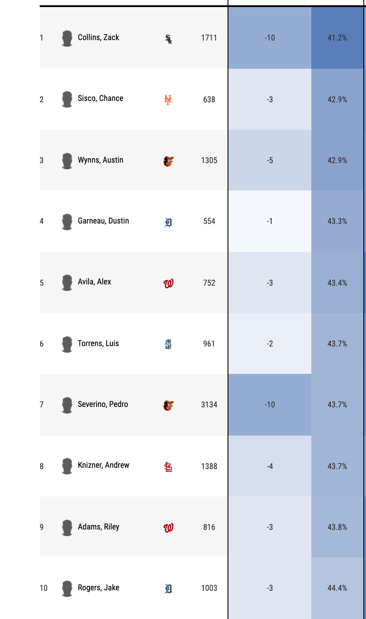
Catchers

Slide 12
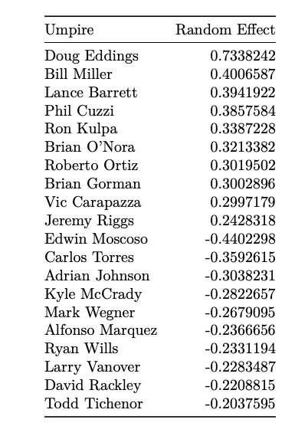
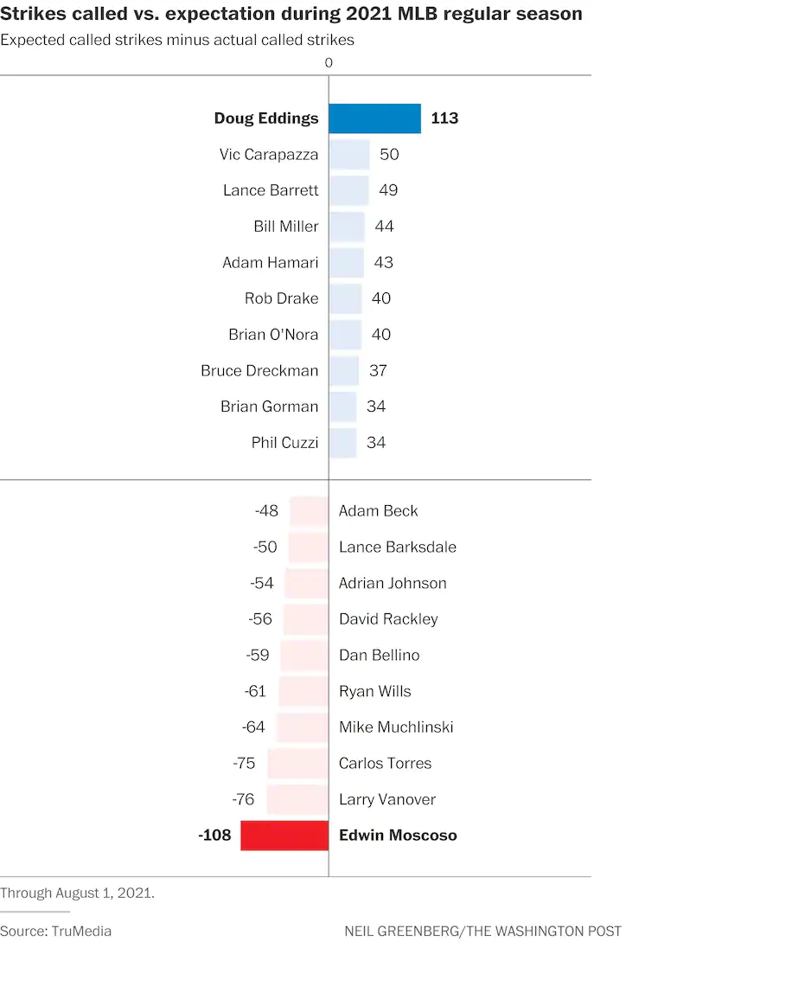
Umpires

Slide 13
Conclusion
GAMs are effective to model the probability of a pitch being a strike
GLMM can be used to identify the individual effects of catchers and umpires on called strikes

Slide 14
Further Research
Explore additional variables that influence strike probabilities
1
Calculate the impact of expected runs for catchers and umpires
2
Explore GAMs and GLMMs to get an even better model
3

Slide 15
Sources
https://baseballsavant.mlb.com/catcher_framing?year=2021&team=&min=500&sort=5,0
https://www.baseballprospectus.com/news/article/25514/moving-beyond-wowy-a-mixed-approach-to-measuring-catcher-framing/
https://www.washingtonpost.com/sports/2021/08/16/worst-strike-zones-data/

