Slide 1
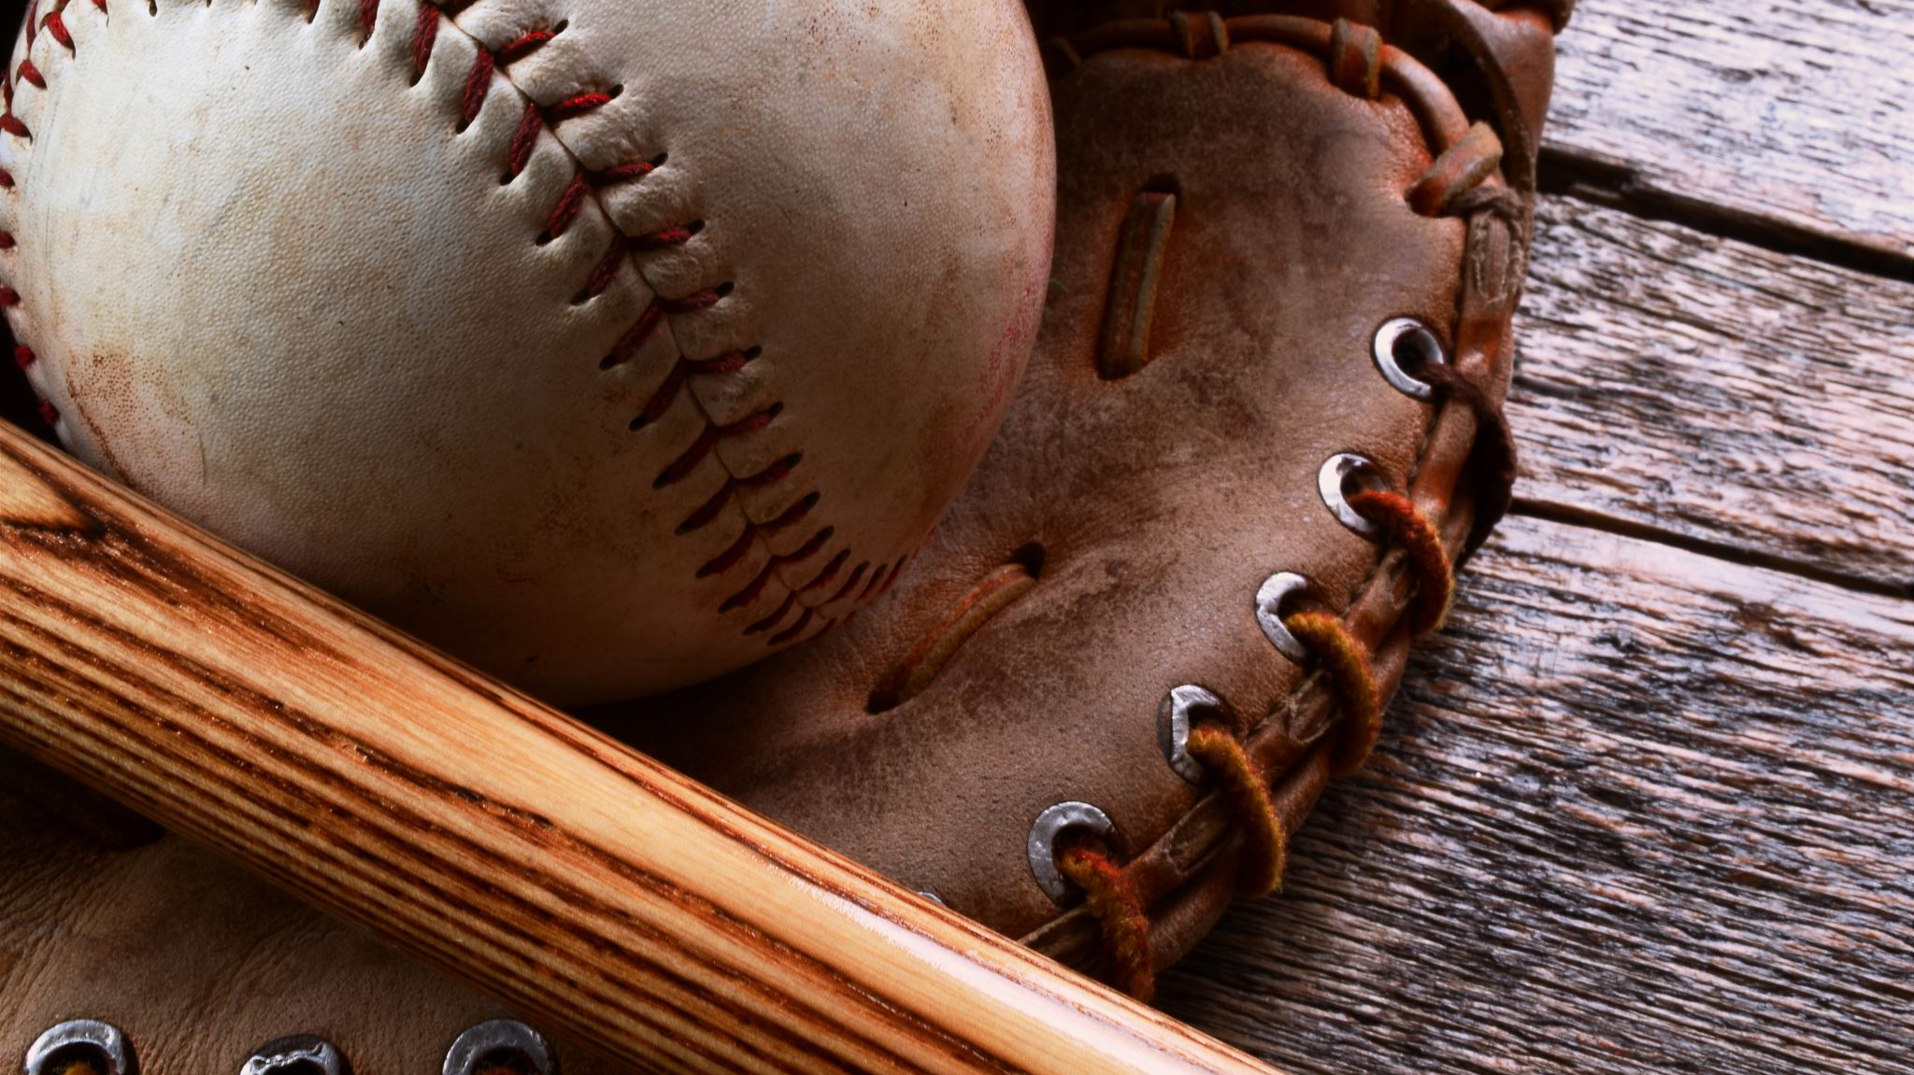
Pitch Framing in Major League Baseball
David Teuscher
Stat 637
December 7, 2021

Slide 2
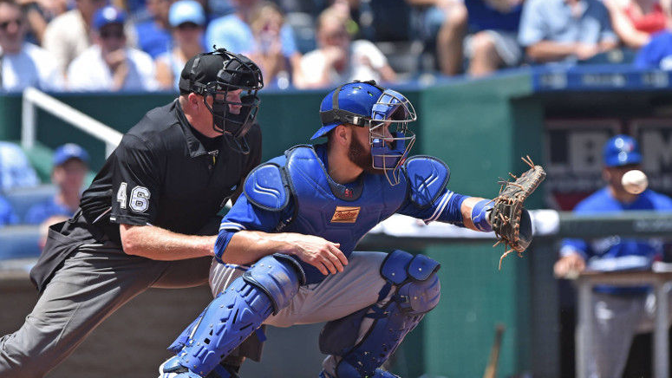
Background
Human error from umpires leads to variation in strike calls
Catchers can “frame” a pitch to make a pitch appear to be a strike when it isn’t

Slide 3
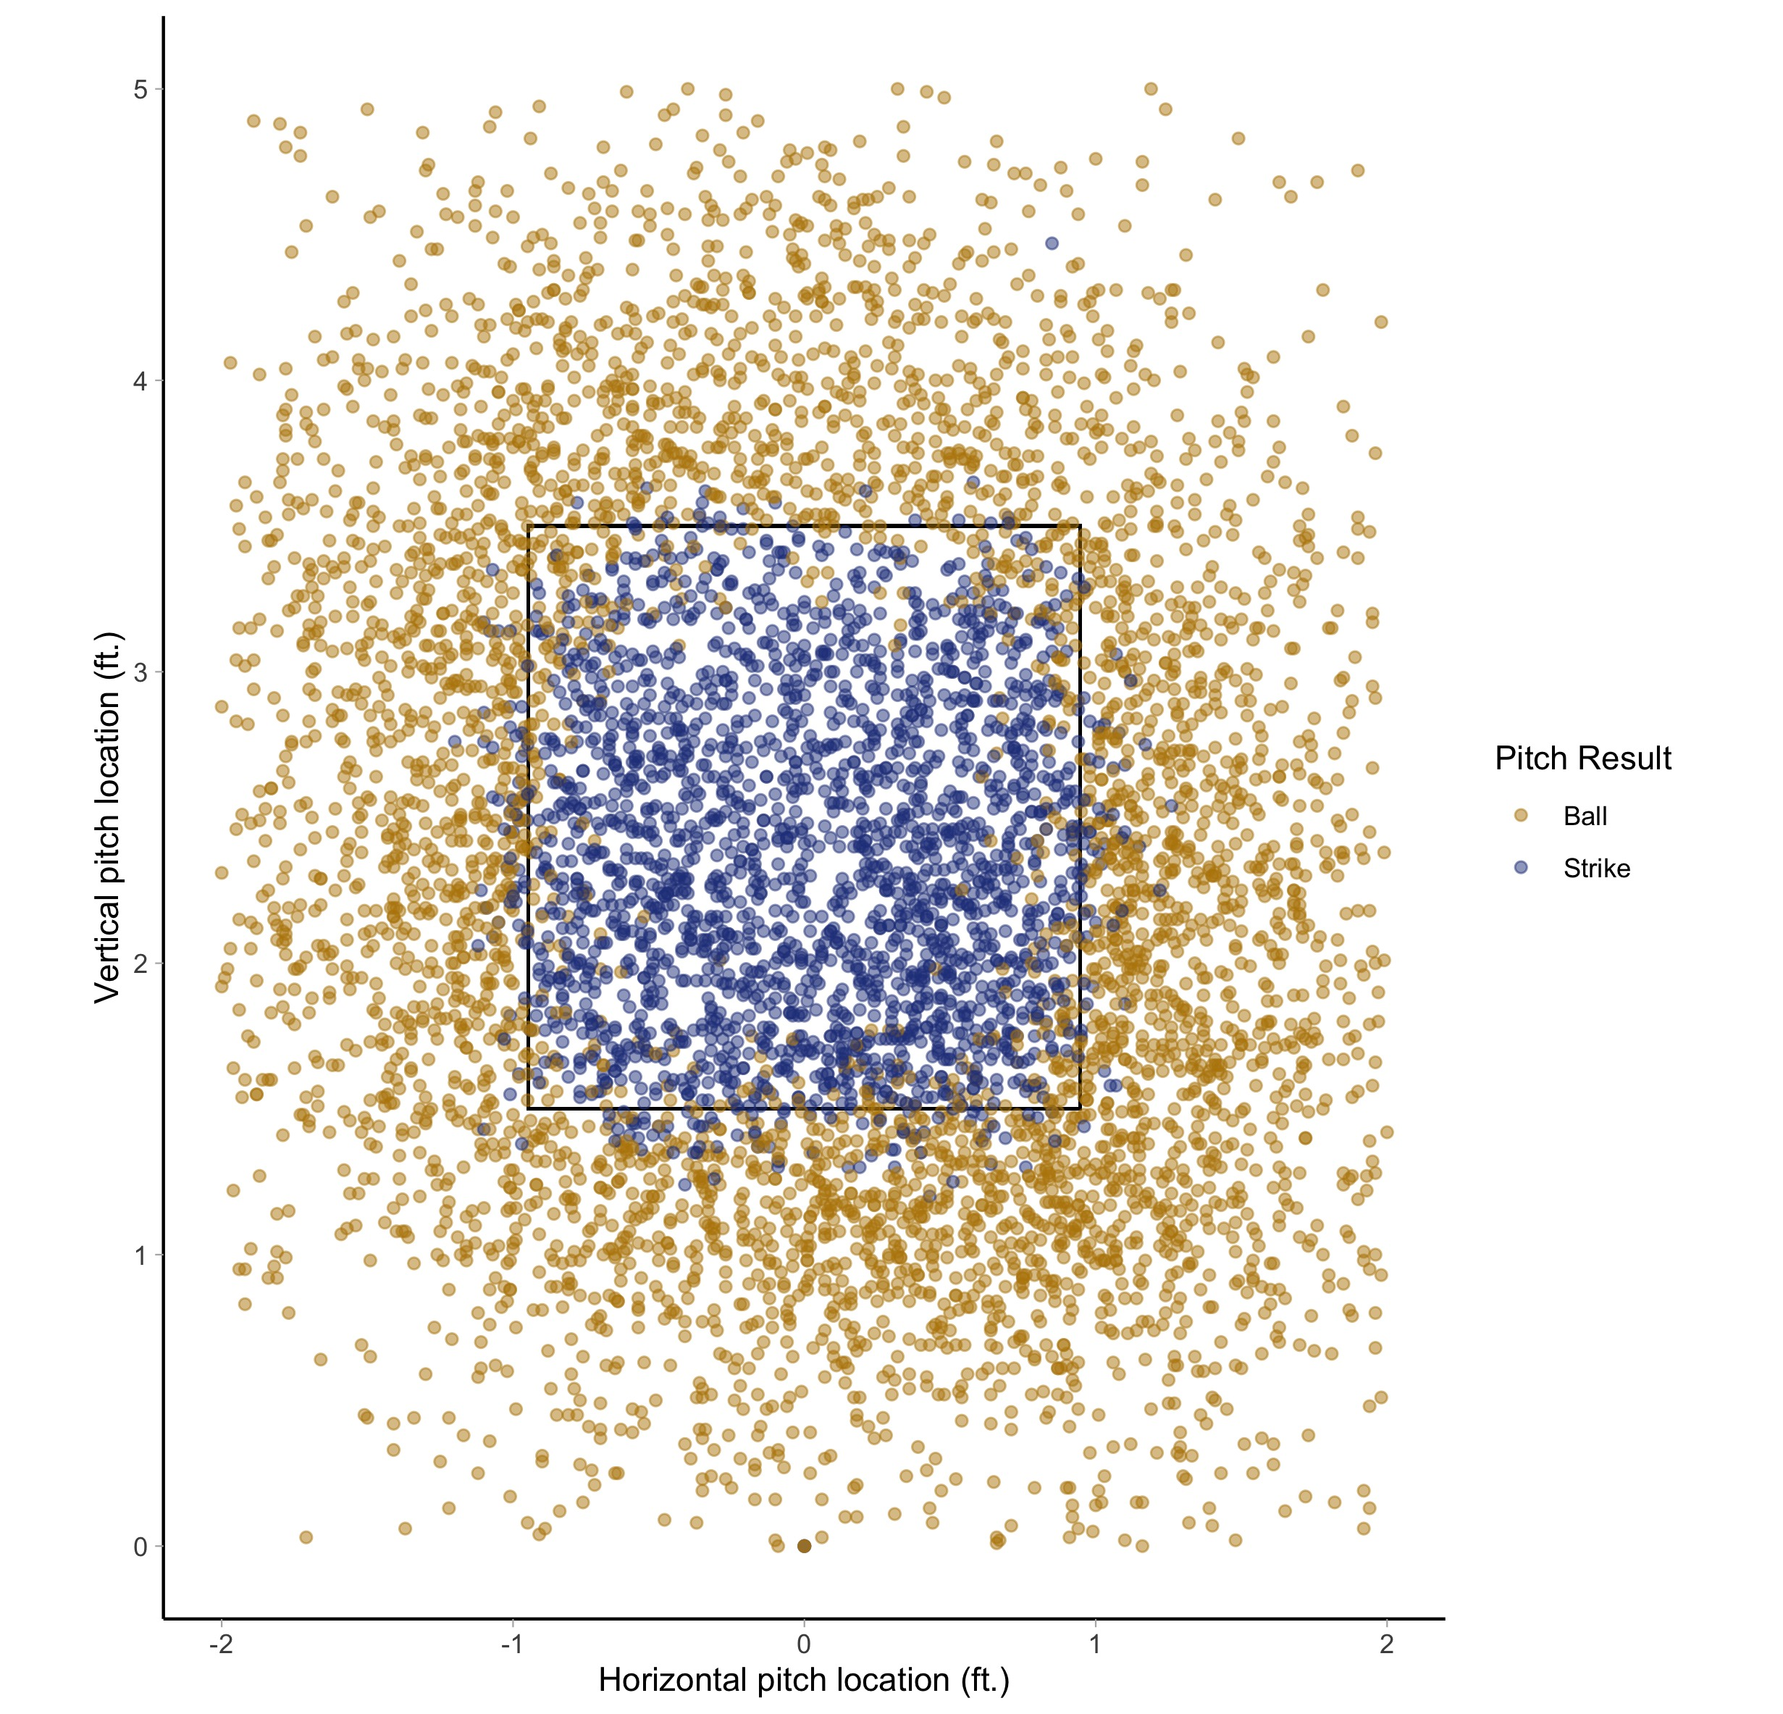
Variation in Strike Calls
Despite a defined strike zone, strike calls vary, especially around the edge of the strike zone
On the edge, umpires and catchers can impact the probability of a pitch being called a strike

Slide 4
Goals
Model the probability of a pitch being a strike
Model the effects that catchers and umpires have on a pitch being a strike

