Slide 1
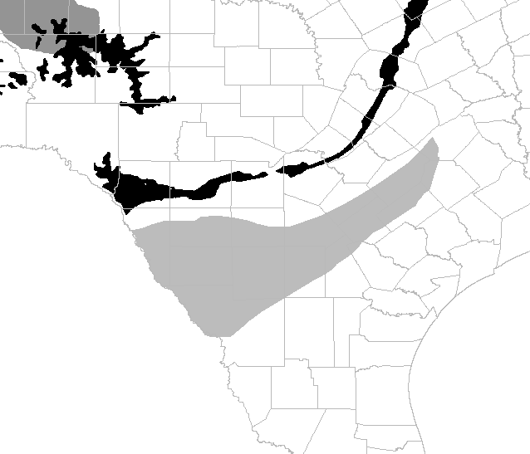
Eagle Ford outcrops
Eagle Ford play extent
I:\UTCS\Region\URC\Org_Data\HS_PG_USERS\Working\14_Users\Wang\Research\miniprojects\Water-derived H\HIPPIE-DIPPIE\arc_junk

